Slide 1
Elevating Tribal Environmental Justice: Sharing Community Priorities through Story Maps
Environmental Information and Innovation National Meeting
Sept 16-19, 2024
Kansas City, MO

Slide 2
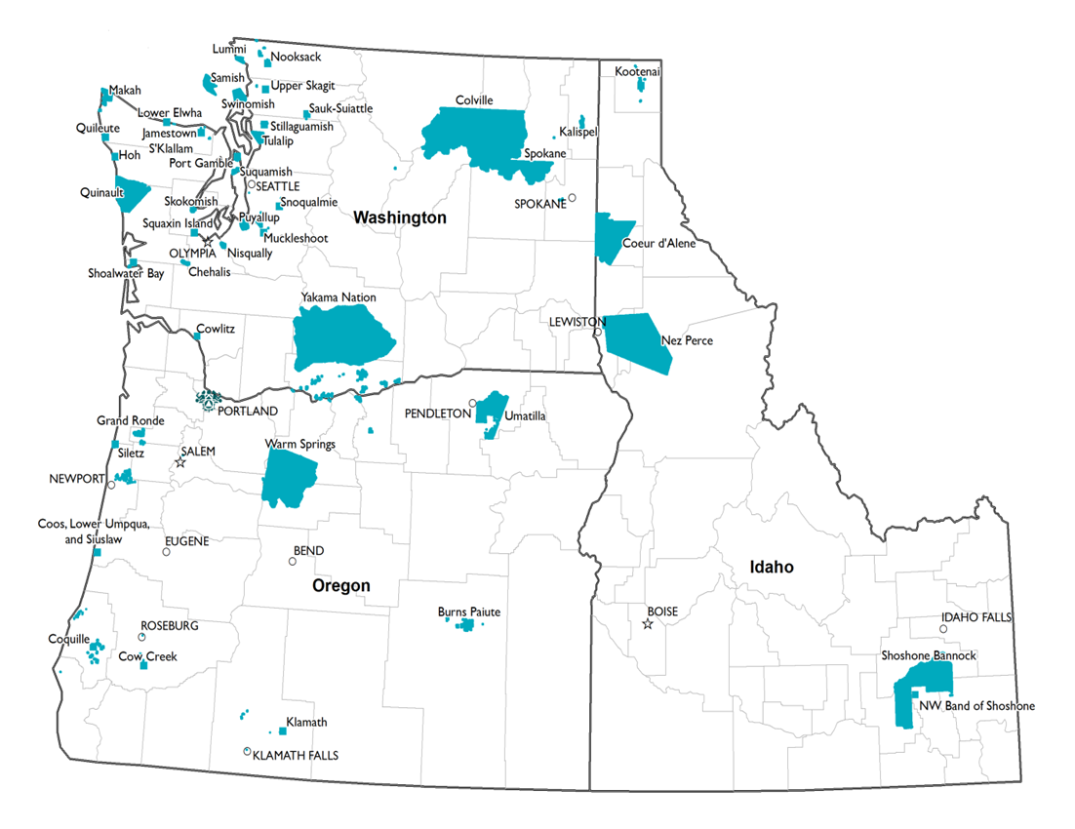
Notes:
Established in 1972, the Northwest Portland Area Indian Health Board (NPAIHB or the Board) is a non-profit tribal advisory organization serving the forty-three federally recognized tribes of Oregon, Washington, and Idaho.
We do: Health promotion and disease prevention
Legislative and policy analysis
Training and technical assistance
Surveillance and research

Slide 3
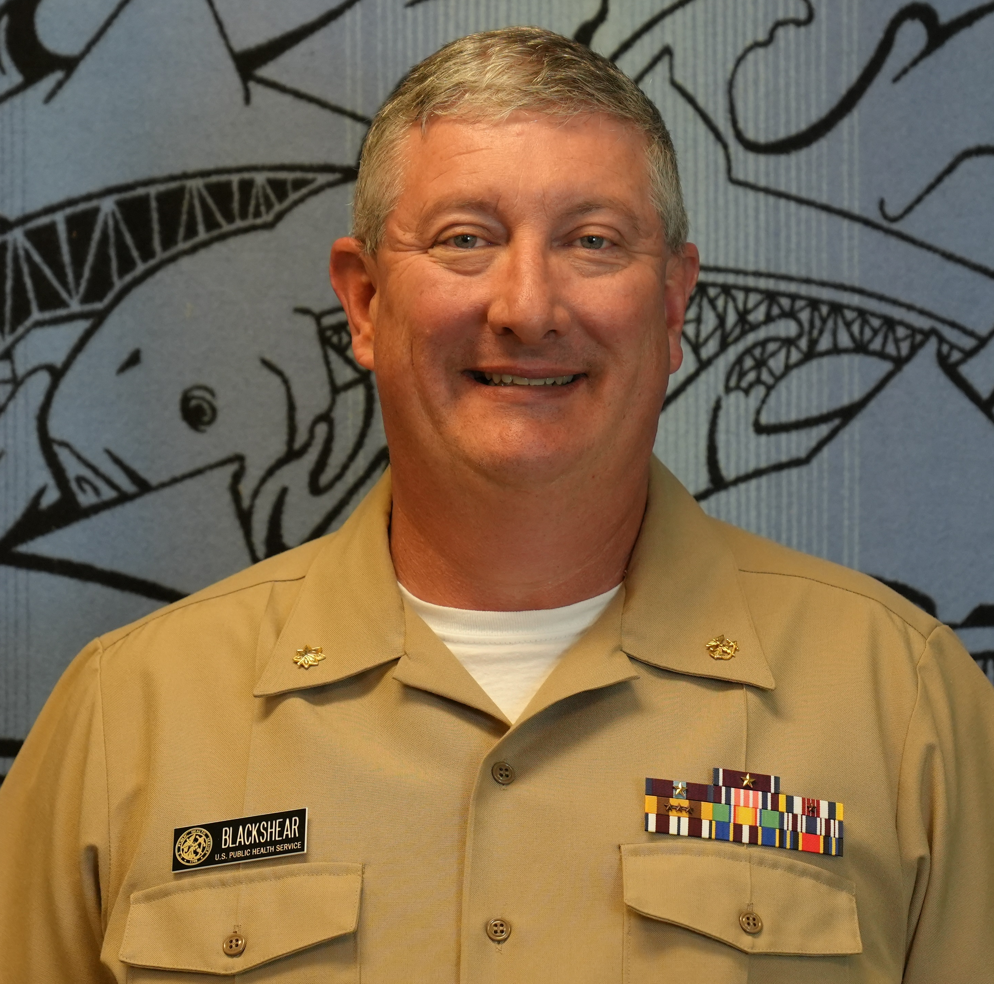
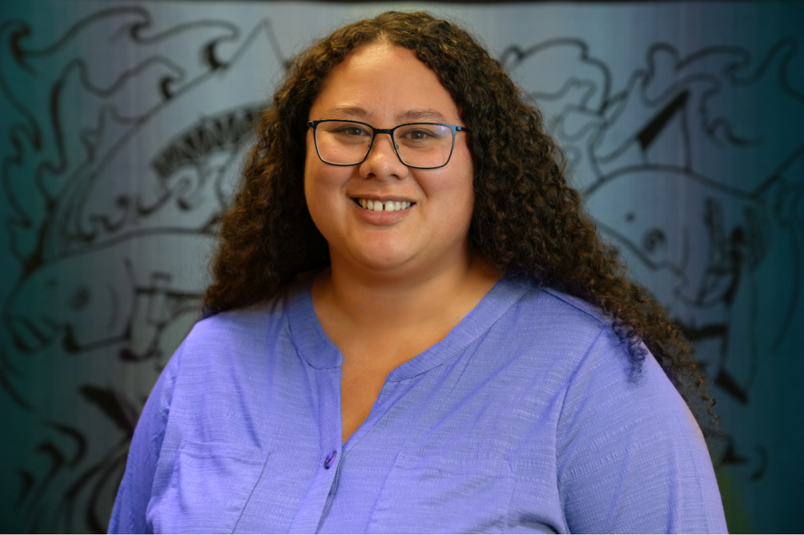
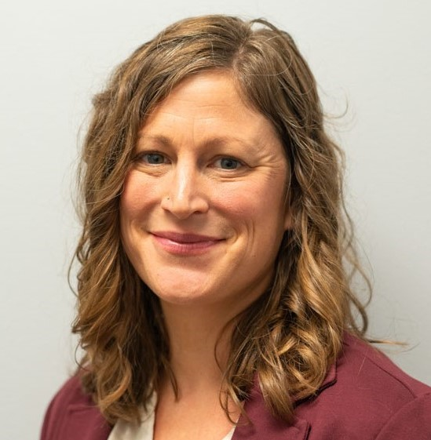
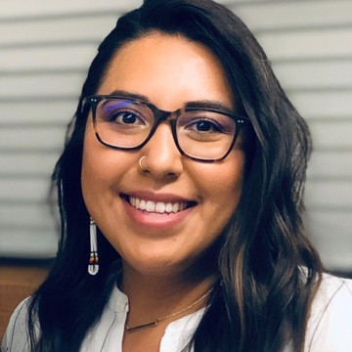
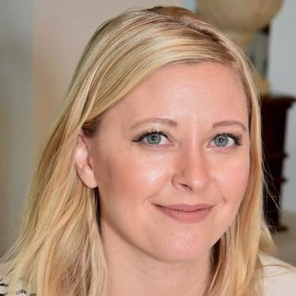
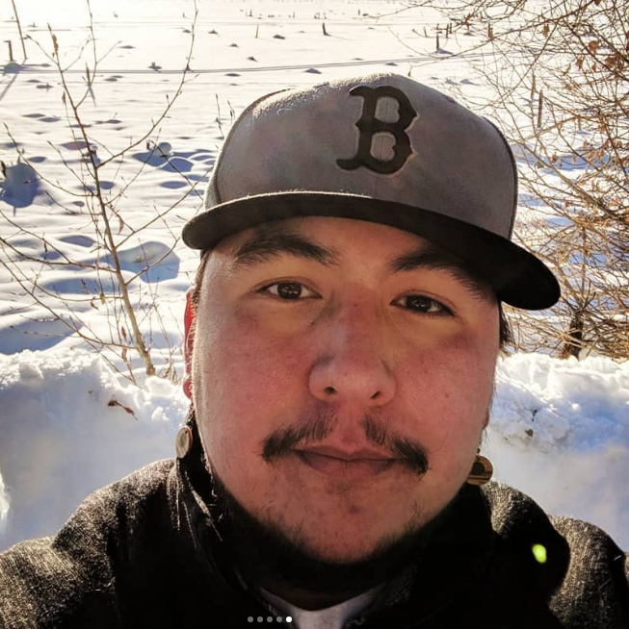
NPAIHB Environmental Public Health Team

Slide 4
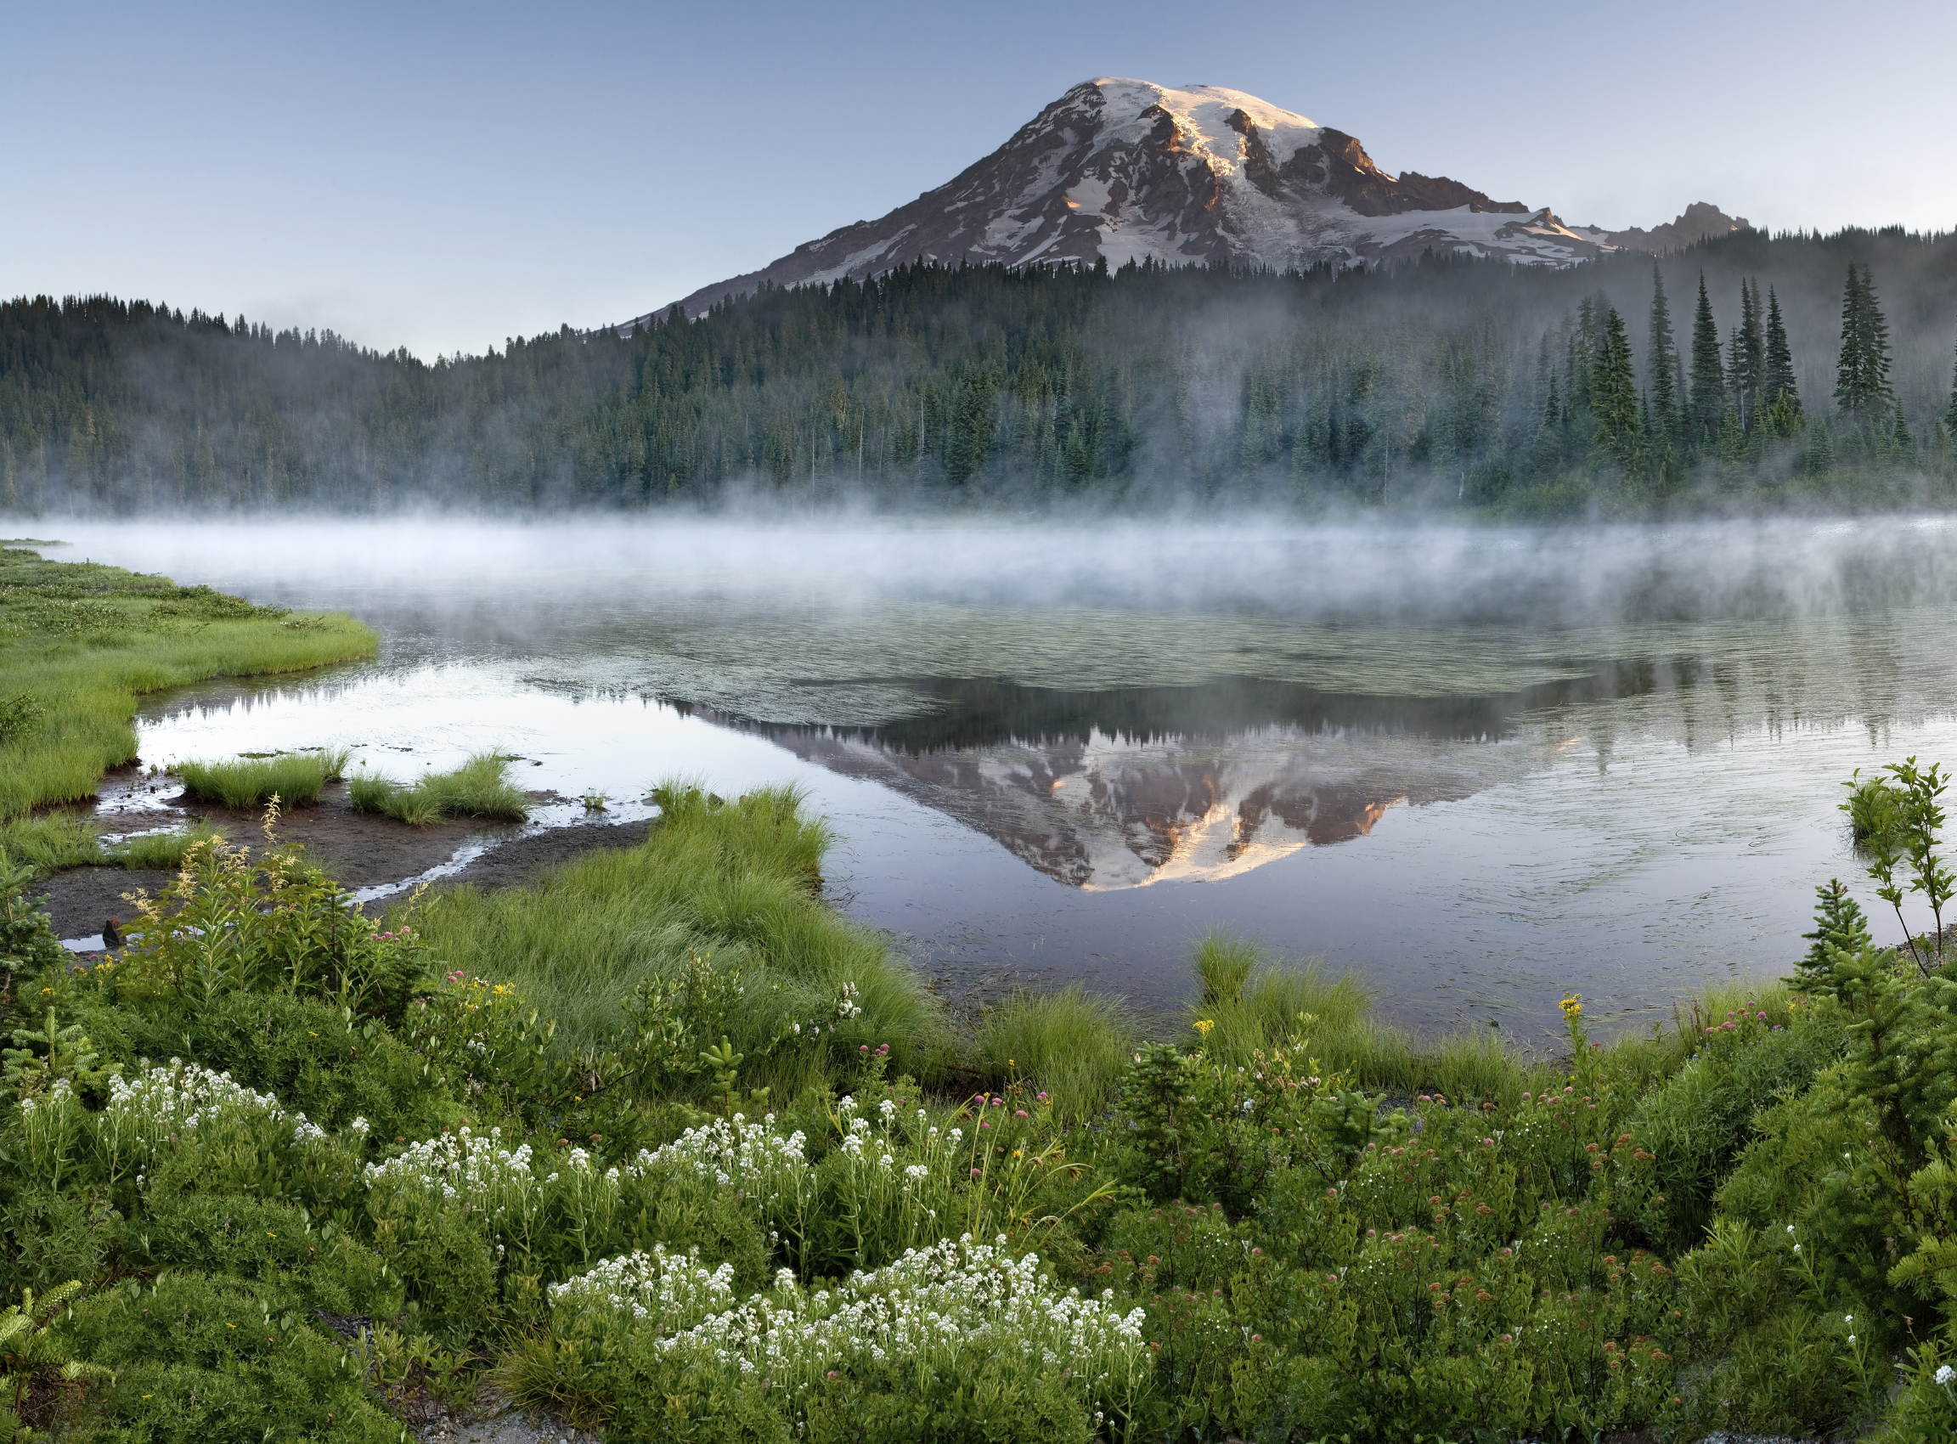
The EPH team supports PNW Tribes by providing comprehensive environmental public health services grounded in culturally-informed science

Slide 5
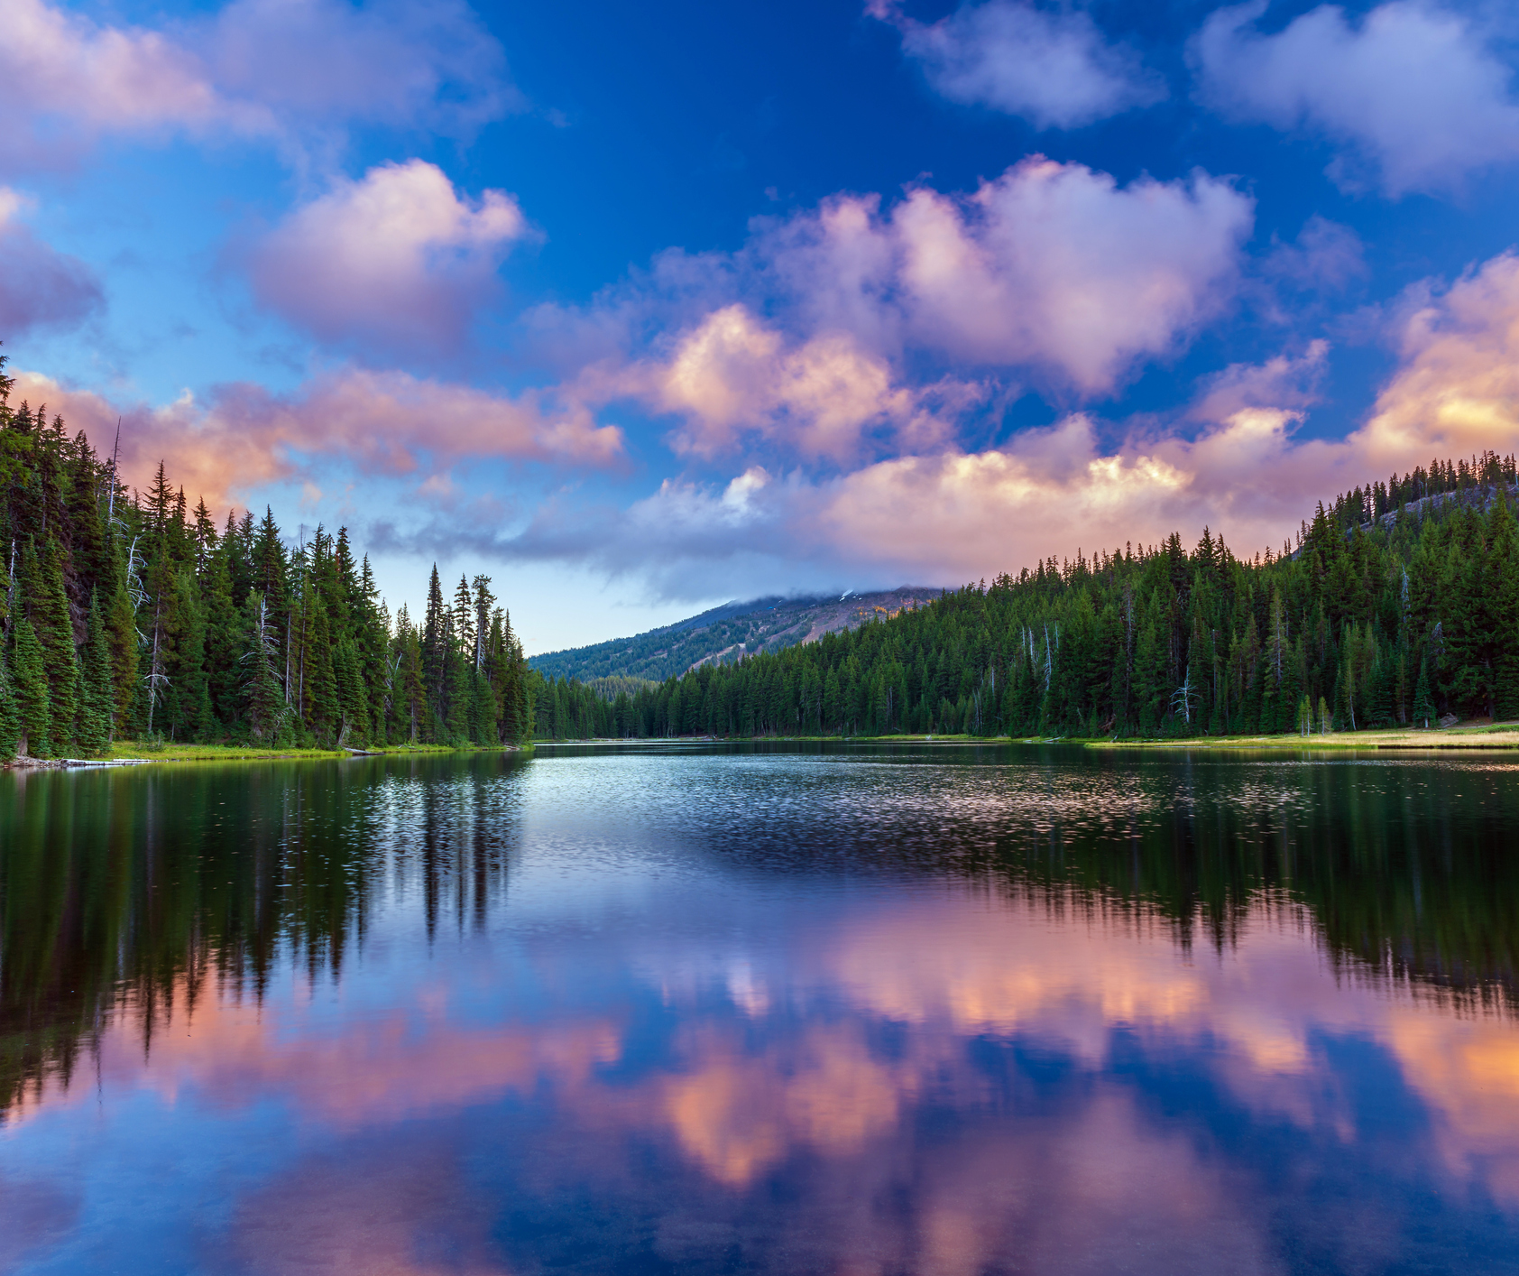
NPAIHB EPH Direct Services
Food Safety
Vectorborne Disease
Drinking Water
Liquid Waste
Housing assessment
Sanitation
Solid and Hazardous Waste
Injury prevention
Facility inspections
Aquatic recreation
Playground safety
Notes:
Indian Health Service functions

Slide 6
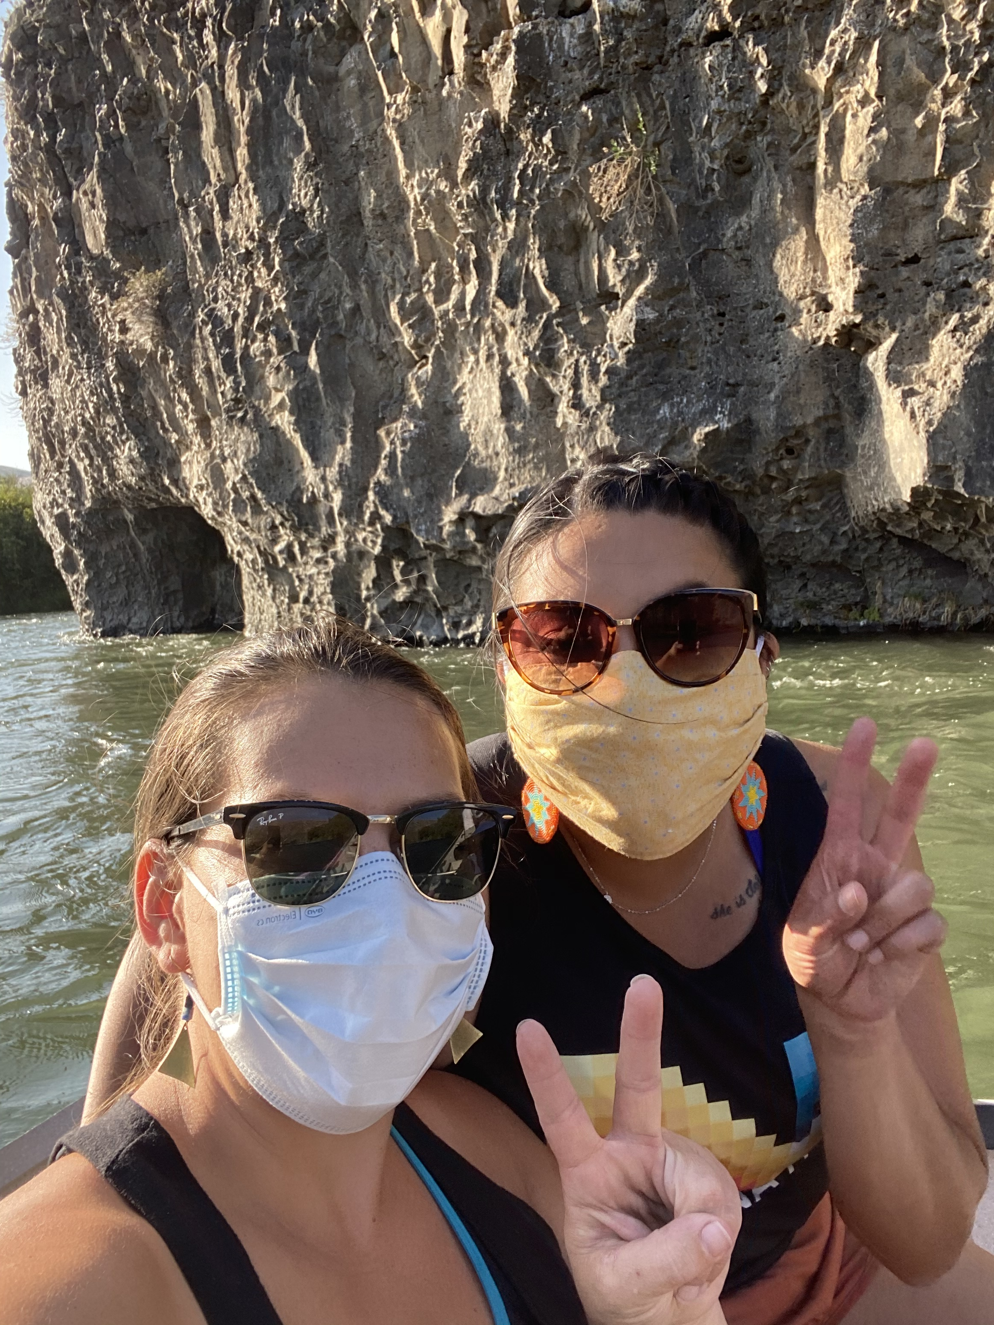
Additional Grant-Funded EPH Services
Lead testing in drinking water in childcare centers
Community Environmental Health Assessments
Well-water testing and mapping
Environmental health data system development
Traditional Ecological Knowledge interviews
Emergency After Action Review
Action Planning for Region 10 Preparedness Center
Hot Wash Planning & Facilitation
Asthma home visiting study
Webinars
Feasibility study for clean and sovereign energy sources

Slide 7
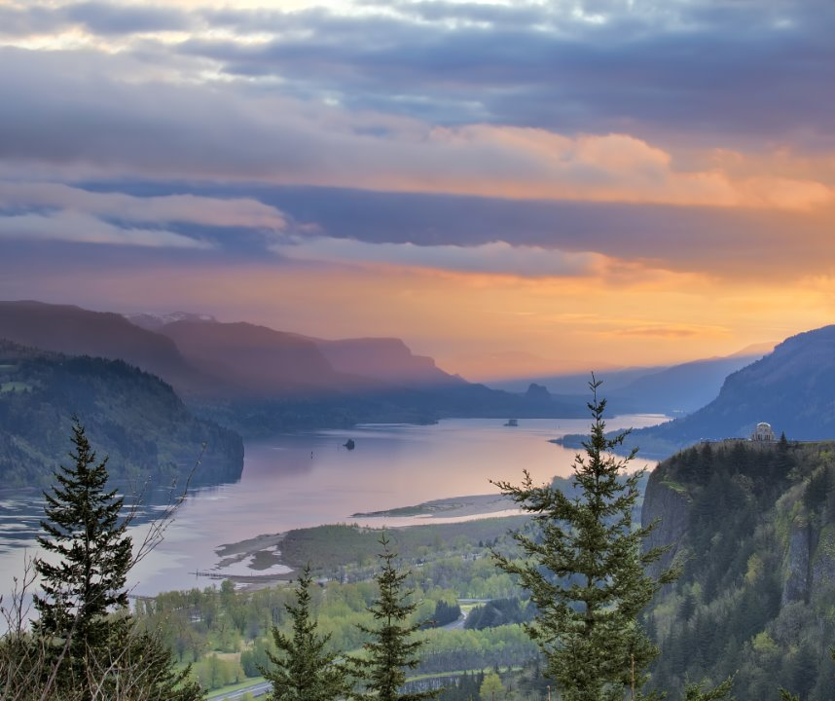
Trainings & Conferences
Asthma triggers in- home assessment
Food handlers
Food inspection
Bloodborne pathogens
Fisherman First Aid & Safety
OSHA 1910 Right to Know
Indoor air quality
Playground safety
Water testing
Tribal Public Health & Emergency Preparedness Conference
Northwest Tribal Environmental Public Health Gathering

Slide 8
Community Environmental Health Assessments
Notes:
When I started working with the EPH team in 2021, very part time, one of the first pieces of data work I saw I could help out with were the Tribal Community Environmental Health Assessments.

Slide 9
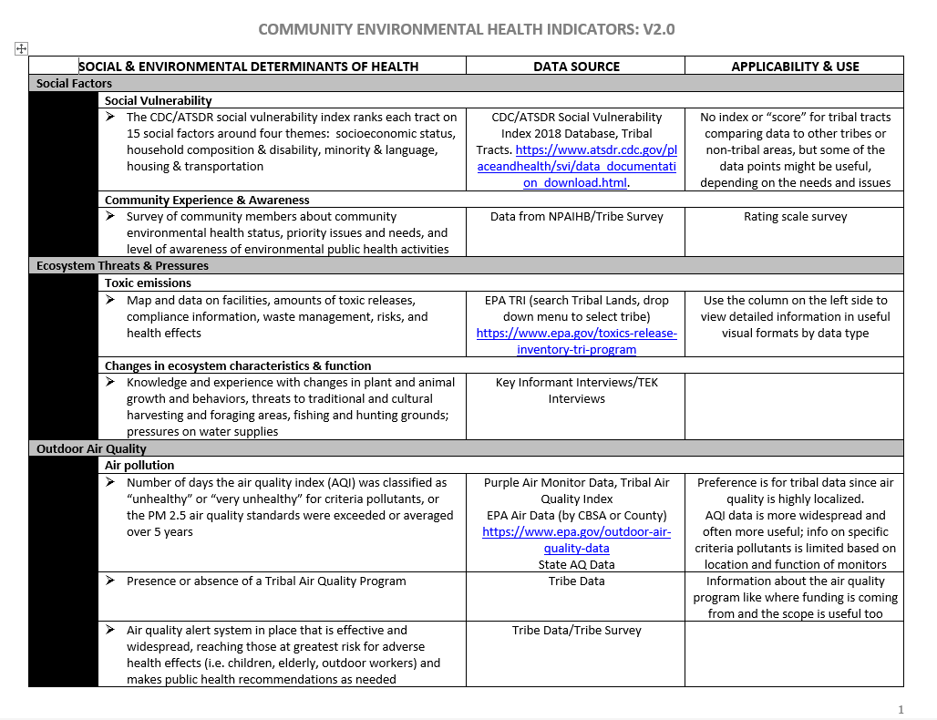
Notes:
The team had already developed a list of indicators to include in the assessment. This is page 1 of 6 pages of indicators. Which was great, and looks like other assessments we are familiar with like the social vulnerability index, or county health rankings.

Slide 10
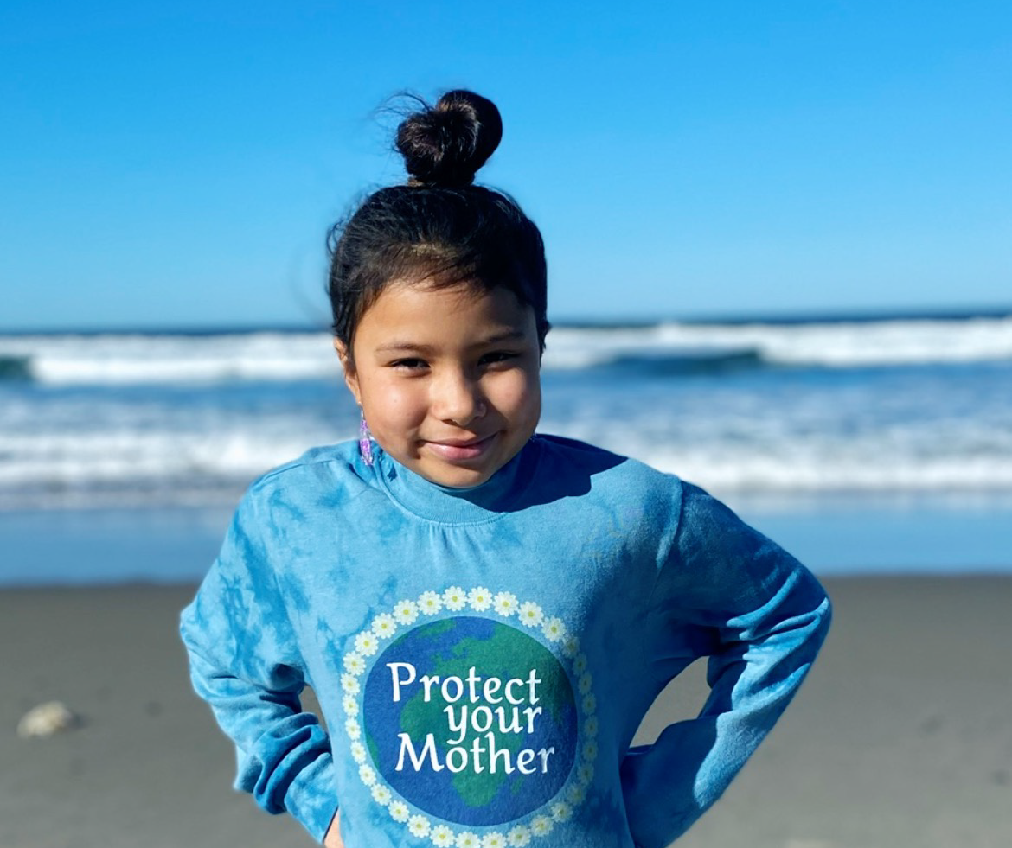
Tribal Environmental Public Health Definition:
Environmental public health focuses on the relationship and the interdependence between people and their environment for the seventh generation.
Notes:
It is also important that CEHAS reflect the tribal definition of environmental public health.

Slide 11
Notes:
They need to reflect the breadth of the work, the cultural context, the history, the feelings.
This image is notes taken at our 2022 Tribal Environmental Public Health Gathering in Coeur d’Alene, Idaho.

Slide 12
Notes:
We also want it to reflect the strategic plan the tribes have created for our organization.

Slide 13
Data and Mapping
Notes:
The CEHA format would center on data and mapping, since tribes use data for funding, strategic planning, decision-making, implementation, evaluation

Slide 14
Traditional Ecological Knowledge
“Preserve the history of our elders. Once it's gone, it's gone.”
“This tribe did an awful lot of work at reestablishing the fisheries and the salmon flow. And some of them hadn't come up the river in 75 years, and they've got them coming back up again.”
Notes:
But data is not just numbers. It's stories. Traditional ways of sharing knowledge and practices.
Why not incorporate the interviews with tribal elders as part of the CEHA.

Slide 16
Needed a format to accommodate multimedia
Notes:
We didn’t want some paper report or toolkit to sit on a shelf. We wanted something living. Something that can accommodate multimedia. And for efficiency, we wanted a live connection to the public data sources, which were the majority of the CEHA indicators on the list. We picked Story Maps because all our tribes have Esri Enterprise systems, so if we work in the Esri universe, tribes have the ability to incorporate their own natural resources data.

Slide 17
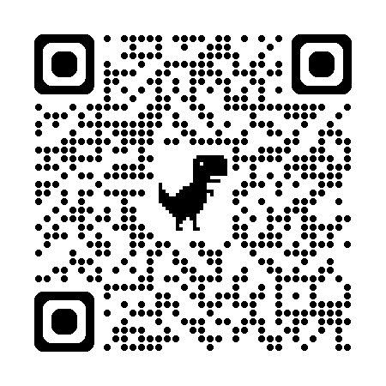
Partnership with Innovate
https://www.innovateteam.com/
Notes:
I only had one day a week of my time, but I did have a 50k budget to work with, so the first thing I did was look for GIS firms to contract with to start the technical work. I interviewed three different firms, and chose Innovate because many of our tribes had already worked with them and had good experiences. We have since expanded our work with them to other projects, you can hear Melino talk about modernizing well water data collection in another session this afternoon.

Slide 18
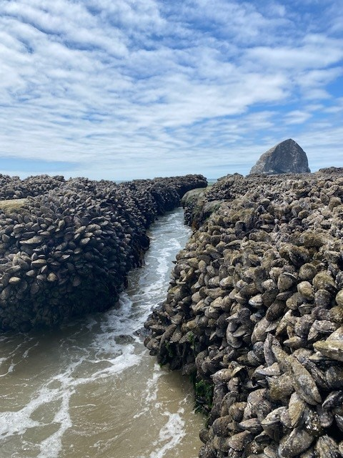
Partnering with individual tribes
Gauge interest
Discuss priority topics
Review indicators
Select additional components
Community surveys
Interviews
Health indicators
Set budget & scope of work

Slide 19
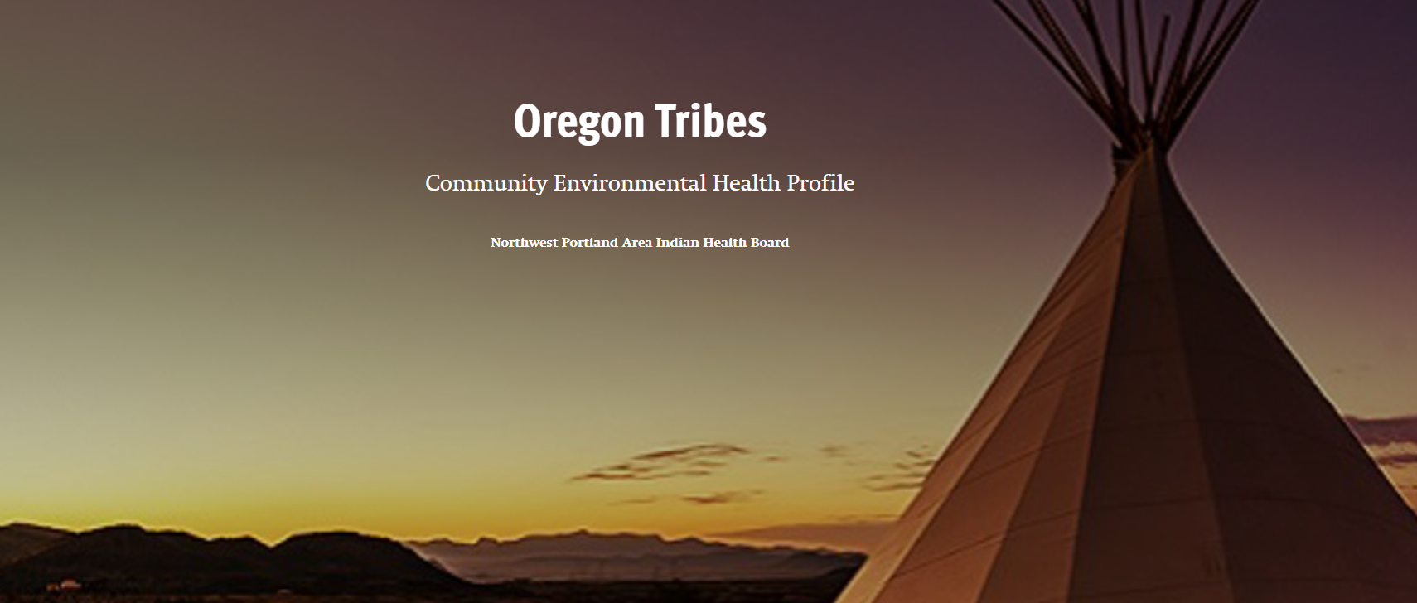
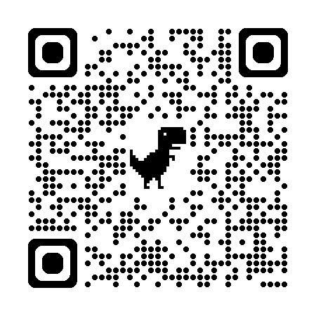
https://storymaps.arcgis.com/stories/b7193507c5574134a0cd373e48ca5a72
Notes:
This is an example of the format we're using to partner with tribes to create tribal community environmental health assessments. This version is a state-level profile using all public-facing data sources, so you're welcome to view it. It's still in development, but is a nice example of bringing data, maps, interviews, photos, together.
Coeur d’Alene’s https://storymaps.arcgis.com/stories/ad39b02130e942fda7cf07c599be27b6

Slide 20
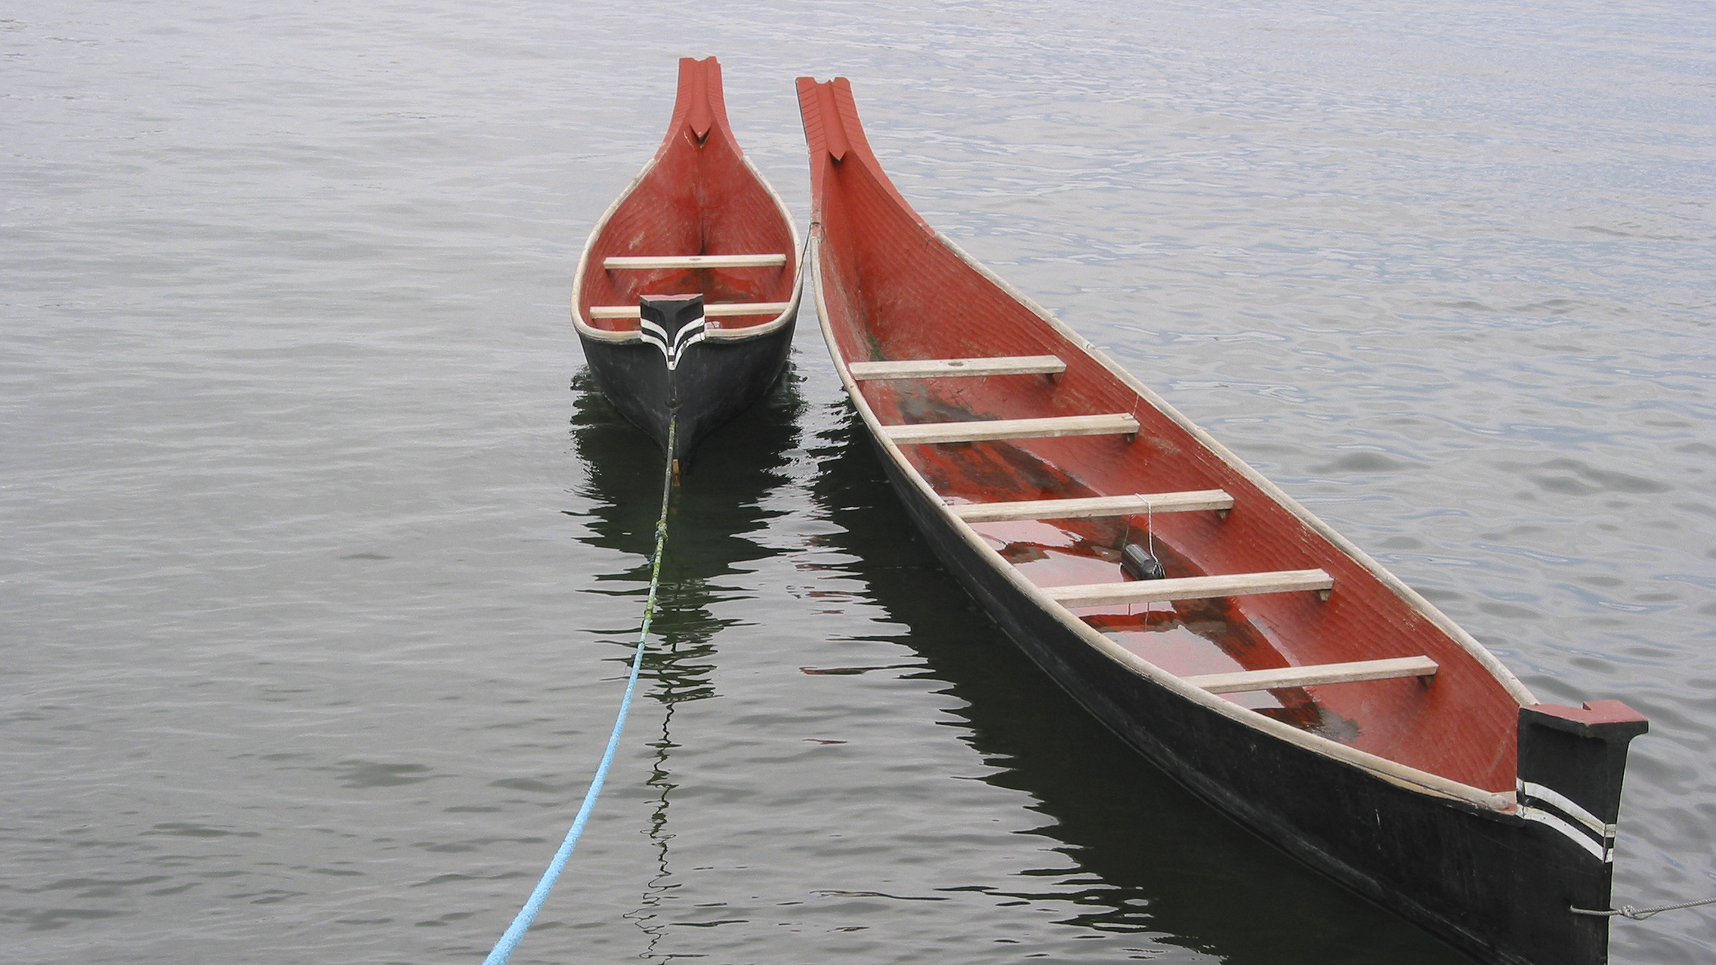
Questions?

Slide 21
Contact
Nicole Smith
Environmental Health Informatics Specialist nsmith@npaihb.org
Funding:
CDC-EH20-2005: Strengthening Environmental Health Capacity (EHC) to Detect, Prevent, and Control Environmental Health Hazards through Data-Driven, Evidence-Based Approaches, Component A: Build Core Capacity to Use Environmental Health (EH) Data
Oregon Health Authority: Environmental Public Health and Climate Change, Public Health Modernization

