Slide 1



A Region 8 Case Study:
SUPPORTING A REGIONAL APPROACH TO STREAMLINING DATA MANAGEMENT ANALYSIS
KAYLA GOWER (PRIBBLE)
MANAGER - GOLD SYSTEMS INC
RONNI CHASE ALONE
WATER QUALITY SPECIALIST - STANDING ROCK SIOUX TRIBE
E2I CONFERENCE
SEPTEMBER 2024

Slide 2

Where it started...
HISTORY
  Region 8 Tribes have utilized the Exchange Network to help facilitate a centralized data management solution for many years
  The very first efforts started with just 6 tribes back in the early 2000s - Headquarters manages the hosting costs since 2015
  Standing Rock has ran the efforts since EN grant cycle FY19, but previous grants have been managed by other tribes in the region including Southern Ute, Fort Peck, and Ute Mountain Utes
Notes:
- Region 8 tribes actually worked with developers at gold systems back in the product line's conception
- This allowed the group to dramatically impact the direction of development and create a solution that was GREAT for tribes

Slide 3
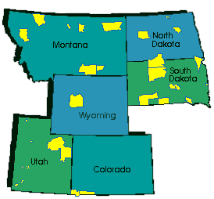
Where it started...
BEGINNINGS OF THE DATA MANAGEMENT PROCESS
  Original efforts were focused on migrating data into the database and flowing it to STORET... that’s it!
  Basic data analysis tools then were built in the system and QC thresholds
  Expanded then the original mission to now include biological and habitat assessment datasets
  Expanded original importing processes to support additional dataset formats and greater ease upload into WQX
Through the various grant cycle efforts, as region 8 tribal programs have been able to expand and use the new tools we’ve had to also expand the software tools available.

Slide 4
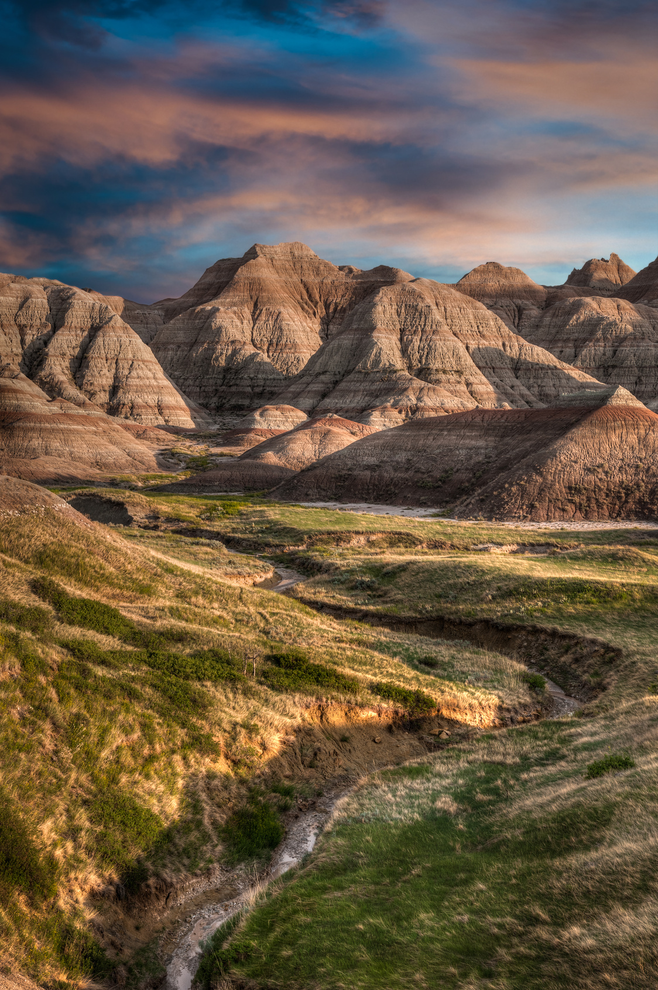
Region 8 Tribes Now
  23 of the 28 federally recognized tribes currently participate in the program
  Strong collaboration between EPA, tribes, and contractor to ensure continuity in support
  Tribal water quality programs gain more time to complete analysis and QA of their data
  Advancement of data collection with support from the data analysis tools provided by EPA, Standing Rock, and contractor
  Data Types Flowing to WQX:
    Field measurement/observations
    Lab samples (nutrients, metals, pesticides, etc)
    Continuous/Time-series Data
    Habitat Assessments
    Biological/Macroinvertebrates
Notes:
The project has provided advanced data access, data management, and data analysis capabilities for our NAEPC member tribes!

Slide 5

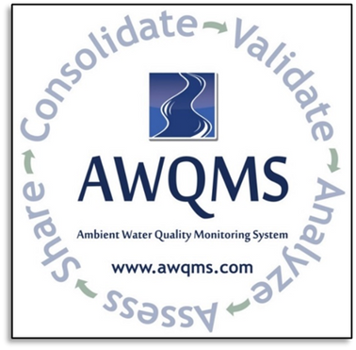
Why GS Elements for this collaboration?
Reusing a tried & true solution
Utilized by over 100 tribes, 8 state organizations, and over 70 volunteer groups. Already used the eXchange Network flows and WQX business rules and been utilized by tribes in the region for over 15 years.
Single sign-on/shared platform
Help reach more tribes with one product. Also promotes cross-training and ease the burden of turnover with one single tool to use.
Environmental specialist support team
Not just software, but a support team built with environmental specialists that understand the unique needs of each organization

Slide 6
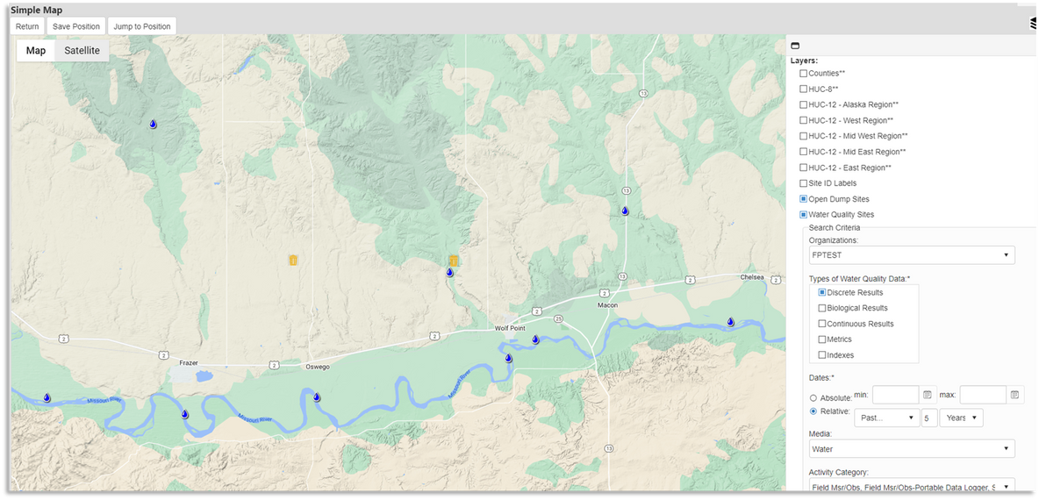
Why GS Elements for this collaboration?
  Built-in Cross-media map/spatial viewer
  Thresholds and built-in QC checking
  Local Data Management FIRST
  Built in data analysis tools
    or use web feature services to connect with your own tool, GIS, R, or other software
  Integrated Google maps
    or use web feature services to connect with your own tool, GIS, R, or other software
  Automatic flow to EPA

Slide 7

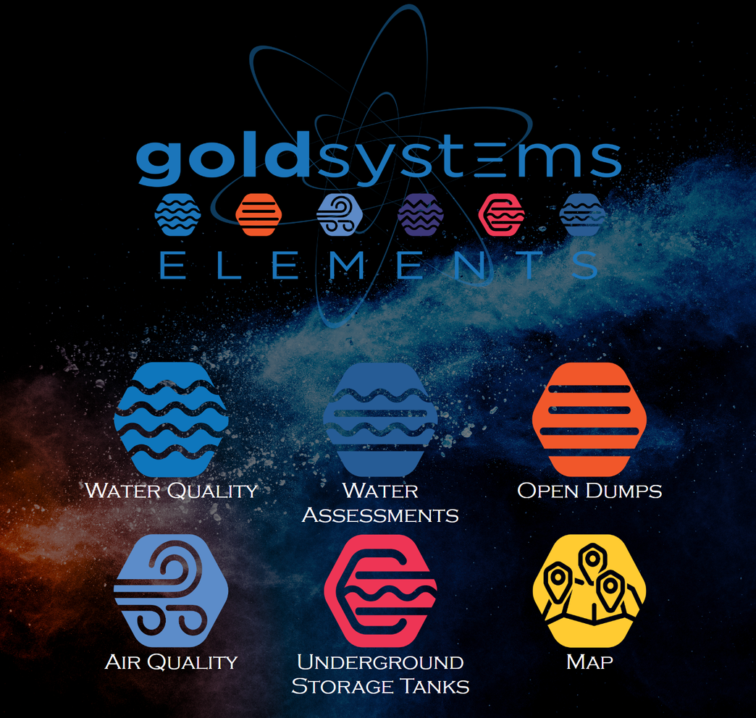
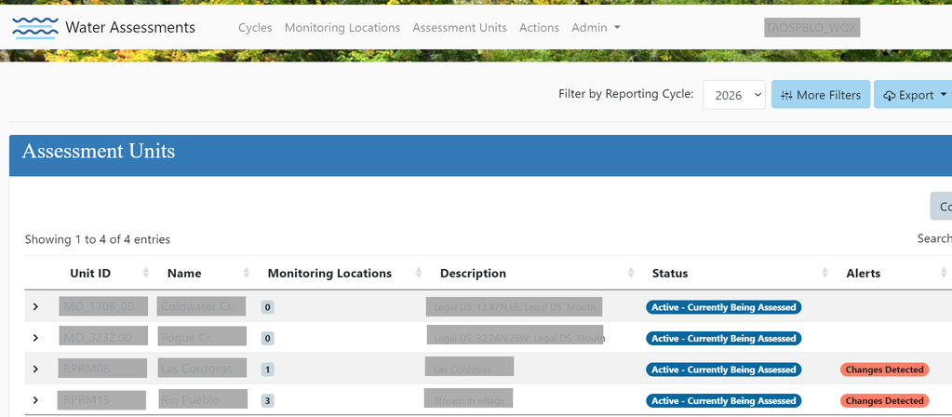

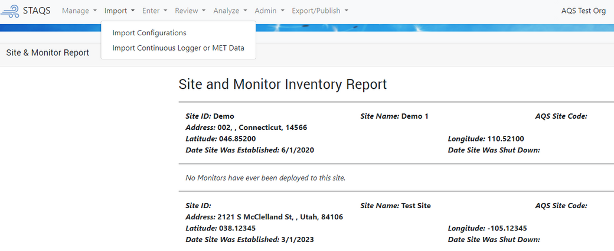

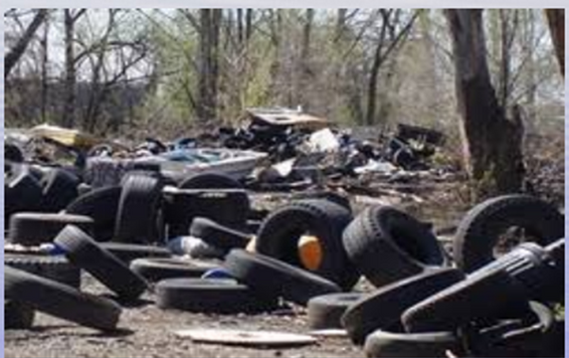
Why GS Elements for this collaboration?
WQX
ATTAINS
AQS
TRIBAL
OPEN
DUMPS

Slide 8
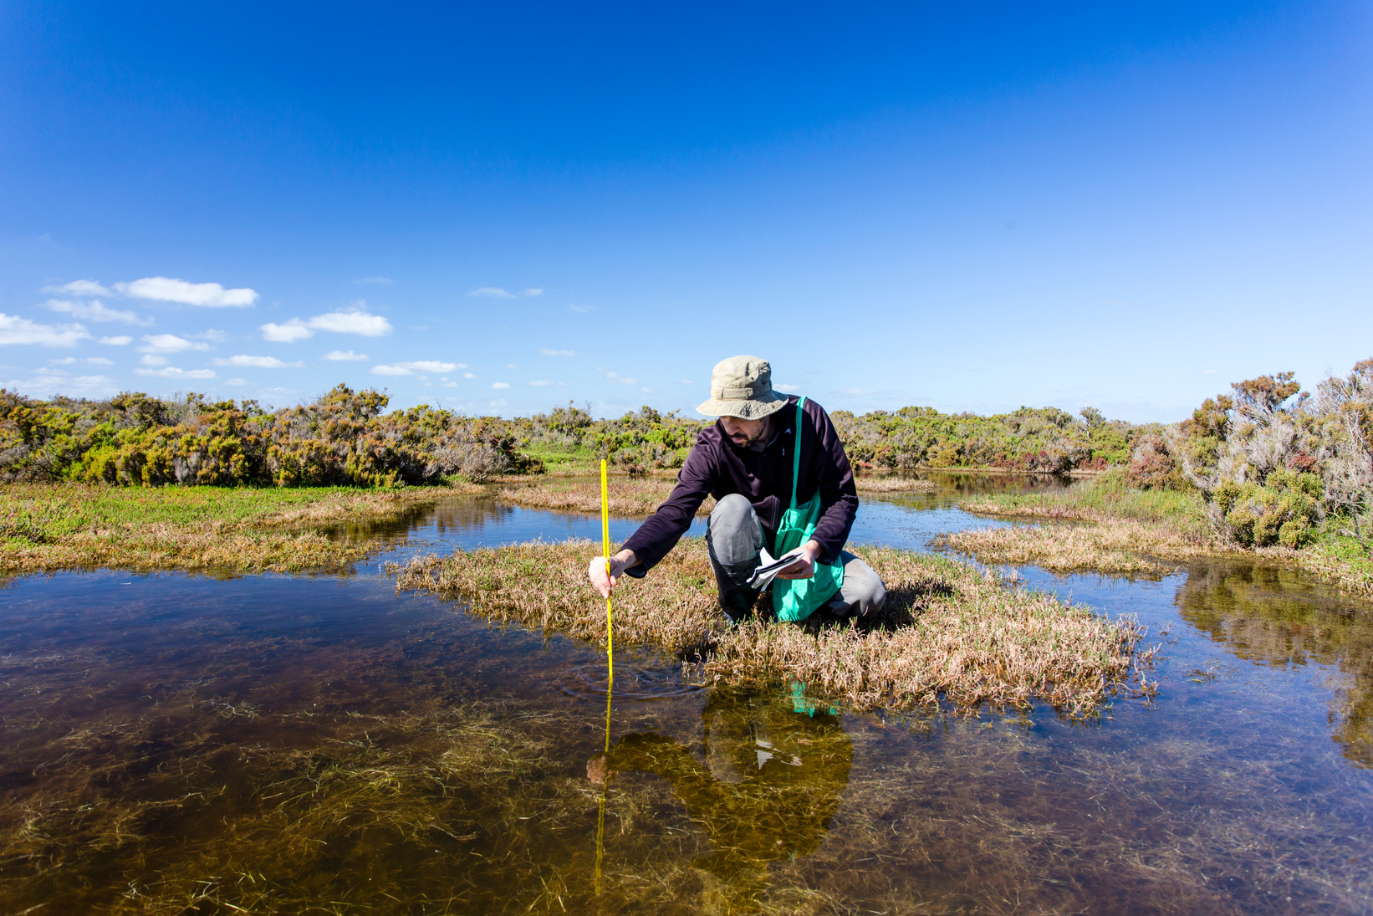

Current EN Grant Goals
Building off previous successes
Virtual Support
  Webinars, phone calls, and email
On-site Trainings
  Host 3 on-site trainings for the participating tribes to learn about new tools as well as to better leverage existing ones
Develop - Mobile App
Notes:
An important point: Over the last few years, when a tribal program has had turnover, our AWQMS to WQX “flow” project have been able to help the participants quickly and smoothly transition in the new personnel and help them get up to speed on the status of their historical monitoring data.

Slide 9

Ongoing Virtual Support
  1-1 virtual support when the tribes need it
    Overviews of the system
    Data Analysis
    Data Cleanup
  Assistance with loading data into the database
  Turnover assistance
  Building custom import and data entry configurations for easy data uploads
Notes:
- this is where most of the work takes place
- on demand
- also help with outreach to labs or epa personnel to help make sure data input is clear and accurate

Slide 10
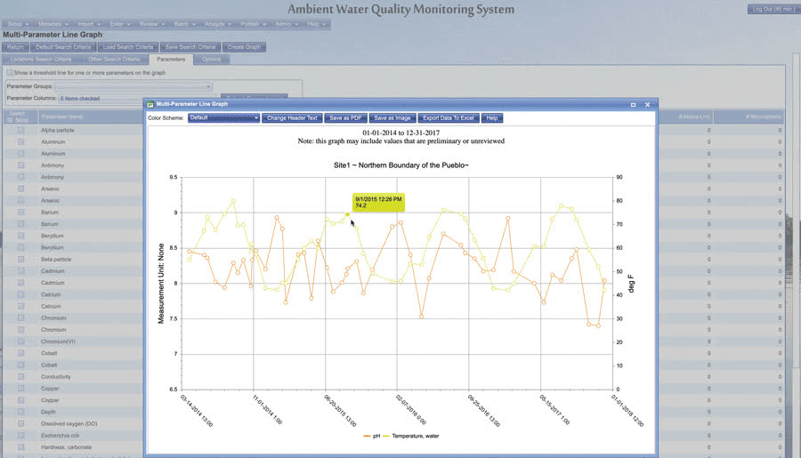
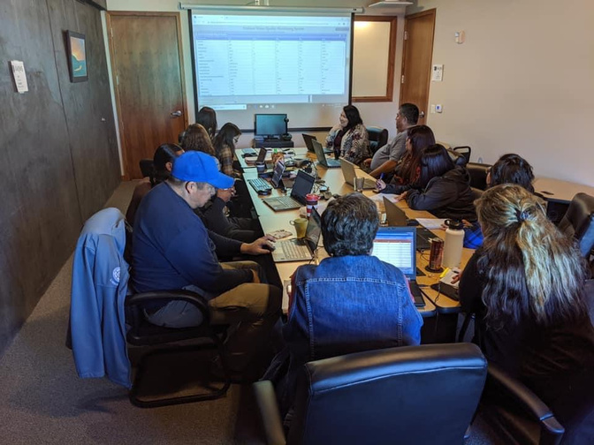
In-Person Trainings
  Each grant aims to host at least
2-3 in-person events
  Trainings include:
    Full overview of the system
    1-1 support for each tribe with a data management specialist
    Discuss the other applications available to tribes
    Hands-on practice on the data analysis tools

Slide 11
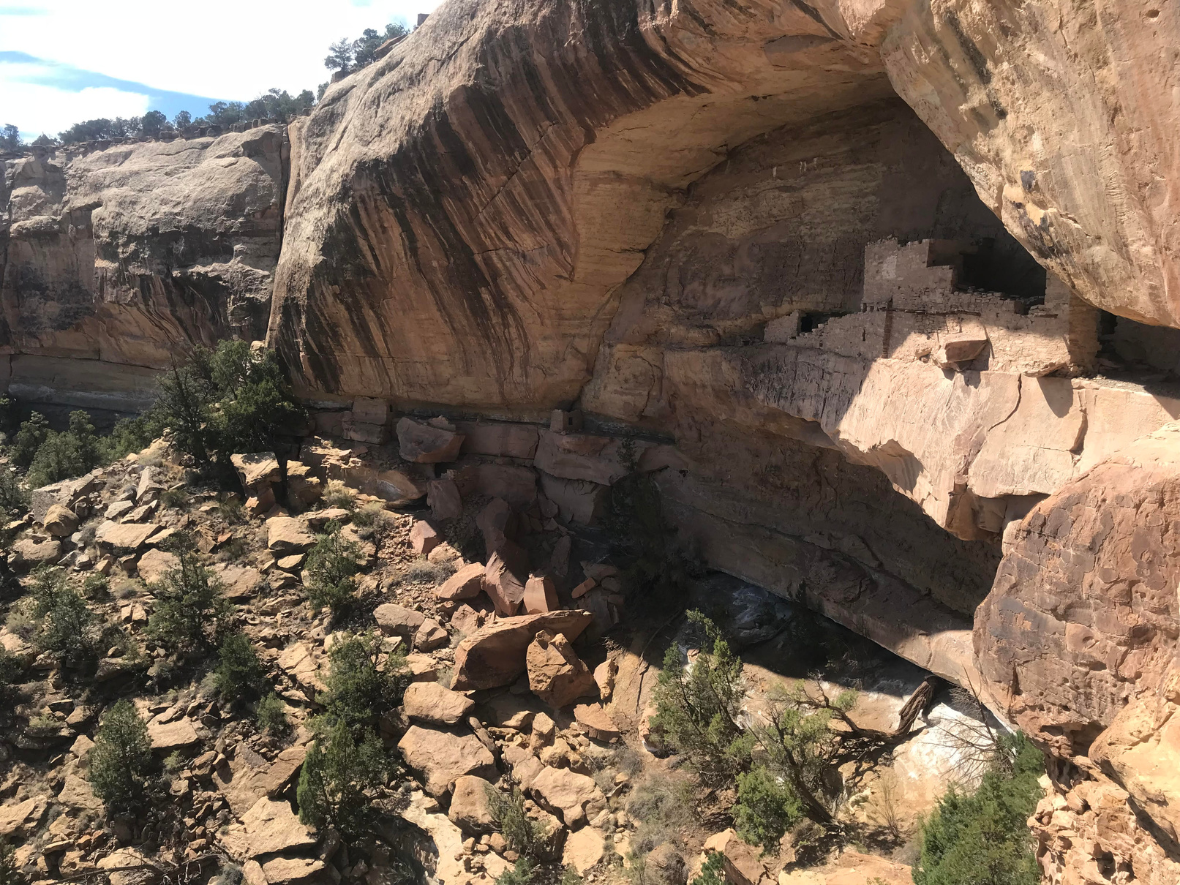
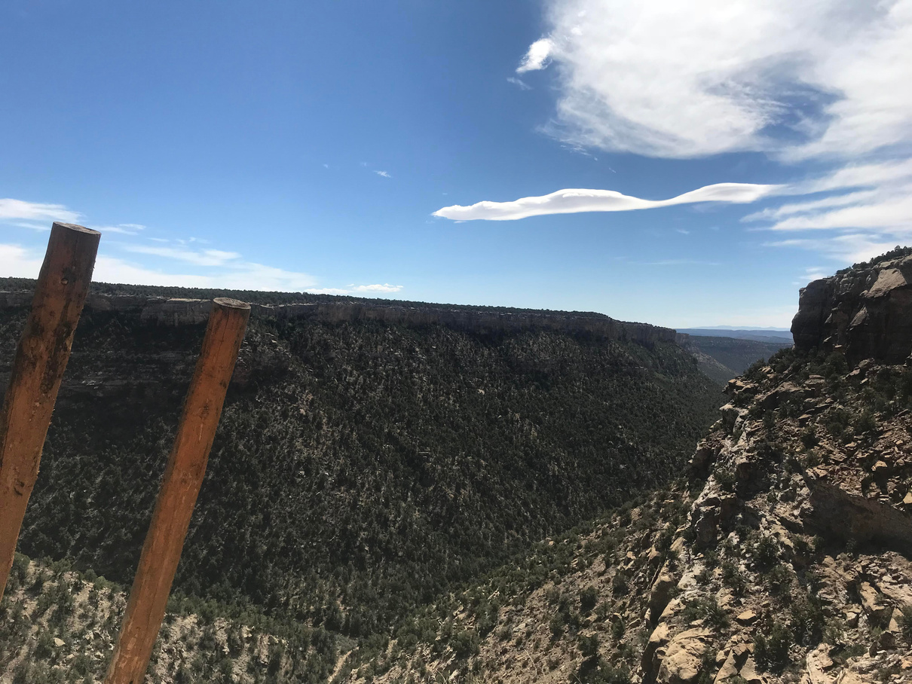
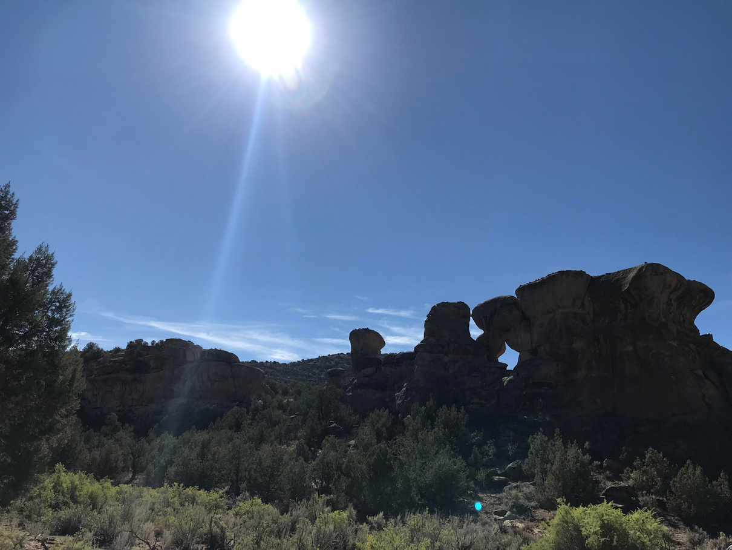
In-Person Trainings
sharing
These events are also great for
  Program Knowledge
  Lessons Learned
  Special Projects
  General Tips/Tricks
  Cultural Stories
Notes:
- We can learn a great deal not only from instructors but just by being together and sharing
- sense of community has been lost in a lot of things staying 'virtual'. in person trainings not only aim to assist users but also to bring back a sense of community to the region as a whole
- Talk about Ute mountain trip!!

Slide 12

How does this approach benefit the tribes?

Slide 13

Provide support with turnover
Helps ensure consistency in long term tracking of vital analytes
Peer Mentorship
Frequent on-site trainings help to not only train reoccurring and new staff, but have also proven to be wildly beneficial for deeper collaboration between the tribes. Younger growing programs get consistent interaction with more advanced programs to gain ideas/momentum/support

Slide 14
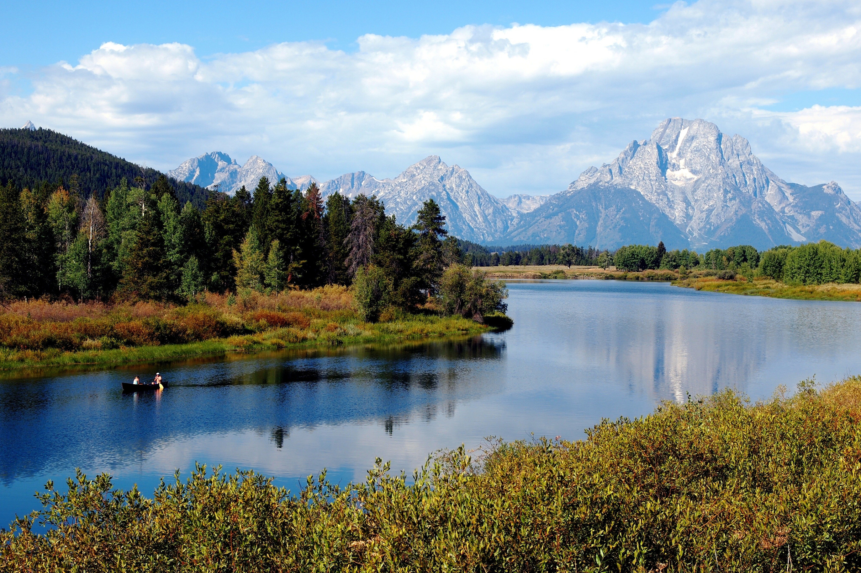
Easy EPA submission
The need for this effort originally started with trying to find a way to make submission to WQX easier to meet grant requirements. All tribes in our region have an auto-submit functionality on in the software which compiles any changes in the system, checks them against the current WQX rules and submits all changes to EPA for us
Additional funding
Working in a consortium, while it does add a temporary increase in workload to one tribe who runs the grant, the efforts benefit all members! Even so, the funding allows all the tribes to secure help from expert contractors in the field to help ease the data management burden without burdening tribal program budgets

Slide 15

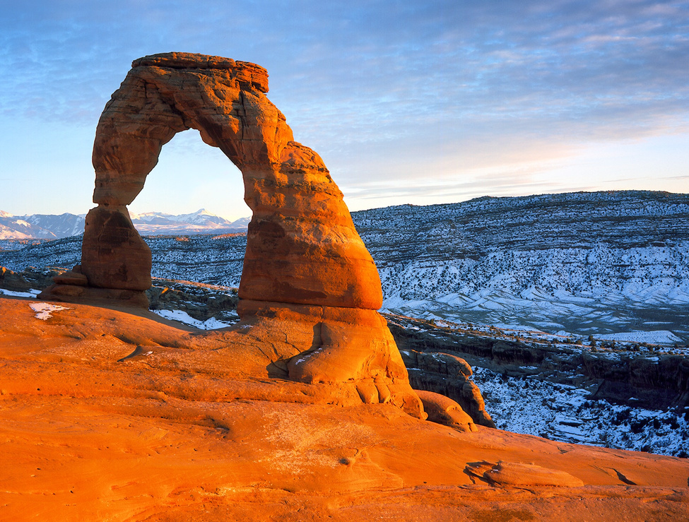
Land Preservation
A lot times tribes have higher standards for natural resource conservation. Having a locally managed system allows you to easily submit required information to EPA, while still having autonomy to be independent of any federal/state organization and manage resources directly. Having data easily accessible also helps tribal staff communicate to tribal policy (i.e. Council) about important issues happening in the water and land
Provides opportunities for expansion
Environmental program expansion not only benefits the land, but increased funding creates more community jobs and more robust environmental programs. Several of the tribes in region 8 are using the support from this grant to assist them with loading assessments into ATTAINS for the first time!

Slide 16
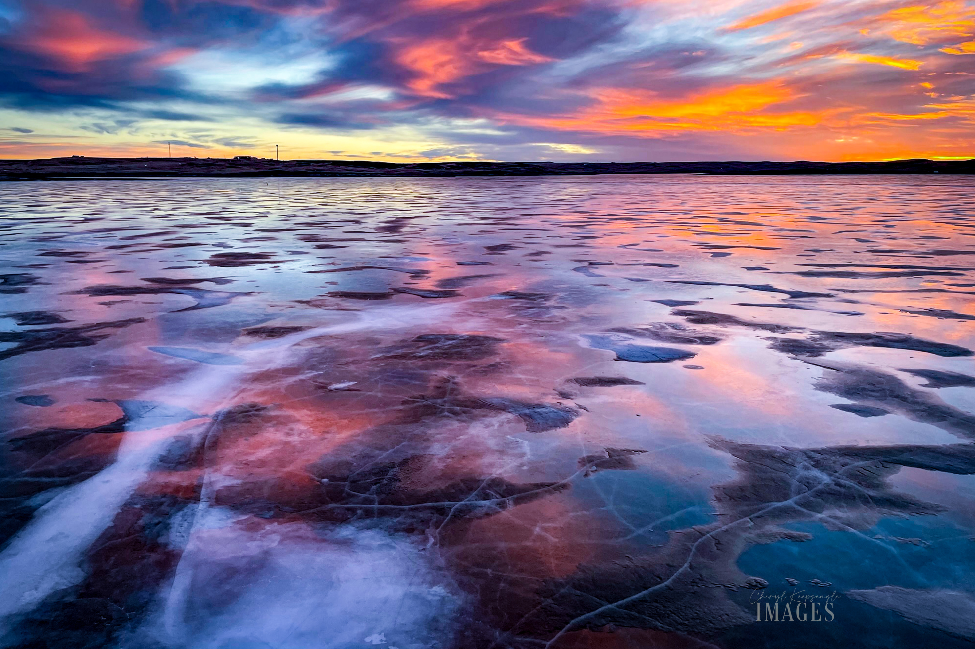
Standing Rock
Having a centralized host for the grant reduces paperwork, time, and red tape for everyone else in the consortium. Being the host of the grant also has it’s perks! Being able to influence the direction of the software through the goals and objectives of our grant allows us to be a leader for the Region 8 tribes and ensure that tribal data management needs are being not only heard but actually being met!
Stewardship Focused
We strive to be leaders in preserving and protecting our relationship and connection to water in our communities and the world. Working in a large collaborative consortium allows tribes to focus on our water quality goals through the support obtained through the grant funding and coordination with peers.

Slide 17

Project Success...
fulfillment of the EN mission
Started the project with 6 active Tribes (early 2000s) and increased to 23 (current)
Since the project’s inception, we have added 3 additional EN flows in addition to AWQMS and are working on #4 (UST)
475%
+3
  Extensive Software ‘Re-use’
    Within project partners
    Broader EN community
  Shared platform
  Shared training and support resources
  Increased flow of data to the National Water Quality Portal
1 Million
As of 09/01/2024 the consortium has just under 1 million records submitted to WQX as a group

Slide 18


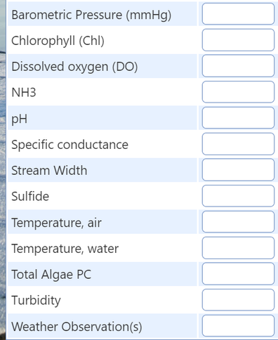
The Mobile App
  Previous EN grant built the prototype and tribes confirmed the need is there!
  Field focused first
  Customizing options so different programs with varying needs can use it
  Offline capabilities & auto-sync with data management system
  Android, Apple, and Microsoft system compatible

Slide 19

Thank you
Kayla Gower (Pribble)
Project Manager, Environmental Data Specialist Lead
Gold Systems Inc
kaylag@goldsystems.com
Ronni Chase Alone
Water Quality Specialist
Standing Rock Sioux Tribe
rchasealone@standingrock.org

