Slide 1
Reimagination of Superfund Enterprise Management System (SEMS)
Powered by Booz Allen Hamilton , AWS and AI technologies
SEPTEMBER 2024

Slide 2
Superfund Enterprise Management System (SEMS) TEAM
Erin Sanborn
SEMS Project Analyst
Pattabhi Nunna
SEMS Chief Architect
Spencer Maghrouri AI/ML Engineer
EPA COR & Program Manager
Steven Wyman
Information Technology Specialist (EPA System Owner)
OLEM-OSRTI-RMD-IMB
EPA Alternate COR
William Bushee
IT Specialist (Security)
OLEM-OSRTI-RMD-IMB

Slide 3
AGENDA
SEMS Background & Vision
Demo
SEMS Records Search and Vision
AI Enhanced Data Processing & Automation

Slide 4
What is the Superfund enterprise Management system (SEMS)?
The Superfund Enterprise Management System (SEMS) is the national system used to track activities at hazardous waste sites considered for cleanup under the Comprehensive Environmental Response, Compensation and Liability Act (CERCLA) , aka “Superfund”. SEMS is the official recordkeeping system of all Superfund sites and site activity and supports Superfund planning, tracking, reporting and decision making.
What is SEMS?
SEMS Modernization
60+ AWS cloud services
DevSecOps pipeline with CI/CD
Automated testing
Zero Trust security architecture
Comprehensive, continuous performance and cost monitoring
Modernization-in-place, cloud-native application, AWS Well Architected Framework (WAF), hybrid-environment

Slide 5
The future of (SEMS) Superfund enterprise Management system
Superfund Data Nexus: A singular access point for comprehensive Superfund data, offering immersive site views and geospatial functionalities like SAM Mapper, NPL site, and Operable Unit boundaries.
GeoProcess Sync: A robust integration of geospatial data, complex documents, and automated processes, enhanced with 2- and 3-D site models from ORD and others.
Site360: Holistic environmental insights with integrated 2D and 3D cleanup models, complex document access, and process automation for streamlined workflows and standardized document templates.
PartnerShield: Secure, non-EPA access tailored for key partners such as USACE, Tribes, States, NIH, USCG, DOJ, ensuring protected collaboration and information sharing.
Visionary Site Analysis: An immersive interface providing comprehensive site analysis with advanced geospatial data layers and audiovisual file integration.
AI Enhanced Analytics: AI/ML-driven capabilities for superior search and data analysis, complemented by OpenSearch, a digital library, third-party application integration, records management dashboards, information repositories, and SPIM integration.

Slide 6
SEMS data driven
Field Samples, Geocoded: Geocoded field samples provide precise location data for environmental samples, enabling accurate mapping and analysis of contamination spread within Superfund sites.
Phones & Tablets: Mobile devices like phones and tablets enable real-time data access, communication, and on-site data collection, enhancing the agility and responsiveness of Superfund operations.
Aerial Photography: Aerial photography captures the extent of Superfund sites from above, providing a visual context for the area's geography and the scope of remediation activities.
Remote Sensing: Remote sensing technology gathers data from a distance to monitor conditions, track changes over time, and identify potential environmental hazards at Superfund sites.
Textual Documents: Textual documents, including reports, legal documents, and correspondence, contain detailed information on site history, contamination levels, and stakeholder communications.
Other Agencies: Collaboration with other agencies brings in additional expertise, resources, and data, enriching the Superfund program's knowledge base and response capabilities.
ARCGIS
ARMS
CEJST (Climate & Economic Justice Screening tool)
Census Data
COMPASS DW/Special Accts
DMAP
EJScreen
FRS
GeoPlatform
PATT
response.epa.gov
TRIBES
CLPSS
Enterprise Identity Data Warehouse
FACTT
RCRAInfo
SRS
Partners Integration (USACE, DoJ, Tribes, States)
FOIA Express
Currently Integrated
Future Integration

Slide 7
SEMS DEMONSTRATION OF CHATBOTS
SPIM Chatbot
SEMS Records Search
Region 01 SOPs & Manuals
7

Slide 8
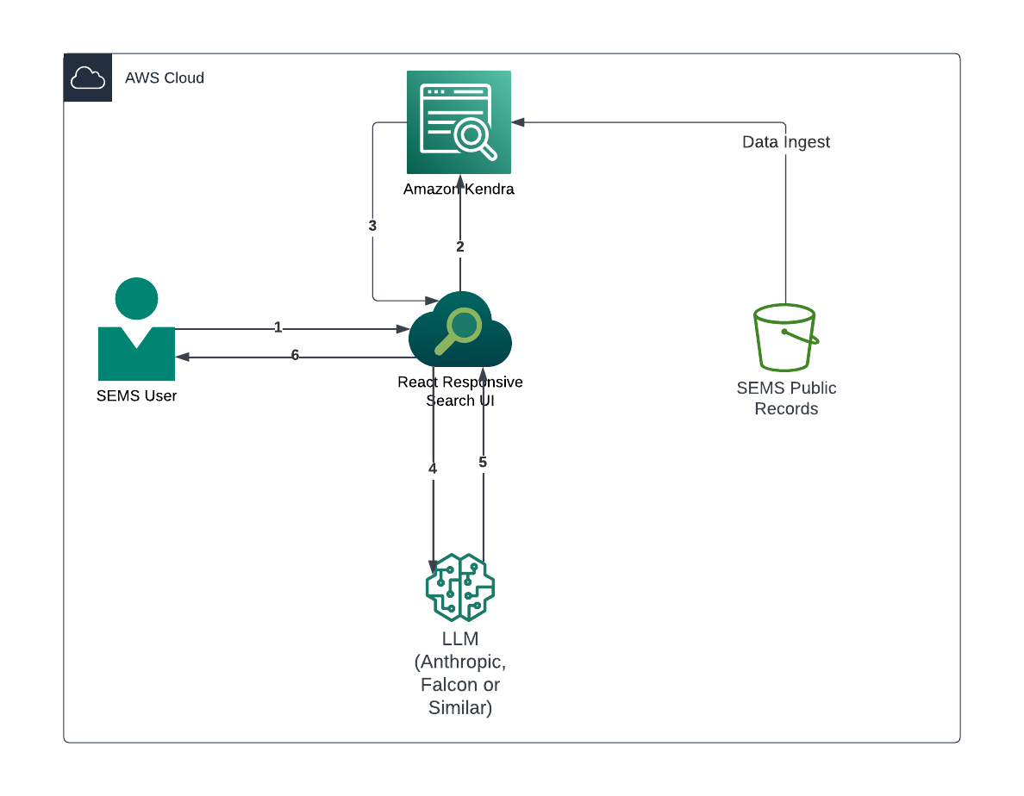
SEMS Chatbot Solution Design

Slide 9
sems records search and vision
Problem Statement
Superfund Data Search Challenges: The EPA Superfund program's main challenge is its data management and user interface. It houses a vast array of records, including 50 TBs of internal data and 2 TBs of public records, with a backlog that's expected to grow significantly. Users struggle with an outdated and cumbersome interface that offers limited search functionality, lacking in accuracy, semantic understanding, and context awareness. The underlying Oracle SES technology further complicates the issue with its maintenance challenges and frequent server outages.
Targeted Outcome
Accelerated Decision-Making & Response: Faster enforcement actions and more efficient field operations
Enhanced Public Health Protection: Quicker risk identification and more timely interventions
Optimized Resource Allocation: Data-driven prioritization of cleanup efforts and budget utilization
Improved Legal & Compliance Processes: Streamlined litigation and more effective compliance monitoring
Advanced Predictive Capabilities: Better contamination modeling and cross-site pattern recognition
Increased Transparency & Collaboration: Enhanced public access and improved inter-agency coordination
Real-Time Impact Assessment: Rapid evaluation and adjustment of remediation strategies

Slide 10
sems Legacy search interface

Slide 11
Search features
Full Text Search: Enables users to search the entire content of the documents using specific keywords or phrases.
Semantic Search: Allows users to search by the meaning of their query, not just by the exact match of the words.
Faceted Search/Filtering: Enables users to narrow down search results by applying multiple filters such as date, author, or location.
Chemical Entity Recognition: Provides a feature to search specifically for chemical entities present in the text.
Metadata Search: Allows users to search or filter by metadata like the date of the report, location, or report author.
Sentiment-Based Search: Allows users to search or filter documents based on their sentiment, offering insights into the overall tone of the text.
Topic Modelling: Categorizes documents into specific topics and allows users to search or filter by these topics.
Document Summarization: Provides concise summaries of documents in the search results, helping users quickly understand the content of the document.
Question Answering: Allows users to ask questions in natural language and get direct answers from the document corpus.
Recommendation System: Recommends related documents to users based on their past behavior and document similarity.

Slide 12
advanced search features
Anomaly Detection: Allows users to search for or be alerted about anomalies in time-series or event data.
Real-time Search: Allows users to search data as it's being ingested in real-time.
Image-based Search: Enables users to search based on image content, either by extracting text from images using OCR or by identifying objects or features in the images.
Interactive Data Exploration: Allows users to navigate the data in a more exploratory and visual way, discovering patterns and insights.
Multilingual Search: Supports search in multiple languages, catering to a diverse user base.
Graph-based Search: Allows users to explore connections between entities in the data, such as relationships between chemical substances, locations, and reports.
Visual Search: Provides a visual interface for geospatial data, allowing users to select areas on a map to retrieve relevant results.
Voice Search: Enables users to verbally issue their queries, facilitating hands-free search experiences.
Predictive Search: Assists users by suggesting possible search terms or results as they type their queries.
Personalized Search: Tailors the search results based on the user's past behavior, preferences, or other personal data.

Slide 13
Original PDF vs Embedded Text
I.IEJT
.INbUSTRJES
PHILADELPHIA, PA
LOCATION . .._ ". V.. . . - PROBLEM
',:A 'TANK 2.7 HYDROCHLORIC ACID TANK
.'A SPILL AREA NEAR TANK 9316
(JA JiEMGLTST-flYIT" ""..__.". . -'" SAf.PLED..PO"QL .OF BLACK. LIQUID
•IE (.lOKAOF. v:;iiCI' " '. .'... - :. ""... .3 OC ""» PHOSPHORIC ACID' DRUMS
*
'* ' i AN! /' '.'.' SPILL UiMDEH TANK - pH 14
..3 jfJRHM UPI.N DRUM -' HNU " bOO--10UO UNITS
.-''.•' I'I-,';.».,!• ^U' \: 1 ANK TRUCK LEAKING .—HNU 30 UNITS
'"'. un-UM!ri v -• -• T ---=. •-~ ^OC^L_;i:nPROI-'ERLY STORI-D DRUMS
•:-i . 'TRi.iCi::' MOOS ' TAM; TM/UCK LEAKING ' "'
-:.:1, '. ANKS /.a^'^3% z.-z^-• -....^--.t UCLED .OIL INSIDE CDK'TAlNMLMT
y.. i'/.\wts •**;*: ------------ IJ;;>I,.J:NI;J TANK -- MNU 50 UN.CTS
^'.' 01 "EN P3-J&L. __. ... . ._1Z1—— " TANK TRl'fCK" DPViOUH SPILLAGE
31.. NEXT..ro.n:_":i^=~" "*.:.":. r " %Er
OMIT . . " c
DC TANK: zo30_.:. .,... ._:...:_ --.-DRIPPING THERMAL HEATER UNIT
BRIOOOI I
13

Slide 14
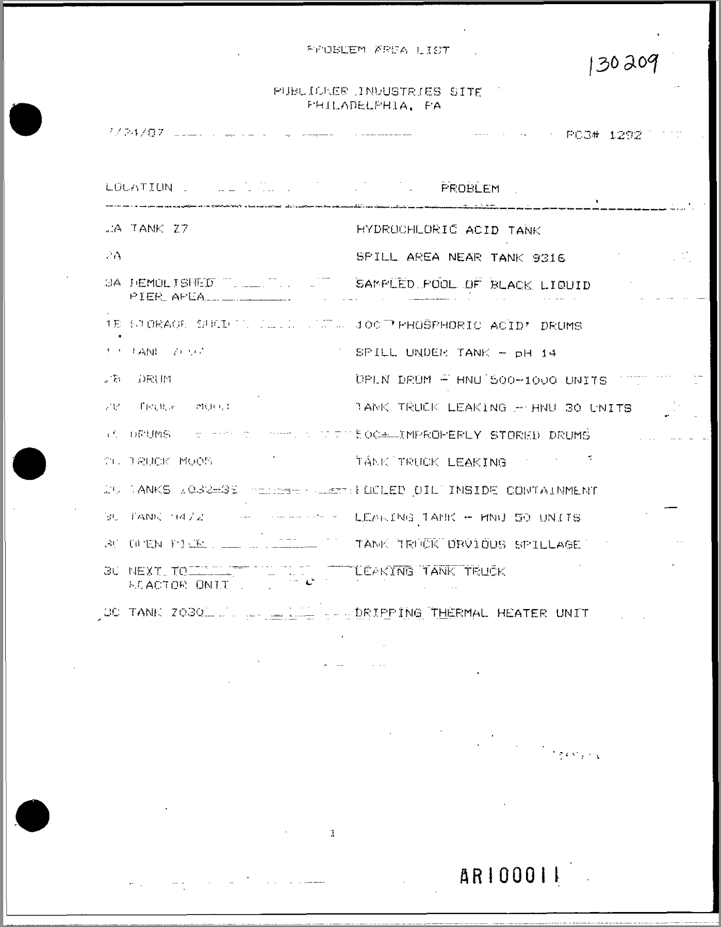
Original PDF vs Textract
PROBLEM AREA LIST
130209
PUBLICKER INDUSTRIES SITE
PHILADELPHIA, F'A
1/24/87
PC3# 1292
LOCATION
PROBLEM
A TANK Z7
HYDROCHLORIC ACID TANK
2A
SPILL AREA NEAR TANK 9316
3A FEMOLISHED
SAMPLED POOL OF BLACK LIQUID
PIER APEA
1E STORAGE SUCI
100 PHOSPHORIC ACID' DRUMS
TANI
and
SPILL UNDEI: TANK - pH 14
DRUM
DPI.N DRUM - HNU 500-1000 UNITS
FROM
MORE
TANK TRUCK LEAKING - HNU 30 UNITS
DRUMS
500+ EMPROPERLY STORED DRUMS
TRUCK MOON
TANK TRUCK LEAKING
ANKS
UCLED OIL INSIDE CONTAINMENT
9412
LEANING TANK -- HNU 50 UNITS
OPEN
PICK
TAMK TRUCK DRVIOUS SPILLAGE
3C NEXT TO
LEAKING TANK TRUCK
LEACTOR ONIT
DC TANK Z030
DRIPPING THERMAL HEATER UNIT
1
AR I 00011
14

Slide 15
AI insights- Coleman-evans Wood Preserving
Can you provide details of the image ?
This image appears to be a topographic map showing the location of the Coleman-Evans Wood Preserving Site near Whitehouse, Florida. The map includes several key features:
The Coleman-Evans Wood Preserving Site is clearly labeled in the center of the map.
The town of Whitehouse is visible just south of the site.
There are contour lines indicating the topography of the area, with a contour interval of 5 feet noted at the bottom of the image.
Various roads and railways are shown, including a "Seaboard" railway line.
The map includes a scale, showing that 1 inch represents 2,000 feet, and there's also a scale bar at the bottom.
A small inset map of Florida in the bottom right corner shows the quadrangle location of this map within the state.
There are numerous small numbers scattered across the map, likely indicating elevation or other reference points.
Different patterns on the map likely represent various types of terrain or land use, such as wooded areas, cleared land, or wetlands.
The map appears to cover an area of several square miles around the site.
This type of map would typically be used to understand the geographical context of the site, including its proximity to populated areas, transportation routes, and natural features that could affect contamination spread or cleanup efforts.
15

Slide 16
AI insights- Coleman-evans Wood Preserving
Based on your knowledge on EPA Superfund program for this document, can you generate top 20 insights users would be interested in.
Based on my understanding of the EPA Superfund program and the information provided in this document, here are 20 key insights users would likely want to know:
Site Location: Coleman-Evans Wood Preserving Site is located in Whitehouse, Florida, about 8 miles west of Jacksonville.
Operational History: The site operated as a wood preserving facility from 1954 to the mid-1980s.
Main Contaminants: The primary contaminants of concern are pentachlorophenol (PCP) and dioxin.
Contamination Extent: Approximately 45,000 cubic yards of soil and sediment are contaminated.
Affected Areas: Contamination extends beyond the 11-acre site to nearby residential areas and drainage ditches.
Groundwater Impact: The upper surficial aquifer is contaminated with PCP.
Selected Remedy: Thermal Desorption with Groundwater Recovery and Treatment (Alternative 4).
Contingency Remedy: Containment by Capping with Groundwater Recovery and Treatment (Alternative 2).
Interim Action: This is an interim action, pending EPA's final dioxin reassessment.
Cleanup Levels: Interim soil cleanup levels are 2.0 mg/kg for PCP and 1.0 μg/kg for dioxin.
Groundwater Cleanup Levels: 1.0 μg/L for PCP and 1.0 ng/L for dioxin.
Cost: The selected remedy is estimated to cost $20,720,000.
Timeline: Estimated 3 years for soil remediation and 10.5 years for groundwater remediation.
Community Involvement: Multiple public meetings and comment periods were held.
Risk Assessment: Conducted in 1986 and updated in 1996 to include dioxin risks.
Exposure Pathways: Include direct contact with soil, inhalation of particles, and potential future groundwater exposure.
Off-Site Impact: Some residential properties may require excavation and temporary relocation of residents.
Groundwater Use: The upper surficial aquifer is considered a potential drinking water source.
Treatment Process: Thermal desorption will heat soil to separate contaminants, followed by off-gas treatment.
Long-Term Monitoring: The site will require ongoing monitoring to ensure remedy effectiveness.
These insights cover the key aspects of the site history, contamination, chosen remedy, and future that would be of interest to most users familiar with the EPA Superfund program.
16

Slide 17
Thank you and Questions
Environmental
Protection Agency
Steve Wyman
OLEM/OSRTI/Information Management Branch
wyman.steve@epa.gov
Pattabhi Nunna
Lead Associate
nunna_pattabhi@bah.com
Erin Sanborn
Lead Associate
sanborn_erin@bah.com

