Slide 1
Site Inventory & Management Tool (BiT) Enhancements:
Integration of the IHS Site Scoring & Cost Calculator
Maggie Belanger & Jacob Rohter
Kansas State University Technical Assistance to Brownfields (TAB)
ksutab.org

Slide 2
KSU TAB
Brownfields Inventory Tool (BiT)

Slide 3
Technical Assistance to Brownfields
TAB
Nationally funded program by U.S. EPA
Technical assistance for tribes and communities undergoing community revitalization through brownfields redevelopment
Services provided are free and tailored to meet specific needs
Capacity
Building
Community Specific Assistance
Outreach & Education

Slide 4
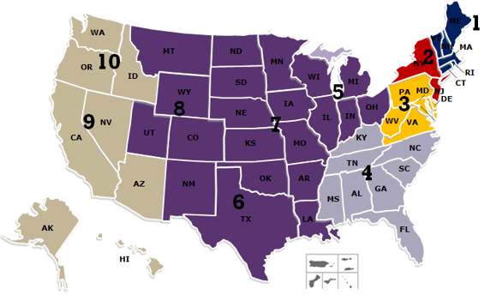
TAB Providers
University of Connecticut EPA Region 1
New Jersey Institute of Technology (NJIT)
EPA Regions 2 and 4
The West Virginia University EPA Region 3
Kansas State University – EPA Regions 5, 6, 7 & 8
Center for Creative Land Recycling (CCLR)
EPA Regions 9 and 10

Slide 5
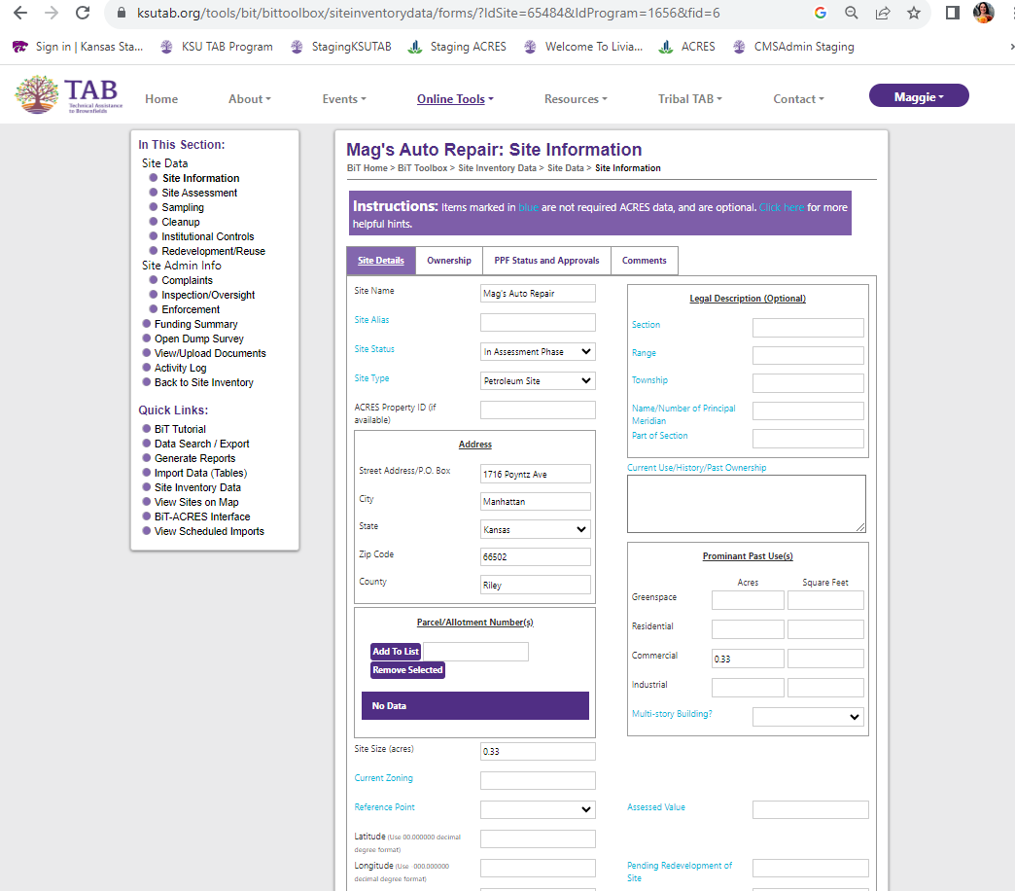
Brownfields Inventory Tool (BiT)
Online Site Inventory & Data Management Tool
Accessed anytime for internal day-to-day use
Enter Site Specific Information
Upload photos and documents
Track funding
ACRES Interface
Data is NOT publicly available
Password protected, stored on third-party servers
Data is ‘Owned’ by the user. Only ‘Owners’ can share data

Slide 6
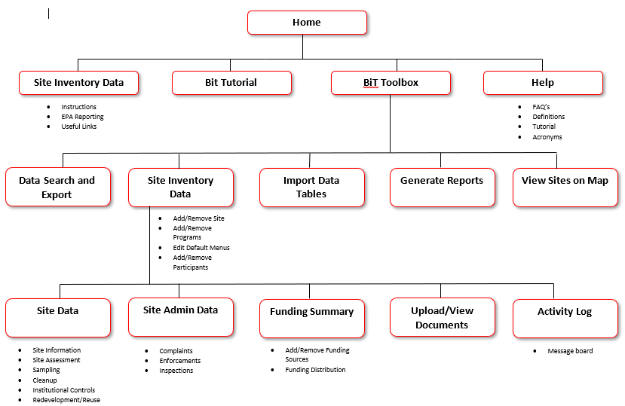
BiT Overview

Slide 7
BiT Benefits
Confidential – User owns and controls the data
Provides continuity during personnel changes
Can be used for multiple programs
Supported by TAB personnel – contact us for assistance
Must have a free KSU TAB account

Slide 8
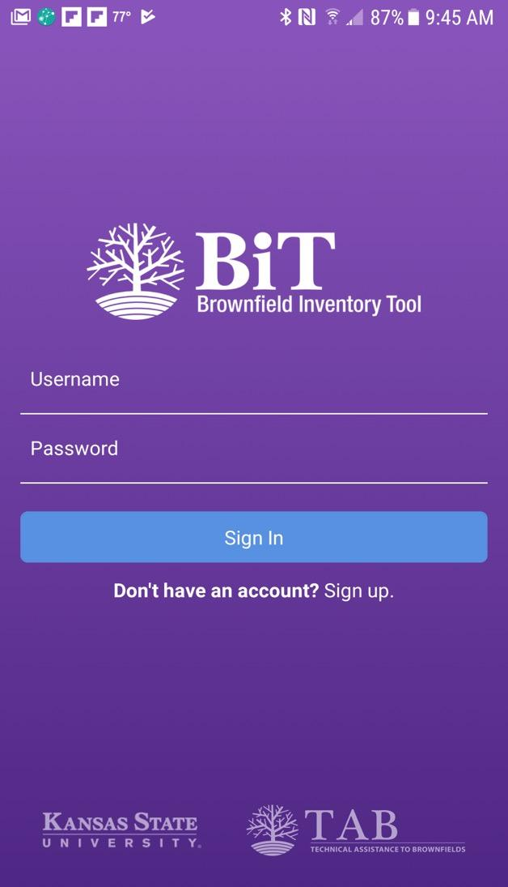
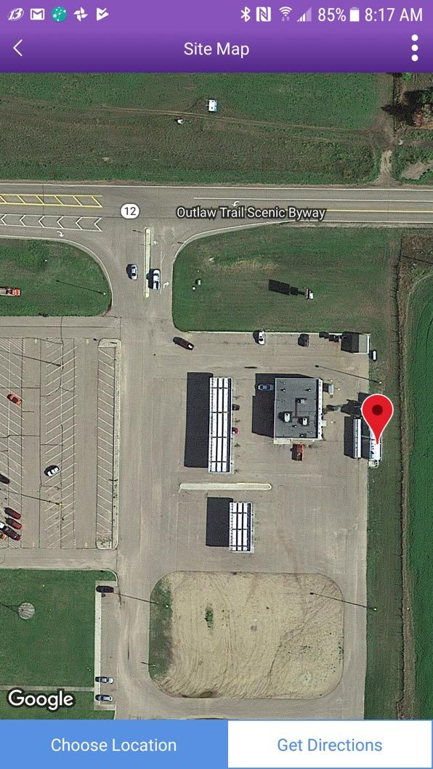
BiT Mobile
View, Add, Edit Site Data in the Field
The app can be installed on iPhones, iPads, Android phones and tablets
The app will store information on your phone when you are out of cell service/wifi range and then synch with your BIT database once you are back online
Take photos
Get GIS Coordinates (View Map Feature)

Slide 9
Exchange Network Grant

Slide 10
BiT Enhancements
Exchange Network Grant (2022 – 2025)
Establish BiT as a centralized node for accessing and sharing data
Develop API Services allowing for two-way data transactions – Completed 2023
Integration with pre-existing tools
IHS Site Scoring and Cost Calculator developed by Muscogee (Creek) Nation
PEER
IHS Open Dumps assessment form
Others
Allow users and non-users to push and pull data from other sources
TAB Grants (2023 – 2028)
ACRES Interface
Mapping Functionality
Compatibility with ESRI
Export of shape files
Improve overall grant management and tracking functionality
We want your input! Contact Maggie Belanger (maggiejessie@ksu.edu) to be included on the stakeholder and feedback group and to test new functionalities.

Slide 11
Exchange Network Grant Enhancements
BiT Mobile
https://etools.ksutab.org/tools/bit
BiT API
Open Dump Data Exchange
Future Integrations
PEER
ACRES API
IHS Site Scoring and Cost Calculator
ACRES

Slide 12
BiT UI Demo

Slide 13
Contact Info
Maggie Belanger
TAB Senior Director & Regional Director in EPA Regions 7 & 8
maggiejessie@ksu.edu
785.532.0782
Jacob Rohter
TAB Assistant Regional Director in EPA Region 7
jrohter@ksu.edu
573.458.9322
ksutab.org

