Slide 1
Exchanging RCRAInfo Data with REST APIs
Presenters: Lori Furr
Rebecca Kane
David Dundua

Slide 2
On the Horizon: Efficient Data Exchange
Where we are?
Where are we headed?
How do we know?
Why now?
What are we doing now?

Slide 3
Where We Are
States
CDX
RCRAInfo
State Node
VES
CDX Node
RCRAInfo Node
VES Connector
RCRA Dataflow
1. Solicit
3. Solicit
7. GetStatus
6. Submit
Report/
Email
8. Download
2. Archive
solicit request
5. Generate report
4. Archive
solicit request
State Database
CDX Database
RCRAInfo Database
Notes:
Workflow – XML and SOAP

Slide 4
Where We’re Headed
States
RCRAInfo
State Environment
RCRAInfo Environment
1. Auth (ID/Key)
2. Requests ( GET Waste Codes,
GET/PUT/POST/DELETE Handler,
GET/PUT/POST/DELETE Evaluation, etc.)
3. Query
4. Generate response
State Database
RCRAInfo Database
Notes:
Direct to RCRAInfo API
Request and API ID/Key
Send XML Requests wrapped in JSON directly to RCRAInfo.
Processing is the same.
This exchange option removes the complications of needing middlemen.

Slide 5
Benefits of RCRAInfo APIs
Easier integration with RCRAInfo
Modern, simpler, and cheaper to maintain
REST APIs - JSON format
Direct to RCRAInfo
Support directly from RCRAInfo Team
Improved security and auditing
Easier implementation
Improved error handling
Notes:
Data systems will always change, and this is a much easier way to adapt to changes.
Easier to support: only one place to make changes.

Slide 6
How Do We Know?
Hazardous Waste Manifest Exchange
Notes:
Recent experience with hazardous waste manifest and international program exchanges shows how successful this method of exchange is.
e-Manifest:
Approximately 80% of manifests are received via REST API
1.5 million manifests created via API in calendar year 2023

Slide 7
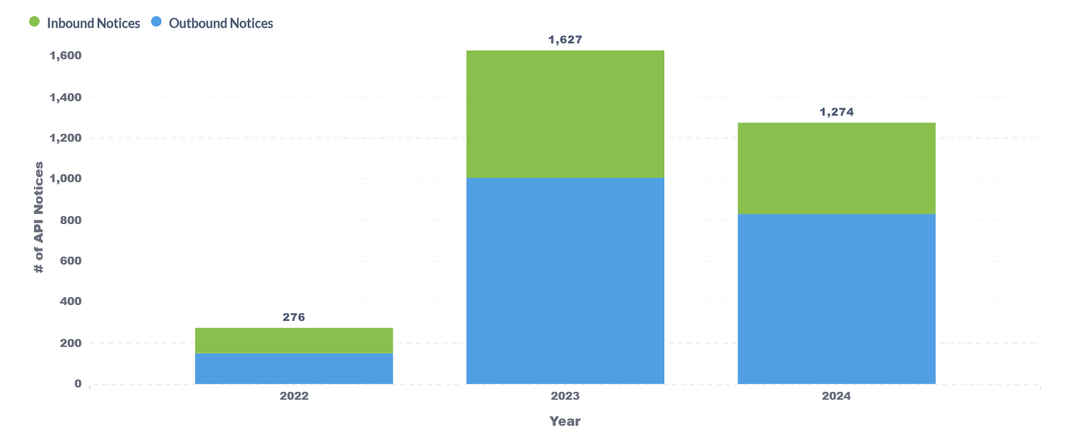
How Do We Know?
Notice and Consent Electronic Data Exchange (NCEDE) International Program Exchange
Notes:
North American Export/Import Notices:
-In two years of operation, exchanged 3,100 notices with Canada and Mexico via REST APIs - directly between RCRAInfo and partner country IT systems
-Exchanged a further 5,800 actions on those notices (acknowledgment of receipt, determinations, etc).

Slide 8
Why Now?
More data is submitted to RCRAInfo
Industry submits data directly to RCRAInfo.
State/Regional partners review and approve industry submissions in RCRAInfo.
myRCRAid - 52 partners
Biennial Report - 60 partners
Annual Report - 9 partners
PCB - country-wide!
Waste Import and Export Tracking System (WIETS) - international partners (CA, MX)
e-Manifest - country-wide!
We are noticing more partners perform data analysis via Metabase.
Partners are already using REST APIs to retrieve e-Manifest data.
Partners want to get the data out for further processing.

Slide 9
Why Now?
Many states use RCRAInfo as their hazardous waste management data system.
Getting data out of RCRAInfo is easier than ever now, so there is less need for maintenance of local datasets.
Resources continue to shrink, and system-to-system exchange doesn’t require specialized vendors.
More and more requests from our state partners.

Slide 10
API Phase I – Completed
Management UI in RCRAInfo (API IDs and auditing)
API ID and Key Authentication
Lookups
Swagger and Confluence Documentation

Slide 11
API Phase II – Transactional API (In Progress)
Retrieve Handler data (Completed)
Individual Transactions
Add / Update / Delete Handler Source (end of 2024)
Other Modules (Compliance, Reporting)
Errors on per-Transaction basis
Real-time integration

Slide 12
Feedback
What do you need?
How can we help?

Slide 13
Contact page
Contact:
furr.lori@epa.gov
kane.rebecca@epa.gov

