Slide 1
Combined Air Emissions Reporting System (CAERS)
Environmental Information & Innovation (E2i) National Meeting
Kansas City, MO
September 17-19, 2024
Julia Gamas (U.S. EPA), Stacy Knapp (MEDEP), Tammy Manning (NCDEQ)

Slide 2
1. Why CAERS?
We believe that air emissions reporting can be streamlined, making the overall process significantly less burdensome and time consuming for industry, federal, state, local, and tribal (SLT) air quality authorities.
Saving/repurposing time
Increasing data consistency and quality within and across programs for the same reporting facility
Industry, SLTs, and EPA programs all have same version of data, or data for which differences are logical and easy to explain.

Slide 3
Bigger Picture Goals
To have multipollutant inventory data at the unit-process level (CAPS, HAPS, GHGs) so we can do multipollutant analyses. All pollutants must be analyzed together if we are to find robust solutions and minimize unintended consequences.
We need to start gathering the data specified in AERR (HAPS) as we have an urgent need for high quality HAP data, given the impact they have on human health and the environment.
We will continue to work towards our CAERS “promise” that through combined air emissions reporting and data sharing, industry will ultimately have less overall reporting burden to meet requirements for NEI, CEDRI, TRI, and GHGRP.

Slide 4
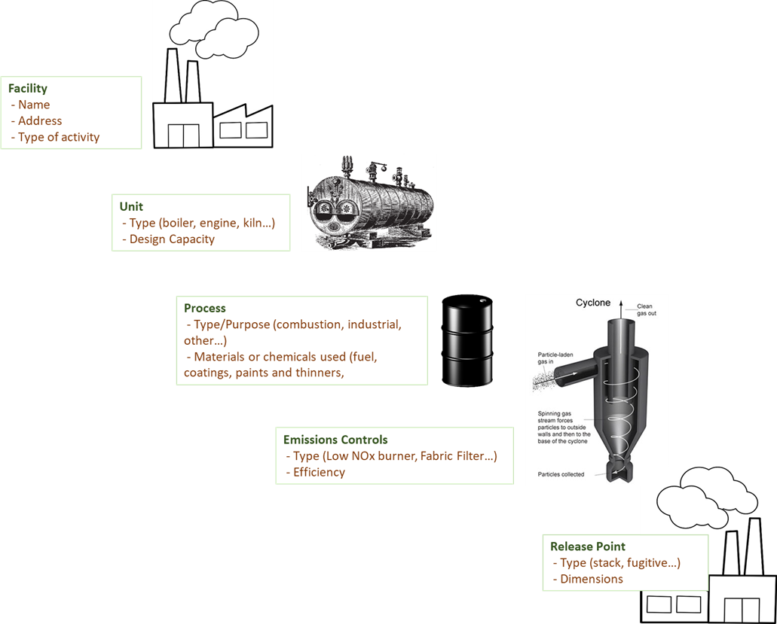
Shared Data
1) Industry reports shared data elements once
Facility – e.g., company name, address
Inputs to emissions estimation:
Activity data – e.g., heat content of coal, operating hours
Test data/emission factors – e.g., tons of VOC per BTU of coal
Identical/related pollutants - e.g., toxics to TRI and NEI
2) Federal and SLT staff repurpose time from
QA where CAERS can run automatic Quality Assurance (QA) checks,
Data reconciliation of mismatched data between programs for the same facility to advanced QA and data analysis

Slide 5
2. How do we get there?
Before CAERS
Industry could be having to report multiple times (potentially x 4 federal programs), and possible additional requirements for their SLT.
Shared data is entered over and over.

Slide 6
After CAERS
Facility data is shared with the programs with input from the SLTs.
Emissions data is reported effectively into one system and shared with the program that requires the same data.
Duplicate data entries and data inconsistencies across programs are minimized.
Cases 1 & 2: Option for SLT to continue receiving NEI reports through custom system and send data directly to EPA
Industry
SLT Custom System
EPA CEDRI
EPA EIS
Cases 3 & 4: Option for industry to report to CAERS, SLT retrieves &/or reviews data in CAERS
CAERS
EPA TRI
EPA e-GRRT
Industry
SLT Air Reporting Program Review

Slide 7
What is CAERS?
A system that currently allows SLTs to collect annual inventory data from their industry, review it, and send it to EIS. Shared data with TRI is sent to TRI-MEweb for a reporter to use it there optionally.
CAERS was developed with the input of our Product Design Team (PDT) composed of SLTs and EPA staff – always looking for new SLTs to join even if not committed to using CAERS.
A number of research projects have been conducted to gather program requirements (business needs) .
The PDT meets every two weeks to discuss CAERS Updates as well as to gather new information to build out additional functionality.
Agile development means we apply lessons learned as we develop avoiding huge/costly errors.

Slide 8
Highlights of CAERS Features - Industry
Previous Year Data Prepopulates Current Inventory Year Report
Four Options for Data Entry:
User Interface (UI)
Bulk Entry via UI
Bulk Upload:
JSON
Excel Template
File Attachments
Report History & Log
Report Summary Download
Calculation and Aggregation of Toxics Air Emissions by Stack and Fugitive for TRI-MEweb
QA Checks before submission
Notes:
Let’s talk a bit about your ability to use data you have entered into CAERS to TRI.

Slide 9
Highlight of CAERS Features - SLTs
SLT Data Retrieval via Application Programming Interface (API)
Customization (e.g., GADNR Opt-In, DC Monthly Reporting)
300+ critical error and warning QA checks (EIS and State-requested, some customized to specific SLT needs)
SLT-only editable fields as needed
Non-Point Fuel Subtraction Report (ICI Template Option A)
Ability to communicate via email with facilities (by type, reporting status, and preparer/certifier roles)
SLT-specific emission factors via compendium
More enhancements forthcoming in response to user feedback

Slide 10
Challenges
CDX Registration process complicated: CDX Registration Process: New users have expressed challenges with the user registration process, with their perspective being registering for accounts in their personal life. We need to help them understand the reason for the added security/controls.
SLTs CROMERR process to onboard: Users must enter their name, work email, physical address, and phone number multiple times.
These protections must be in place to secure the data. Is there a way to keep our security and streamline these processes in future?

Slide 11
Challenges
Large Facilities (100’s of units/processes/pollutants):
Time out in CDX is impractical to reporters: “…when I was working on bulk reporting I was logged out several times and lost data. “
Certification, COR generation and submission process for multiple facilities at the same time, e.g.
Oil and gas facilities with e.g. 600-1000 facilities (well pads) where certifying and submitting 600-1000 times is unworkable
Frequent changes in ownership of facilities: 100’s of facilities are now associated with a new Industry Reporter and organization, how might they “batch” register/change their organization and facility access for all of them instead of having to do so one by one?
Excel template becomes slow: A lot of data and then excel template validations and equations. Accepting a “raw” file without validations means potentially huge number of errors. The more errors, the more QA checks will bog down the upload and the QA checks process.

Slide 12
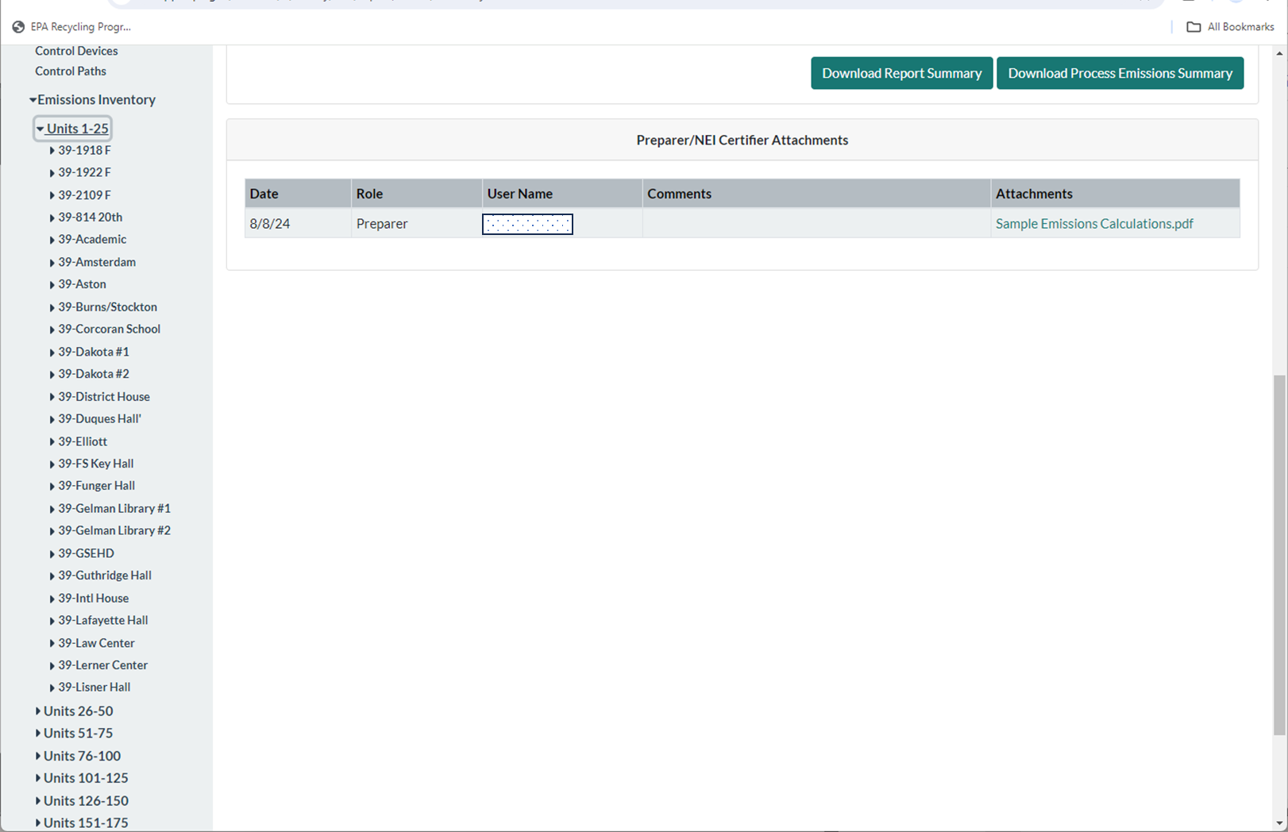
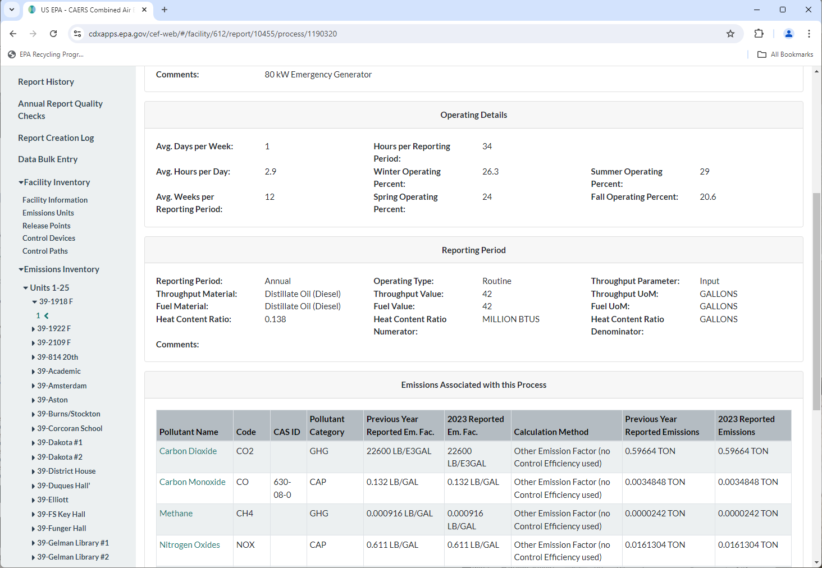
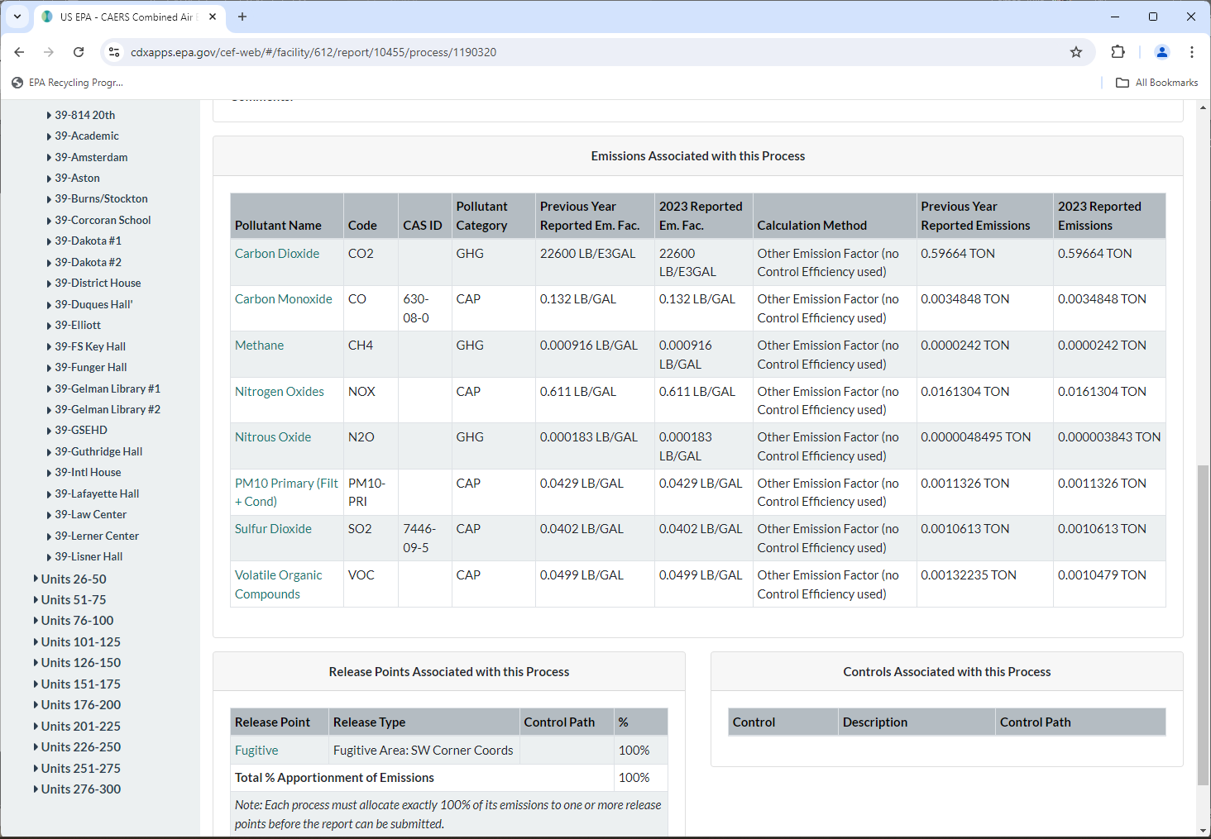
Snapshot of Large Facility’s Data

Slide 13
Number of “Data Points” in Excel Template
Units: 311 x 7 = 2,177
Processes: 322 x 7 = 2,254 (some are temporarily shut down)
Release Point Apportionment: 322 x 2 = 644
Reporting Period: 319 x 13 = 4,147
Operating Details: 319 x 9 = 2,871
Emissions: 2,638 x 14 = 36,932
49,025 data points
Accepting a “raw” file without validations means potentially huge number of errors that then will bog the UI down when they run the QA checks.

Slide 14
Challenges
SLTs have unique business needs: e.g. additional pollutants, codes, data fields, and it doesn’t make sense for them to have to collect additional information separately when it is tied to the same unit, process information. Rather than stand up and maintain their own reporting system, could they build additional functionality outside of CAERS that works with CAERs and then share it with other SLTs that also need it?
More data coming: need for multipollutant inventory to conduct analyses that are more complete on exposure to harmful pollutants, and the means to curtail them most effectively. This means collecting HAPS together with CAPs and GHGs.

Slide 15
Future Steps for CAERS
Automatic EPA emission factors update using WebFIRE webservices part II.
Enhance current basic workflow with TRI to provide detailed information to the TRI reporter about how data from CAERS was generated.
Obtain reported test data (NSPS, NESHAPS) when Industry Reporter selects “test data” as calculation method in CAERS.
SLT-specific pollutants
Other per SLT and Industry request to improve UI functionality.

Slide 16
Upcoming Transition
OAQPS to consolidate all our program information under one roof to maximize resources: Unified Platform
Project is in discovery phase with new contractor. Expect to be a 3-year process.
CAERS functionality will be “folded into” the new system:
Reporting functionality for AERR compliance will be available in time for rule implementation.
All current CAERS functionality will remain, including workflow with TRI.
Will proceed with data sharing of internal OAQPS processes first.
Project will include a workflow that modernizes the sharing and availability of stack test information as well as WebFIRE emission factors.
Expect workflow with GHGRP to follow after OAQPS systems transition is complete.

Slide 17
Unified Platform
Facility data is shared with the programs with input from the SLTs.
Emissions data is reported effectively into one system and shared with the program that requires the same data.
Duplicate data entries and data inconsistencies across programs are minimized.
Cases 1 & 2: Option for SLT to continue receiving NEI reports through custom system and send data directly to EPA
SLT Custom System
EPA TRI
Industry
Data in:
CAERS
-EIS
CEDRI
ERT
WebFIRE-
Cases 3 & 4: Option for industry to report to CAERS, SLT retrieves &/or reviews data in CAERS
EPA e-GRRT
Industry
SLT Air Reporting Program Review

Slide 18
Questions
Thank you for your attention.

