Slide 1
AI Chatbot for Environmental Regulatory Support September 17, 2024 Presented by Will Rensmith Windsor Solutions, Inc.
Environmental Information and Innovation National Meeting

Slide 2
Agenda
Project Background
Why a Chatbot
How we Built It
Lessons Learned/Learning
What’s Next
Beyond the Chatbot: Other Candidate AI Use Cases

Slide 3
Project Background
Partnership with South Carolina DES
SCDES ePermitting System is a comprehensive Environmental Information System (EIS) based on Windsor’s nVIRO platform
Supports all environmental programs and media
Full regulatory lifecycle management: permitting, inspections, compliance, enforcement, financials, spatial data, sampling…
Hundreds of agency users, thousands of external (public users)

Slide 4
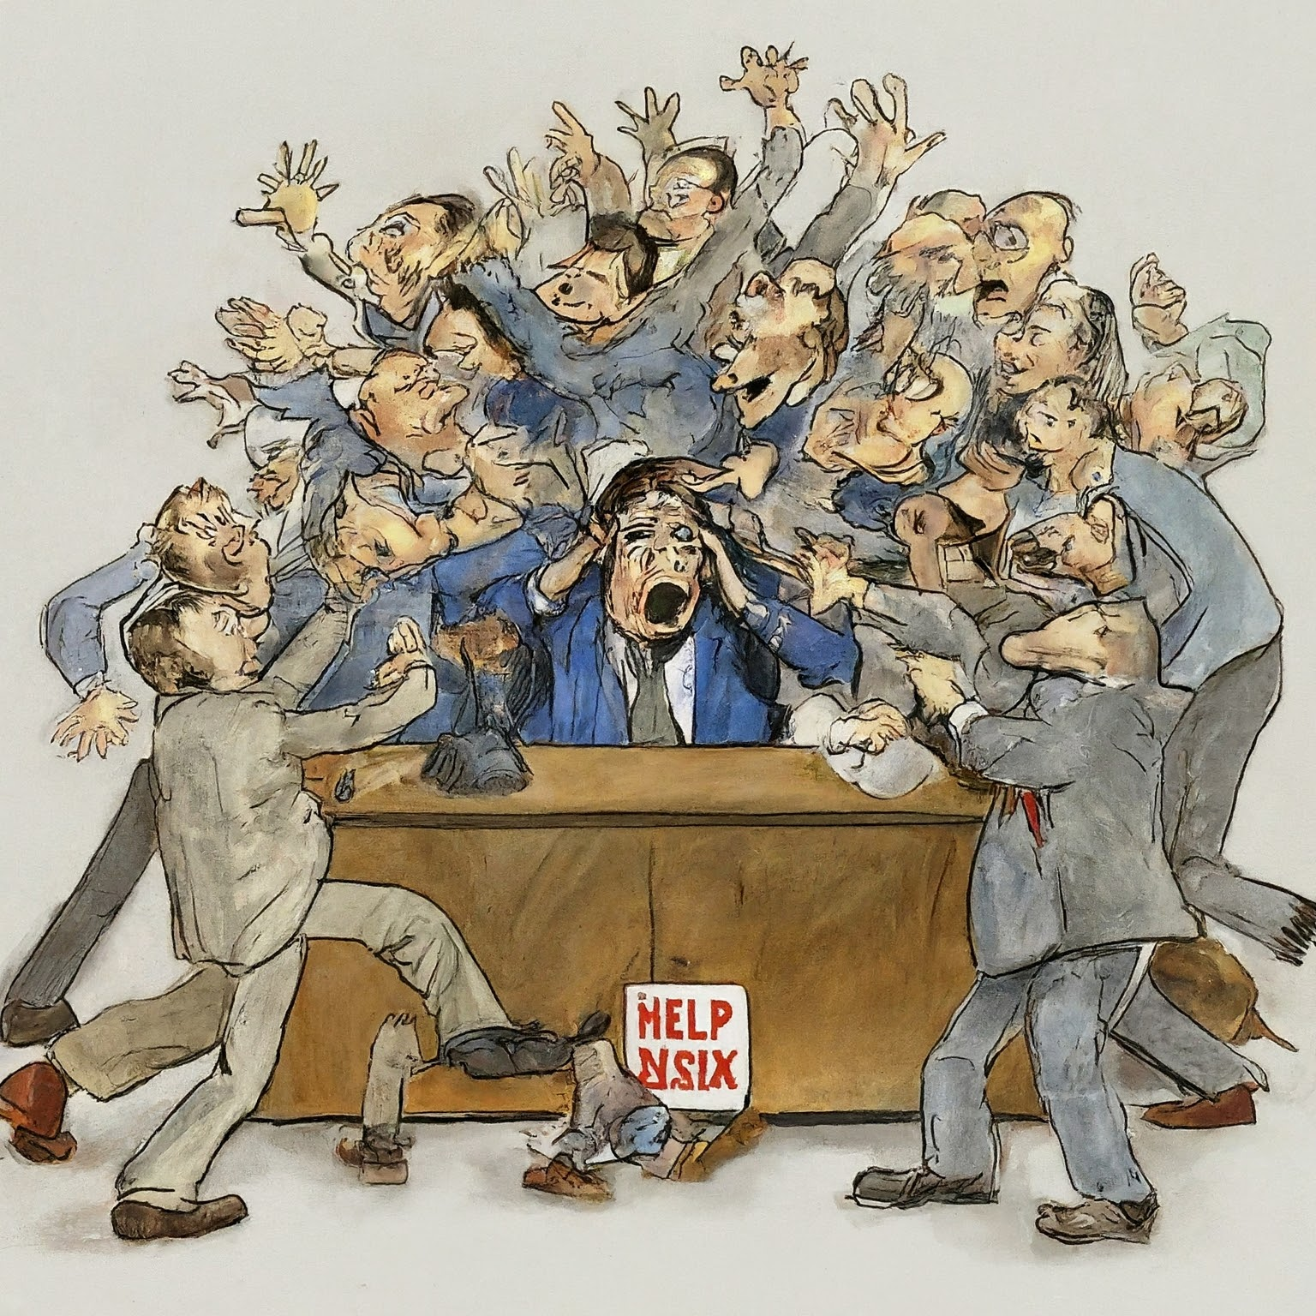
Why a Chatbot?
Agency resources required to support:
A large community of both agency and external users
The complexities of regulatory programs and software
Relatively low barrier of entry into AI
Proven use case
Prompt: “Create an illustration of a mob of people waiting to speak to a person sitting at a desk with a computer. A sign reading "Help Desk" is prominently displayed on the desk”

Slide 5
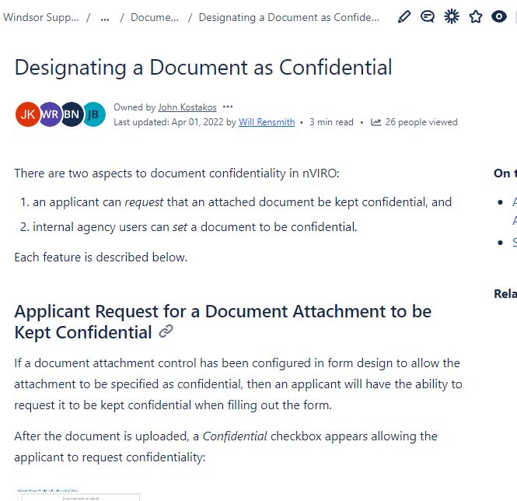
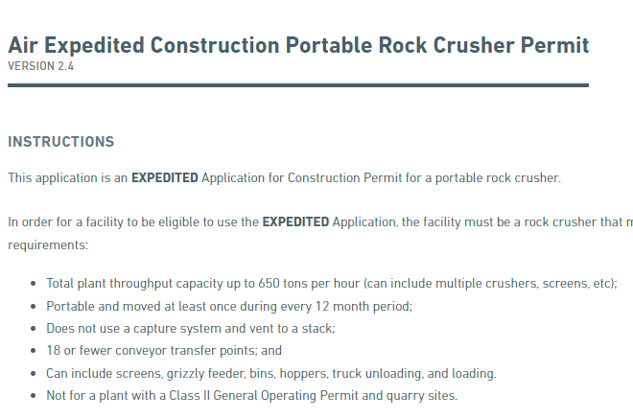
How We Built It
Step 1: Create Knowledge Base
Exported entire customer support wiki (150+ pages)
Exported library of 450+ dynamic application forms
2000+ Instructions controls within forms
Optional: scrape agency program web pages
DOCUMENT REPOSITORY

Slide 6
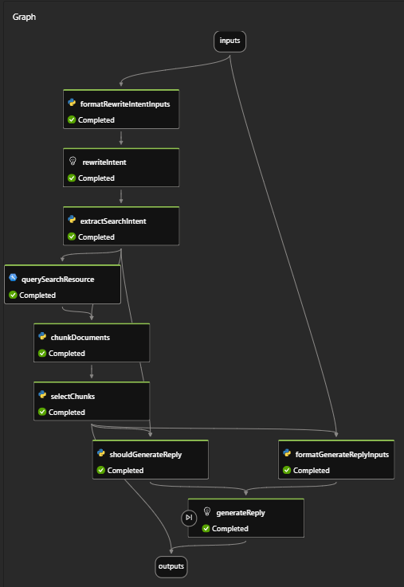
How We Built It (Cont’d)
Step 2: Develop Model
Used Azure AI Studio
Load docs to Azure storage
Create index/vector
Create flow
Develop prompt
Step 3: Test Model
Use Azure chat playground to test/exercise the chatbot
Step 4: Deploy Model
Publish REST API
Azure AI Studio Flow Graph

Slide 7
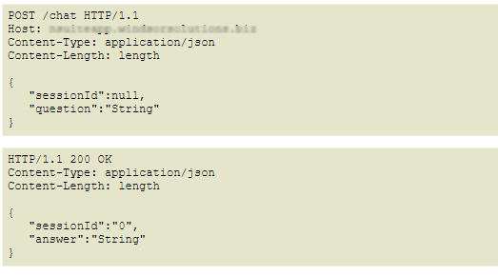
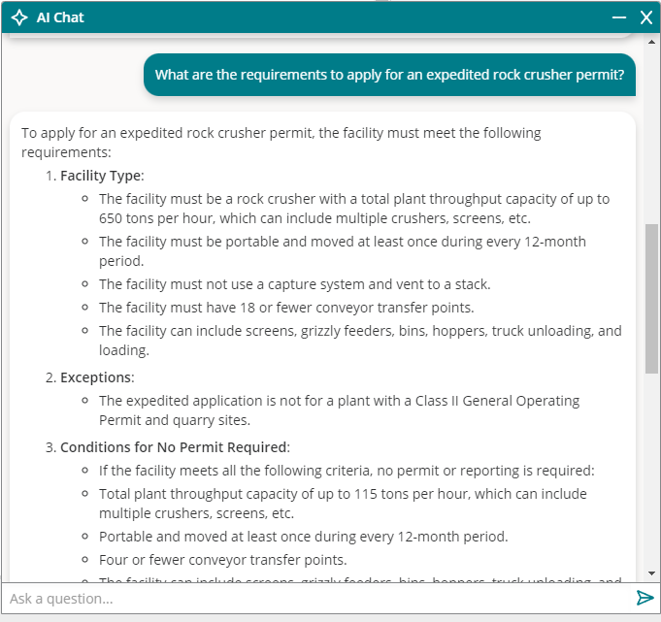
How We Built It (Cont’d)
Step 5: Develop App Services
Azure authentication
Stores chat session history and metadata in database
Provides REST services to web client
Step 6. Develop User Interface Component
More design decisions than we anticipated

Slide 8
Lessons Learned/Learning
Separate configurations for external and internal users
External users need customer service
Internal users need technical support
Automated refresh of AI knowledge base
Chat session memory
ChatGPT API has no memory of previous questions/responses
Client needs to include relevant history in each new chat message request for chatbot to “remember” what is being discussed
Cost mitigation
Terms of use/legal considerations
Asked if a restaurant could serve cheese nibbled on by a rodent, it responded: “Yes, you can still serve the cheese to customers if it has rat bites,” before adding that it was important to assess the “the extent of the damage caused by the rat” and to “inform customers about the situation.”

Slide 9
What’s Next
Add User-specific Knowledge
When chat session is begun, app will tailor the chat prompt with information about the current user’s facilities, permits, reporting requirements, etc.
Collect/Analyze User Feedback
Update prompt to gather feedback about usefulness/quality of responses 👍👎
Analyze interactions, tune model/prompt
Assess Costs
Determine Next Steps for Wider Deployment

Slide 10
Beyond the Chatbot: Other Candidate AI Use Cases
Reporting
Natural Language data search and summarization
Natural Language spatial search
Application Processing and Review
Document analysis for legal compliance
Automated document processing
Permitted limit analysis
Predictive Analytics
Identify anomalous air or water quality trends
Inspection planning - identify facility inspection priority
Image analysis - identify issues observed during a site inspection

Slide 11
Questions?

