Slide 1
New Mexico Environment Department
REINVIGORATE | COLLABORATE | INNOVATE
SEPTEMBER 17 - 19, 2024 | KANSAS CITY, MO
New Mexico Environment Department Presenters:
Meta Hirschl, Chief Data & Technology Steward
Angela Ollison, Applications Developer III

Slide 3
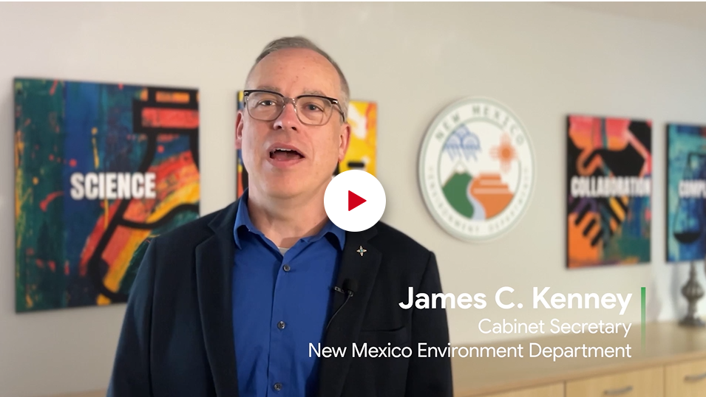
Play video: https://app.frame.io/presentations/1d2fa46c-a226-4e28-9935-676701d98b5a

Slide 4
Official Announcement Video

Slide 5
Innovating Water Leak Detection
A tool to save state and local governments time and money
This pioneering initiative uses satellites to provide real-time insights, enabling operators to quickly detect and repair leaks.
At the core is Google Earth Engine, which enables the platform to detect subsurface anomalies in moisture, temperature and a variety of other factors.

Slide 6
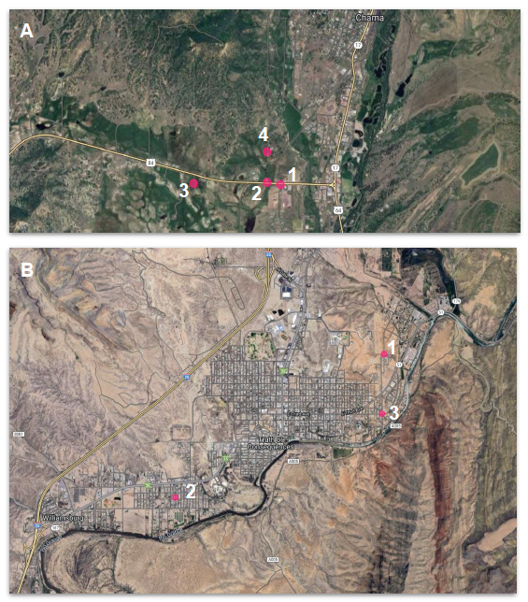
System Test Plan
Test Data:
Four locations for leaks occurred in Chama during the summer of 2022 (figure A).
Three locations for leaks occurred in Truth or Consequences (figure B).
Test Plan:
The Woolpert team tests Continuous Change Detection Engine (CCDE) algorithm against the known locations listed above.
Testing will be done using location-specific time series analysis and qualitative assessment of the anomaly index images produced by CCDE
Success Criteria:
CCDE will be considered successful if
It detects significant anomalies that are interpretable as water-driven dynamics, and
the known leaks listed above are detected as such anomalies.

Slide 7
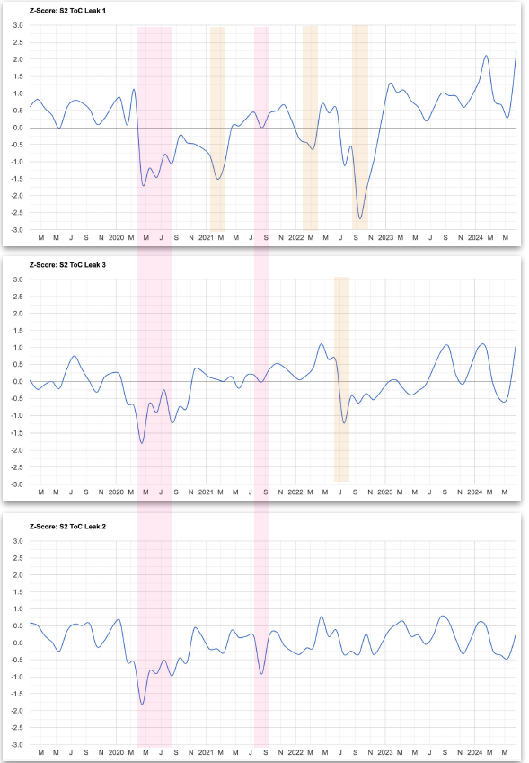
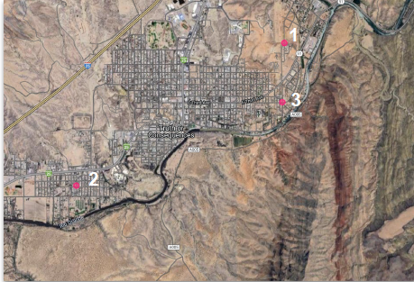
Truth or Consequences – Time Series
Anomalies are clearly visible from the time series of spectral indices anomalies from known leaks locations.
Notes:
The exact timing of the leaks is not known, so a direct validation was not possible. However, the fact that some remarkable changes were present at those exact locations is encouraging.

Slide 8
Hydro Delta Dashboard

Slide 9
Dashboard - Layers

Slide 10
Dashboard – Fly to Location

Slide 11
Dashboard – Filter Events

Slide 12
Dashboard – Feature Info

Slide 13
Dashboard – Zooming In

Slide 14
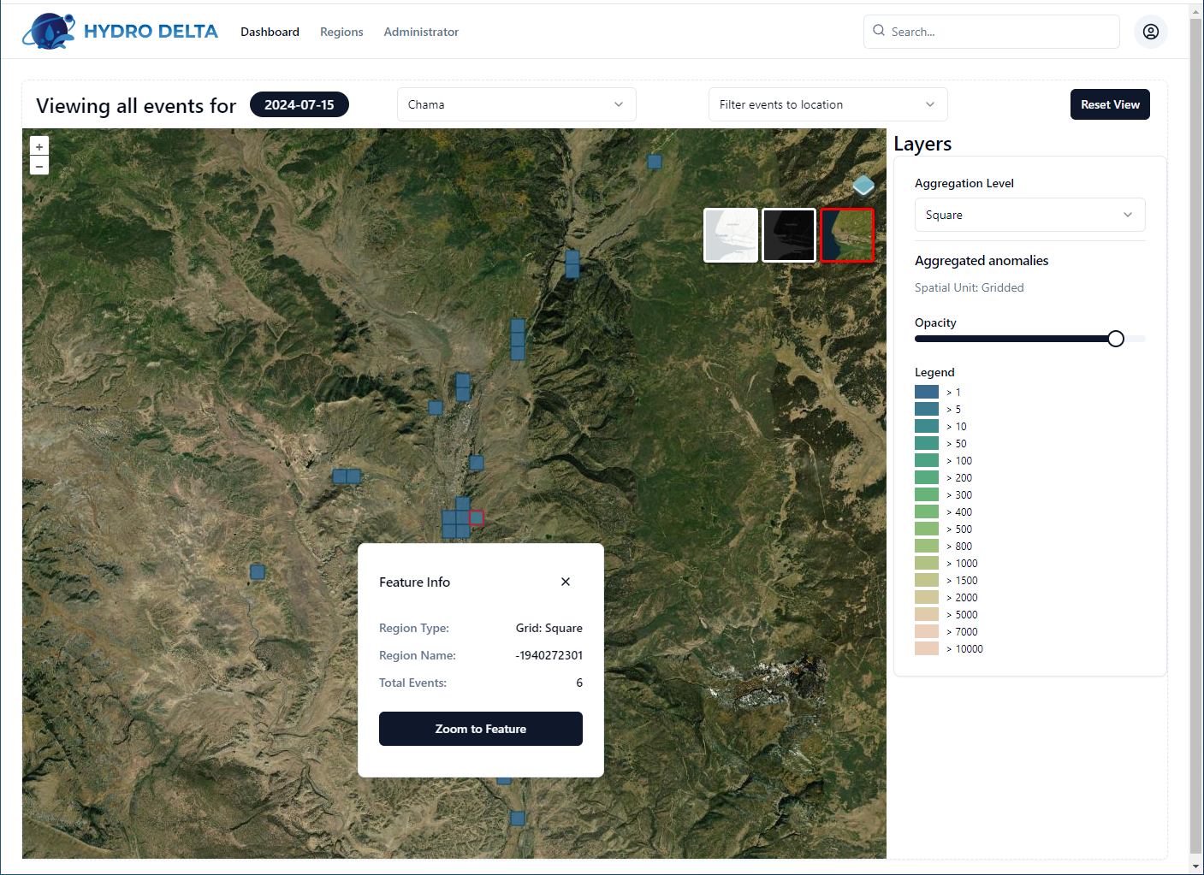
Hydro Delta Layer Option
Satellite Layer Option
Dark Layer Option

Slide 15
Close-Up Anomaly Detection

Slide 16
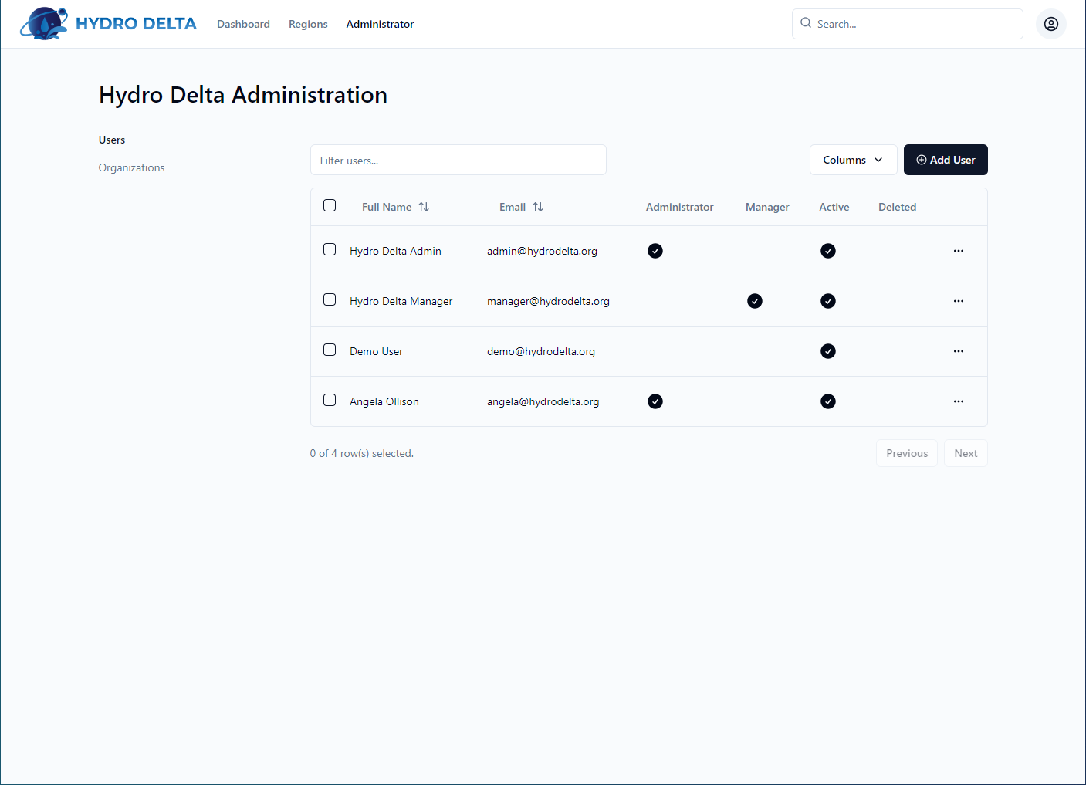
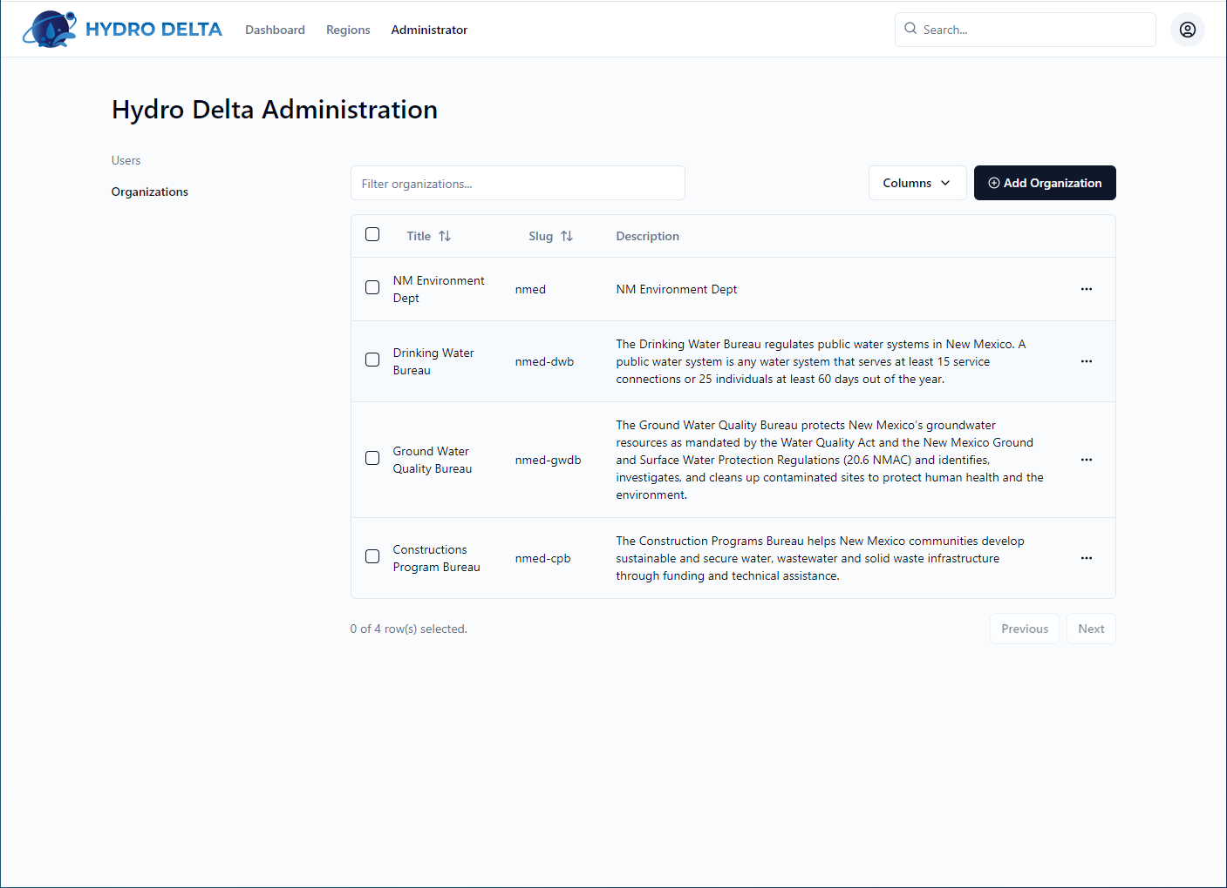
Hydro Delta Admin
Admin Users
Admin Orgs

Slide 17
Thank you!

Slide 18
Additional Resources

Slide 19
Hydro Delta - Admin - Regions

