Slide 1
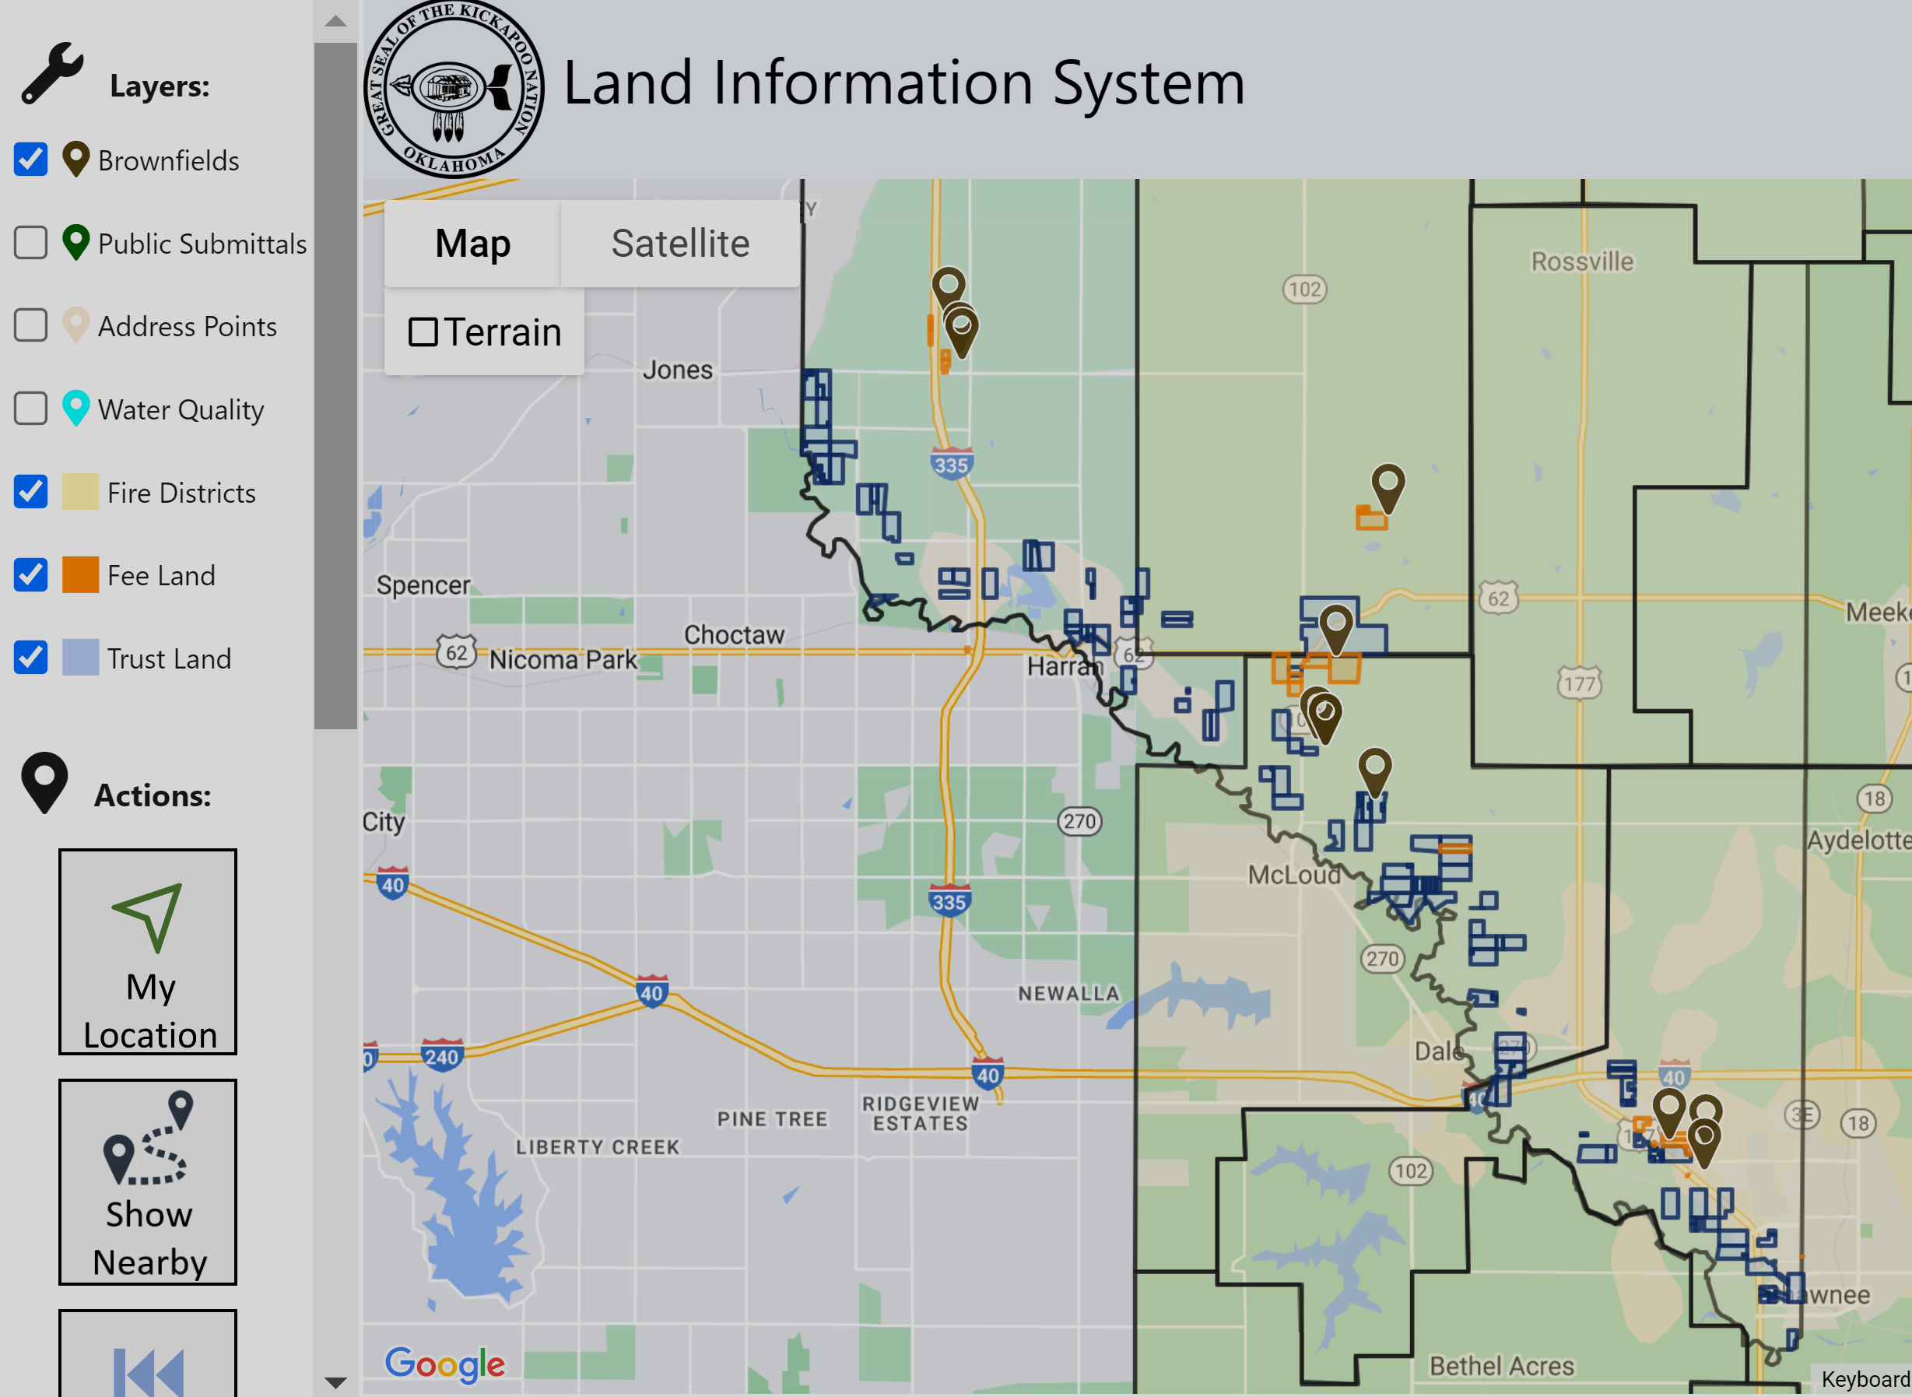
Mapping Tools and AI
to Better Manage Environmental Data
September 17, 2024

Slide 2
Introductions
Mission: protect and manage the reservation environment for the jurisdictional and service area of the Kickapoo Tribe of Oklahoma.
Expertise: surface water, drinking water, air, solid waste, brownfields, underground storage tanks, hazardous waste, emergency response, environmental justice, pesticides and environmental planning projects

Slide 3
Kickapoo Tribe of Oklahoma Case Study
Objectives
Public Engagement
Better Understanding of Brownfield Sites
Allow Public to Submit Concerns
Interdepartmental Data Sharing
Brownfields Program
Water Quality Program
Land Department
Police Department
Use AI to Streamline Workflows and Better Understand Data

Slide 4
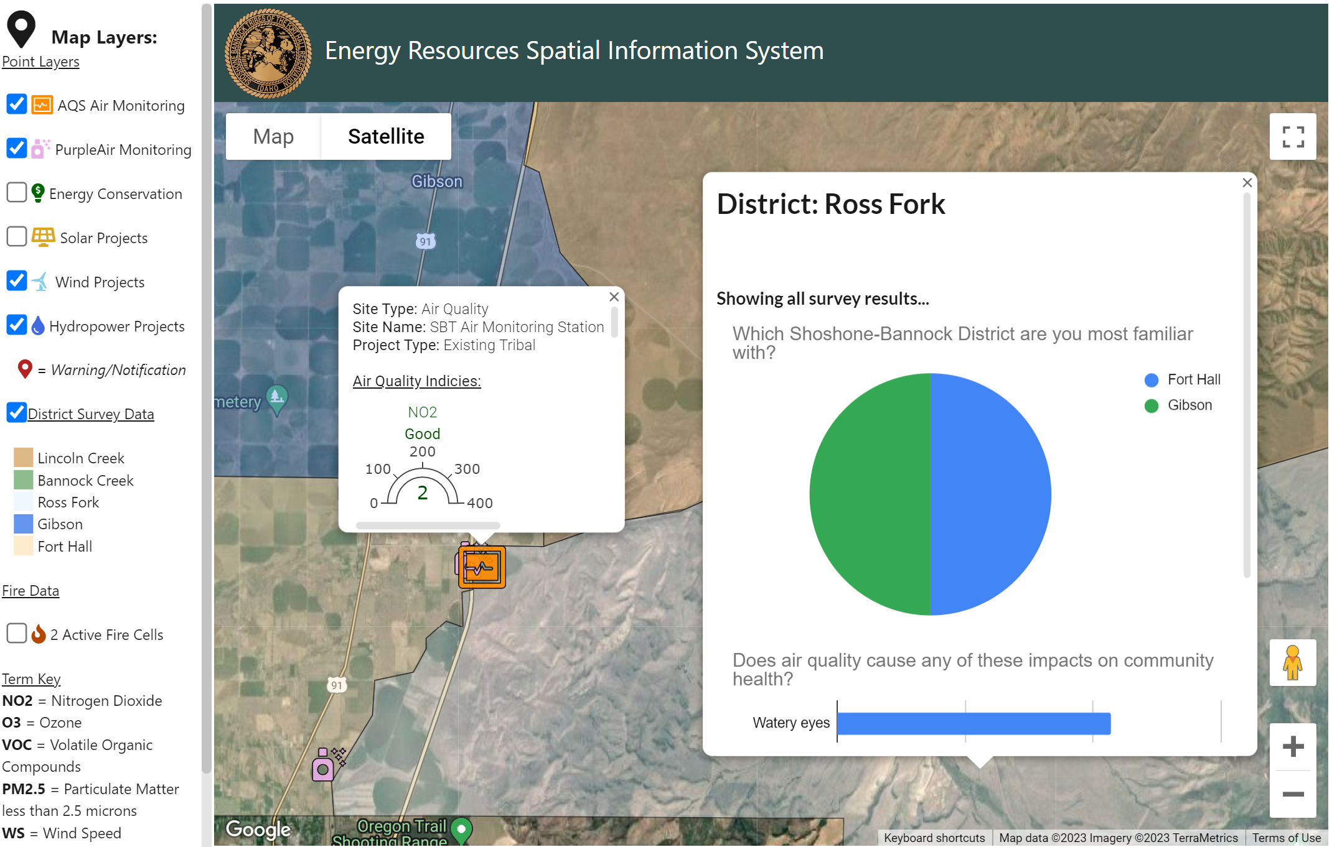
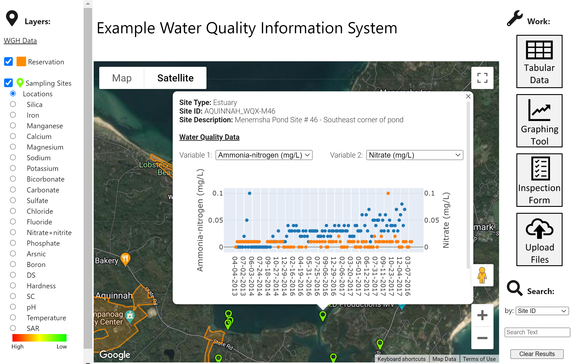
What are Website Map Applications?
Definition: A website with an interactive map
Typically using ArcGIS or Google Map APIs
Purpose: Improve Your Organization’s Ability to Access and Utilize Spatial Information

Slide 5
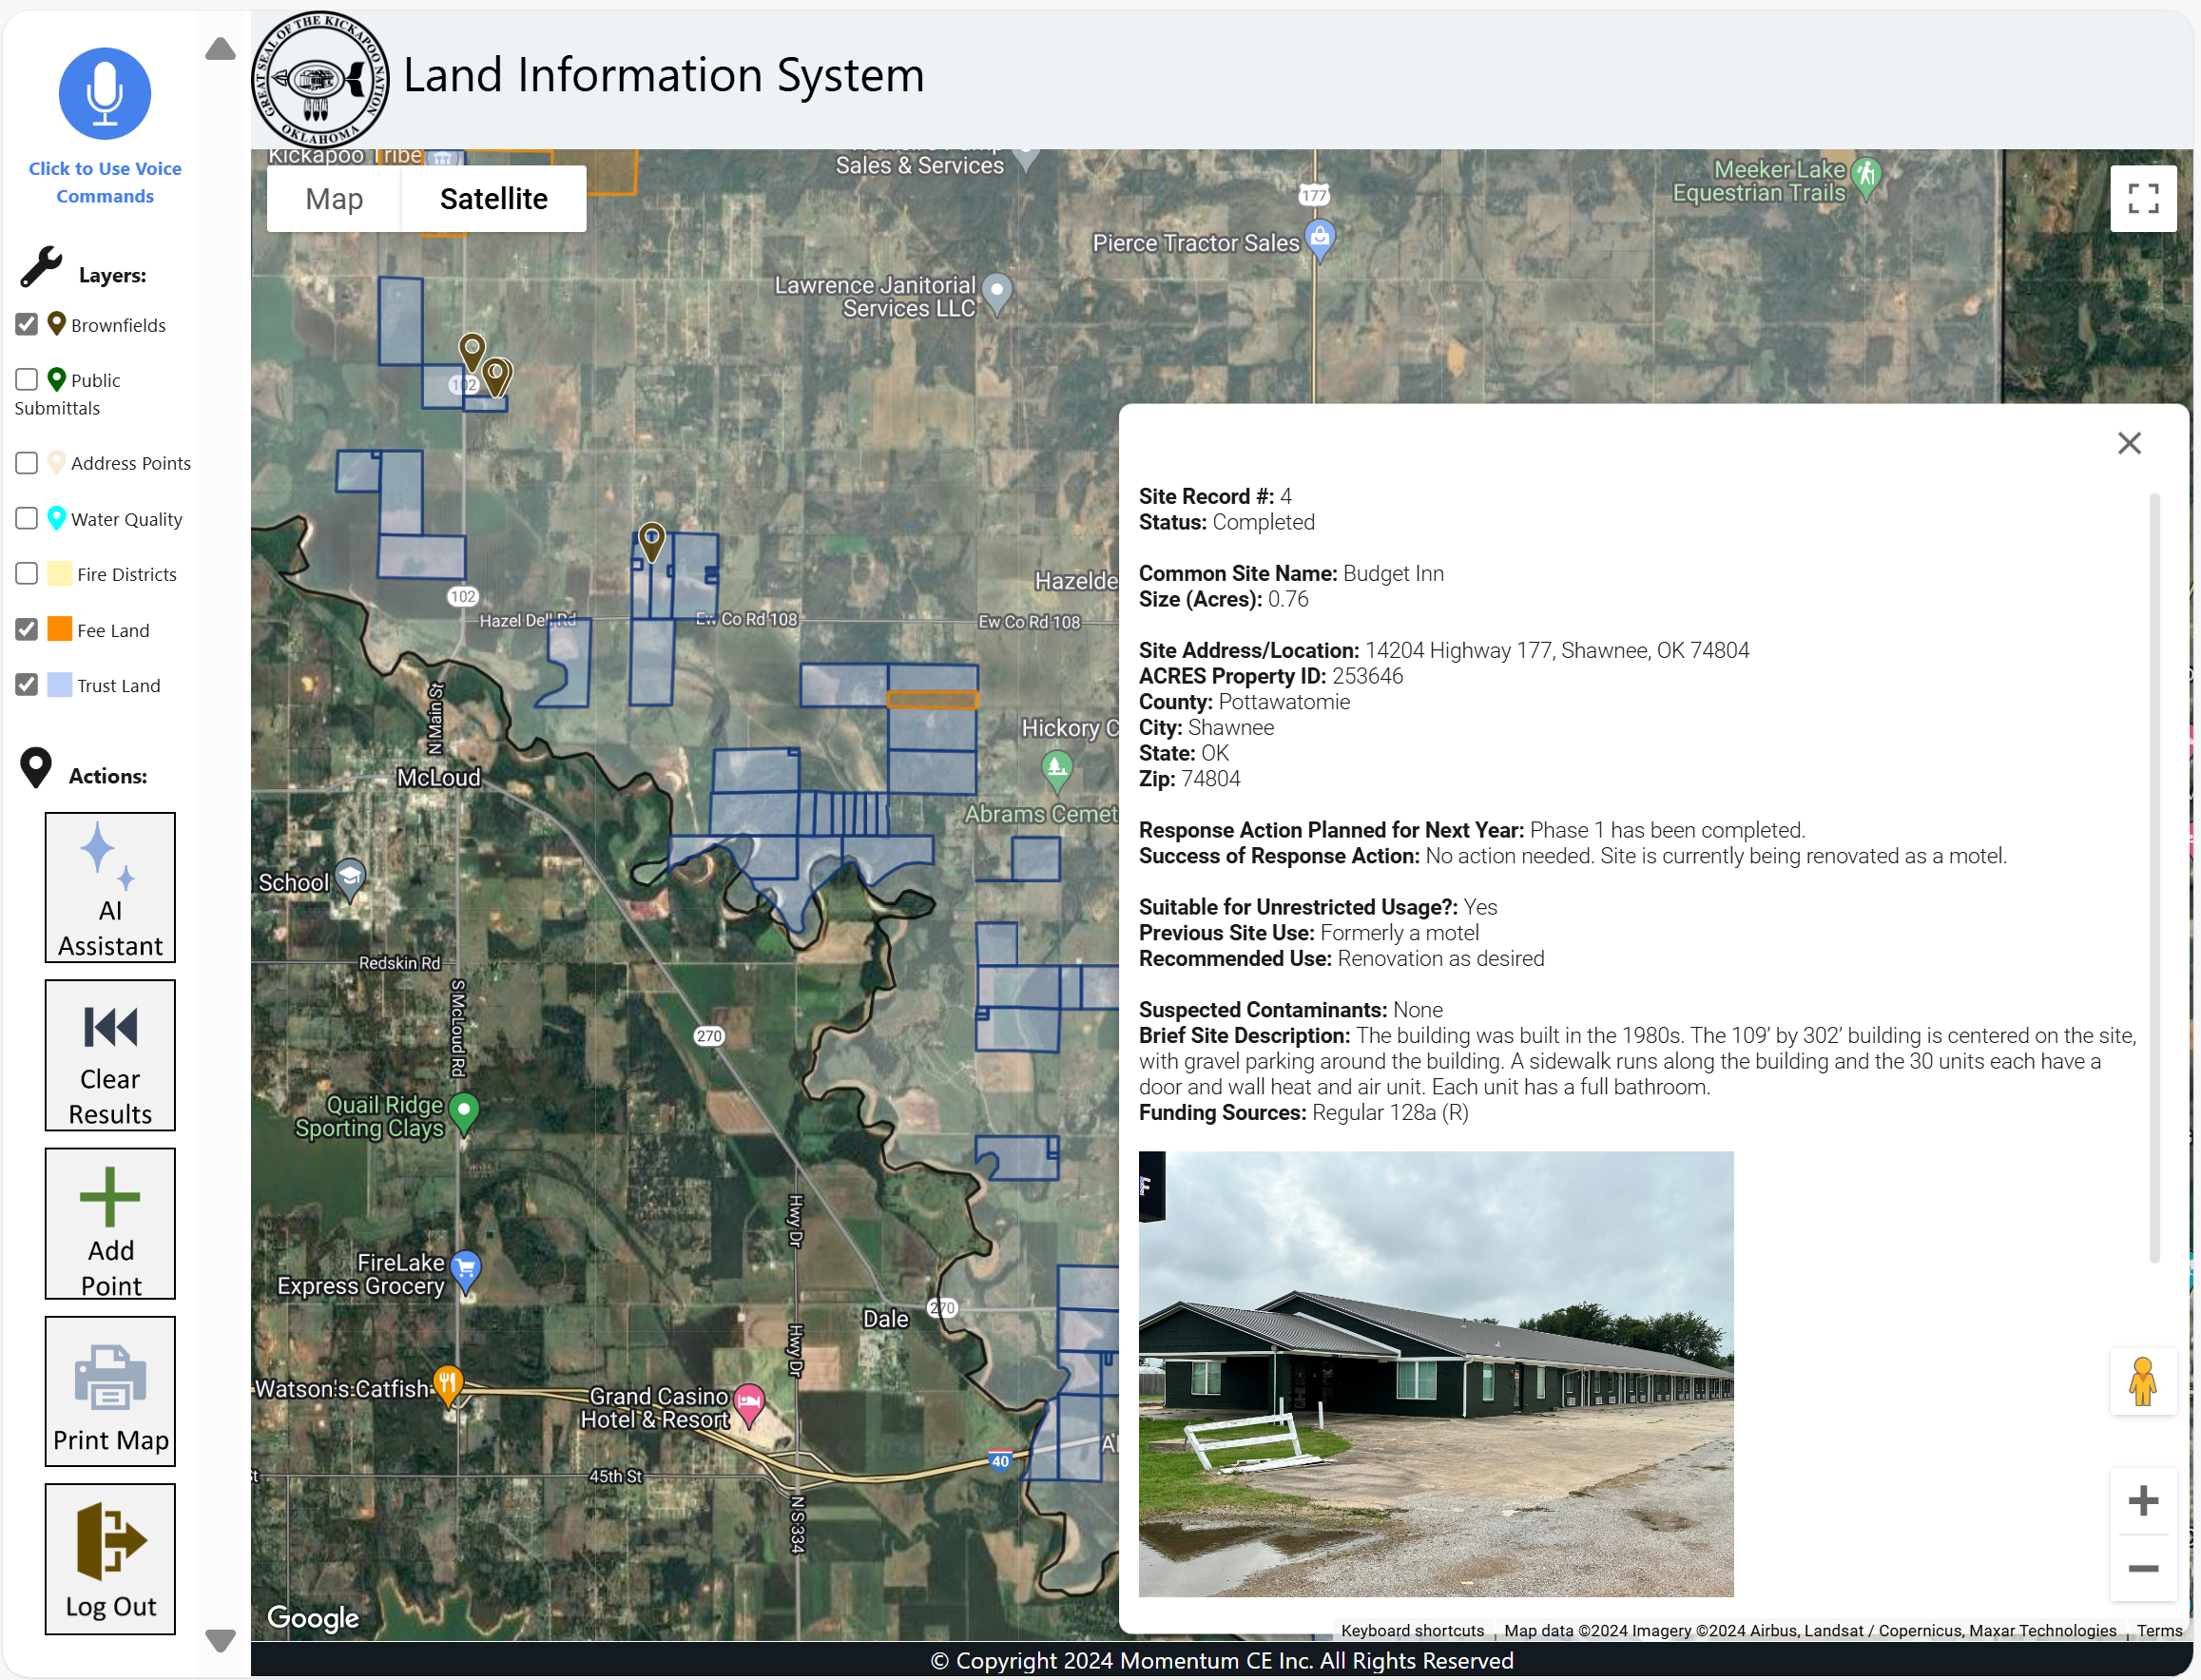
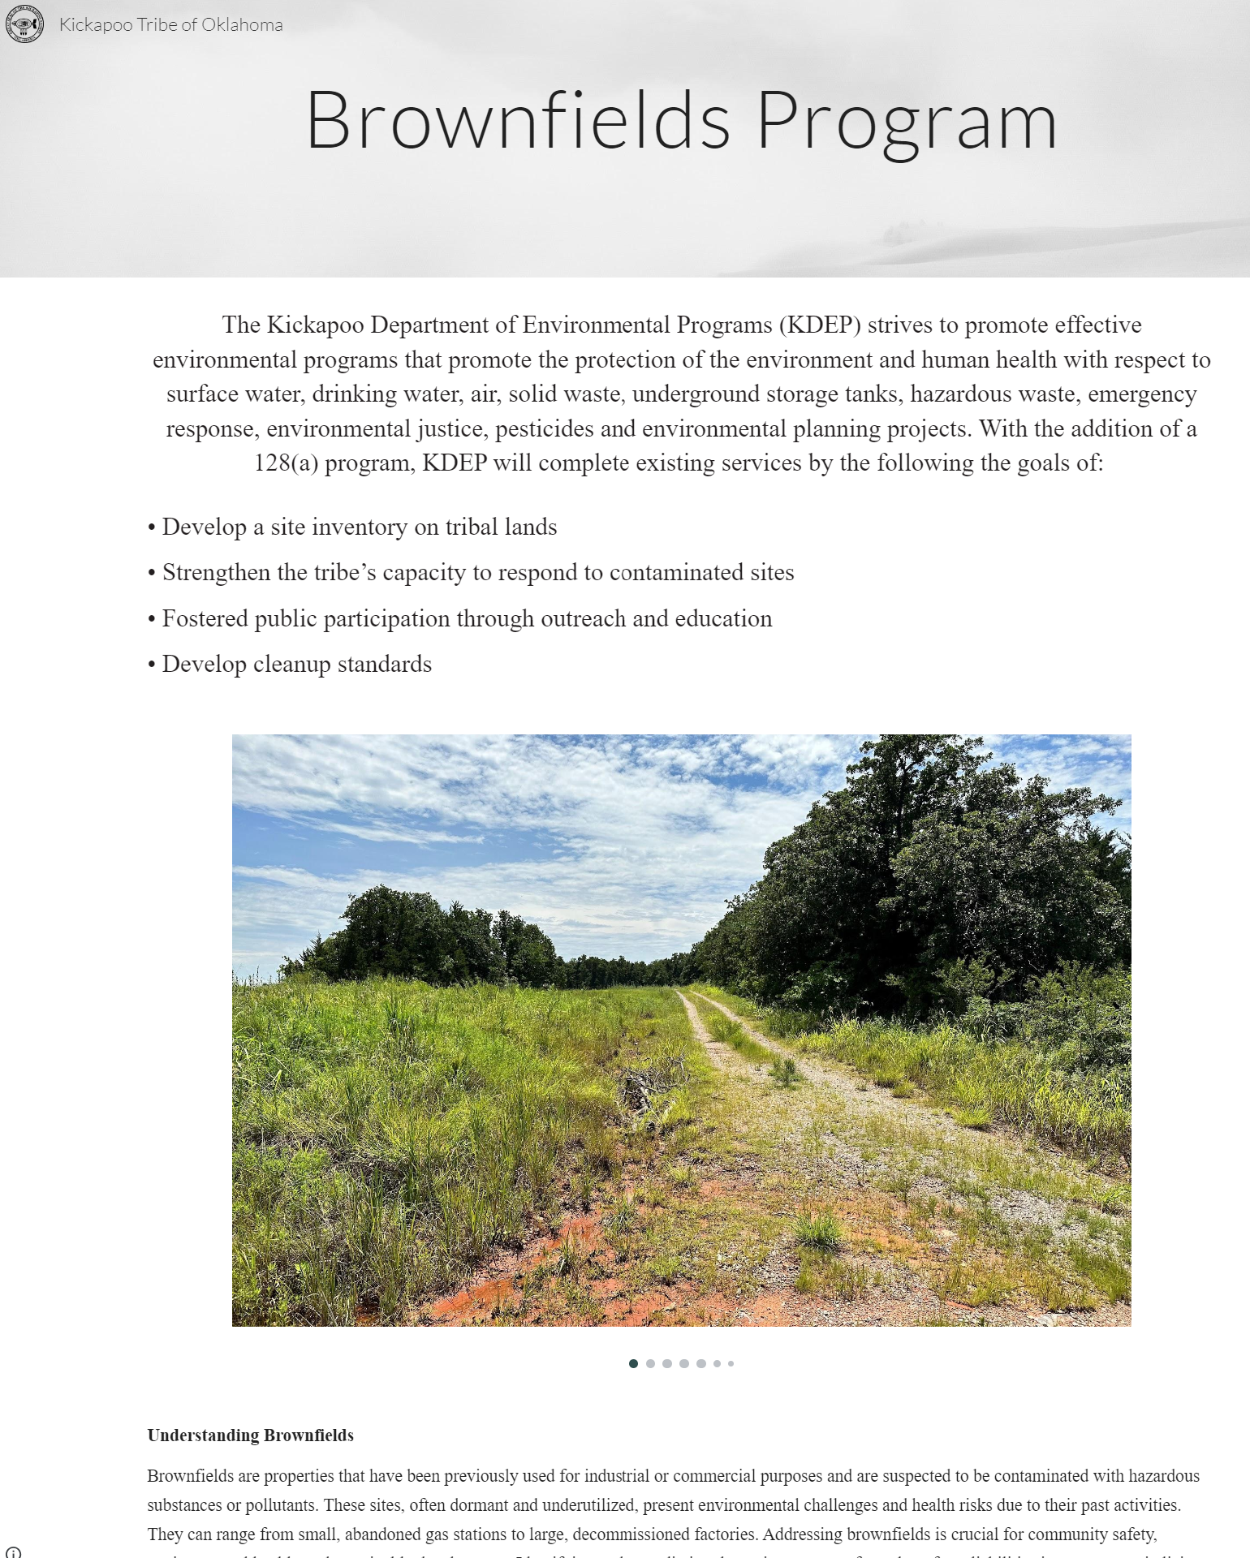
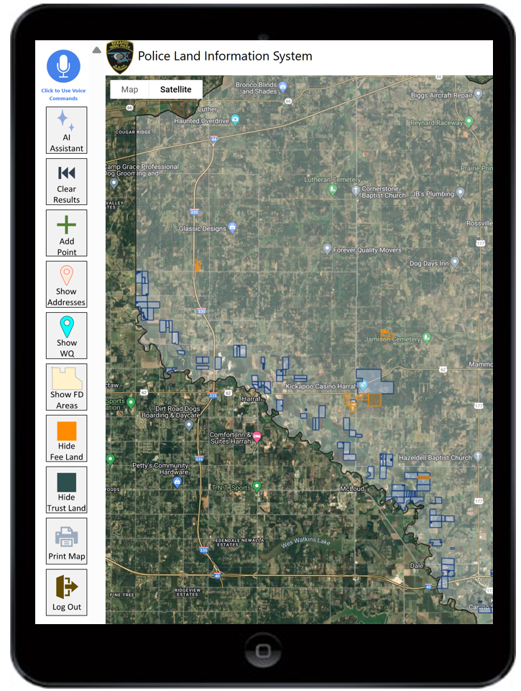
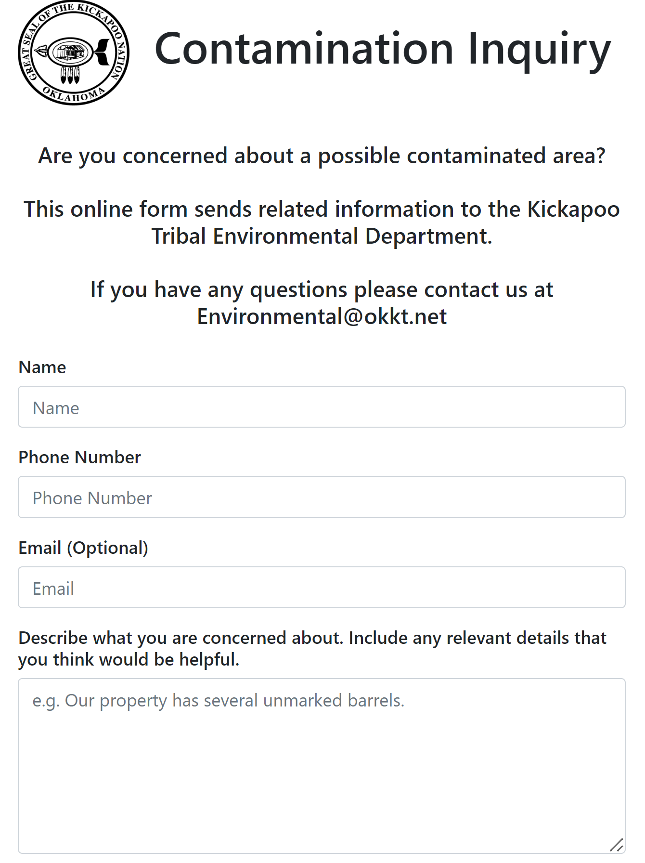
Project Structure
KDEP Dashboard
Public Website
Police Web App
Public Data Submittal Portal

Slide 6
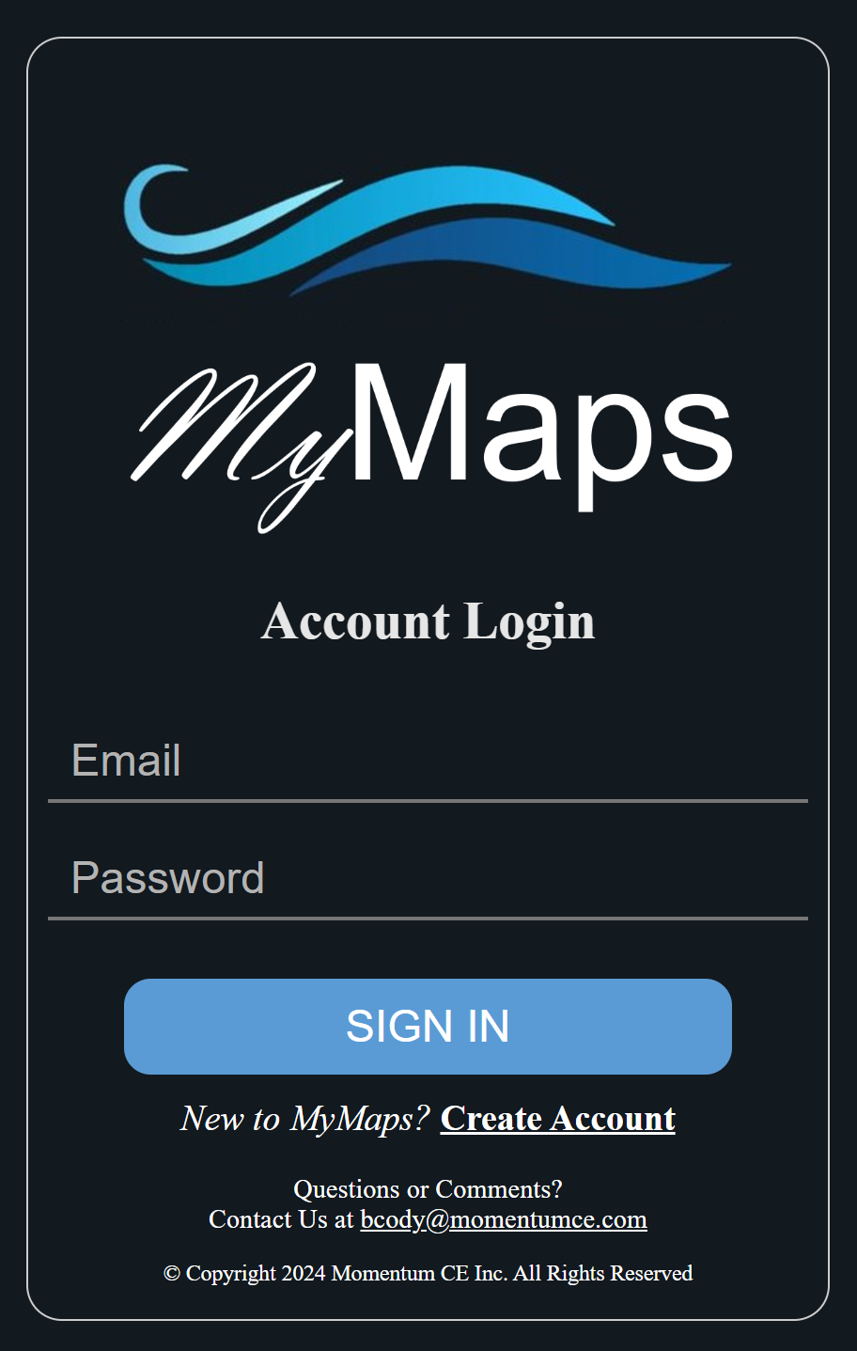
Website Map Applications: Inputs/Outputs
INPUTS
OUTPUTS
Public Online Data
(USGS flow rates, climate data)
Realtime Workflow and Data Visualization
Public Portal Data
(survey responses, permit applications and payment)
Realtime Workflow and Data Visualization
AI Generated Content and Documents
(e.g. write a report discussing water rights impacted by reduced Blackfoot River flow
Private Online Data
(Tribal air quality, Tribal land status)
Staff Data
(field data, inspection forms, photos)
AI Powered Map Integration
(e.g. Show all water quality points within 3 miles of tribal trust lands with a yellow marker)
GIS Data
(ArcGIS shapefiles, boundaries and attributes)

Slide 7
KDEP Departmental Dashboard

Slide 8
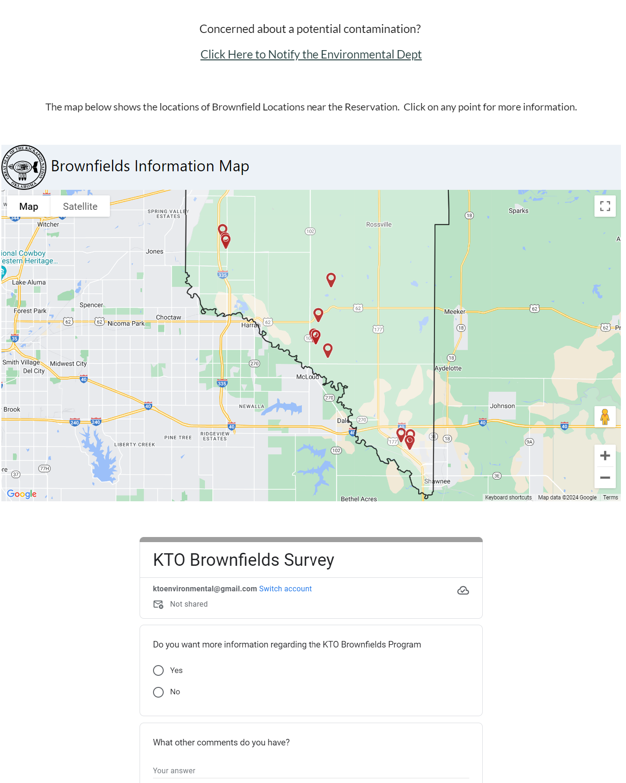
KDEP Public Website

Slide 9
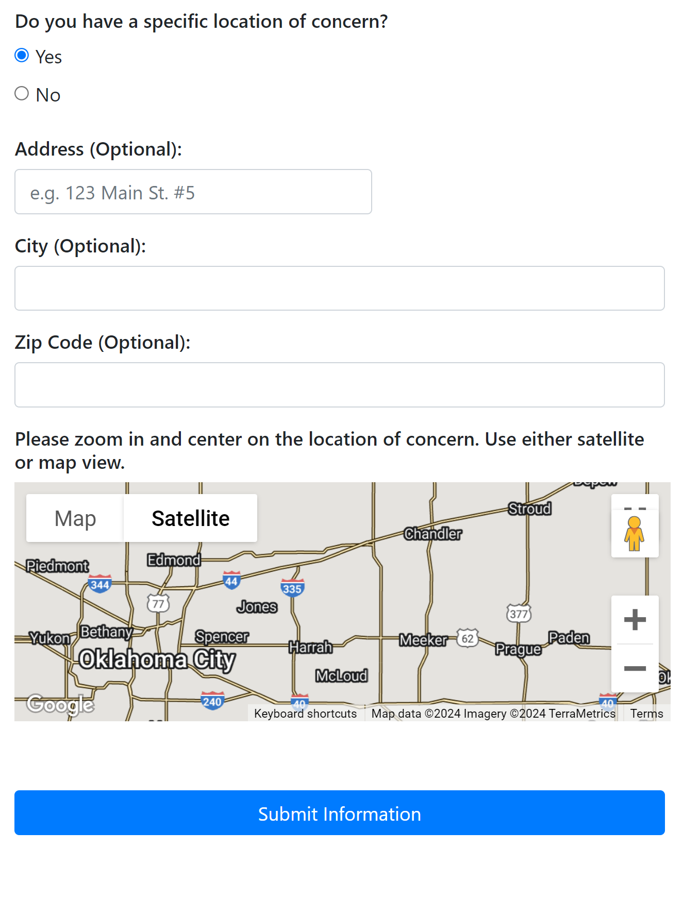
KDEP Public Portal

Slide 10
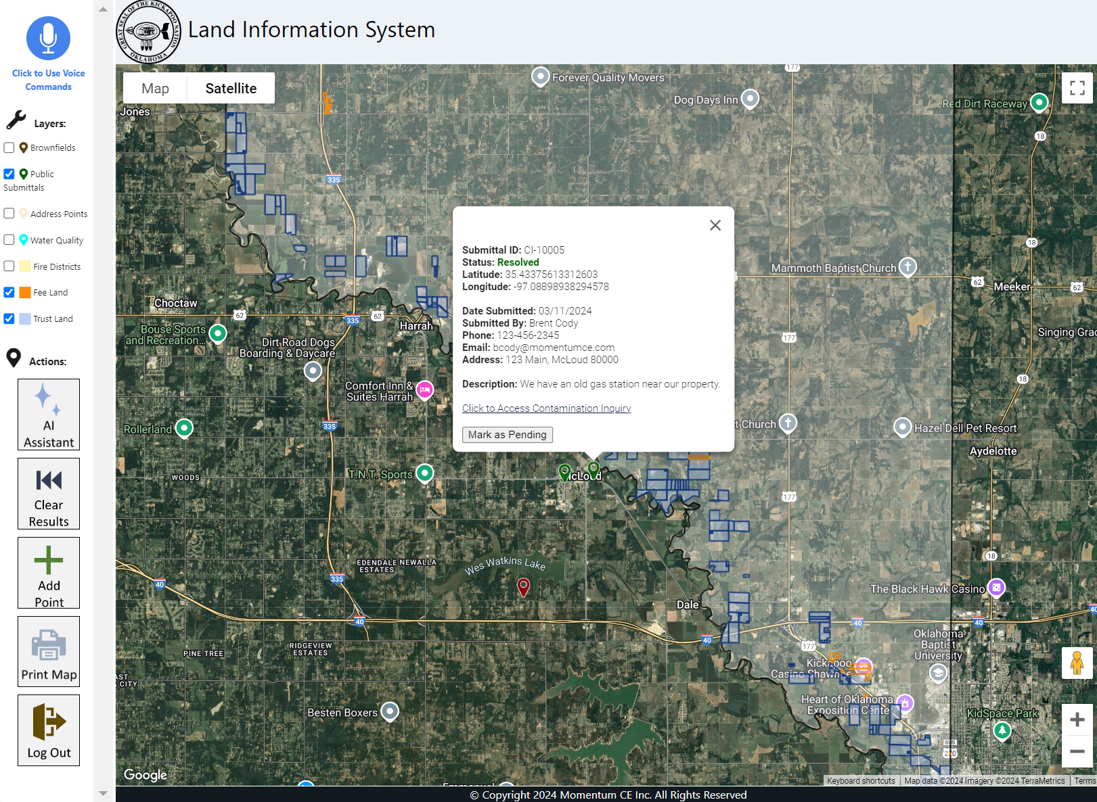
KDEP Dashboard – Portal Submittals

Slide 11
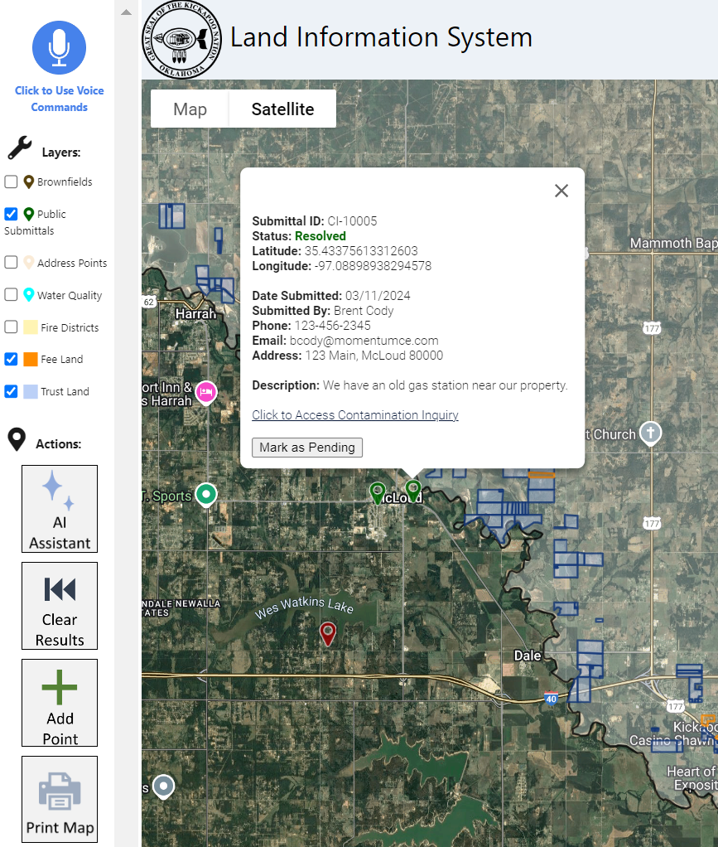
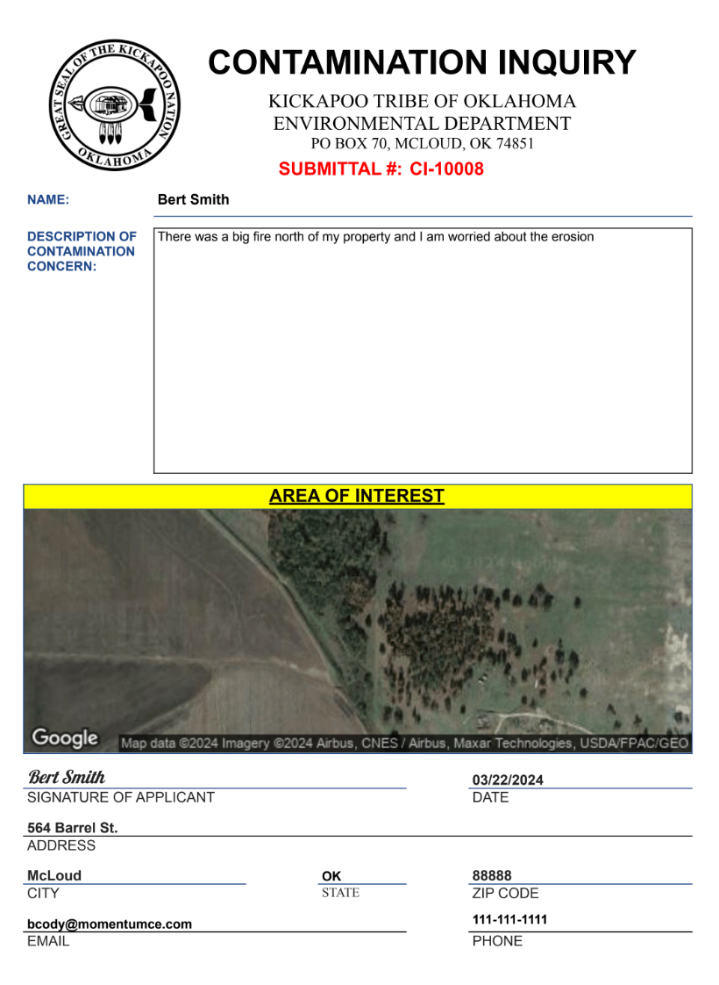
KDEP Public Portal

Slide 12
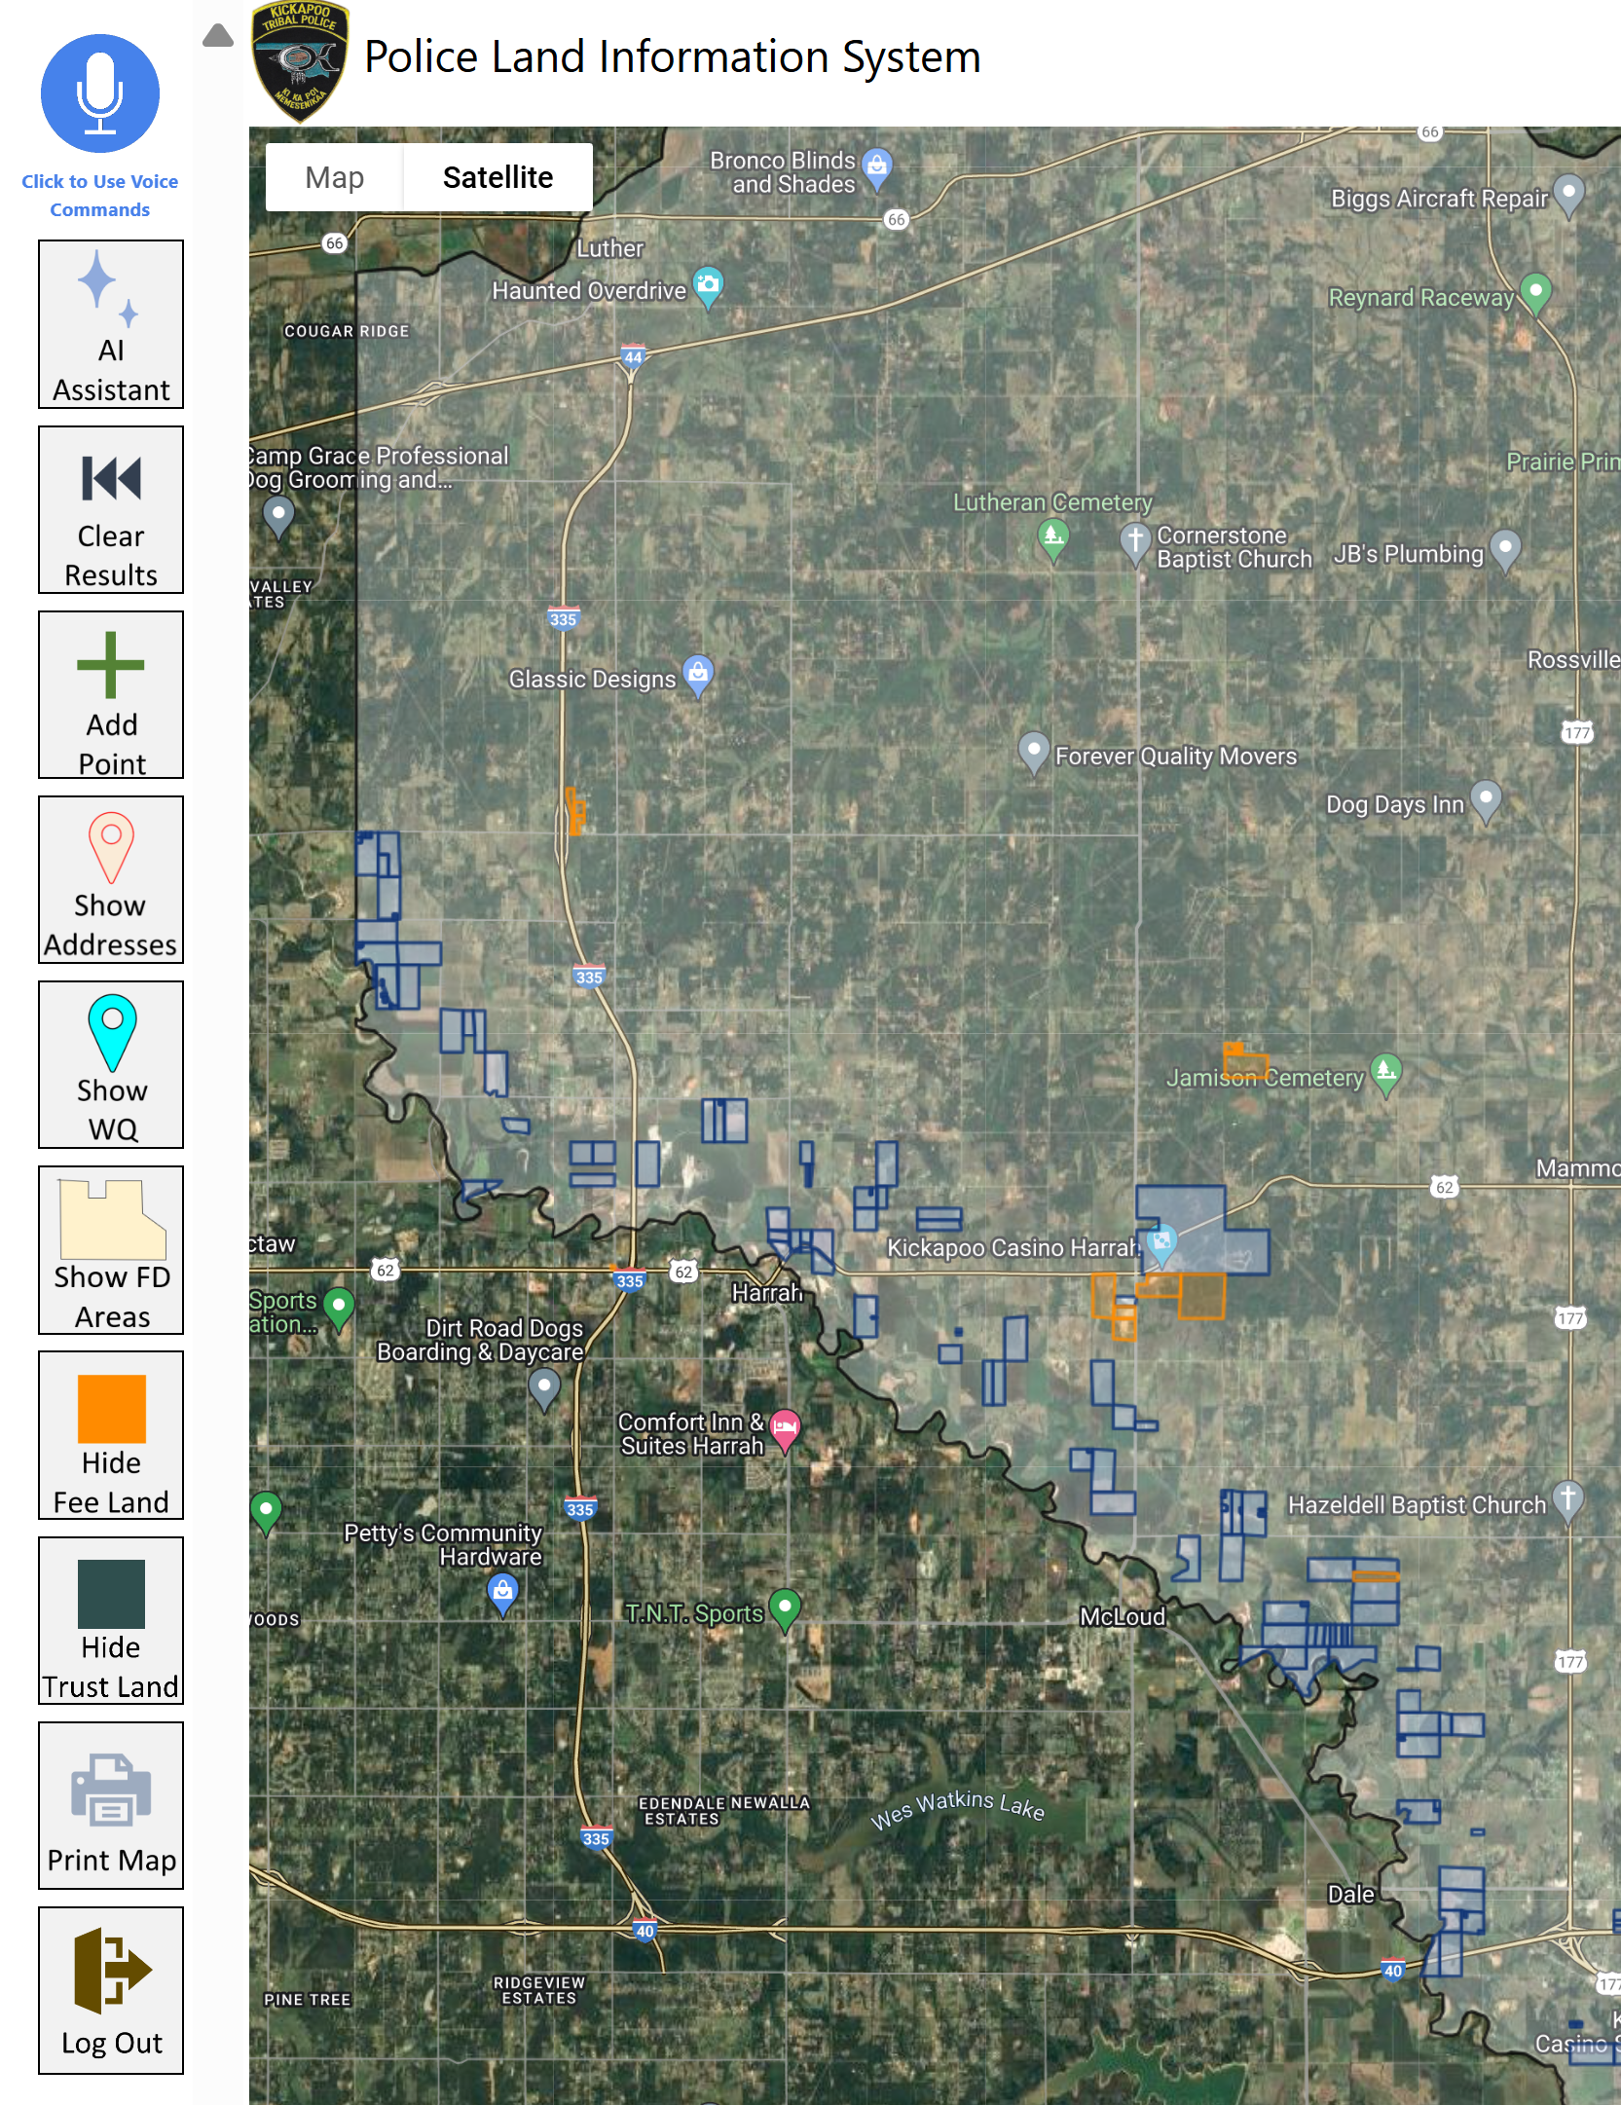
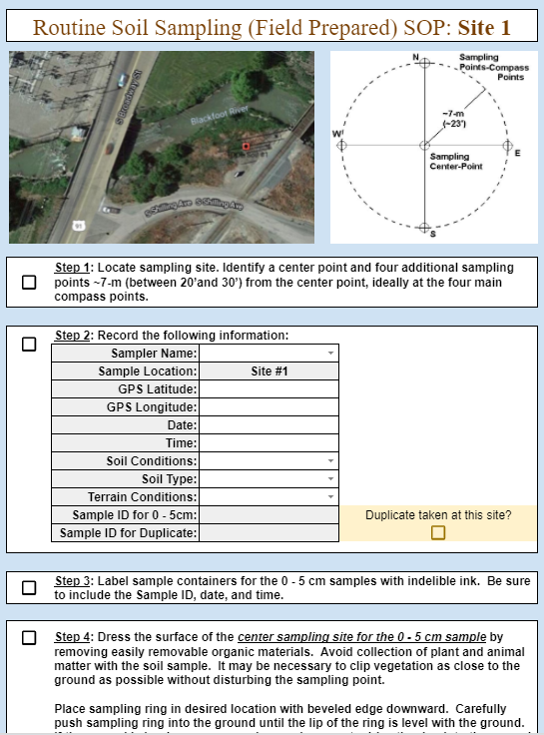
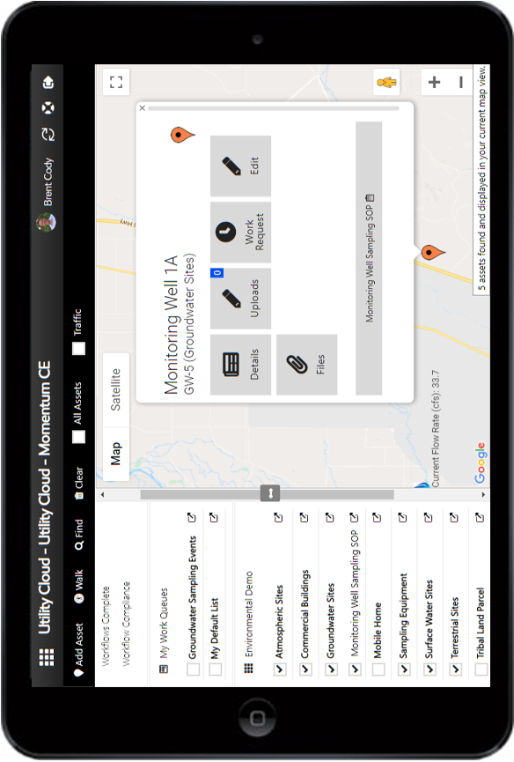
Kickapoo Police Web Mapping App

Slide 13
KDEP Dashboard – AI Assistant

Slide 14
KDEP Departmental AI Assistant

Slide 15
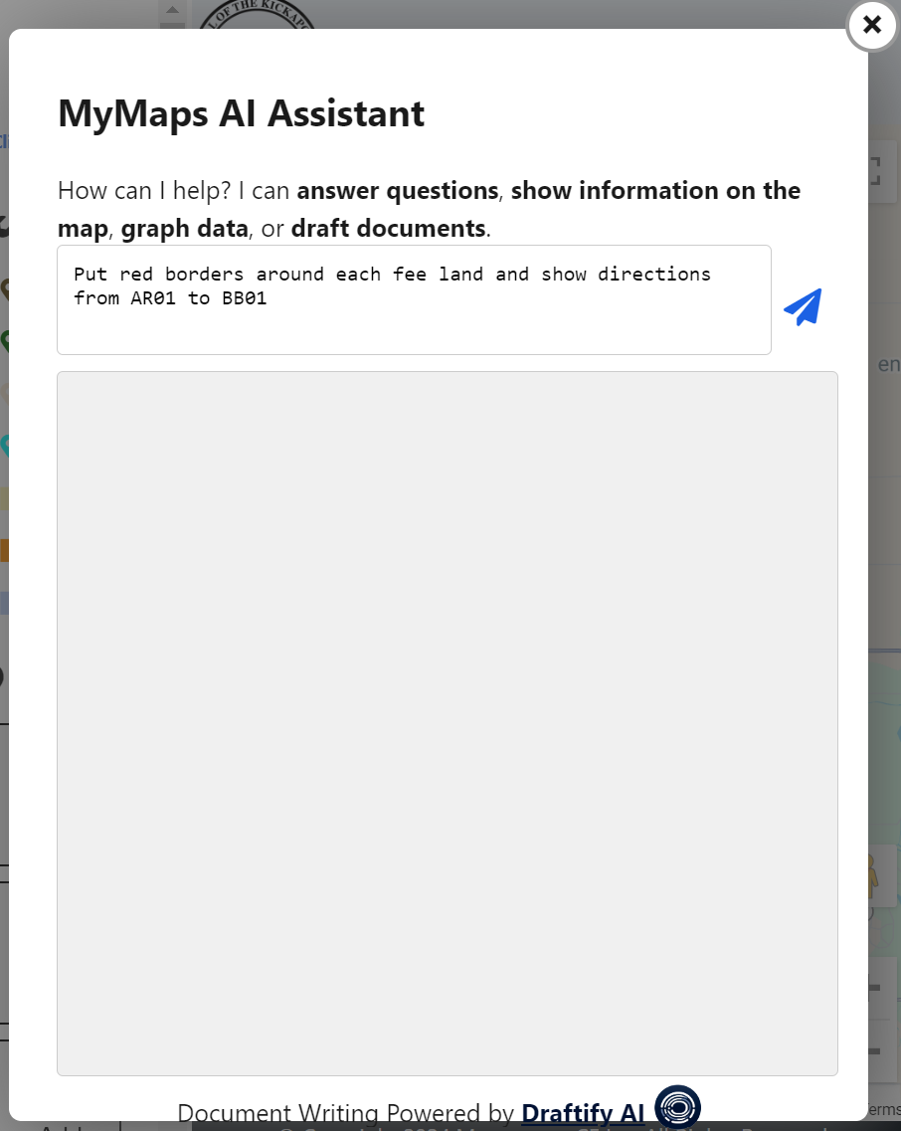
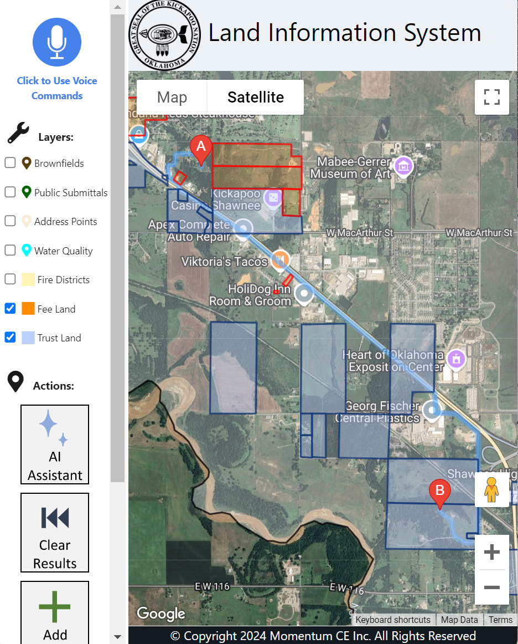
KDEP Departmental AI Assistant

Slide 16
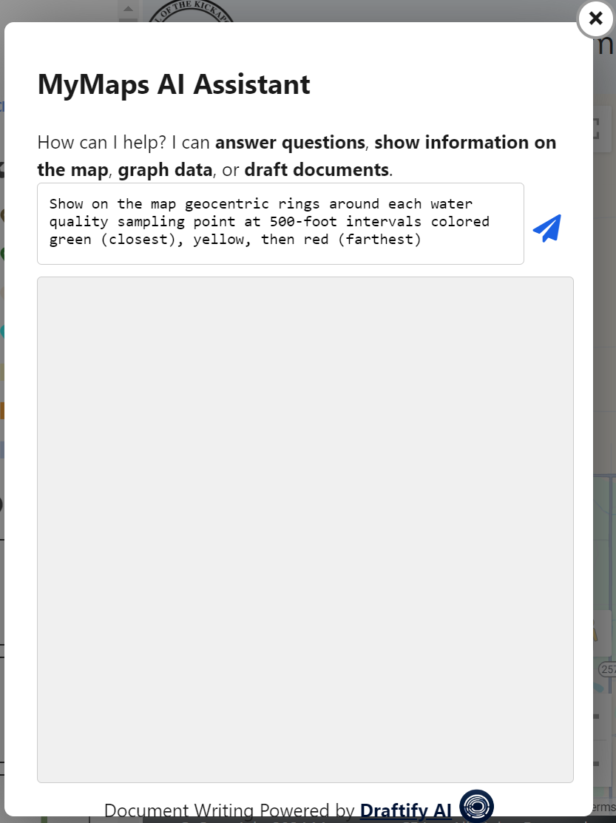
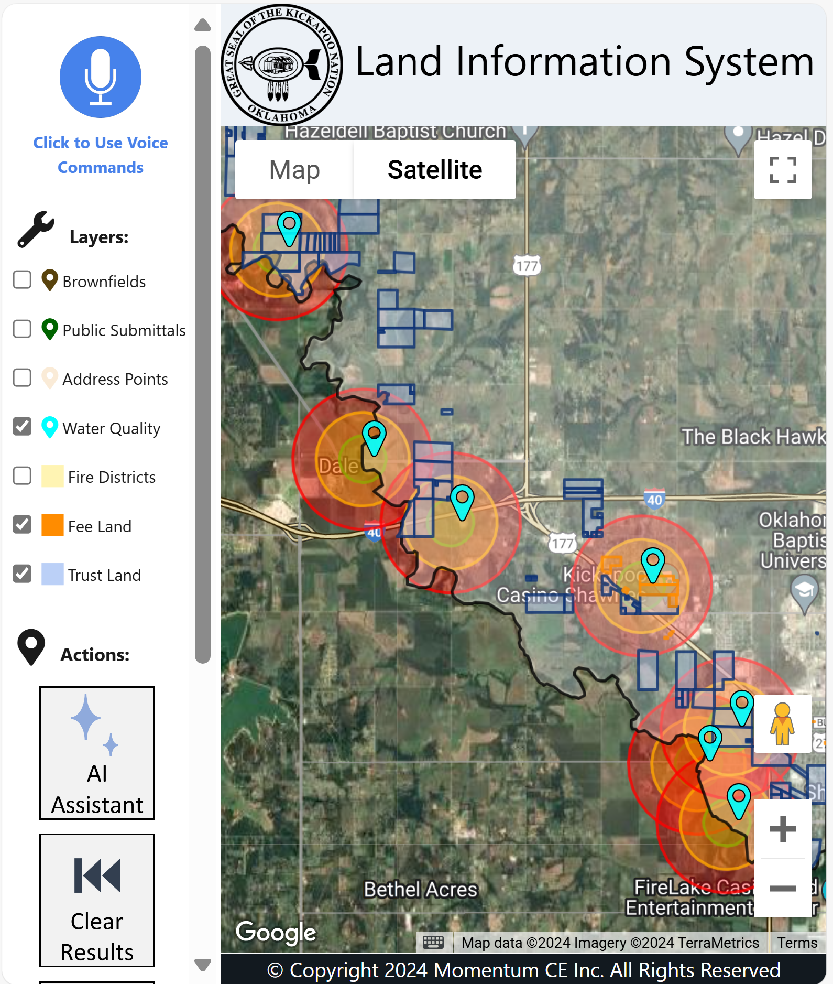
KDEP Departmental AI Assistant

Slide 17
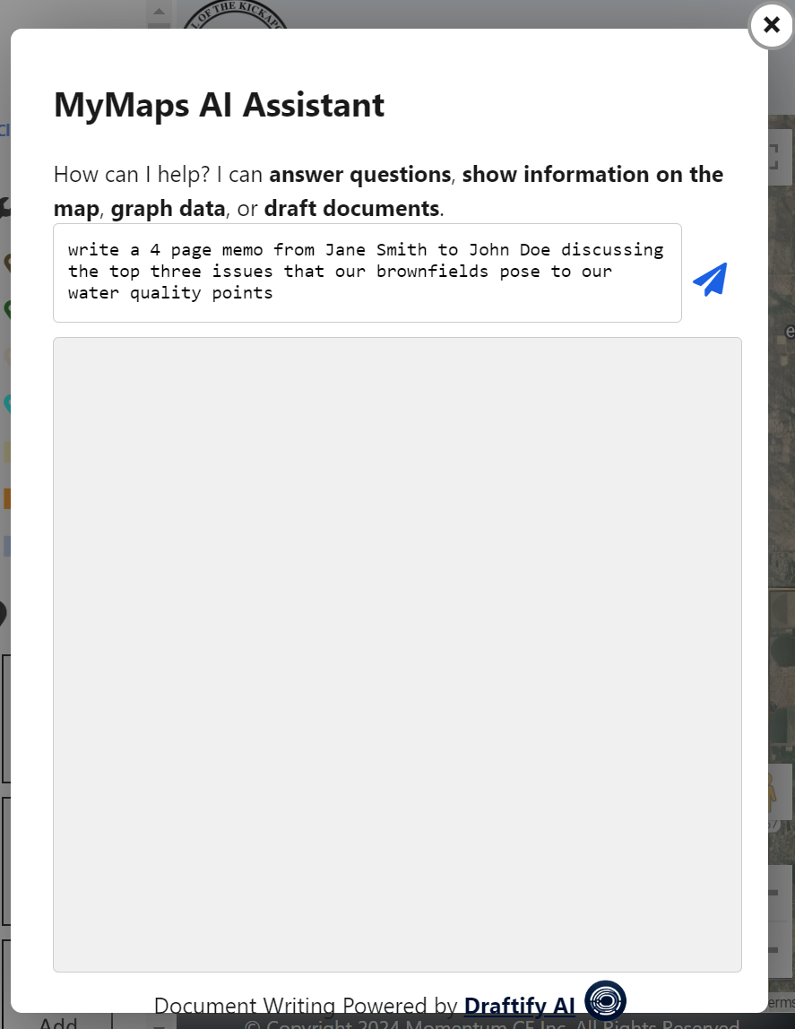
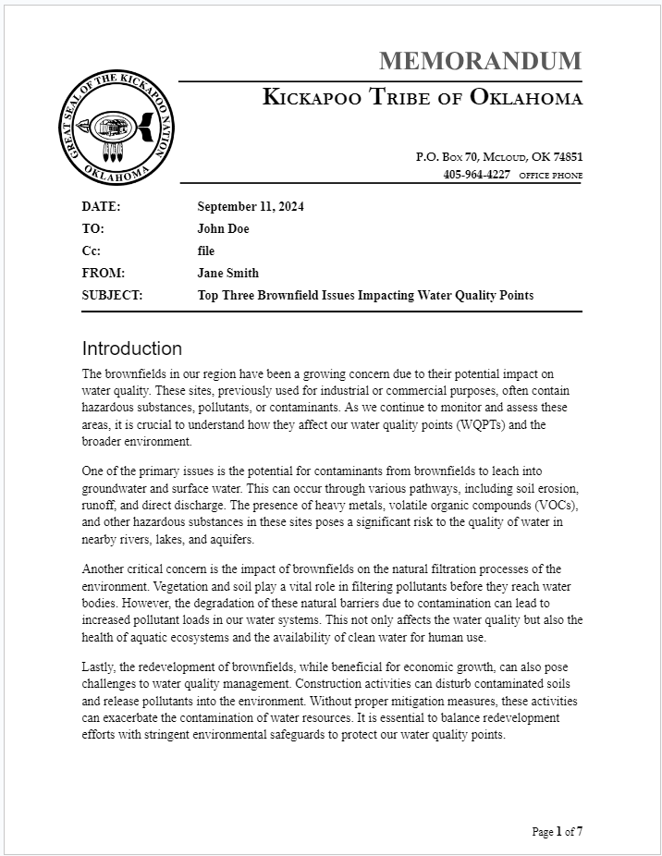
KDEP Departmental AI Assistant

Slide 18
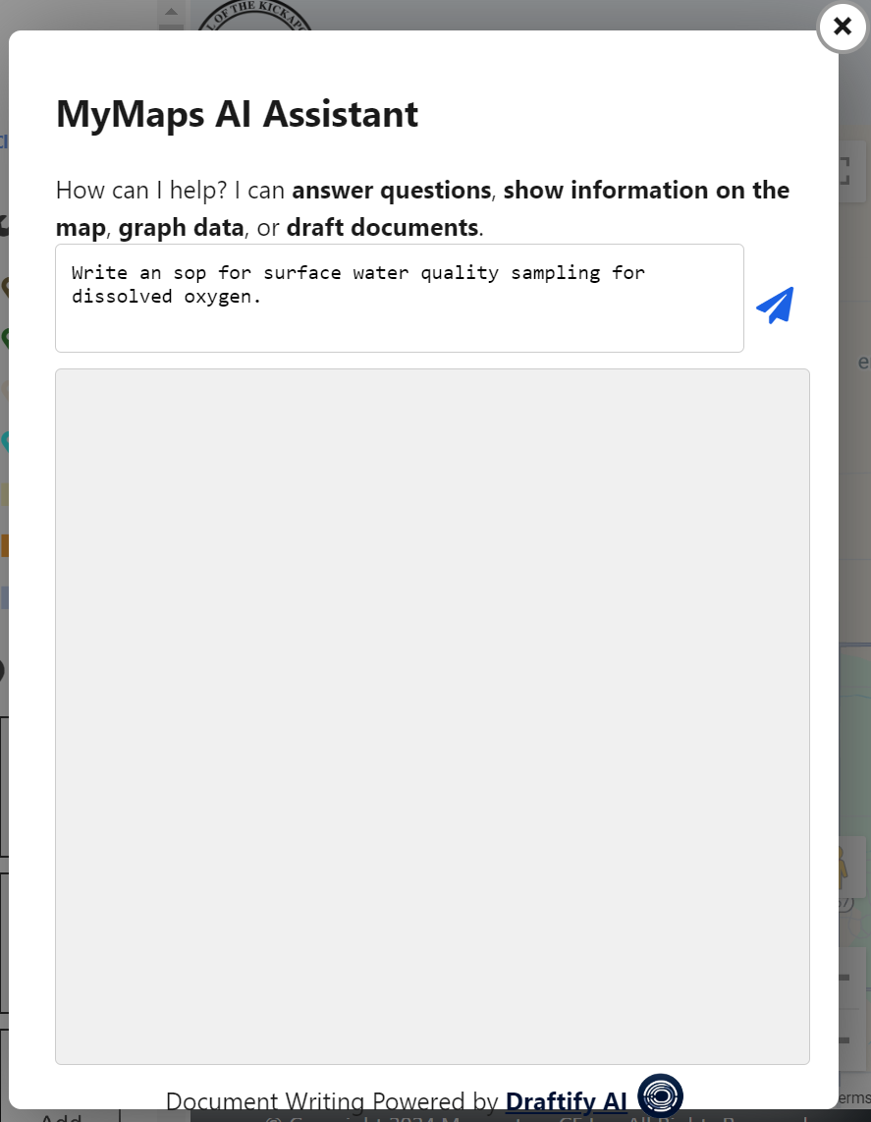
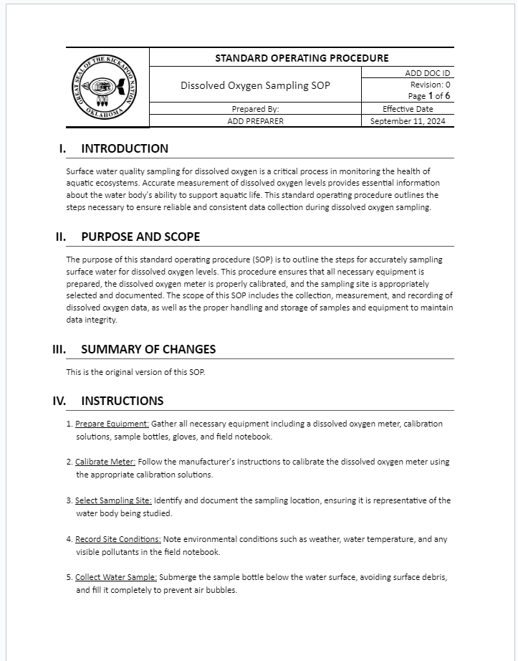
KDEP Departmental AI Assistant

Slide 19
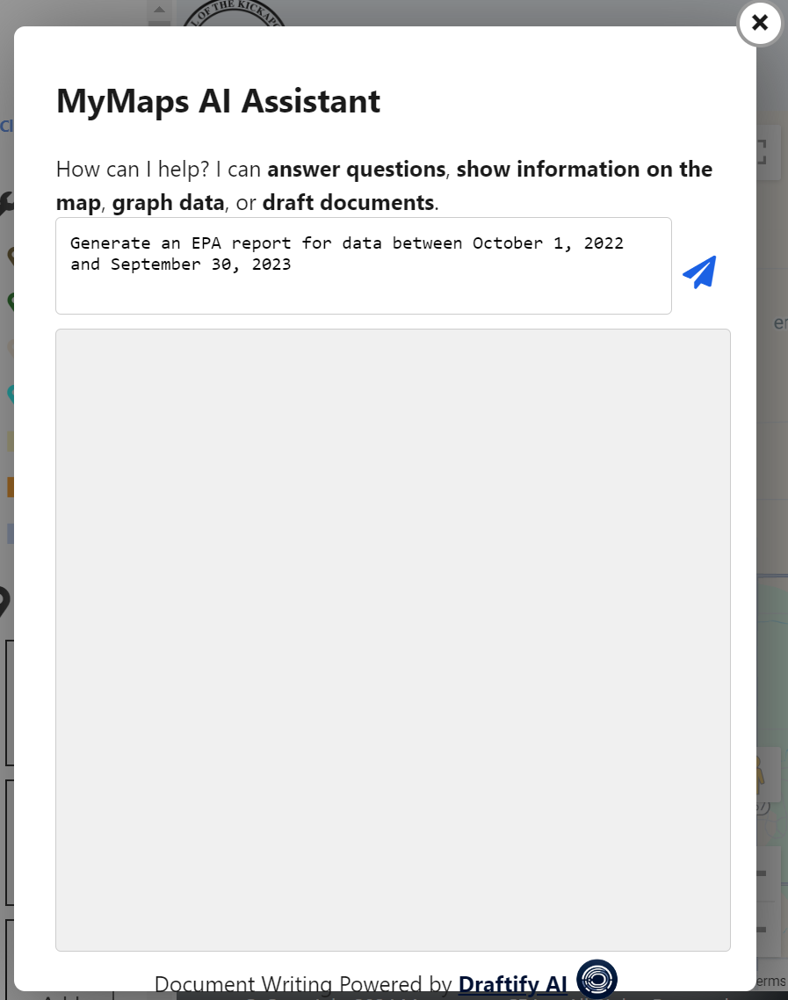
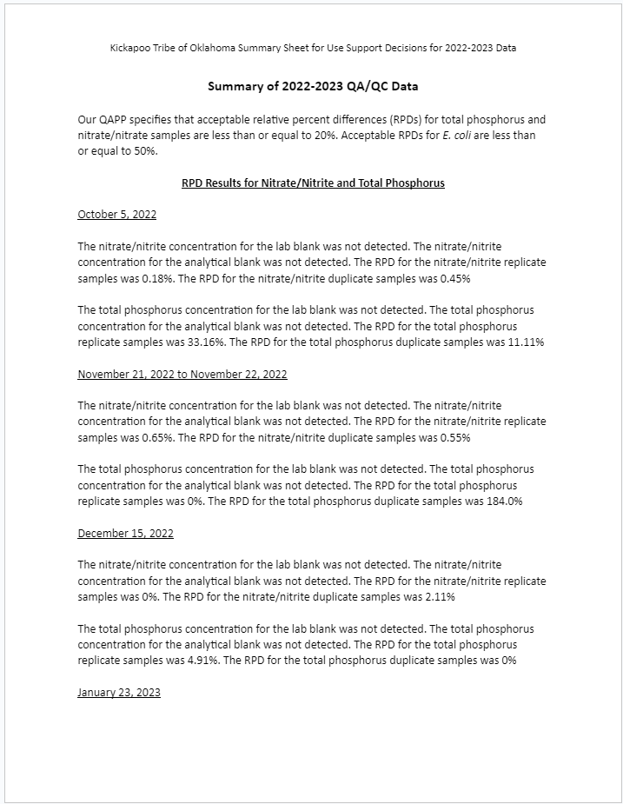
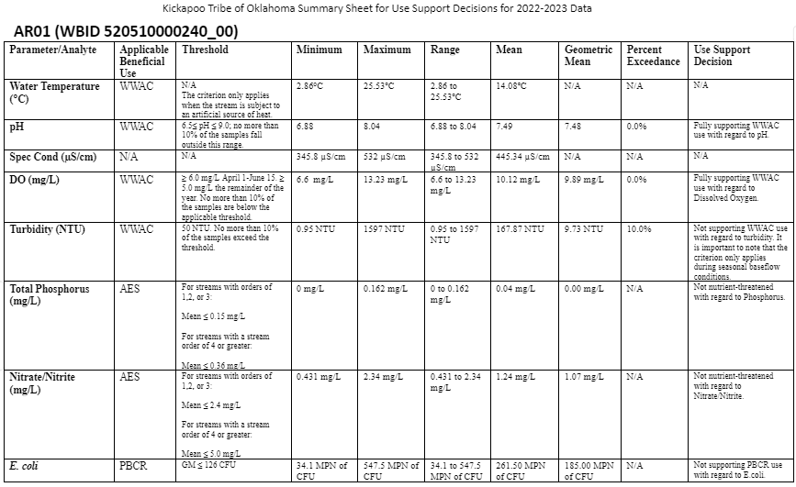
KDEP Departmental AI Assistant

Slide 20
AI Tips and Best Practices
Provide Effective Background Knowledge:
Provide detailed, context-rich prompts.
Refine prompts based on AI outputs.
Ensure Answer Accuracy:
Review AI responses for accuracy.
Use regularly updated and validated input data and models.
Protect Data Security:
Know organization and platform data policies
Use secure data storage and access controls.
Anonymize sensitive data.

Slide 21
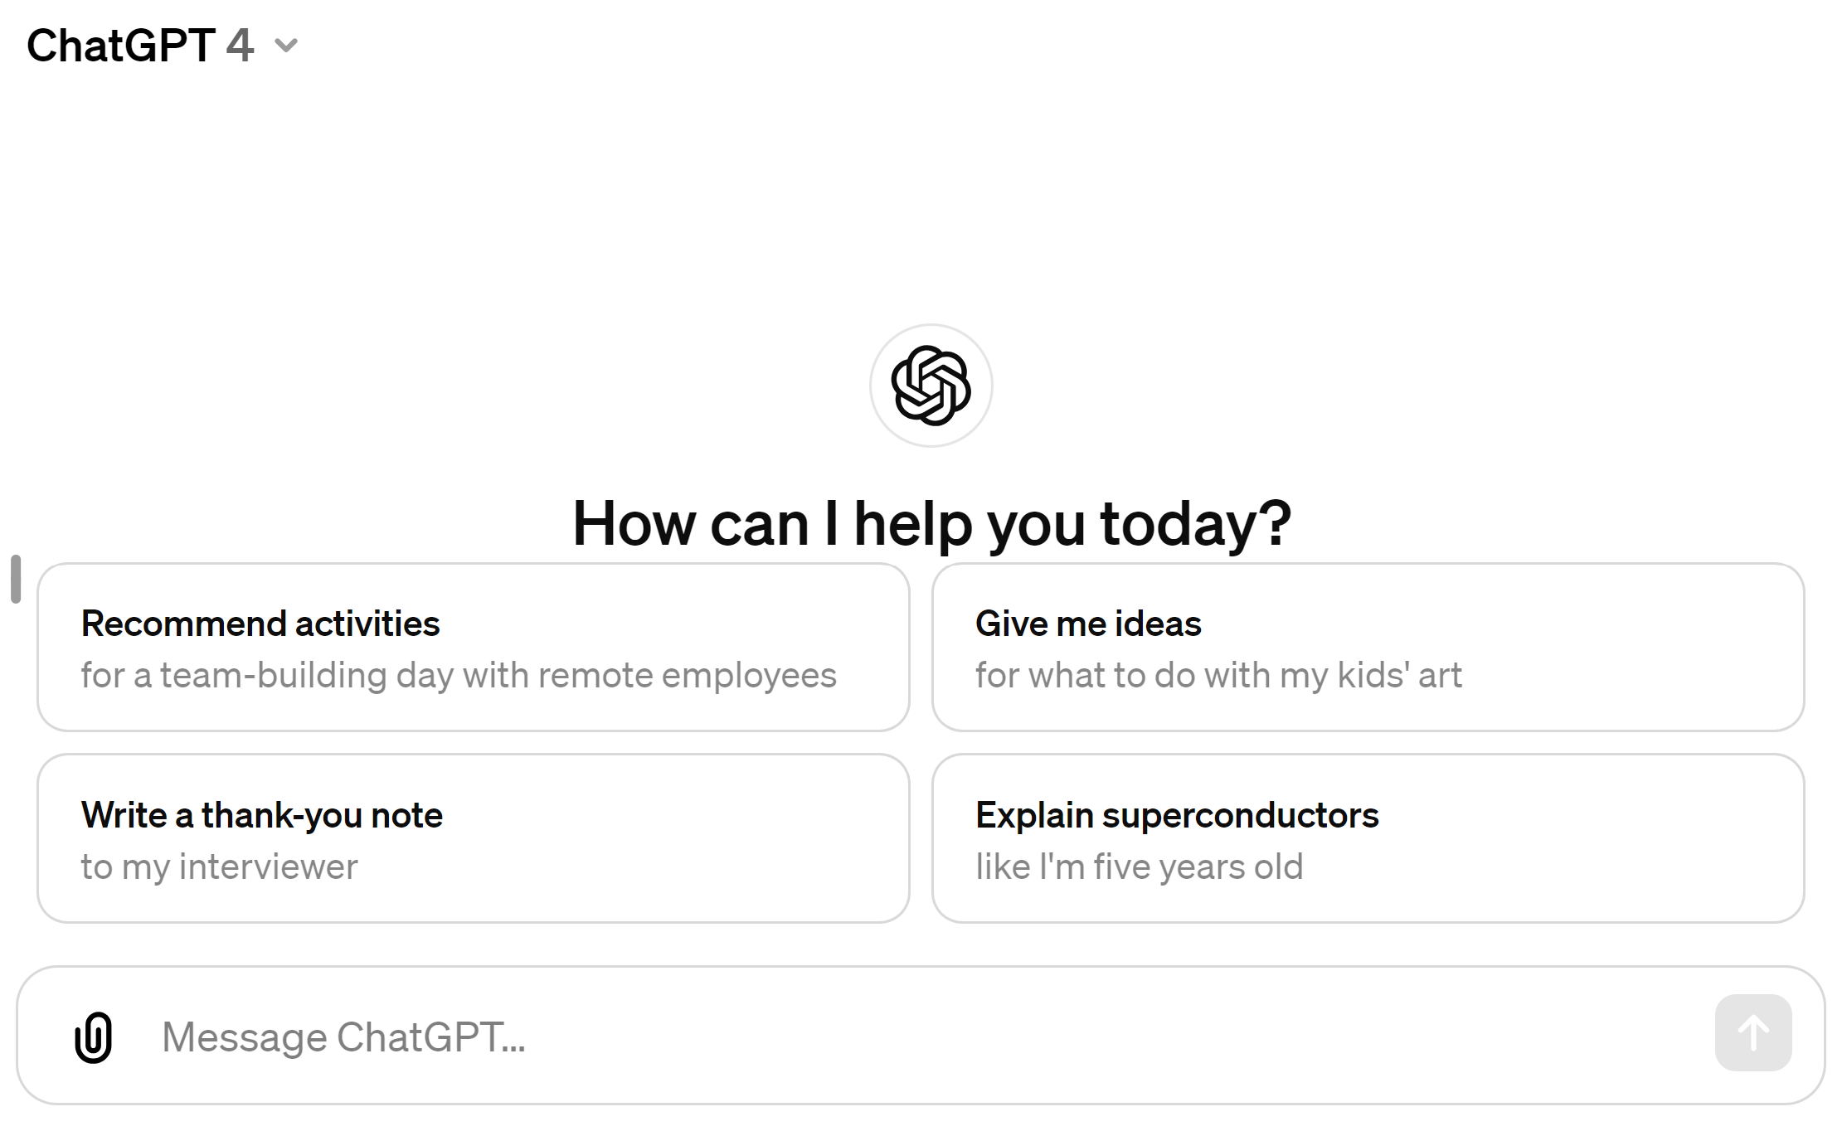
AI Tools: ChatGPT 3.5 (free) or 4.0 ($20/month)
Designed for conversational engagement, able to understand and generate human-like text responses.
Versatile tool for various applications where natural language processing is key
Access: https://chat.openai.com/

Slide 22
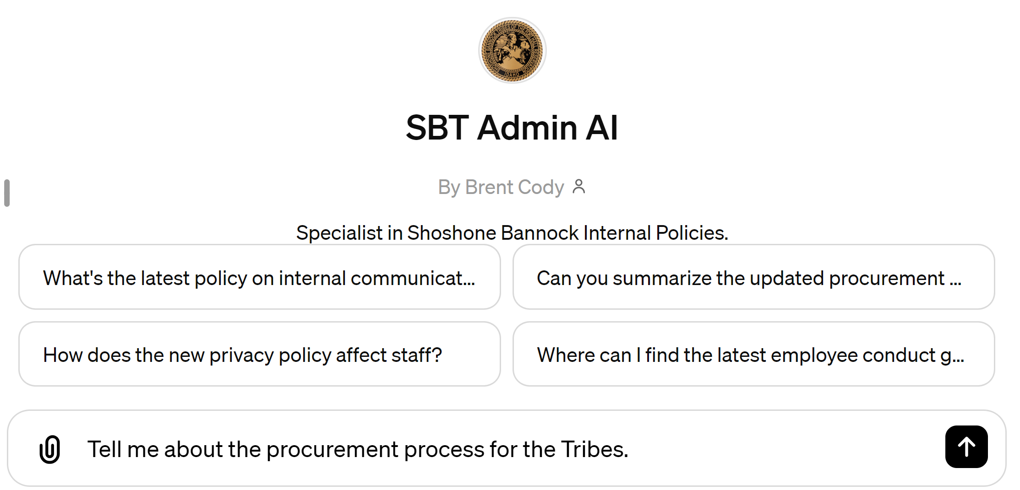
AI Tools: OpenAI Custom GPTs ($20/month)
Customizable AI language models
Users can train these models on their own datasets, allowing the AI to understand and generate text that's relevant to particular domains or industries.
Access: https://chat.openai.com/ (must have v.4.0)

Slide 23
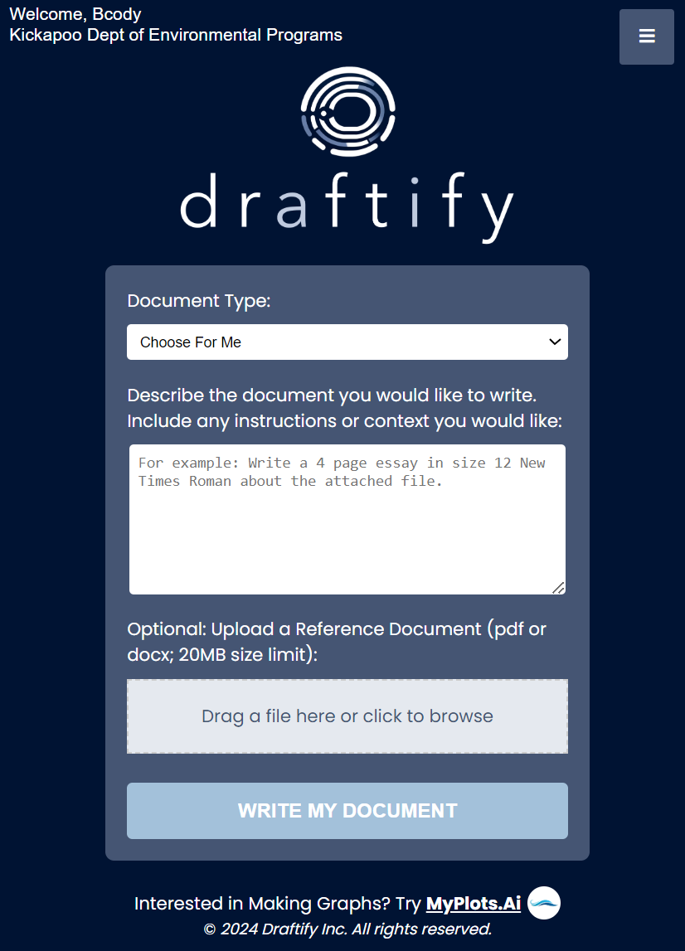
AI Tools: OpenAI APIs ($/token)
OpenAI provides Application Programming Interfaces (APIs) that allow developers to integrate its advanced AI models, like GPT and DALL-E, into their own applications.
Used for building a variety of applications, from chatbots to content creation tools.
Access: https://openai.com/blog/openai-api

Slide 24
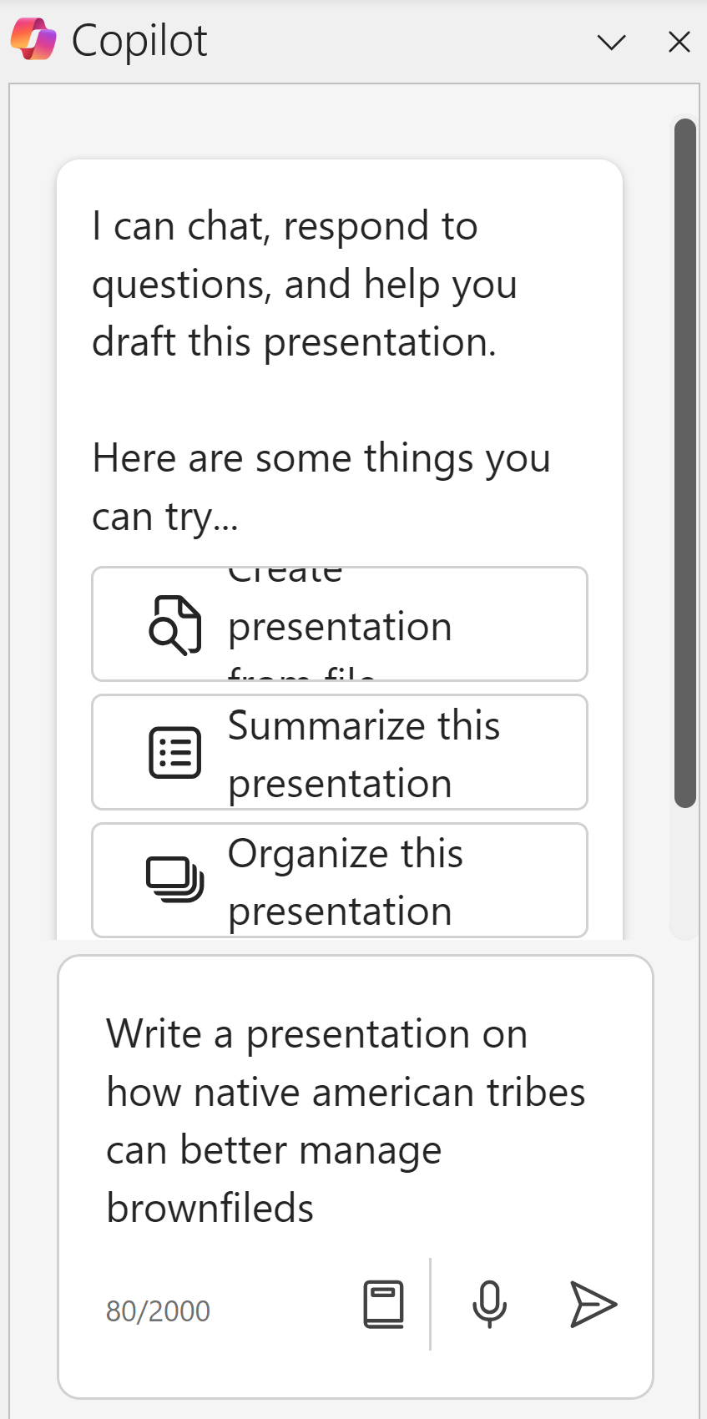
AI Tools: MS Copilot for Office ($30/month)
AI-powered assistant designed to enhance productivity within the Microsoft 365 suite.
Automating tasks, generating content, and providing intelligent suggestions in applications like Word, Excel, PowerPoint, and Outlook.
Access: https://support.microsoft.com/en-us/topic/where-can-i-get-microsoft-copilot-40a622db-6d25-4266-b008-4bbcb55cf52f

Slide 25
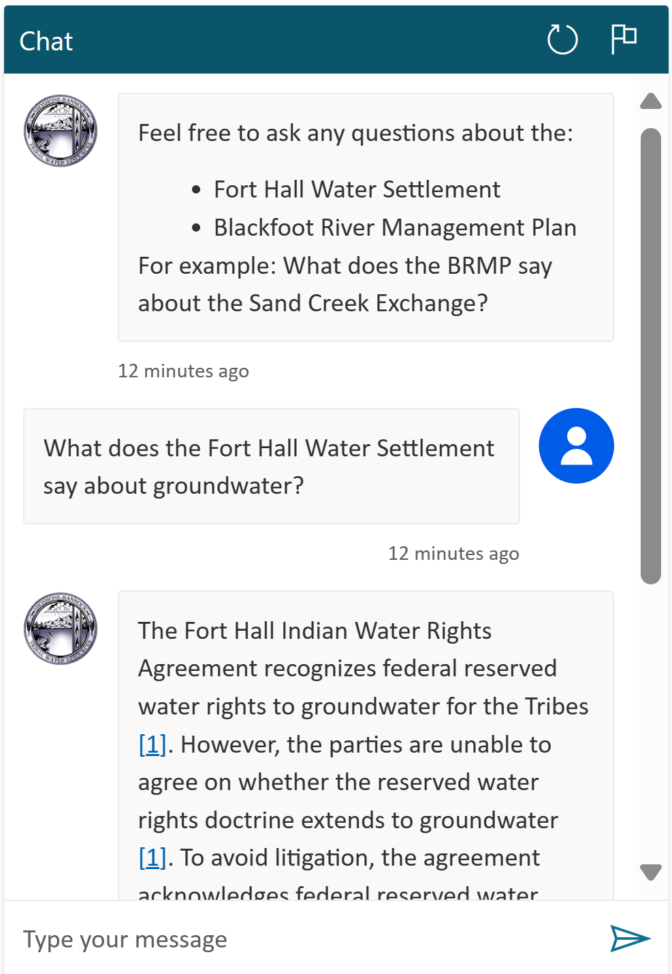
AI Tools: MS Copilot Studio ($200/month)
Microsoft Copilot Studio with Generative AI is an advanced tool designed for developing custom AI solutions tailored to individual or organizational needs, using specific Microsoft data.
Can analyze and learn from an organization's existing Microsoft data to develop AI solutions
Access: https://copilotstudio.microsoft.com

Slide 26
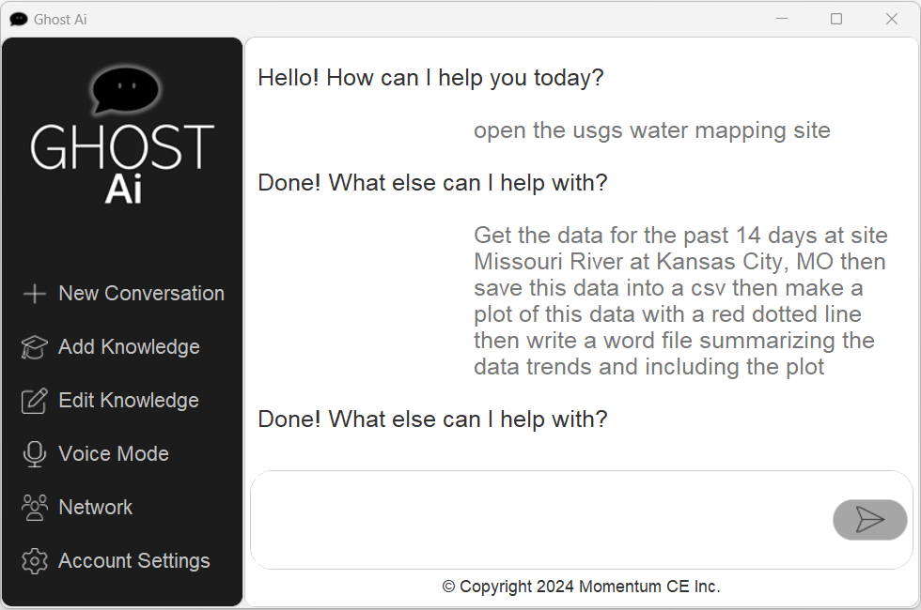
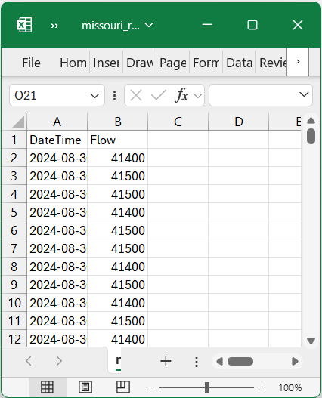
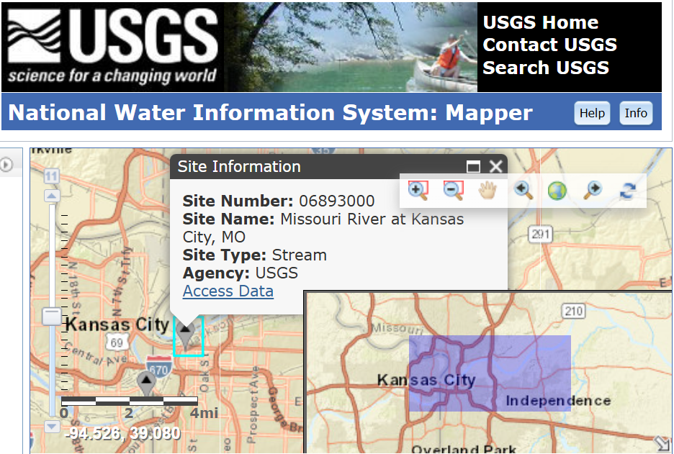
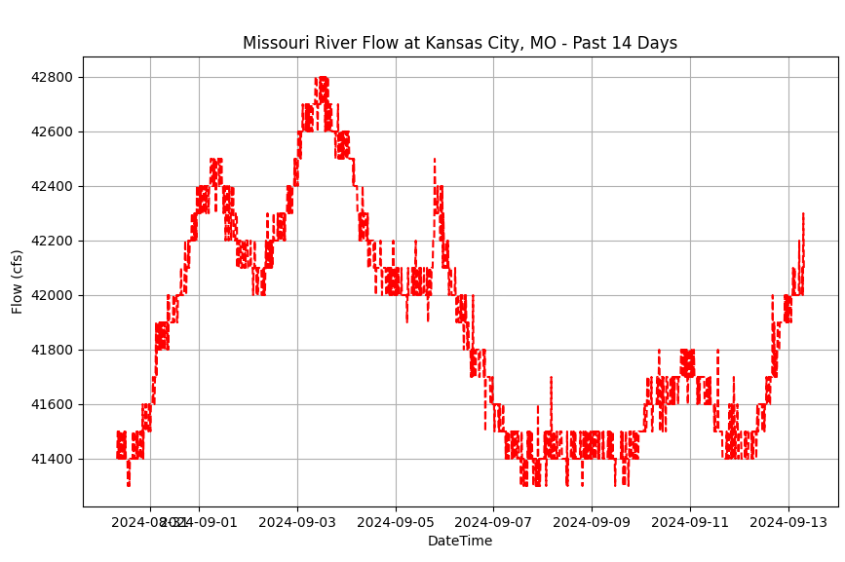
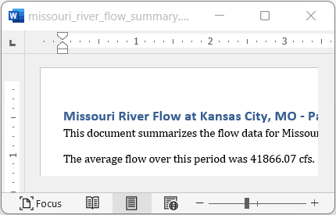
What’s next with AI? AI-Assisted Operating Systems:GhostAi.net

Slide 27
Examples, Discussion, and Questions

