Slide 1
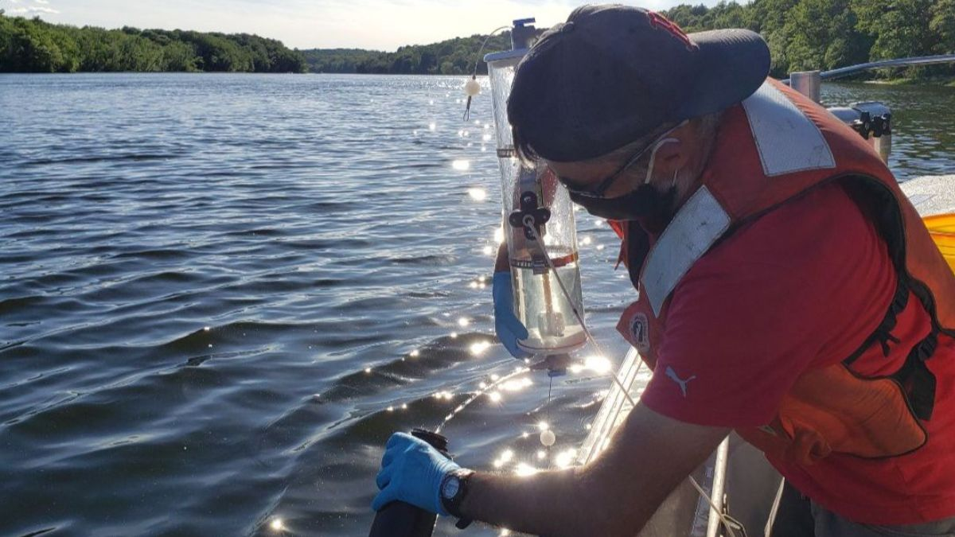
Increasing the quantity, quality, and accessibility of NGO water quality data through exchange network tools
Jill Carr
Coastal Data Scientist
jillian.carr@umb.edu
E2i National Meeting
September 17, 2024

Slide 2
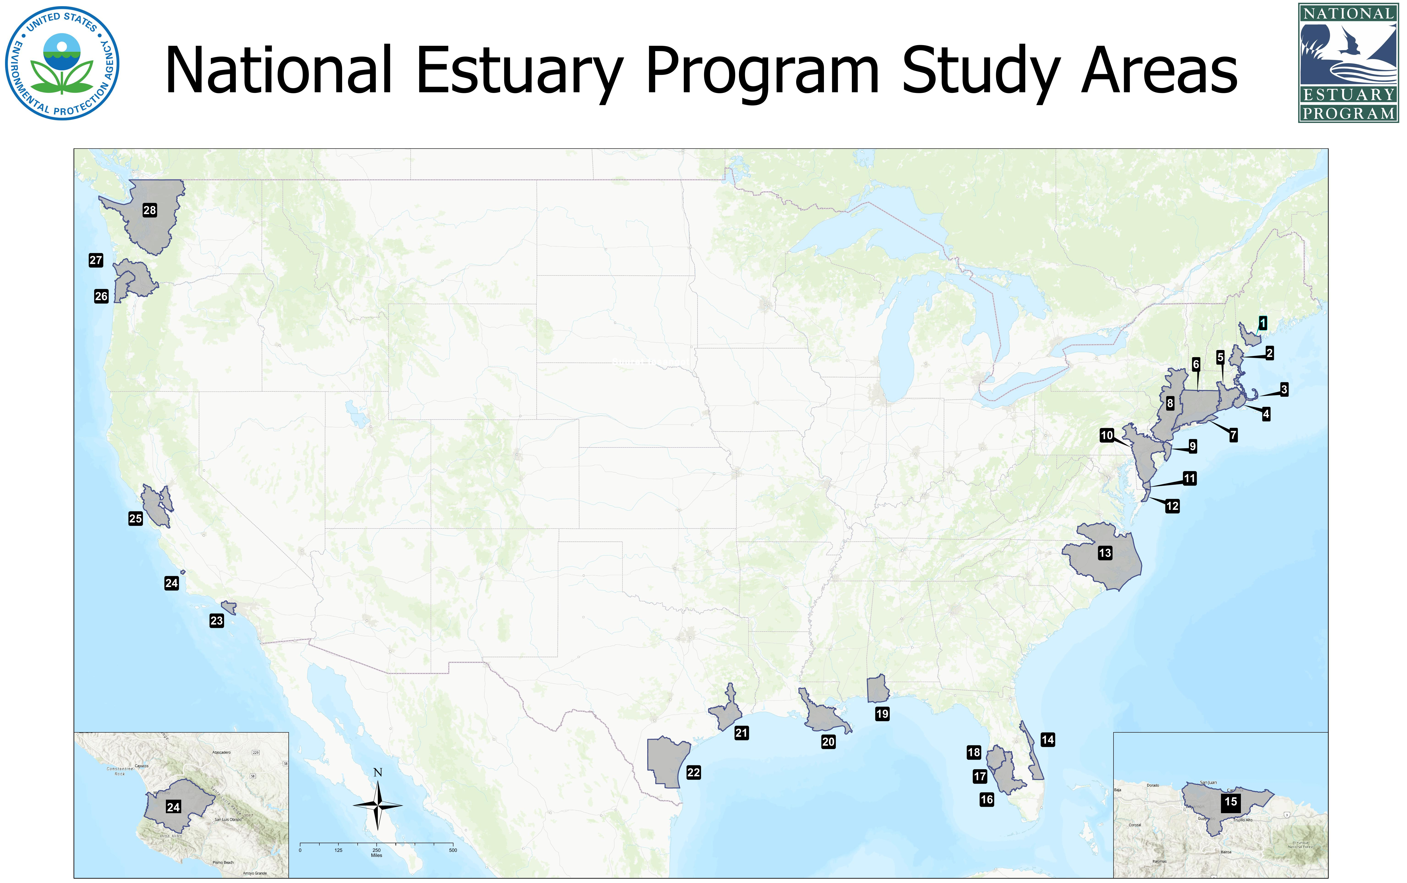
National Estuary Program Study Areas
MassBays Mission
To empower 50 coastal communities to protect, restore, and enhance their coastal habitats. To fulfill this mission, MassBays engages local, state, and federal entities to advance the use of scientific information and provide technical support for decision making

Slide 3
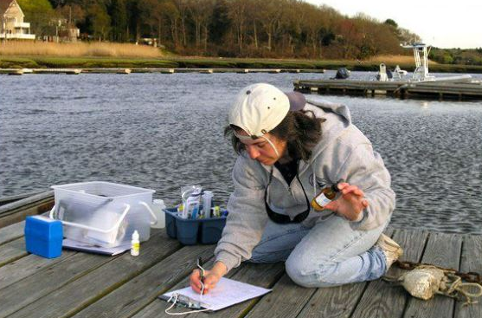
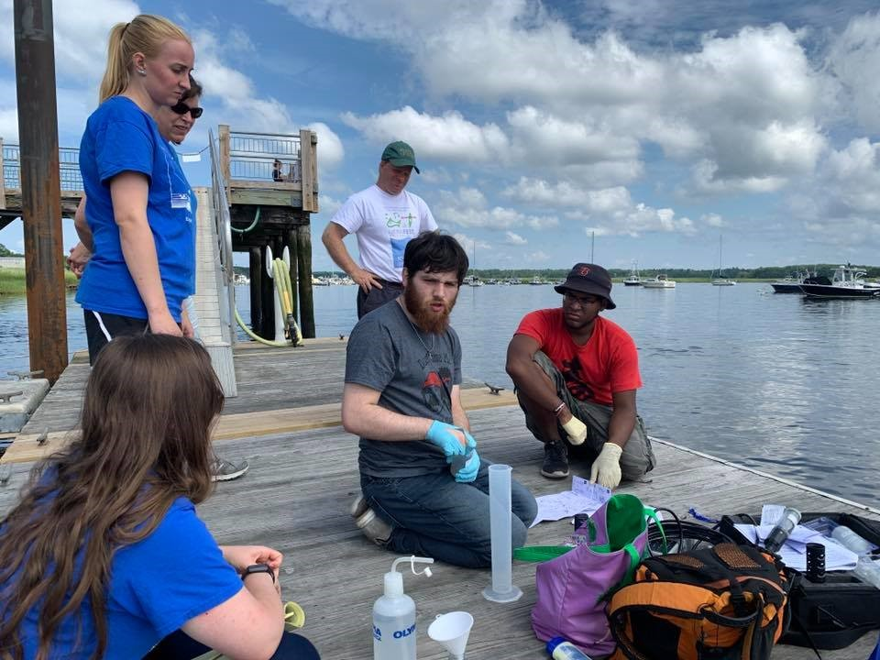
Community-based WQ monitoring in Massachusetts

Slide 4
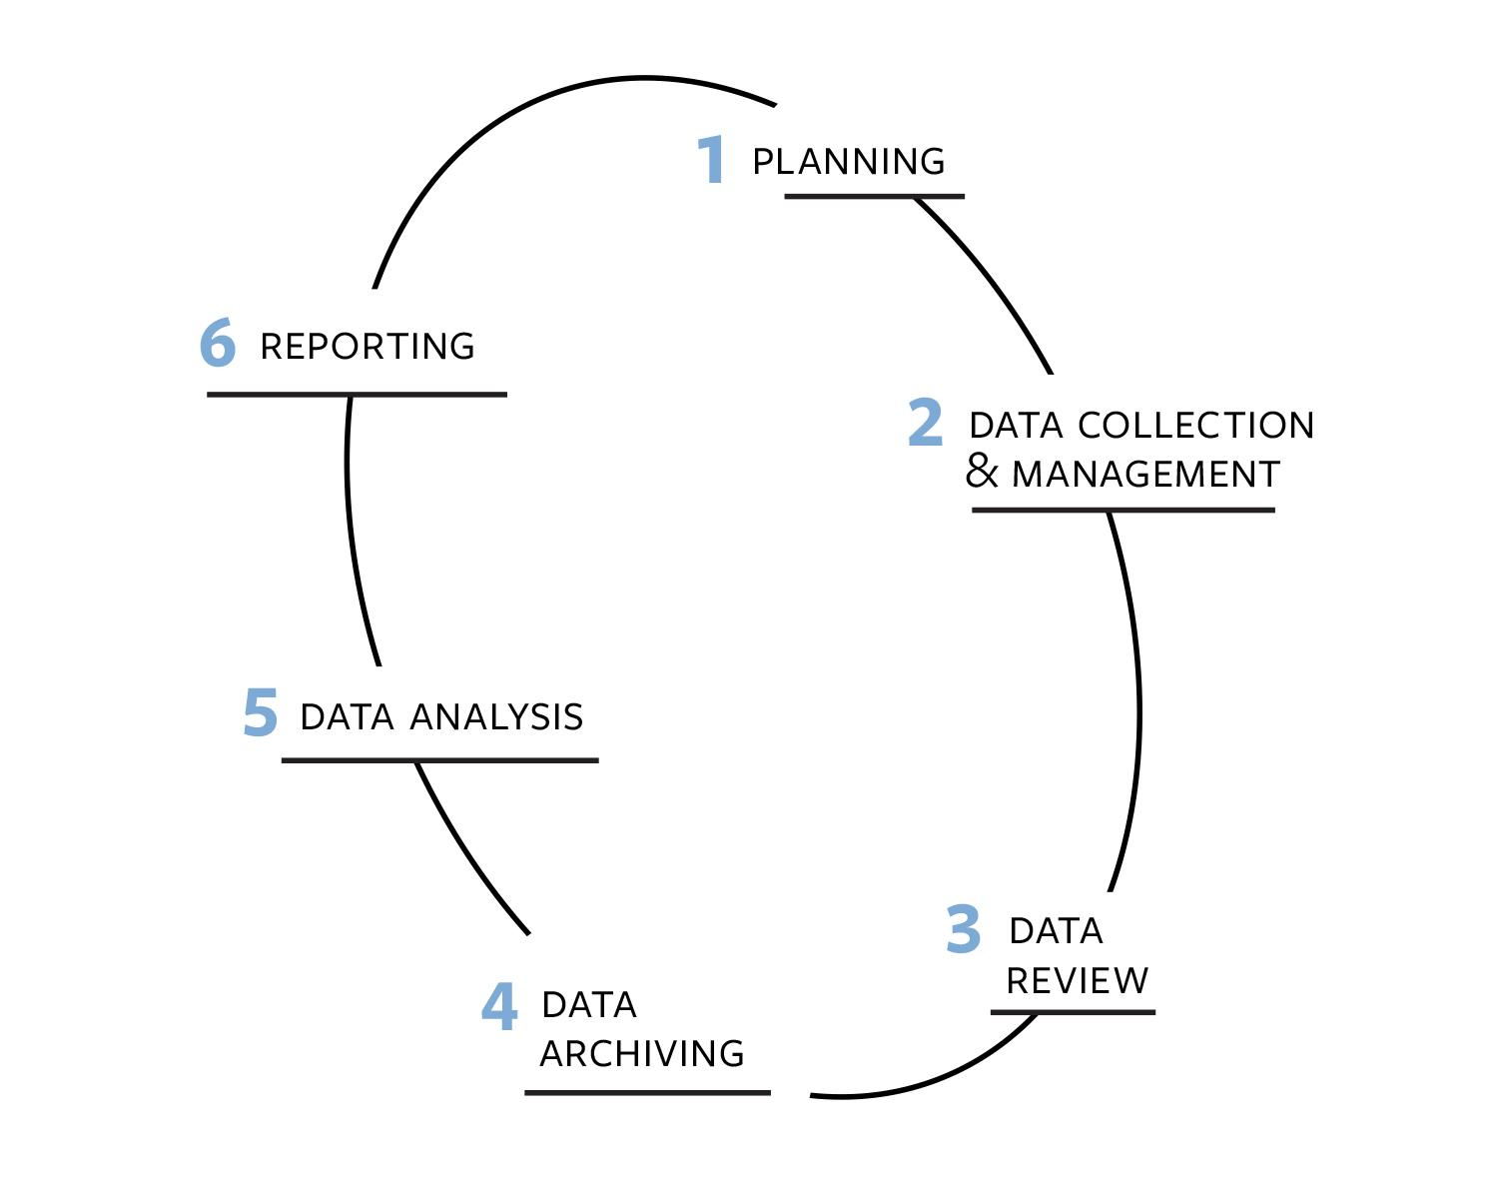
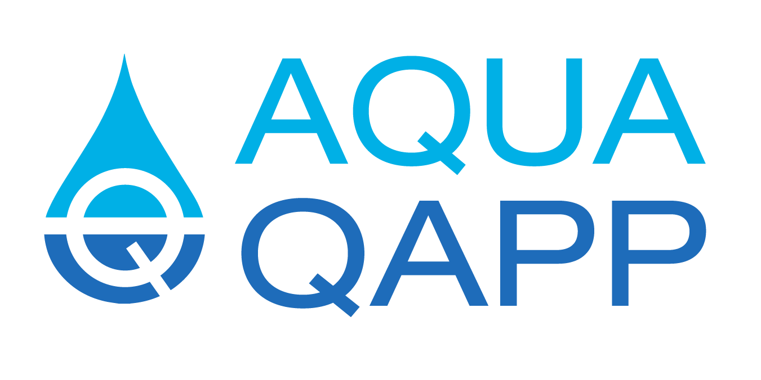
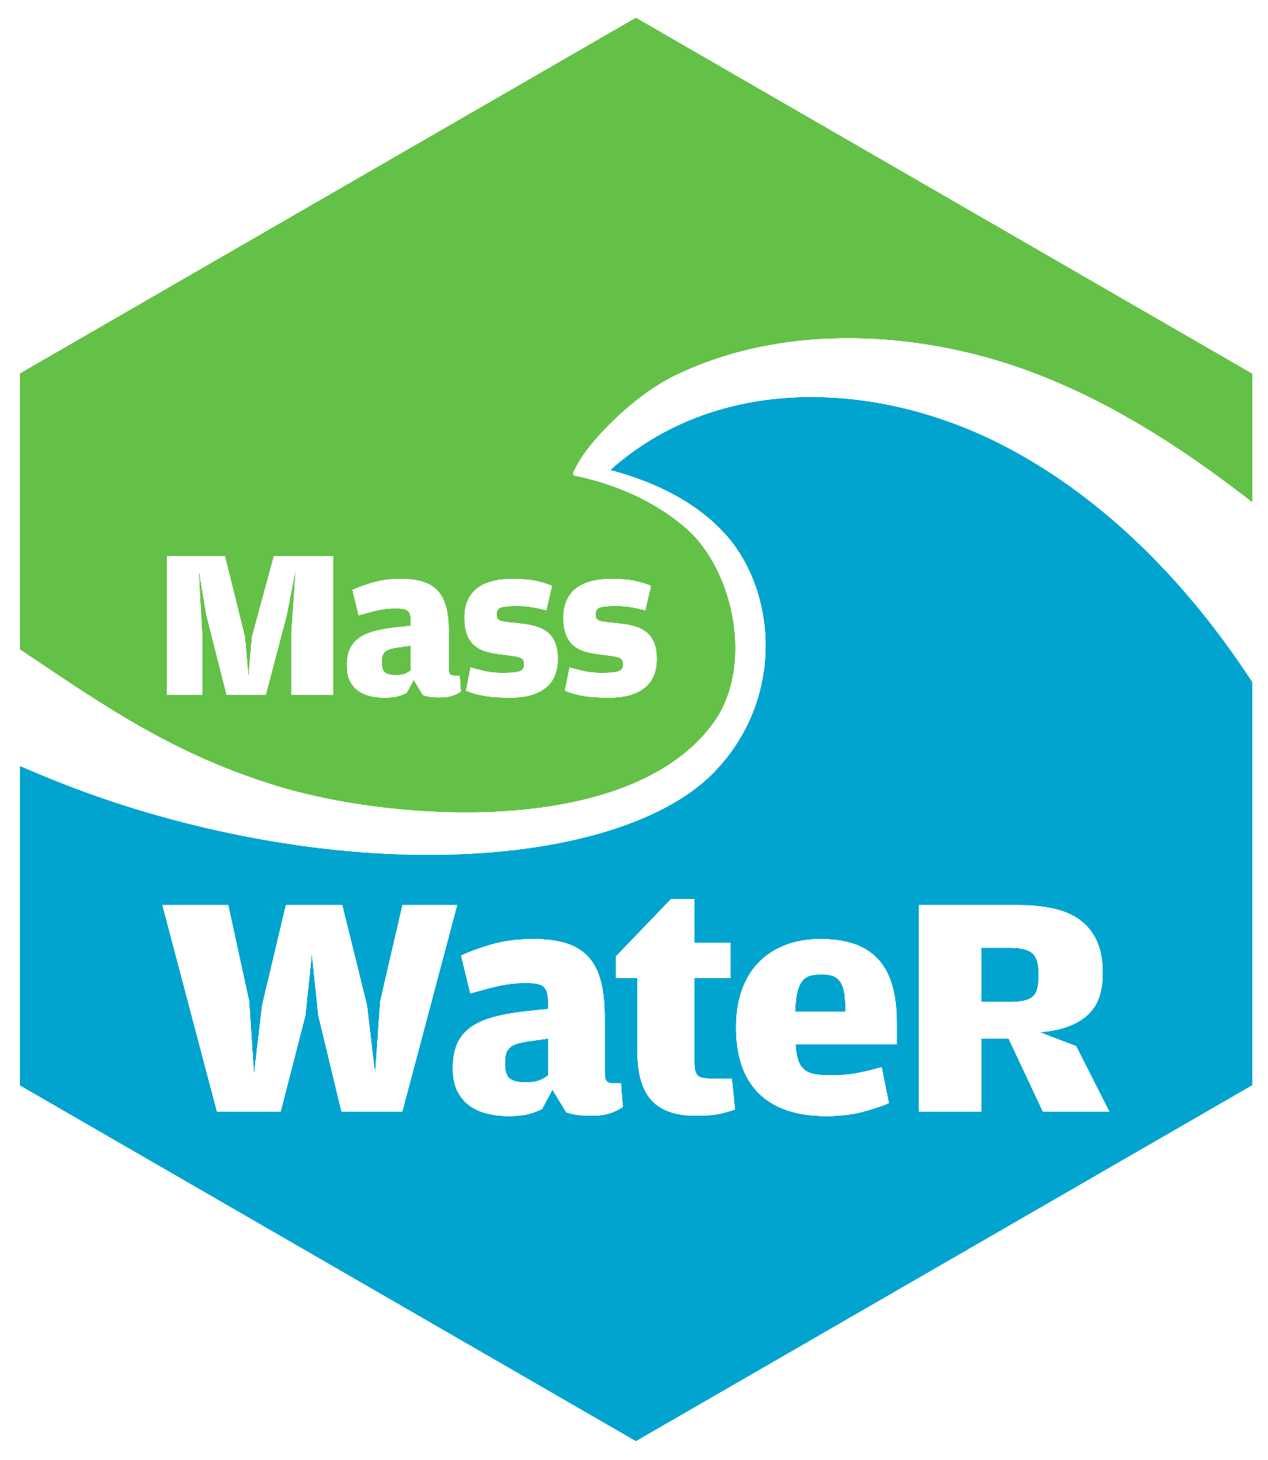
Data Life Cycle
www.aquaqapp.com
www.MassBaysEcoHealth.org
Maps, plots and other data visualizations
QA/QC
Assessments
WQX formatting
Ongoing tech support
These tools were produced with funding from U.S. EPA, Grants No. OS-83941701, OS-84029801-0, and CE-00A00865, with matching funds from MA Department of Environmental Protection.
Notes:
Both tools funded by EPA Exchange Network Grants.

Slide 5
Overview

Slide 6
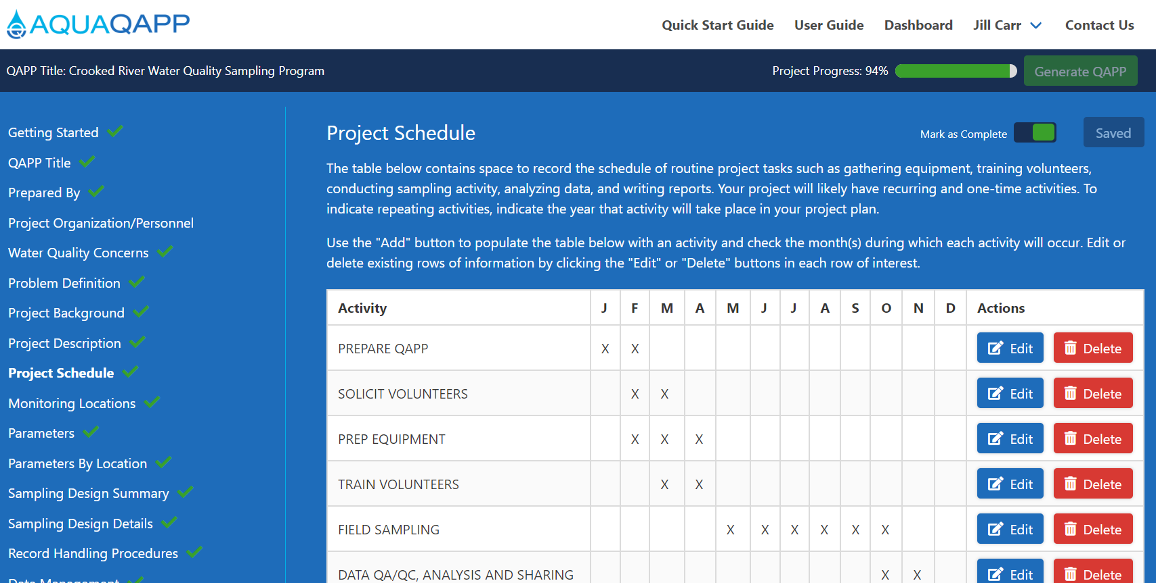
For freshwater & marine water quality and benthic sampling programs
Web-based wizard, guides users through forms
Generates a Word document QAPP considered pre-approved
Developed in collaboration with MA DEP and EPA
Notes:
And acceptable to EPA
~ 30 different data sheet templates

Slide 7
DEMO
Notes:
And acceptable to EPA
~ 30 different data sheet templates

Slide 8
FAQs:
Can AquaQAPP be used in other states?
Yes! But your QAPP may need to be adjusted to meet local requirements.
Can it be modified to meet my state’s needs?
Yes! The code is open source on GitHub.
Is there a long-term support plan?
Yes! Tech support and training is part of my role. Now pursuing upgrades to meet new EPA QAPP Standard.
Notes:
Nothing really specific to MA, except for that MassDEP was part of the development process and helped define acceptable analytical methods, data quality criteria, etc. These specifications are likely adequate across state lines, but we can not guarantee that, and other state QAPP reviewers have not agreed to the “pre-approved” nature of an AquaQAPP QAPP.

Slide 9
Overview

Slide 10
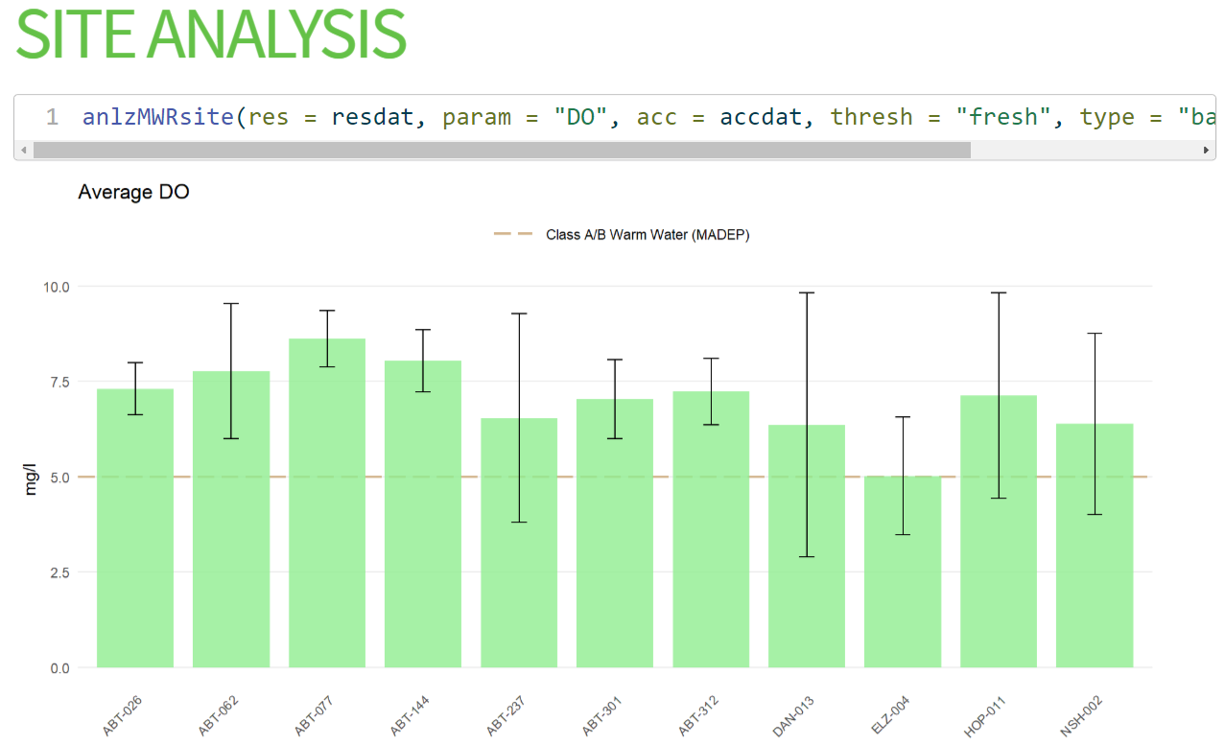
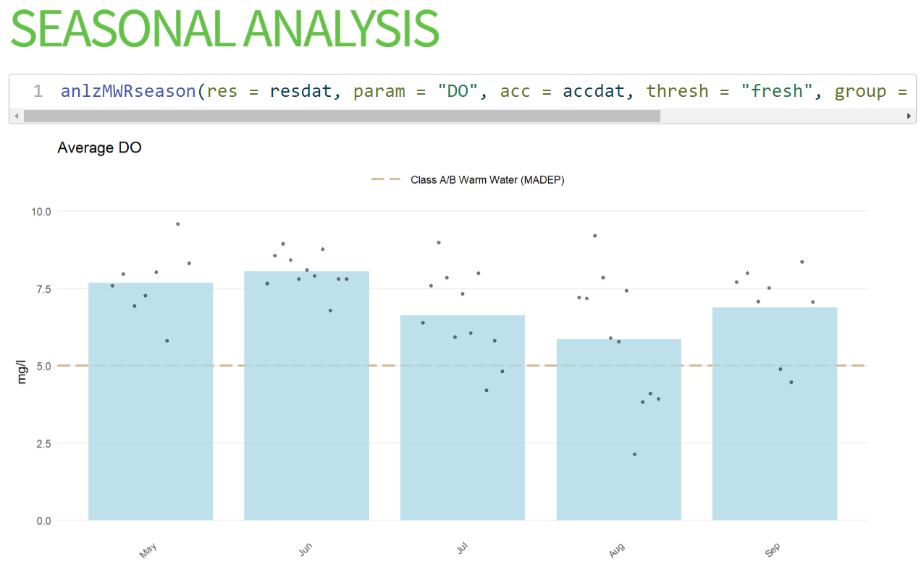
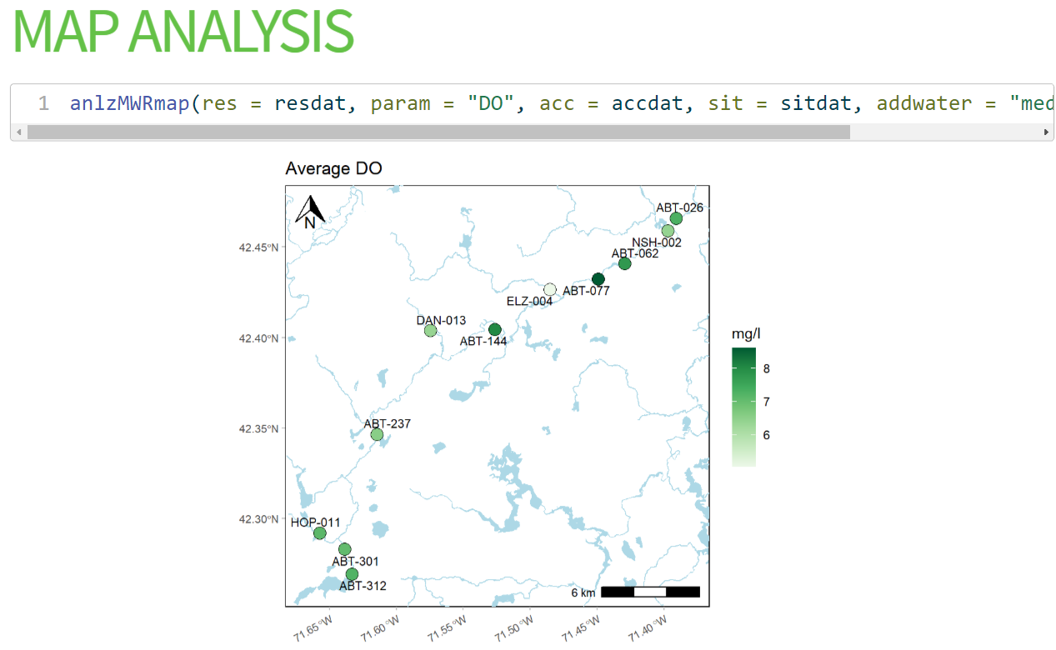
R-based package for discrete surface water quality monitoring data
Provides a streamlined and repeatable means of:
Screening data for QC,
Preparing QC summary report,
Creating graphics for analysis, and
Formatting data for upload to WQX
No R experience necessary
Add’l resources: Detailed website/user guide, recorded trainings,
Community of Practice forum

Slide 11
Meta Data
Site Meta
DQO Accuracy Meta
DQO Frequency and Completeness
WQX Meta

Slide 12
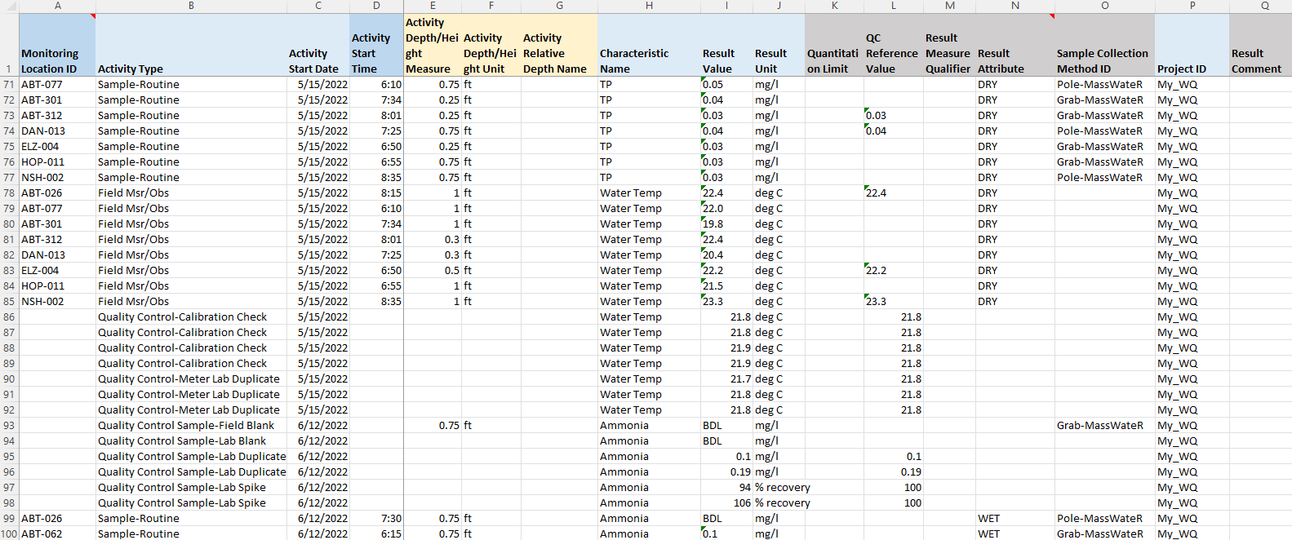
Results

Slide 13
DEMO

Slide 14
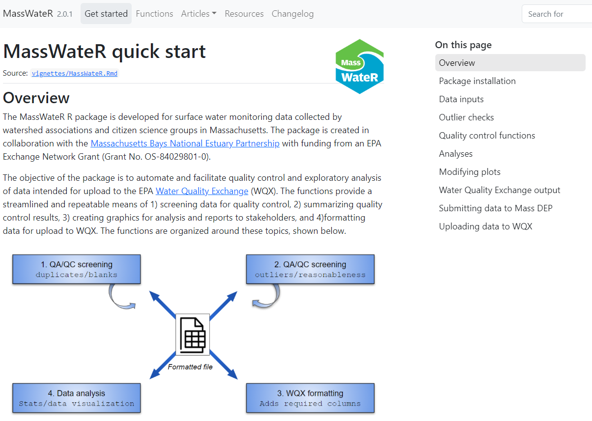
Website / User Guide
https://massbays-tech.github.io/MassWateR/

Slide 15
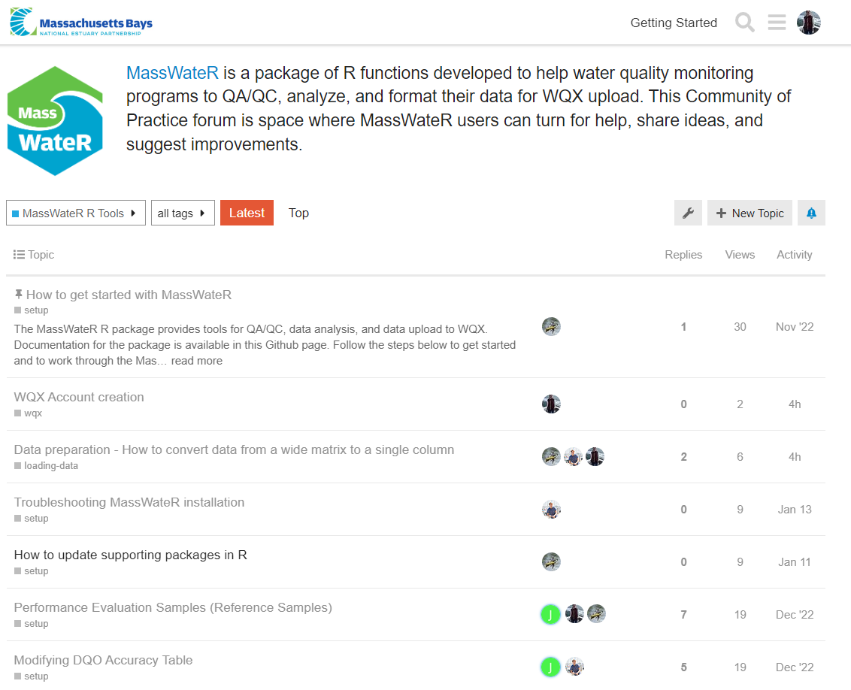
Community of
Practice (CoP)
https://massbays.discourse.group/c/masswater-r-tools/

Slide 16
Can MassWateR be used in other states? Yes!
Developed with significant input from Massachusetts watershed organizations
QC report designed to meet MassDEP’s needs, some graphics display DEP thresholds
Should get feedback from your state’s tool users AND data end users
Want to make changes?
Code re-write (open source)
Pursuing EN’24 funding that will also expand use across U.S. Northeast
Open to improvement suggestions via our CoP forum
Notes:
Nothing really specific to MA, except for that MassDEP was part of the development process and helped define acceptable analytical methods, data quality criteria, etc. These specifications are likely adequate across state lines, but we can not guarantee that, and other state QAPP reviewers have not agreed to the “pre-approved” nature of an AquaQAPP QAPP.

Slide 17
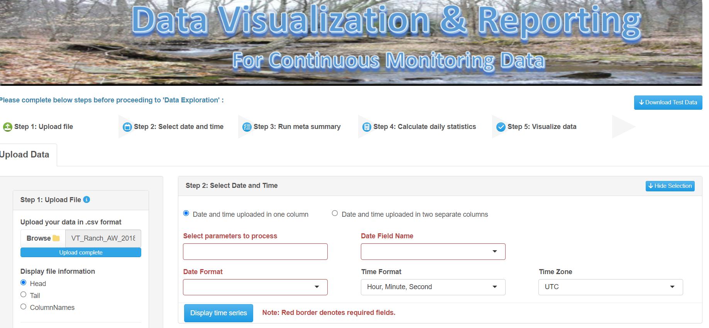
Increasing reach & accessibility
Applied for EPA Exchange Network Grant (2024)
Partnering with 4 NEPs across New England to:
Create R Shiny app for MassWateR
New functions for non-MA states
Adapt R Shiny app for continuous data
Improve outputs
Trainings & tech support
Notes:
Nothing really specific to MA, except for that MassDEP was part of the development process and helped define acceptable analytical methods, data quality criteria, etc. These specifications are likely adequate across state lines, but we can not guarantee that, and other state QAPP reviewers have not agreed to the “pre-approved” nature of an AquaQAPP QAPP.

Slide 18
AquaQAPP website:
www.AquaQAPP.com
MassWateR GitHub website (user guide)
https://massbays-tech.github.io/MassWateR/articles/MassWateR.html
Community of Practice (help forum)
https://massbays.discourse.group/
Contact:
Jillian.Carr@umb.edu
Questions

Slide 19
Acknowledgements
AquaQAPP, Ecohealth Tracking Tool, and MassWateR were produced with funding from U.S. EPA, Grants No. OS-83941701, OS-84029801-0, and CE-00A00865, with matching funds from MA Department of Environmental Protection.
AquaQAPP was developed with the assistance of Eastern Research Group
Ecohealth Tracking Tool was developed with the assistance of Comprehensive Environmental, Inc.
MassWateR was developed with the assistance of Ben Wetherill (ACASAK Aquatic Monitoring Technologies) and Marcus Beck (EnviroDev LLC)

Slide 20
Extra slides in the event demo does not work

Slide 21
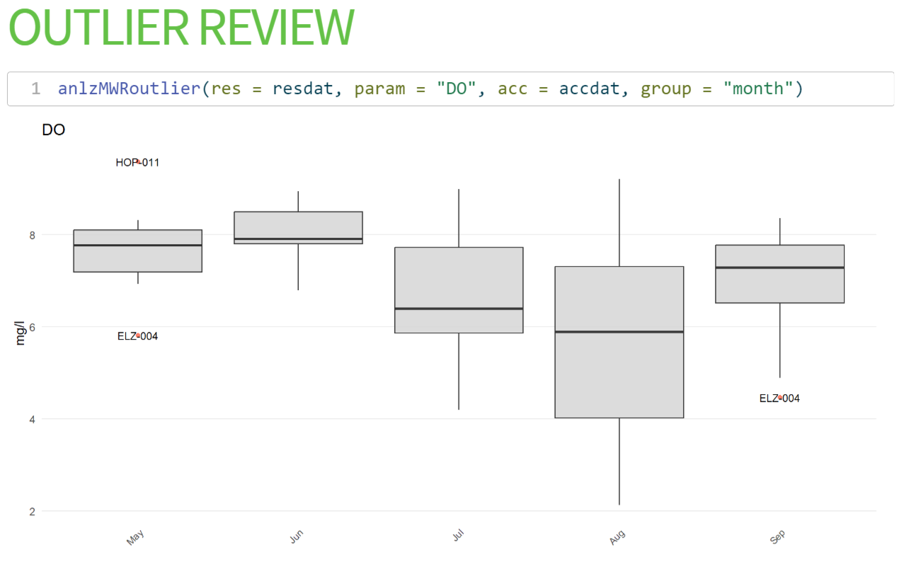
Notes:
Box & whisker plot; Can group by month (in example), week of the year, or by site, and can further constrain the data by a date range

Slide 22
Notes:
Can group by month (in example), week of the year, or by site, and can further constrain the data by a date range

Slide 23
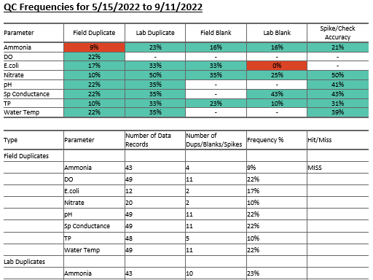
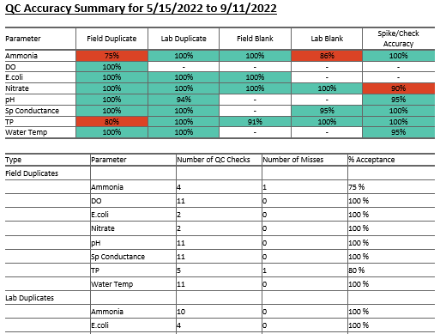
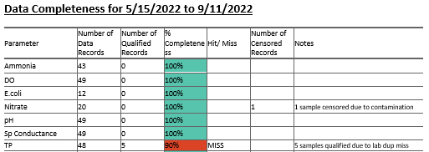
QC Report

Slide 24
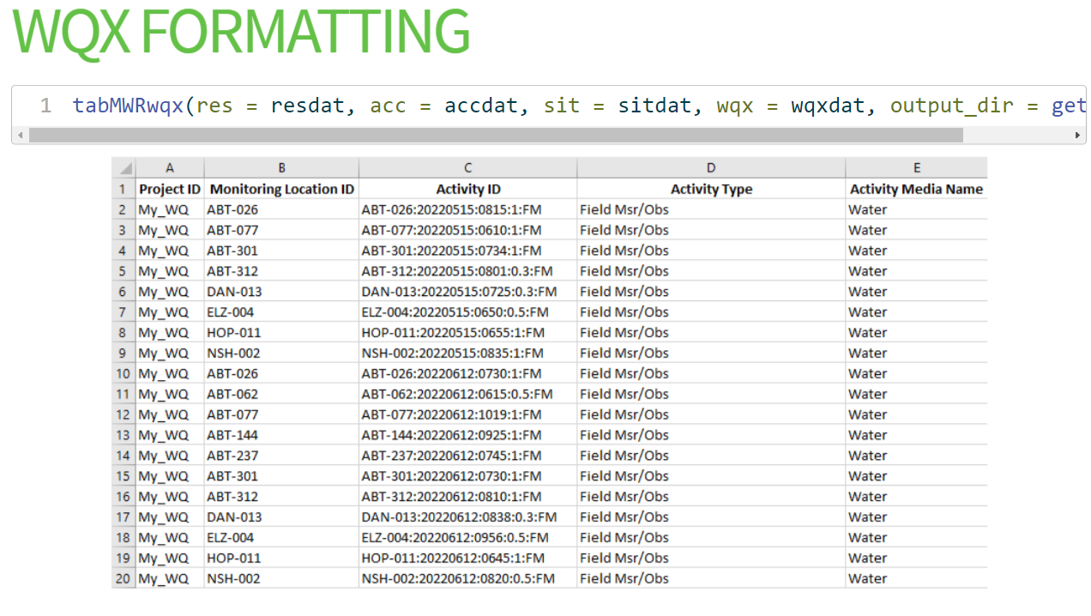
View Output

Slide 25
Notes:
Barplot with jitter points

Slide 26
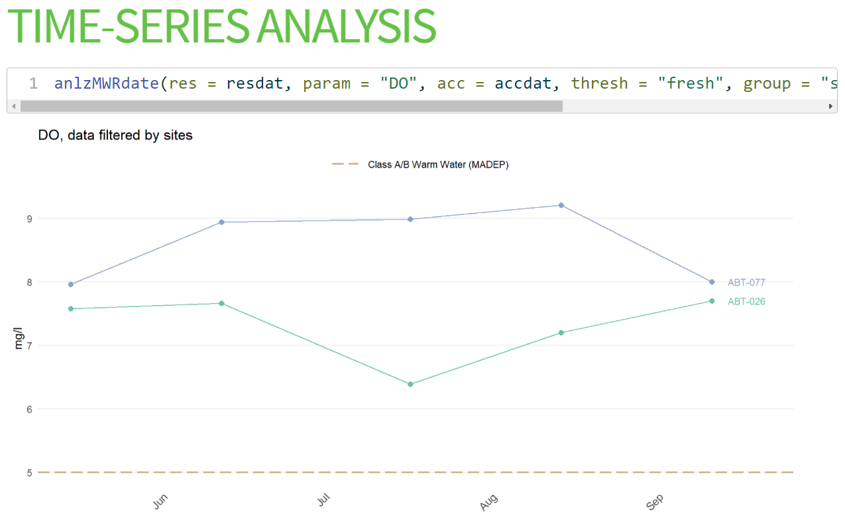
Notes:
time series plot by site, filtered to only look at 2 sites. Threshold added, can also add symbology legend.

Slide 27
Notes:
Analysis by site with Confidence intervals added

Slide 29
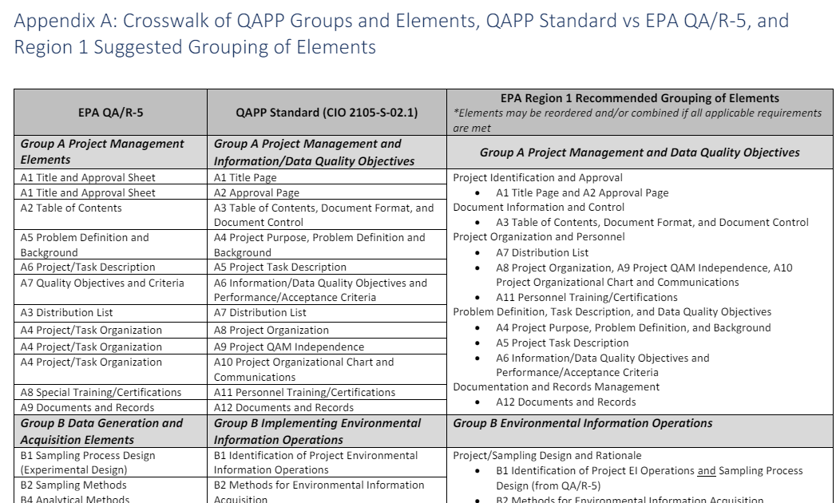
Staying in compliance
Applied for DEP 319 grant (May 2024)
Originally based on 2001 EPA QAPP Standard
New EPA Standard released July 2023
Long wish list of improvements
Open to additional feedback!
Notes:
Nothing really specific to MA, except for that MassDEP was part of the development process and helped define acceptable analytical methods, data quality criteria, etc. These specifications are likely adequate across state lines, but we can not guarantee that, and other state QAPP reviewers have not agreed to the “pre-approved” nature of an AquaQAPP QAPP.

