Slide 1
Water Data Modernization
How we leverage APIs to support data up/down in the Water Quality eXchange and the Water Quality Portal
Any opinions expressed in this presentation are my own and do not represent official positions of EPA. Any product mentions do not constitute an endorsement.

Slide 2
Integrated Water Data Systems Supporting the Clean Water Act
(List Decisions)
ATTAINS
Data Standards and Interoperability
Water Quality Data
Standardized Hydrography
Designated Uses
Assessment Decisions
Public Information
Support to numerous other Water Programs
User Support – Lowering the barrier to entry
Water Data Integration Branch
(Analyze)
TADA
(Integrate)
HMW
WQX / WQP
(Monitor)
Others
NHDPlus
(Identify)
Who We Are: Staff of 9, mix of scientists and IT specialists

Slide 3
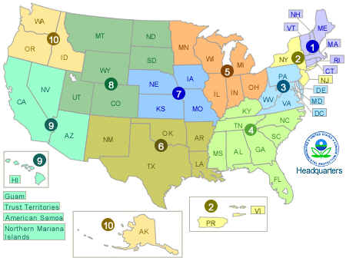
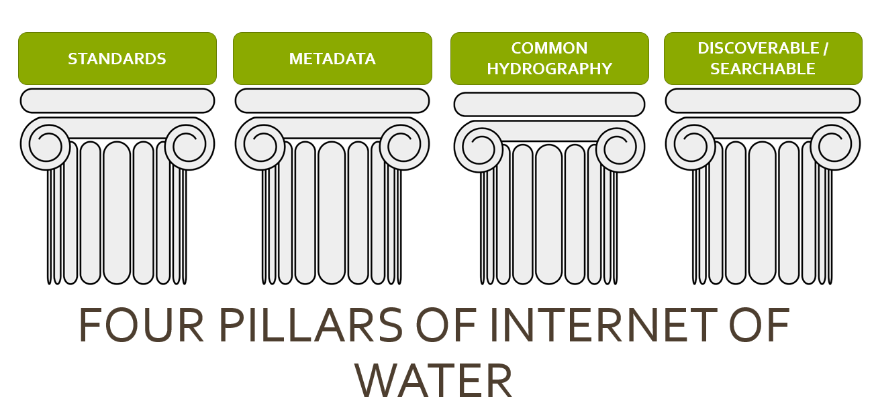
The Water Data Framework
Findable Accessible Interoperable Reusable
The CWA is implemented by the States, Tribes, and Territories. Data produced by these programs are unique. National roll-up of the data benefits from these principles.

Slide 4
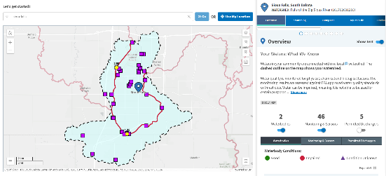
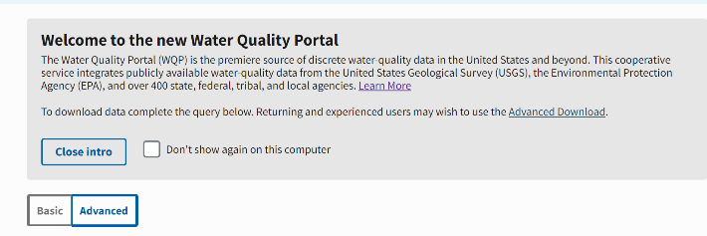
Connected Water Quality Data Systems
How’s My Waterway?
Data Viewer
Data Portal
Water Quality Portal
Data Standard
Water Quality eXchange
Notes:
At EPA, and nationally here in the US. The standard for describing and sharing water data from surface waters is the Water Quality Exchange or WQX. WQX forms a foundation for connected and integrated public water data. WQX does not serve data publicly. In our systems, data shared through WQX are warehoused and served in the Water Quality Portal. In addition to serving users with downloadable datasets, the WQP also supplies data as web services which allow other web-based applications like How’s My Waterway to query, retrieve, and display data through the web. In our connected systems, WQX provides the Standard, WQP serves as the data warehouse, and How’s My Waterway presents that data as publicly accessible information. In the examples we look at today, all integrate with these systems at some point.

Slide 5
What Is WQX today?
WQX is a ‘standardized’ approach for sharing water quality monitoring data of various types
WQX defines a common data model for documenting water quality data (sample data)
WQXWeb is an application to help prepare datasets, designed to be flexible, approachable
The structure and technology of partner data systems don’t matter, so long as they can map data to WQX standards
Many ways to prepare and submit data to WQX: templates, custom imports, or automated exchanges (EN/API)

Slide 6
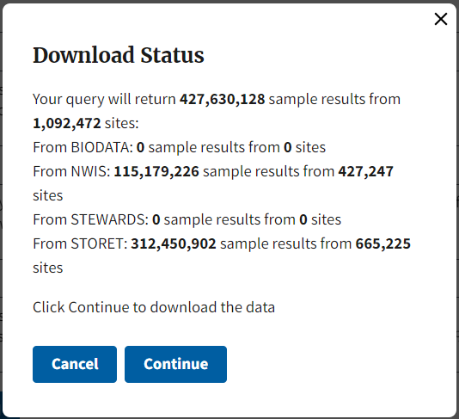
Who is using WQX?
1,589 WQX/USGS ‘Organizations’ with data
Federal and State Agencies and Programs
Tribes, Pueblos, First Nations
Local Government
Research/Academia
Private Industry
Non-Governmental Organizations
Volunteer Monitoring

Slide 7
WQX Submission Options
For Database Admins to self-publish a WQX XML file via a node/client
Manually reformat a dataset to the WQX standard using Excel templates
eXchange Network
WQXWeb Templates
WQXWeb API
WQXWebCustom Import
For Developers/ Advanced Users to build modern client-side solutions
Create a custom import for your data in WQXWeb to read your on-going datasets

Slide 8
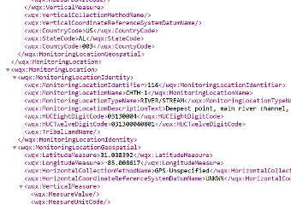
Ways to share your data to WQX
WQXWeb
T
Little help please
Tools to help you map, reformat, and document your dataset
A WQX formatted XML file
+
→
Raw Dataset or WQX Template
Import
Configuration
WQX-XML
WQX
2x/week
WQP
API
Central Data Exchange
I got this
Only registered users
Data must pass validation:
Complete
Unique
Adheres to allowable values
USGS

Slide 9
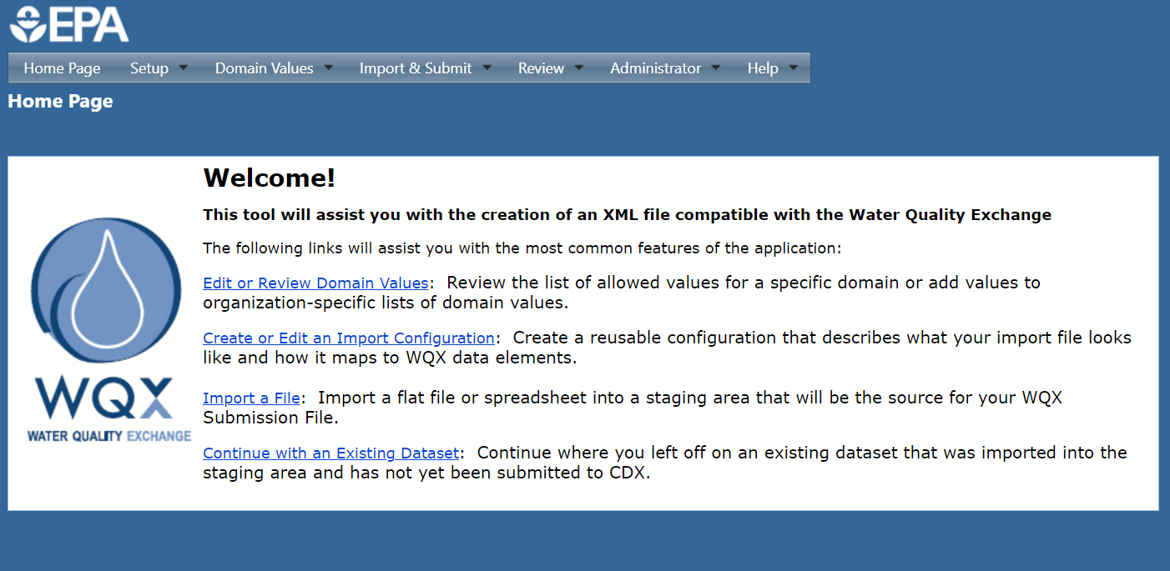
What is WQXWeb?
WQXWeb is the web application that allows users to import, manipulate, validate, and upload their datasets to WQX.

Slide 10
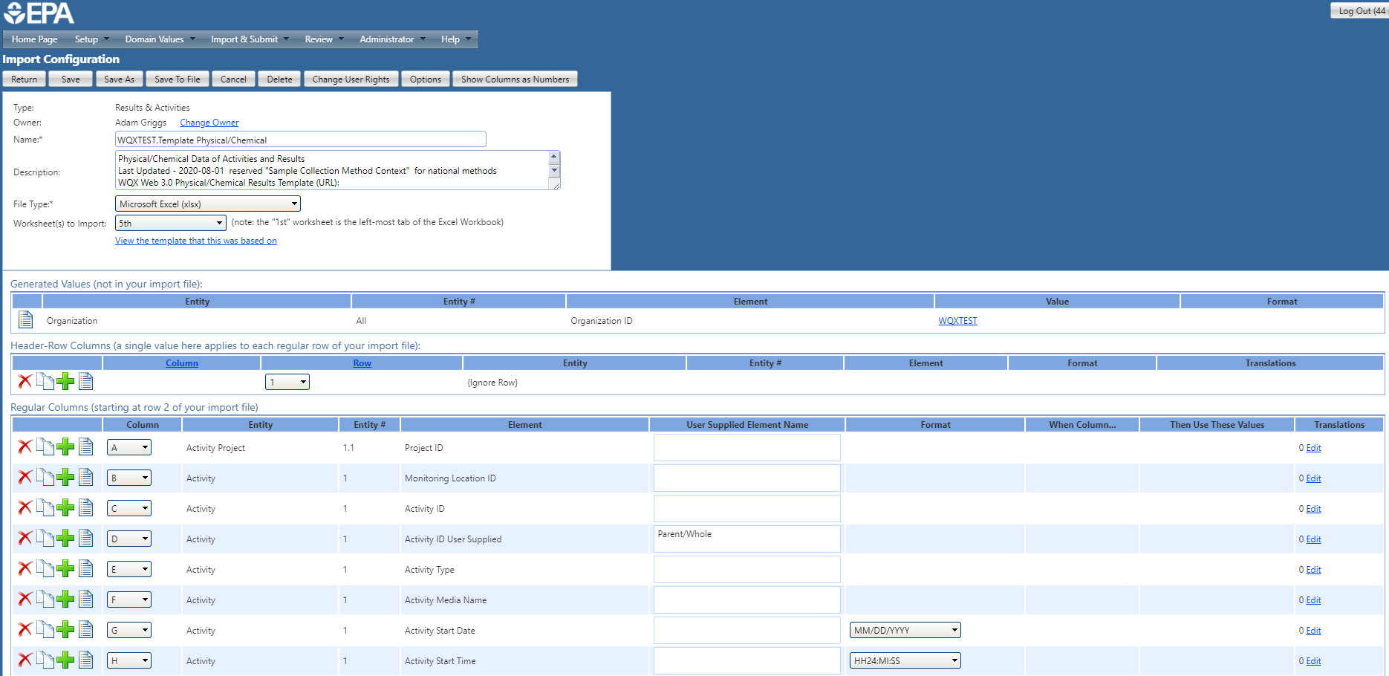
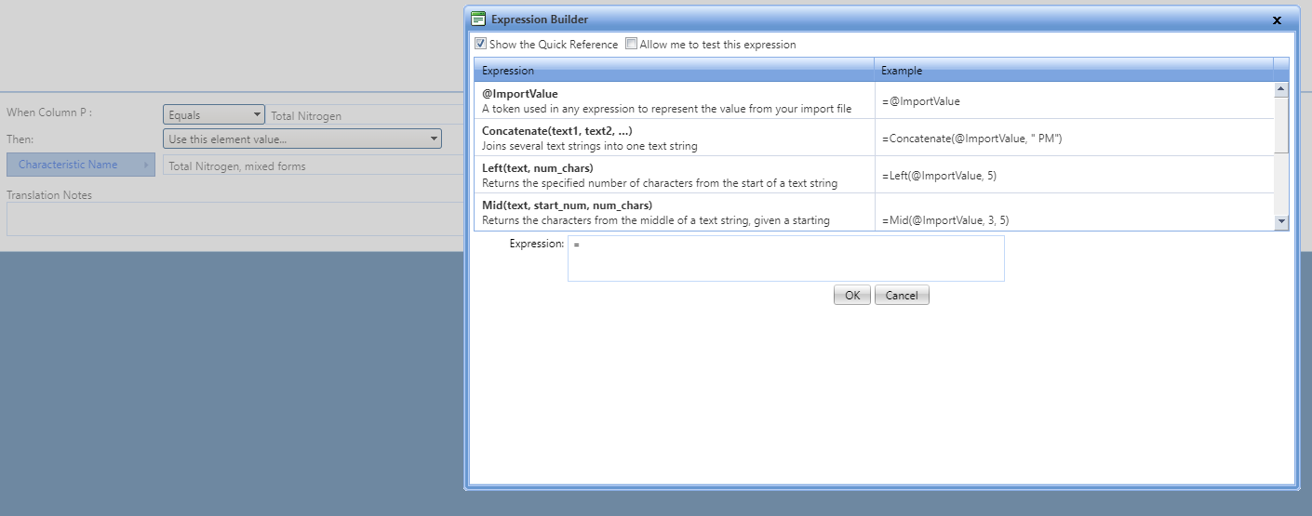
Custom Import Configurations
ID your dataset and file type
Add in any universal metadata (Org ID, Media, etc.)
Map the columns of your dataset to WQX Elements
Apply a variety of When/Then statements to translate your data to WQX format
1.
2.
3.
4.

Slide 11
What is a REST Style API?
REST = Representational State Transfer
API = Application Programming Interface
Uses HTTP requests to access and use data
Allows one application to call another and share or receive certain information.
Commands and parameters are packaged into a URL that act as a set of instructions for the application to perform.
Ex: https://www.waterqualitydata.us/data/Result/search?statecode=US%3A51&characteristicName=Nitrate&startDateLo=01-01-2015&mimeType=csv&zip=yes&dataProfile=narrowResult

Slide 12
WQXWeb API
The WQXWeb API allows for the primary functions of WQXWeb to be enabled through HTTPS requests.
EPA WQXWeb API page: https://www.epa.gov/waterdata/wqx-web-application-programming-interface
Documentation:
https://www.epa.gov/sites/default/files/2018-09/documents/wqx_web_application_programming_interface_api.pdf
https://cdx.epa.gov/WQXWeb/StaticPages/WebServicesGuide.htm
Language: The API may be used with any language capable of issuing HTTPS requests with an HMAC-SHA256 encryption algorithm (Java, PHP, Perl, Python, C, etc.

Slide 13
WQXWeb API – Primary functions
Upload a file and optional attachment.
Request that WQX Web start importing the uploaded file. There are up to five for overriding generated element/value parameter combinations. These parameters can be used to alter any existing generated elements in the import configuration.
Get the status for that dataset, periodically, to confirm whether it imported without any errors
If the final status is "Imported", then ask WQX Web to submit that dataset to CDX. During that process, the data from your flat file or spreadsheet will be converted to XML (via an import configuration that you previously created) and submitted to CDX. Alternatively, you can request that WQX Web automatically export and submit your dataset to CDX upon completion of the import. It's important to understand that data is not final/permanent until it has been submitted to CDX and has received a final status of "Completed at CDX"
If a dataset receives a status of Failed, you can get a list of documents relating to the dataset, and download the "Import Log.xlsx" or "ProcessingReport.zip" (among other files) to review the issues with your import file or the submission to CDX.

Slide 14
WQXWeb API – Benefits to use
Develop an in-house DM system that integrates with WQXWeb to facilitate client-side data submissions
Enables developers of Enterprise DM systems to build modernized data delivery applications
Allows for automated, iterative uploads
Currently submitting via the API: South Carolina (DHEC), CN DEEP, Big Valley Band of Pomo Indians of the Big Valley Rancheria, Washington Dept. of Ecology, others.

Slide 15
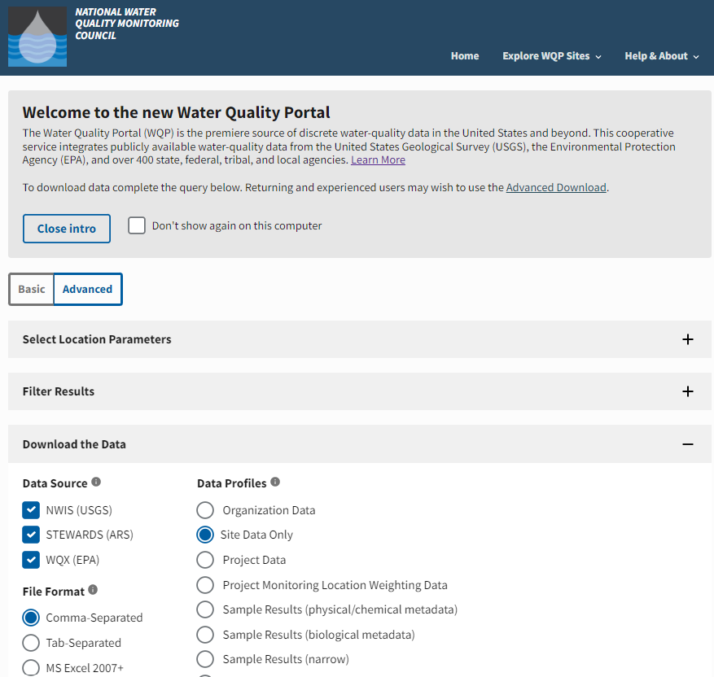
Water Quality Portal
Operated under An Interagency Cooperative agreement (USGS & EPA)
Serves data from USGS, EPA, USDA, NPS in a standard WQX format
# WQP: Data from >1,500 organizations
# WQP: >430m records from >1.5m sites
Serves data of All Water Types
Includes a Graphical User Interface (GUI) & Web Services
One of Our Integrated Systems (IOW HUB)
DATA ServiceS can directly power analytics like those in HMW
Growing Number of internal/external Tools built on top of this Primary data source

Slide 16
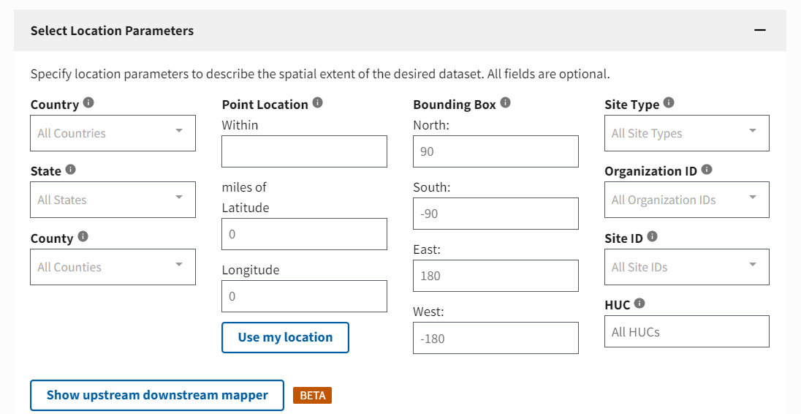
Building Your Query - Locations

Slide 17
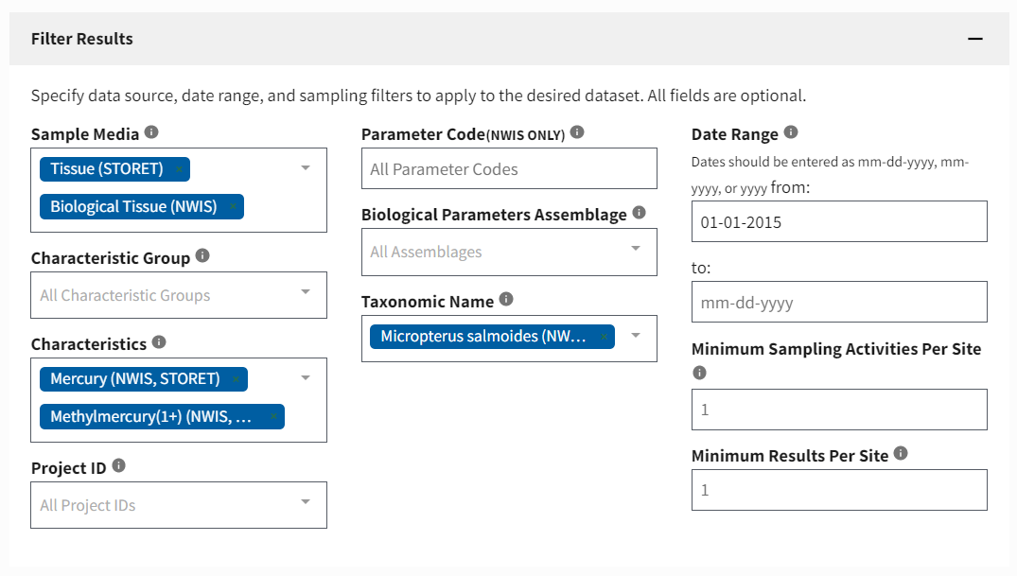
Filtering Your Results
*optional
Water, sediment, tissue, etc.
Assemblages: Fish/Nekton, Macrinvertebrates
Chemicals, physical measures, obs., etc.
Example of a query to retrieve fish contaminant data (Mercury in largemouth bass)
Latin names

Slide 18
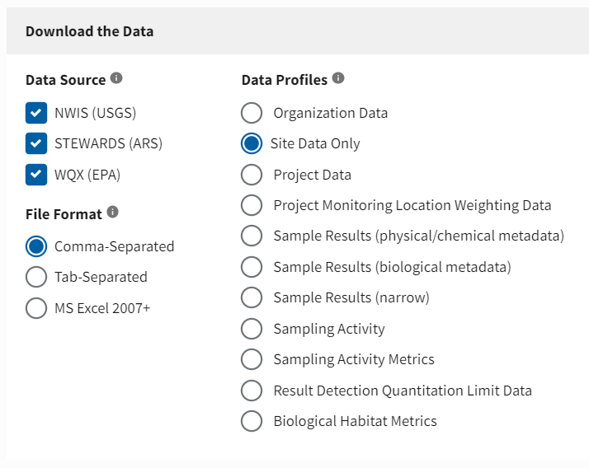
Download your Data
WQX/WQP support a LOT of metadata.
Results measures and result-level metadata
Choose your download format

Slide 19
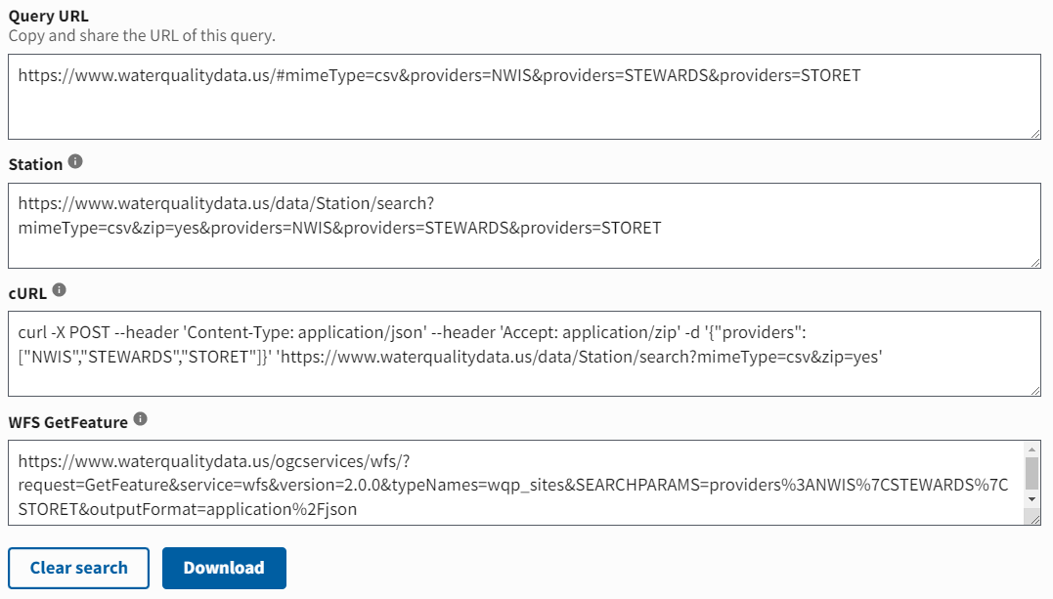
WQP Web Services
https://www.waterqualitydata.us/data/...
Routine Data Services:
Organization
Projects
Locations
Results
Code Service:
Domain values
Search terms
Summary Service:
PeriodofRecord
SummLocation
File Types:
csv, geojson, excel

Slide 20
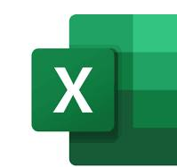
Using Data from WQP Web Services
Web services provide URLs that can include the instructions from your query and retrieve the requested data automatically
Save the URL to your Query
URL of your data download
Use this web service URL in data applications

Slide 21
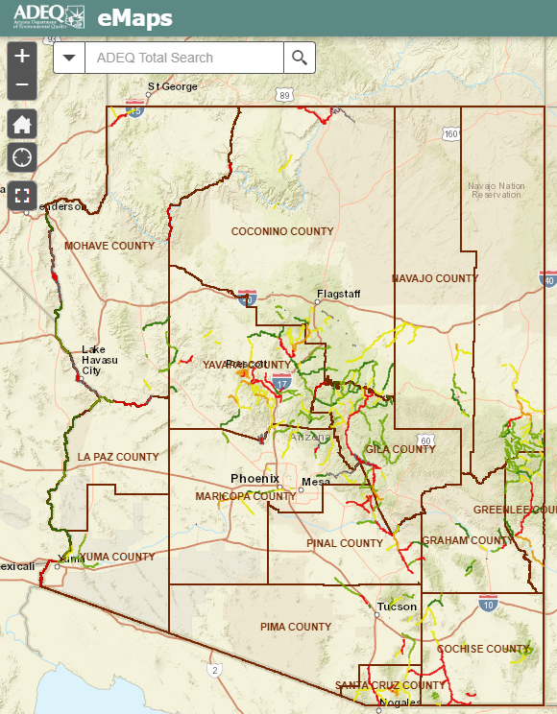
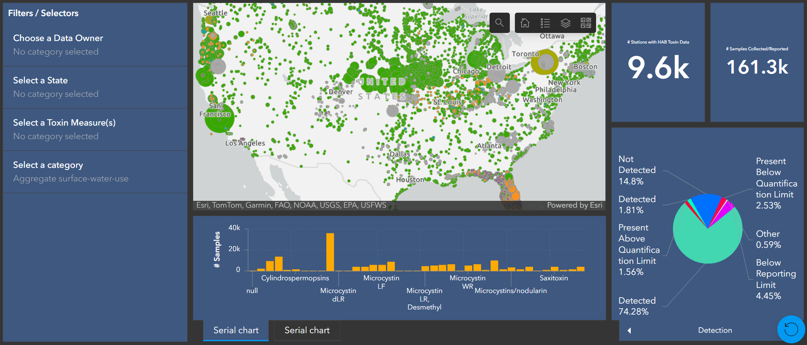
Examples Using the Outbound Services

Slide 22
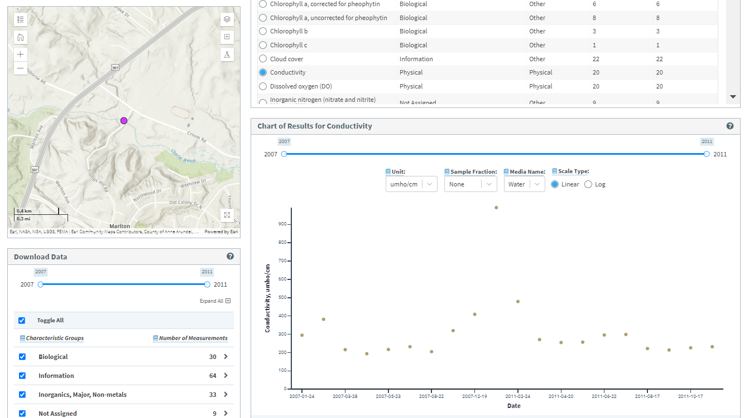
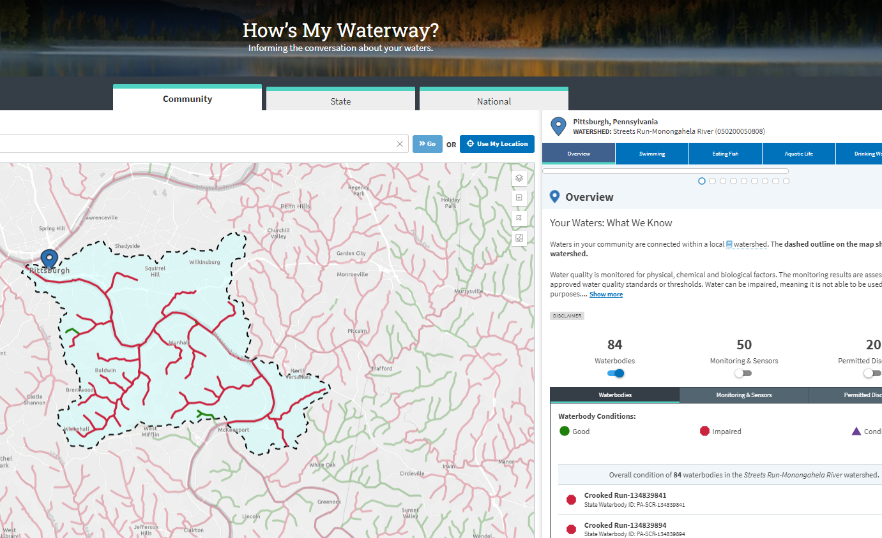
How’s My Waterway
Serving Public Information
Powered by open data and web services
Accesses, interprets, and displays data from over a dozen sources
Including ATTAINS, and the WQP among many others
Notes:
Electronic data are more valuable than data in file cabinets
The more data are re-used, the more valuable they become
Collect once – use multiple times
Shared data are of even higher value
Provide for better planning decisions
Incentivize collaborative efforts
Make the most use of the data collection resources being invested

Slide 23
Questions?
griggs.adam@epa.gov
wqx@epa.gov

