Slide 1
AQDx: A Common Data Format for Air Quality Instruments
Erik Joplin, Ashley Collier-Oxandale, Leah Gibson, Jason Schroder, & Michael Ogletree
Environmental Information & Innovation
September 2024

Slide 2
Outline
Why Standards are Important
AQDx design and purpose
AQDx data format specifics
Pilot Program progress

Slide 3
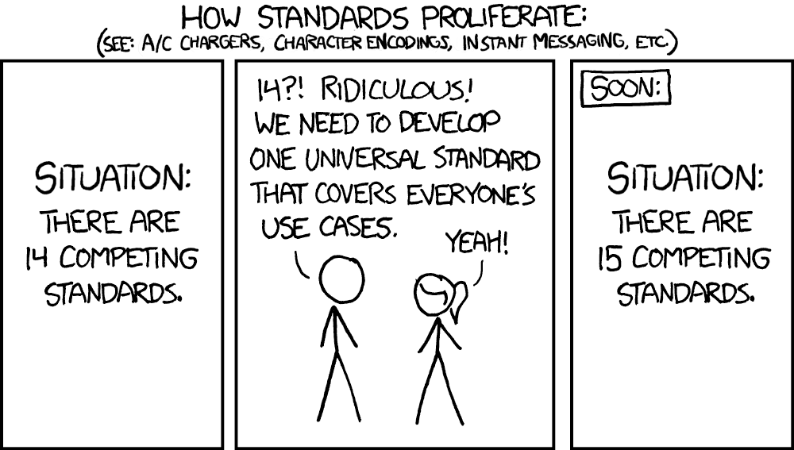
AQDx desired outcomes: A Motivating Example
Expectation Reality!
When a strong community of stakeholders adopts a well architected standard, the result is an efficient and robust ecosystem

Slide 4
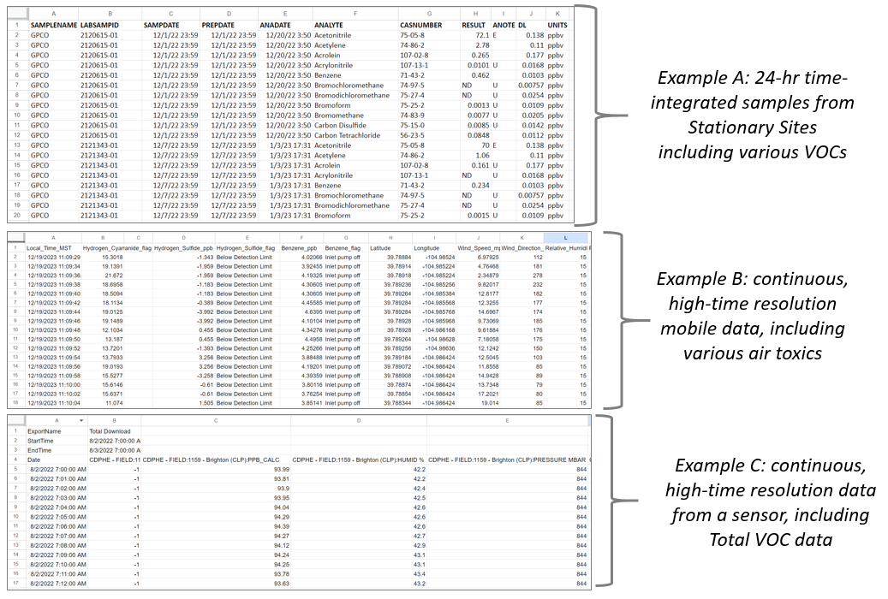
Data Cleaning challenges
EXAMPLE: modifying files for compatibility/analysis
Check units
Different
timestamps
Different headers
Data needs to be transposed
Sample duration? Filtering based on flags?

Slide 5
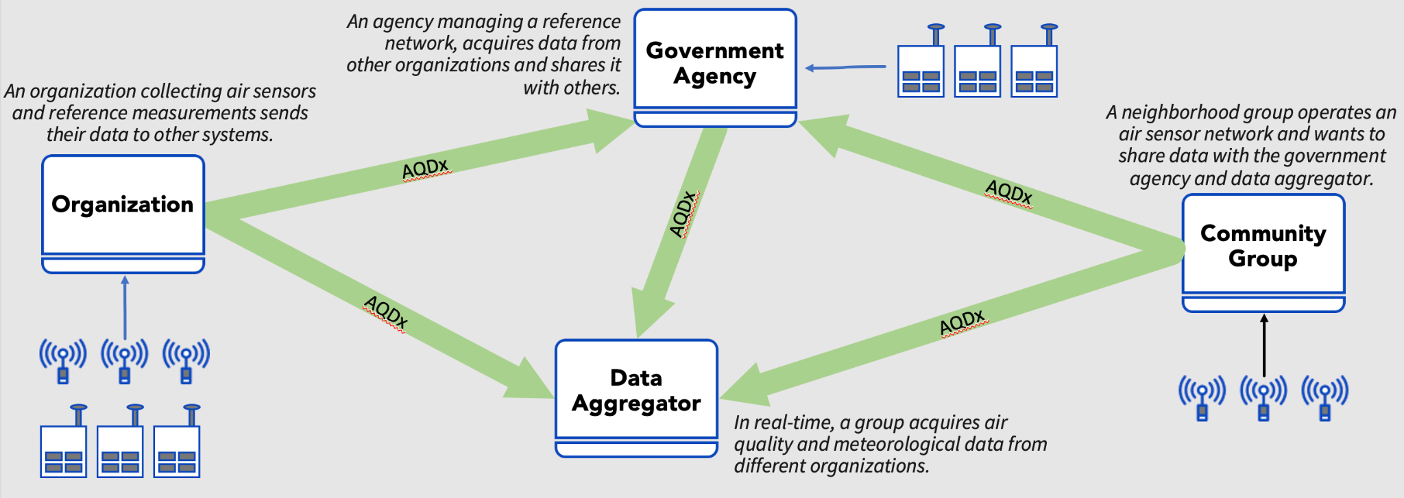
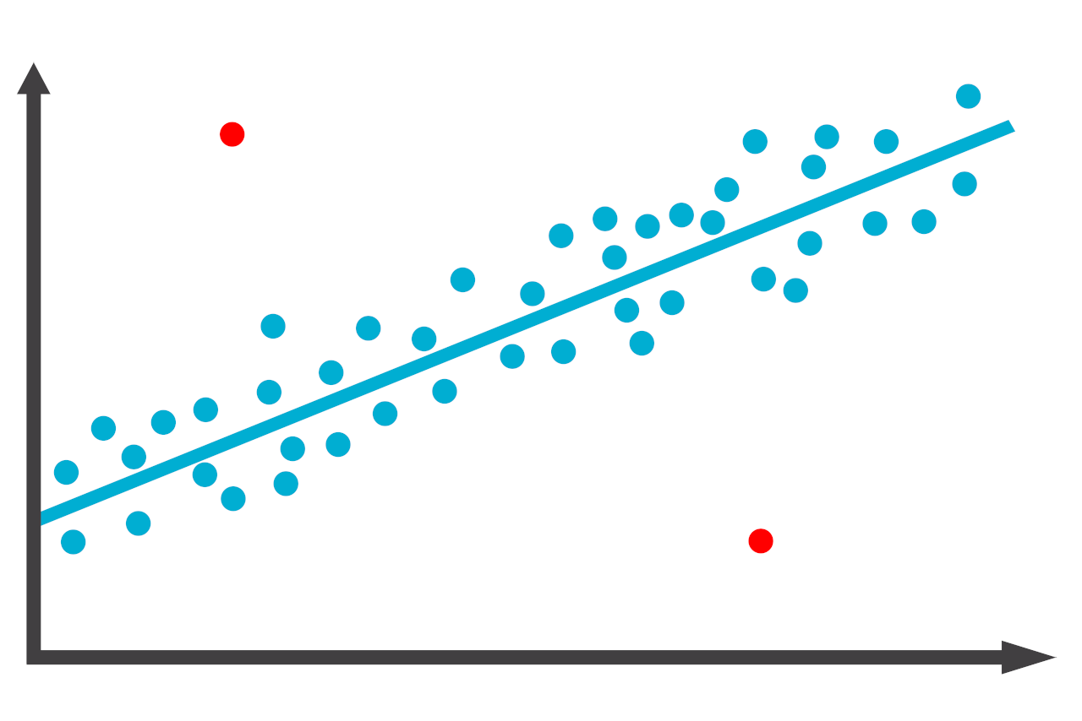
Purpose of AQDx: Data Exchange
Instrument metadata form + common data specification + data quality levels

Slide 6
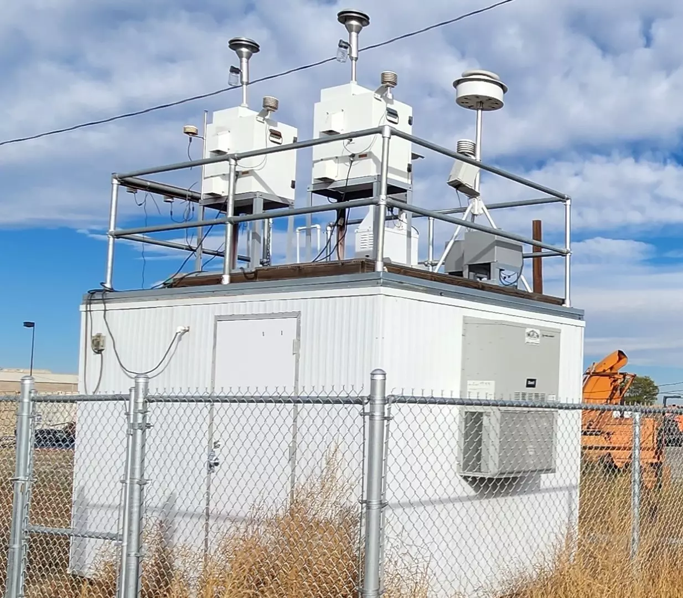
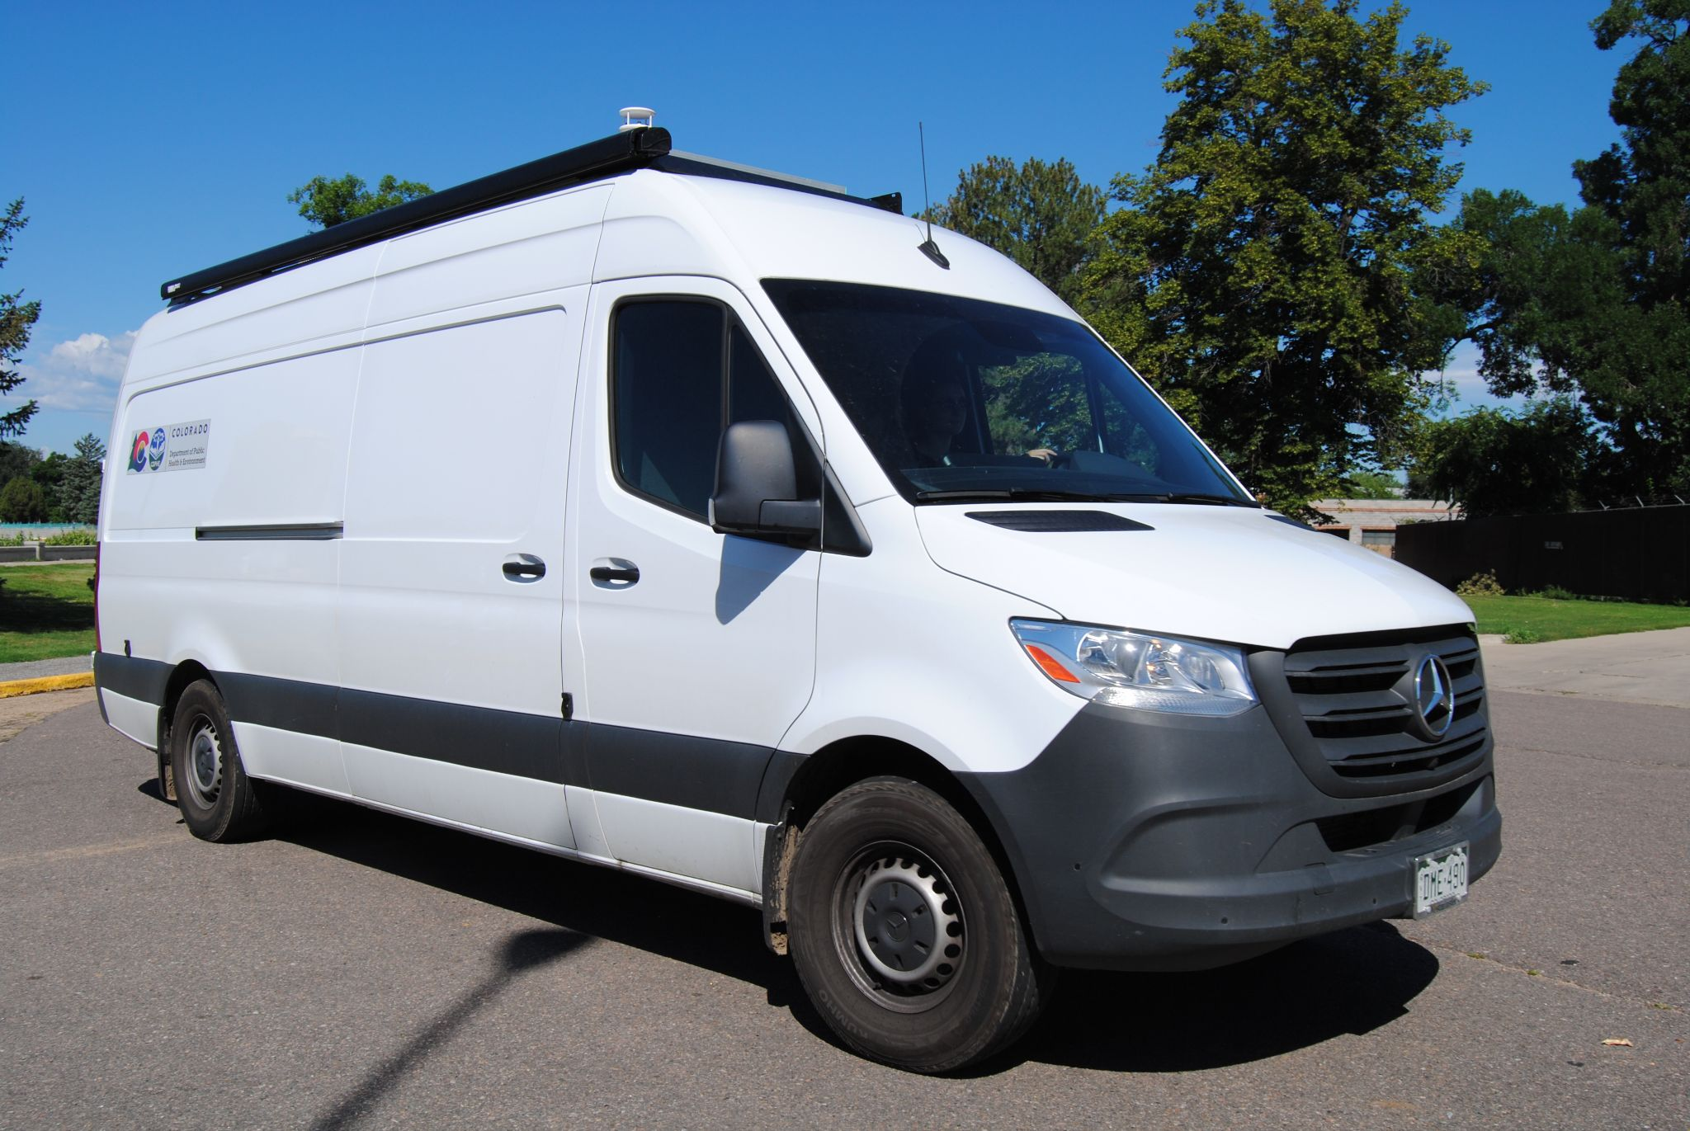
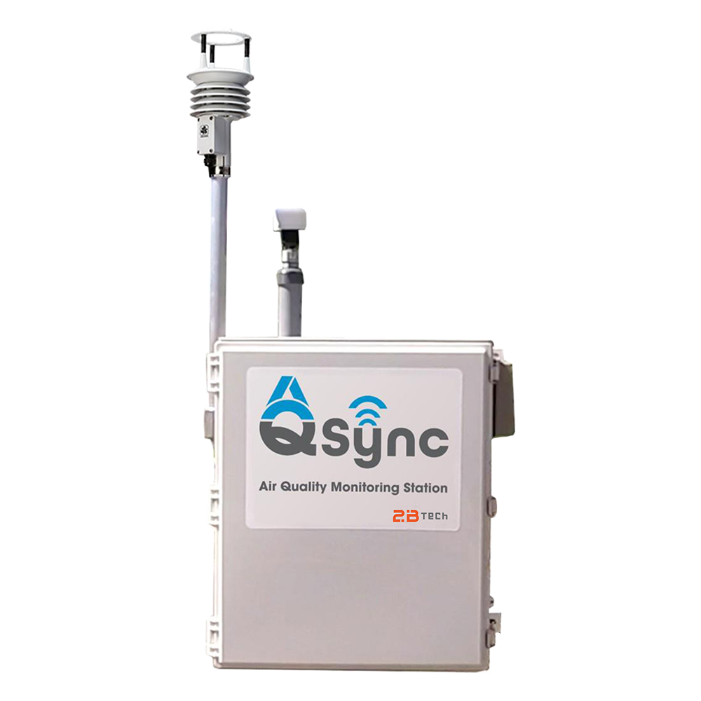
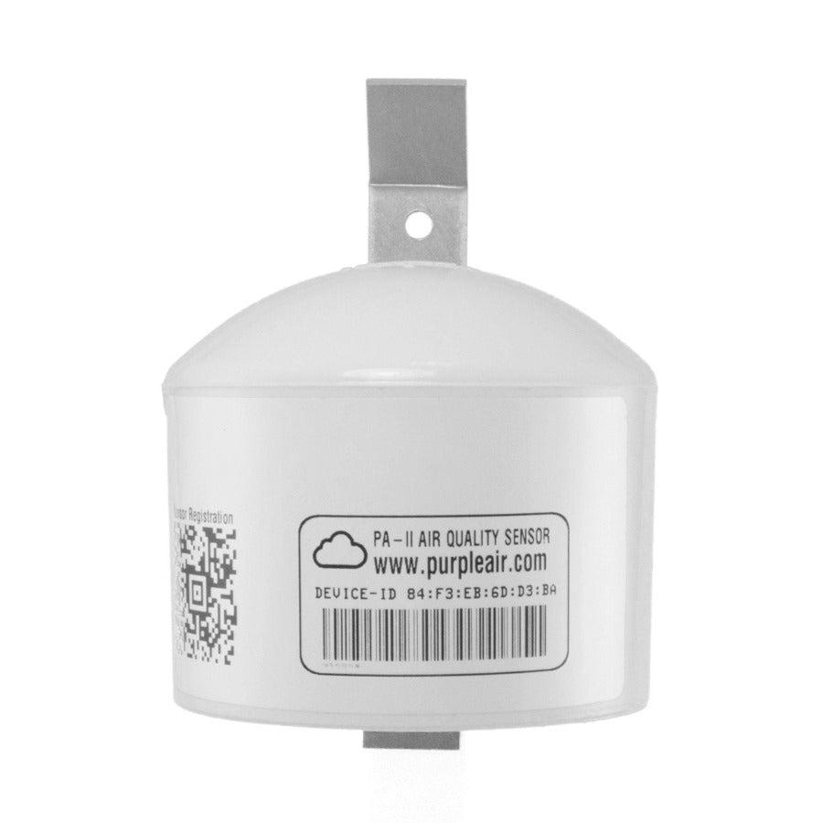
AQDx will unite regulatory and low cost ecosystems
{
National Air Toxic Trends Sites (NATTS)
Instrument metadata form
common data specification
Regulatory mobile monitoring platforms
data quality levels
Consumer grade low cost air sensors
(E.g. AQSync, PurpleAir)
AQDx will enable community members to participate in air quality research both by contributing their own data and easily analyzing diverse datasets

Slide 7
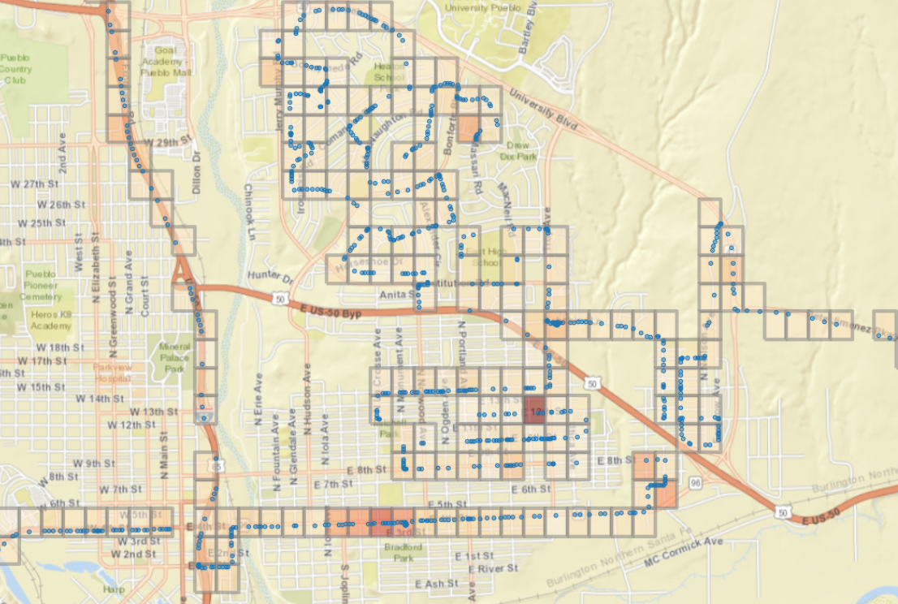
AQDx enables Data Harmonization
EXAMPLE DATA
Data Harmonization can help address:
Has CDPHE driven a mobile monitoring van nearby recently?
Do my or my neighbors personal air sensors agree with those results?
Goal:
View all data (including many compounds besides pm2.5) on a single webpage or dashboard
27
30
28
51
AQSync PurpleAir

Slide 8
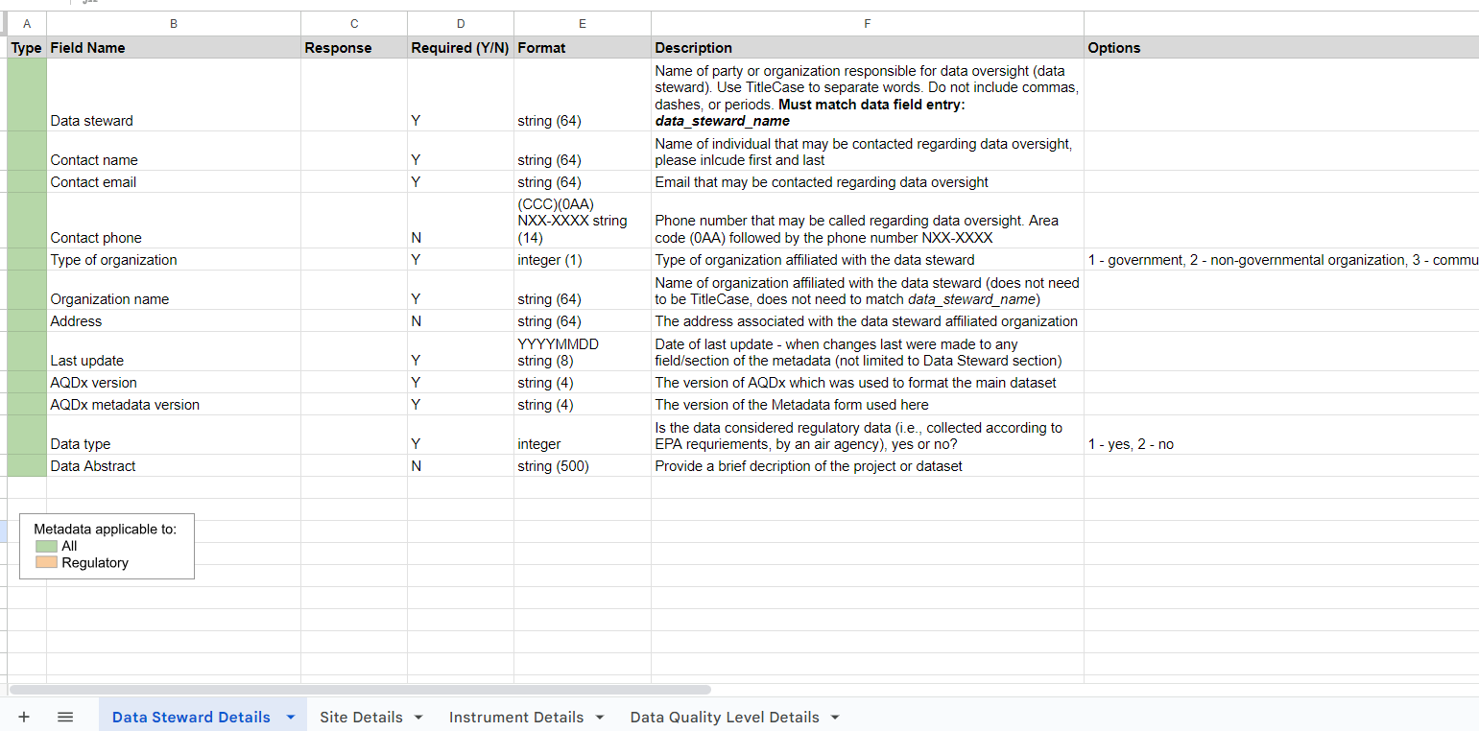
Instrument metadata form
A single spreadsheet text form describing the capabilities of the instrument,
reducing ambiguity, capturing edge cases, and increasing usability

Slide 9
Common Data Specification: CSV or JSON
(1) CSV (Comma-Separated Values)
For finite datasets, such as historical data
For monthly to quarterly updates
Recommended format for general public
(2) JSON (JavaScript Object Notation)
For real-time or streaming data
May support direct submission to a database, enabling automated processing (e.g., automated QA and reformatting to save needed information in preferred format)
Each version includes the same parameters, but is optimized for different use cases

Slide 10
Common Data Specification: CSV vs JSON
CSV:
Data_steward_name,device_id,device_manufacturer_name,datetime,lat,lon,duration,parameter_code,method_code,value,unit_code,autoqc_check,corr_code,review_level_code,qc_code,data_license_code,elev
CleanAirVision,11402,AirSensingLLC,2023-05-23T23:50:00-06:00,30.06111,-89.94084,3600.,88501,0,3.1,105,1,0,1,0,0,0,3.2
JSON:
{"data_steward_name":"CleanAirVision","device_id":"11402","device_manufacturer_name":"AirSensingLLC","datetime":{"UTC":"2023-05-23T23:50:00-06:00","sample_hash":"aee0123affeg"},"location":{"type":"Point","coordinates":[-89.94084,30.06111]},"measurement":{"duration":"3600","parameter_code":88501,"value":3.1,"unit_code":105,"autoqc_check":1,"corr_code":0,"review_level_code":1,"qc_code":0,"elev":3.2}}

Slide 11
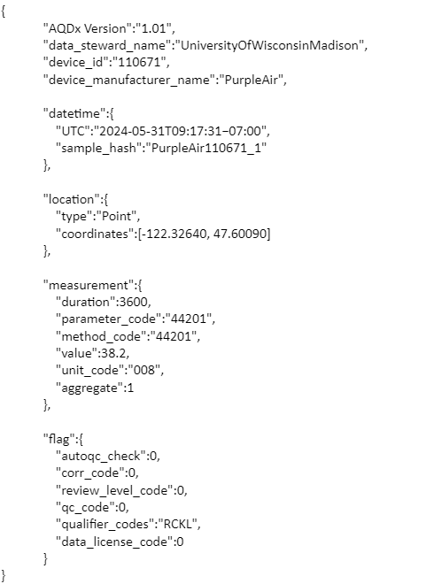
Common Data Specification: JSON structure

Slide 12
Data Quality Level Indicators
The following three fields provide a more complete picture of the level of processing, correction, and review for data 🠞 facilitating appropriate use of the data
autoqc_check: has the data been processed using automated tools, algorithms, or software? [inputs: 0 = no, 1 = yes]
corr_code: has the data been calibrated against a known standard, or has the data been adjusted using an established method? [inputs: 0 = no, 1 = yes]
review_level_code: what level of review has the data received? [inputs: 0 = none, 1 = internal, 2 = external, 3 = certified]

Slide 13
AQDx Pilot Program preliminary improvements
Pilot 1 - Nearly Complete
JSON AQDx output for a large network of FRM/FEM-type monitors
Pilot 2 - In Progress
Positioned network of sensors to monitor air quality for concerned community group
Instrument manufacturer working on supporting AQDx JSON output
Pilot 3 - Beginning
Local government testing sending batch data from network of FRM/FEM-type monitors to state using AQDx CSV version

Slide 14
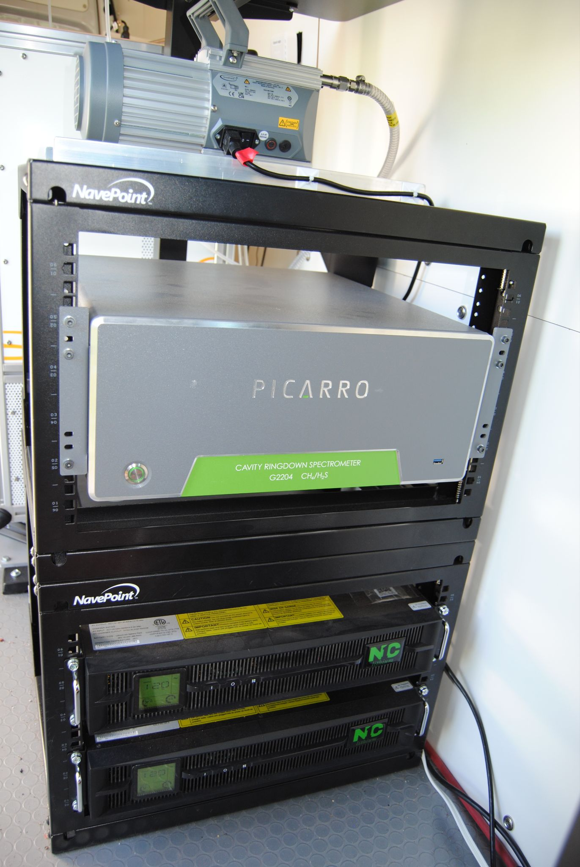
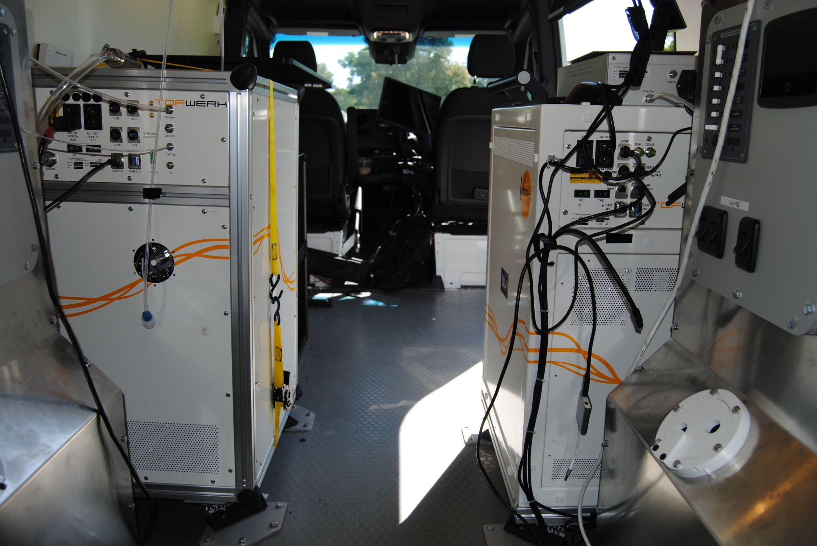
Clarification on how many metadata forms
Vocus Aim “B”
Vocus Eiger PTR-TOF
Picarro G2204 Analyzer
240101-CAT.csv

Slide 15
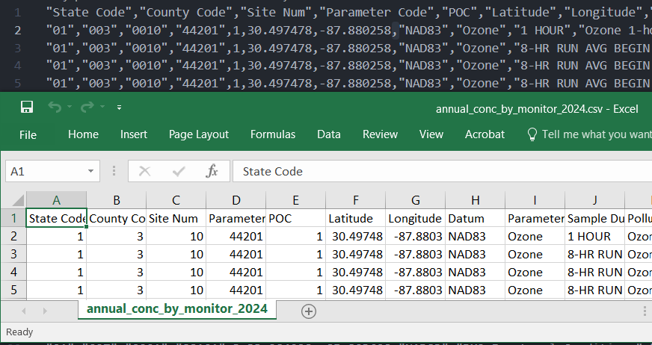
Microsoft Excel, enemy of the state
While keeping things vendor agnostic would be ideal, many community members will use spreadsheet software such as excel and google sheets
This is an EPA AQS “AirData Download” summary file
In AQDx, we will prepend text such as “code0010” to all codes to make sure they are string type and retain trailing zeros

Slide 16
Conclusions - AQDx Pilot Programs
Pilot 1 has successfully produced AQDx JSON output
File size is large but manageable for quarterly data (<16MB)
Improvements will be in next version of the standard based on user feedback
Making the metadata form more machine readable
Modifying the format of individual fields and adding more specificity to guidance documentation
We are exploring opportunities to integrate AQDx into existing data visualization tools
Each additional pilot user is able to add their perspective and use case, improving AQDx. Please consider joining our pilot program!

Slide 17
Final Discussion & Questions
We have published our first official version, available at the link below
Internally, we are using AQDx to create a division-wide database with a public front-end to display 3rd party data as well as our own data
We are looking for opportunities to add AQDx into regulations and rules to standardize data being submitted to the state of Colorado
Ways to get involved
Join the Stakeholder Group
Review the latest version of AQDx
Provide feedback to ashley.collier-oxandale@state.co.us
AQDx (Version 2.0) Metadata Form
Metadata Form Guidance
AQDx Webpage

Slide 18
Acknowledgments
Thanks to the AQDx Working Group: Ron Evans, Andrea Clements, Vasu Kilaru, Richard Wayland, Phil Dickerson, Corey Mocka, Robb Wildermann, Brandon Feenstra, Wilton Mui, Michael Flagg, Michael Ogletree, Jason Schroder, Amber Eglund, Madelyn Percy, Loren Speer, Erick Mattson, Erik Joplin, Leah Gibson, Nathan Bradley, Steve Szocik, William Vicars, Steve Mccannon, & Jim Reasor
Thanks to the additional partners at CDPHE: Jenna Channel, Stephen Johnson, & Angelika Selviyan
Thanks to project partners at TDEnviro: Tim Dye & Helena Pliszka
AQDx pilot program participants

Slide 19
The Standard - MetaData Form (1 of 4 tabs)

Slide 20
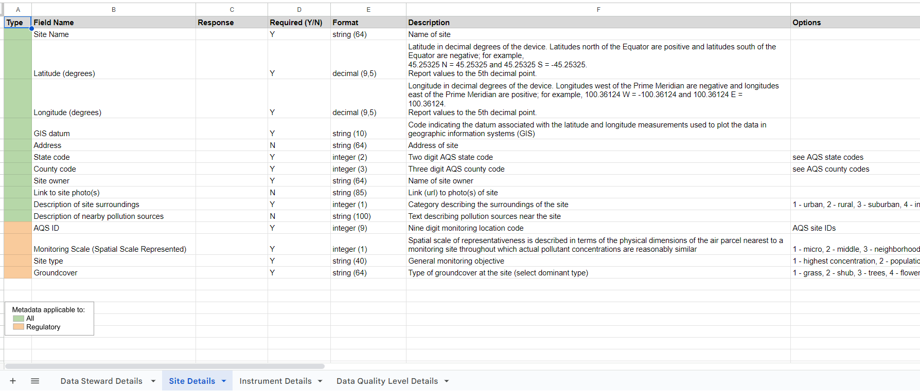
The Standard - MetaData Form (2 of 4 tabs)

Slide 21
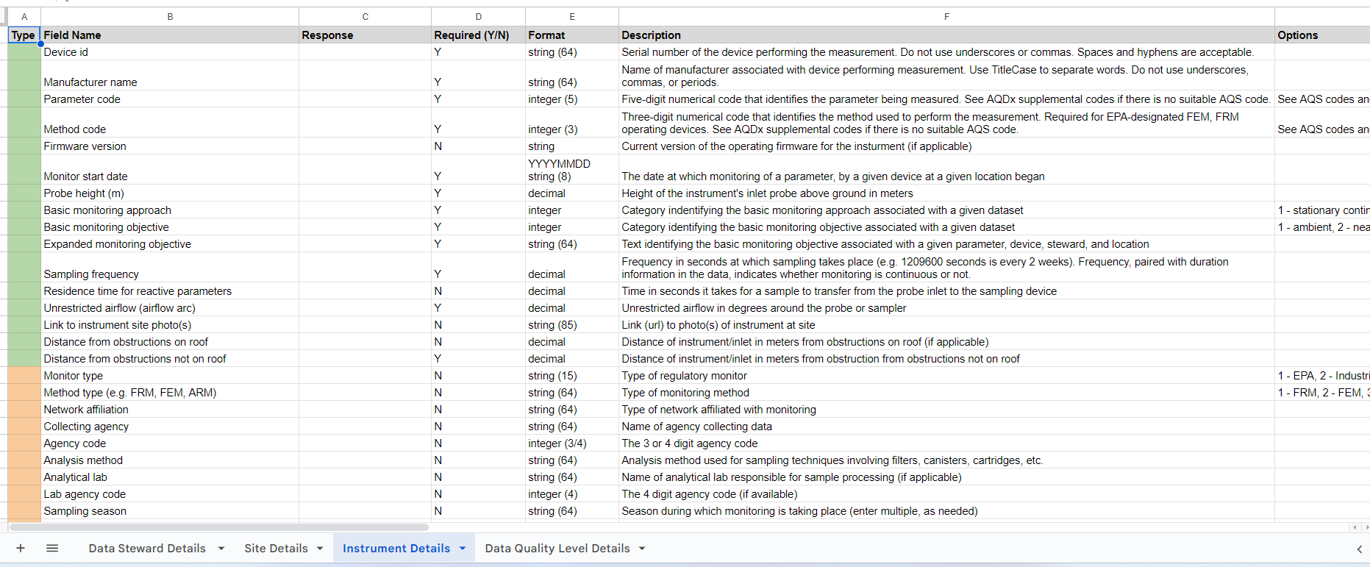
The Standard - MetaData Form (3 of 4 tabs)

Slide 22
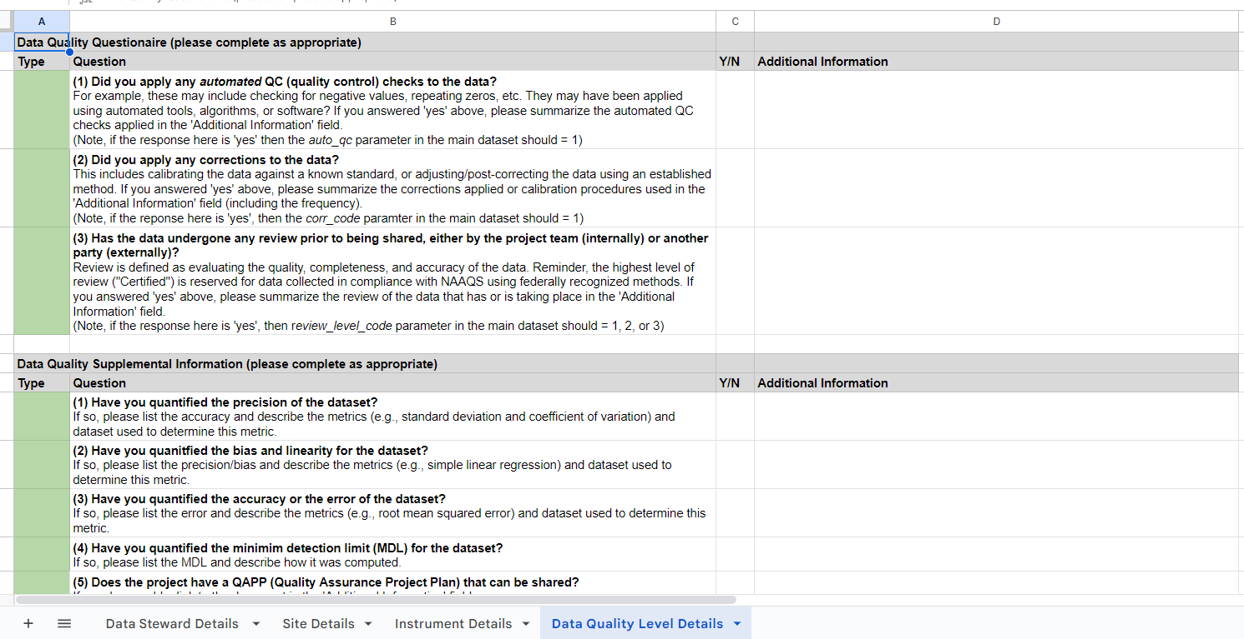
The Standard - MetaData Form (4 of 4 tabs)

