Slide 1
Regulated Facility Data Governance Subgroup
An update on the implementation of governance for regulated facility data at EPA
EPA
Programs
EPA
Regions
Executive Level Involvement
September 18, 2024
States
Tribes
Representation Across Data Lifecycle

Slide 2
Agenda
Overview of Regulated Facility Data Governance Subgroup
High Level Principles - first deliverable
Group Organization and Structure
Task Force Updates
Next Steps and Discussion
9/18/2024
2
Notes:
“Members of the Regulated Facility Governance group will provide background on the newly created group and accompanying subgroups. The session will also review accomplishments and project updates from the Common Facility Data model and Data Lifecycle Roles and Responsibilities subgroups.”
Overview of session:
Overview of Regulated Facility Governance group, a subgroup of the Data Governance Council
Background and brief overview on the implementation of the group and progress on establishment of subgroups
Introduction of tri-chairs (Ana Greene, Matt Lee, Kiki Schneider) and state participants (Josh Kalfas, Eric Cleckler)
Components of governance group:
Core group that meets quarterly
Voting members - intending to represent interests of their office broadly
Taskforces formed to tackle problems:
Common Facility Data Model (Jennifer Sutton, Ron Evans)
Data Lifecycle Roles and Responsibilities (Matt Kelly)
Corporate data - in progress (John Veresh)
Sub-facility - unclear (Elinor Keith)
Regulated Facility Data High Level Principles review - first deliverable of subgroup
Project updates from Common Facility Data model and DLRR groups
Common Facility - looking to have a draft data model to share by around that time period.
DLRR - Lifecycle deep dive (TRI) and draft inventory of roles and responsibilities
Desired outcomes:
Raise awareness of the effort, feedback on approach

Slide 3
Overview: Background
The Regulated Facility Data Governance Subgroup is an outcome of the Regulated Facility Data Needs Project ​
​
Multi-phase effort
Phase 1: Business Needs
​Phase 2: Options Evaluation​
Phase 3: Charter Development​
Phase 4: Initiating Regulated Facility Data Governance Subgroup​
More detail in subsequent slides
9/18/2024
3
Notes:
This Photo by Unknown Author is licensed under CC BY-SA

Slide 4
Overview: Background
Phase 1: Summer 2020 - Gathering business needs​
Collected over 200 survey responses​
Interviewed 23 groups including EPA Programs, Regions and States​
Resulted in a report describing high level regulated facility business needs at EPA​
Identified Top 6 facility data business needs​
Consistent, Accurate Content Across Facility Data Systems ​
Sub-Facility Location and Attribute Data ​
Accurate Location Data and Support for Various Types of Spatial Features ​
Comprehensive Corporate Data​
Accurate Contact Data that Provides Fields to Differentiate Key Contacts ​
Expanded Historical Data (e.g., Permits)​
Key drivers for current work
9/18/2024
4

Slide 5
Overview: Background (cont’d)
Phase 2: October 2020 to June 2022 – Options Evaluation​
Project Leads: Ana Greene (U.S. EPA-Office of Mission Support) - lead; David Jacobson (U.S. EPA-OMS) Ron Evans (U.S. EPA-Office of Air and Radiation)​
Created a Regulated Facility Data Needs Workgroup
Representatives from EPA Programs and Regions as well as States and Tribes​
Held “Deep Dives” with numerous groups​
Developed Phase 2 Options Evaluation
Focused broadly on options for solving problems including culture change​
Improvements to regulated facility data management at EPA require culture change at a basic level for technology changes to have an impact. ​
Facility data is not “one size fits all” across the Enterprise – governance needed to help navigate this ​
Also included recommendations related to policy, business process, and technical topics
9/18/2024
5
Notes:
This Photo by Unknown Author is licensed under CC BY-SA

Slide 6
Overview: Background (cont’d)
Phase 2 (cont’d): Primary Recommendation was Governance​
Establish governance structure that includes stakeholders across the data lifecycle and participants from:​
OMS​ and Program Offices​
Regions​
States​
Tribes​
Executive-level Involvement​
Implement as a Subgroup of Data Governance Council​
Coordination across programs and across the data lifecycle is critical to achieve success​
EPA
Programs
EPA
Regions
Executive Level Involvement
States
Tribes
Representation Across Data Lifecycle
9/18/2024
6

Slide 7
Overview : Progress To Date
Phase 3: October 2022 to May 2023 - Charter Development​​
Identify issues that are in scope
Define group structure and membership
Outline voting processes
Signed Charter (May 2023)
Phase 4: June 2023 to Present - Regulated Facility Data Governance Subgroup​
Key Themes
Emphasis on high-level questions, decisions and principles​
Continuously refine overall approach for managing regulated facility data
Obtain consensus and “buy-in”​
Details regarding implementation taken care of separately through the application-level governance (ex. Change Control Boards)​
9/18/2024
7

Slide 8
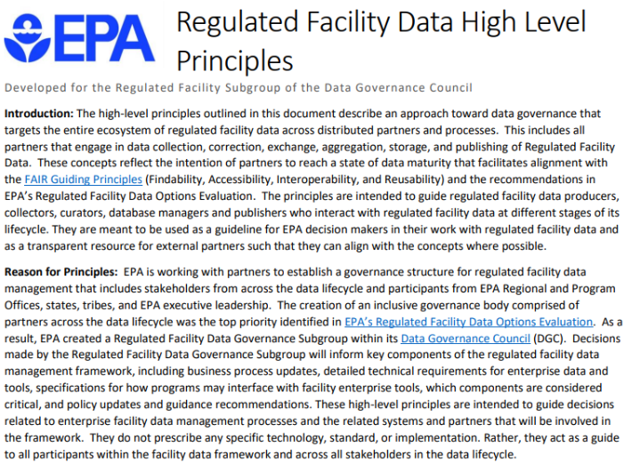
Overview : Progress To Date
Some Initial Actions/Products:​
High Level Principles: May 2024
First official membership vote
100% concurrence (some with comments)
In Progress
Core Facility Data Model
Facility Terminology Proposal
Documenting Roles and Responsibilities across the Facility Data Lifecycle​
9/12/2024
8

Slide 9
Regulated Facility Data High Level Principles
Intended to guide decisions related to enterprise facility data management processes and the related systems and partners
They do not prescribe any specific technology, standard, or implementation
High Level Principle categories:
Data Stewardship
Data Accuracy
Data Consistency Across Partners
Data Accessibility and Transparency
Data Transparency
9/12/2024
9

Slide 10
Subgroup Organization and Structure
Introduction of Leadership
EPA: Jeffrey Avery (U.S. EPA-OMS), Matt Lee (U.S. EPA-Office of Environmental Justice and External Civil Rights), Kiki Schneider (U.S. EPA-Office of Enforcement and Compliance Assurance)
Thanks to Ana Greene and Casey Johnston for serving!
State: Josh Kalfas (Oklahoma), Eric Cleckler (Alabama)
Subgroup meets quarterly to discuss key topics, review issues and products, and vote
Next Meeting: September 30, 2024
Task Forces meet frequently to work on specific topics (more in subsequent slides)
Common Facility Data Model
Data Lifecycle Roles and Responsibilities
Corporate Data
Sub-facility
9/18/2024
10

Slide 11
Task Forces
Intended to allow members of the Regulated Facility Subgroup to focus on key topic areas​
Create and evaluate products for review by larger subgroup​
Dig deeper to provide summaries, reports or recommendations to subgroup​
Operate in parallel to achieve faster progress
Member Expectations:
​Help define the group's “charge” or mission​
Identify/characterize proposed products and “deliverables”
​Participate in regular work sessions/meetings
​Provide input on key decisions and help create task force products ​
Support presentations on task force topics at subgroup meetings
​Support timely delivery of completed products to subgroup ​
9/18/2024
11
Notes:
This Photo by Unknown Author is licensed under CC BY-NC

Slide 12
Task Forces
Common Facility Data Model - Ron Evans (U.S. EPA-OAR) and Jennifer Sutton (U.S. EPA-OMS)
Develop designs for a core data model for locations of environmental interest​
Data Lifecycle Roles and Responsibilities - Matt Kelly (U.S. EPA-OMS)
Establish roles and responsibilities across the facility data life cycle, including data collection, quality control, exchange, aggregation, management, and publication
Corporate Data - John Veresh (U.S. EPA-OECA)
Standardize corporate data collection across EPA systems and partners, evaluate and integrate external corporate data, and improve corporate data sharing with external partners
Sub-facility (TBD):
Develop a detailed depiction of sub-facility data, illustrate how it relates to core facility data, and will define mechanisms and standards for cataloging sub-facility data
9/18/2024
12
Notes:
This Photo by Unknown Author is licensed under CC BY-NC

Slide 13
Common Facility Data Model update
Task Force Leads:
Ron Evans (U.S. EPA-OAR) and Jennifer Sutton(U.S. EPA-OMS)
Charge/Mission Statement: Develop design(s) for a core data model for locations of environmental interest, aka “Facilities”
A critical goal is to consistently identify and link to a location across all programs at EPA
The outputs from this group are expected to inform designs for secondary data models as well as proposed processes for accessing and maintaining data by EPA and its regulatory partners
Leverage information provided by the technical team supporting FRS and the OIM optimization project team
9/18/2024
13
Notes:
This Photo by Unknown Author is licensed under CC BY-SA

Slide 14
Common Facility Data Model update
Key Products Planned:​
Core Facility Data Model Depiction
​Define what a “facility” is - it's not only regulated facilities
Define information categories included in core data model vs secondary data models
Define “Core Facility”
Identify sources for core data
​Depict relationships between facility locations (geographic proximity, capability, corporate, legal, etc.)​
Use Case Scenarios​
How to answer the question “What is going on here” for scenarios (e.g., green goo seeping from a manhole)​
Discussions on what is needed for data collection versus data analysis vs data dissemination / visualization
Common Facility Data Maintenance Plan
​Roles and Responsibilities for maintaining, accessing and linking to common data including what this means to those collecting the data
​Expected maintenance for core data and linkages with secondary data models
In Progress
9/18/2024
14
Notes:
This Photo by Unknown Author is licensed under CC BY-SA

Slide 15
Data Lifecycle Roles and Responsibilities update
Task Force Lead: Matt Kelly (U.S. EPA-OMS)
Charge/Mission Statement: Work to establish roles and responsibilities across the facility data life cycle, including data collection, quality control, exchange, aggregation, management, and publication.
The group will outline how partners participate in governance of facility data with the development of partner agreements to formalize expectations of involved parties
The group will identify which groups are considered authoritative for different facility data interests and addressing areas of data overlap and/or inconsistency
9/18/2024
15
Notes:
This Photo by Unknown Author is licensed under CC BY-SA

Slide 16
Data Lifecycle Roles and Responsibilities update
Key Products Planned:​
Inventory and standard description for individual roles within the data lifecycle​
Comprehensive facility data lifecycle flow diagram​
High-level facility data quality management plan​
Draft partner agreements for: ​
Exchanging data, in the form of a Service Level Agreement (SLA)​
Shared Data Quality Assurance, including reviewing and correcting data quality issues across partners/programs​
Connections to Common Facility Data Model group:​
Linking documented roles in data lifecycle with outcomes explored in the Common Facility Data Model group, including specific uses of the data model that match identified roles
In Progress
9/18/2024
16
Notes:
This Photo by Unknown Author is licensed under CC BY-SA

Slide 17
Contact
Moderator: Jeffrey Avery (US EPA)
Panelists: Jennifer Sutton (US EPA), Matt Kelly (US EPA)
9/18/2024
17

Slide 18
Thank you!
Questions?

