Slide 1
A review of Information Technology tools and services
EPA Search Tools & Resources
for Environmental Protection
September 18, 2024

Slide 2
Agenda
System of Registries (SOR) overview
Terminology (TS)
Laws and Regulations (LRS)
Substance Registry (SRS)
Tribal Identification (TRIBES)
Facility Registry (FRS)
EJScreen demonstration
Geospatial services
9/12/2024
2

Slide 3
What are Registries?
Easy-to-access sources of centralized, standardized, and authoritative EPA data that add value for stakeholders.
9/12/2024
3

Slide 4
Why Registries?
Improves data quality by standarizing the different names of chemicals, industries, Tribes, etc.
Standardize
To solve the different reporting structures and requirements of laws, EPA regulations, policies, and guidance
Provide
A single source of regularly refreshed authoritative data
Ease
Reduce burden of EPA programs, states and regulated community by making it easier to find trusted data on a specific topic
Aggregate
EPA data by creating a centralized platform to overcome the siloed approach to information management
9/12/2024
4

Slide 5
Why Registries?
Make data easily available to stakeholders and their applications by leveraging technology like web services
Improve access
Stakeholder Engagement
Continue working with partners to maintain data and discover new use-cases
Gather & Store
Gather content from stakeholders, EPA programs, and authoritative sources
Increase Value & Quality
Associate content with other information to increase value
Continuously review and check stored data to ensure quality
Store data in the appropriate tool
9/12/2024
5

Slide 6
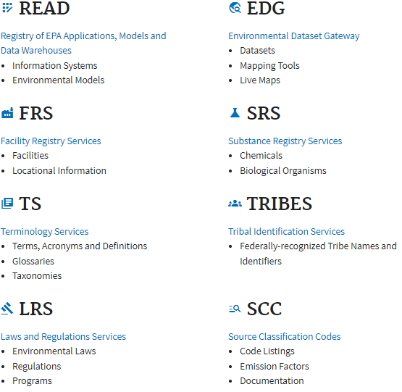
Introduction to the Registries
9/12/2024
6
Notes:
We will be discussing the Registries outlined in red

Slide 7
Terminology Services (TS)
EPA and the regulated community are dependent on terms and definitions. Multi-disciplinary nature of EPA science results in terms that have different meanings
Making EPA's information ‘findable’ requires that it be cataloged and indexed. TS provides the tools needed to develop and manage vocabularies used to catalog and index EPA's information assets
9/12/2024
7
Notes:
READ at Bullet 2: Part of making data FAIR (findable, accessible, interoperable and reusable)
EPA programs often define terms and acronyms differently or use different terms to mean the same thing. Understanding the terms EPA uses is essential to properly interpret information used in decision making. To be transparent, EPA needs to provide access to its terminology.
Making EPA's information ‘findable’ requires that it be cataloged and indexed. Terminology Services provides the tools and services needed to develop and manage vocabularies used to catalog and index EPA's information assets. It also provides various export options and direct links to vocabularies to expand access where needed.
In order to have quality, information must be understandable to the user. Well-defined, well-documented terminology is critical to this process. Is the definition of hazardous waste the same across federal and state laws and regulations? If not, what are the differences? Can data about acid deposition be aggregated with data about acid rain? Developing clear, unambiguous meaning for EPA's terminology is the core business of Terminology Services.
Terminologies change, meanings change; therefore, it is critical that those changes be reflected in a timely and reliable manner so that the comprehension is not compromised. Terminology Services, through its system of stewardship and web service capabilities, is able to keep terminology current and reliable.

Slide 8
Laws and Regulation Services (LRS)
A catalog of environmental laws, regulations, & EPA program offices
LRS adds value by creating associations that connect:
Laws relevant to EPA
Environmental regulations implementing those laws
EPA programs that oversee those regulations
LRS associates law and regulation data with keywords, NAICS codes, EPA programs and offices, and substance lists from the Substance Registry Service (SRS)
9/12/2024
8
Notes:
READ at Bullet pt 2: LRS adds value by creating associations! It doesn’t simply store law, regulation, and EPA Program Office information, but connects them together in meaningful ways.
LRS associates EPA-relevant laws to the environmental regulations that implement them and it connects those regulations to the Program Office that oversee them
This provides EPA employees and the regulated community information about laws, their implementing regulations, and where to find more information at EPA by linking to the appropriate page
READ Bullet 3

Slide 9
Substance Registry Services (SRS)
EPA’s central point for receiving and providing information on substances tracked or regulated at EPA
Information on programs regulating substances by multiple names
86,000+ substances regulated by EPA
242,000 substances regulated by over 175 programs
86,000 ≠ 242,000 - Why are they different?
9/12/2024
9
Notes:
Read at bullet 2: Just about every EPA program regulates or tracks a substance – these could range from smokestack pollutants to contaminants discharged from a pipe at a Superfund site to a wood preservative!
At EPA, there are over 175 programs that regulate around 242 thousand substances. Of which about 86 thousand are unique substances. You might be asking yourself – what’s going on here? Why the discrepancy?? Next Slide

Slide 10
Substance Registry Services (SRS)
Lindane is called eight different names across EPA regulations
National Primary Drinking Water Regulations (OW): Lindane
SARA 110 (OLEM): Hexachlorocyclohexane, gamma-
RCRA (OLEM): Cyclohexane, 1,2,3,4,5,6-hexachloro-, 1.alpha.,2.alpha.,3.beta.,4.alpha.,5.alpha.,6.beta.)-
EG Part 423 (OW): gamma-BHC (Lindane)
CWA Priority (OW): gamma.-BHC
CERCLA (OLEM): Hexachlorocyclohexane (.gamma. isomer)
CAA112(b) HAP (OAR): 1,2,3,4,5,6-Hexachlorocyclohexane
40 CFR 302.4 (List of Hazardous Substances) (OLEM): Cyclohexane, 1,2,3,4,5,6-hexachloro-, (1[alpha], 2[alpha], 3[beta]-, 4[alpha], 5[alpha], 6[beta])
CWA 311-HS (OW): .gamma.-Benzene hexachloride
9/12/2024
10
Notes:
The reason for this being – many programs may use different names for the same substance! Different chemists may use vastly varying nomenclature. SRS includes information about which EPA program regulates which substance and by which name that program uses. SRS has a record for each substance regulated at EPA and contains identifying information including the scientific name (also known as the CAS name), the standard name, substance synonyms, and identifiers.
One example of this being leveraged would be the Toxic substances control act (TSCA) chemical data reporting (CDR) tool. The TSCA program performs a facility specific chemical data call to industry every four years. In 2006, 4,107 facilities who responded to this; and during this reporting period, there were 11,200 chemical name errors, which took the Office of Chemical Safety and Pollution Prevention 21 months and hundreds of hours of effort before the final inventory of chemicals could be released to the public. For a report that is due every 4 years, I’m sure you can see how having to wait 2 years for the data to be released can be an issue. For the next reporting cycle, SRS was employed, which resulted in less than 10 chemical name errors and the data was released to the public in 6 months.
Programs use SRS to determine which chemicals are regulated by other programs to gather data for their own needs. When programs integrate SRS services to validate chemical identification information, they reduce the burden for the reporting community while also improving data quality.

Slide 11
Tribal Identification Services (TRIBES)
EPA tribal web service for non-geospatial systems. Automatically maintains accurate and current tribal information such as current tribal names obtained from Bureau of Indian Affairs' (BIA) official list of federally recognized tribes.
Ensures the correct identification of tribal partners and can be used to identify name changes over time by leveraging EPA internal identifier numbers
Increases EPA’s ability to exchange and integrate tribal data, helping the agency coordinate and work with our tribal partners
9/12/2024
11
Notes:
EPA routinely works with tribal partners. Many EPA systems and applications contain tribal data. Maintaining the accuracy of this data is difficult because tribal names can change. Allows for improved reliability as BIA codes are not currently provided for Alaska Native entities and some American Indian entities.

Slide 12
Now What?
Okay, great. Now how can these registries help me and my applications?
9/12/2024
12

Slide 13
SoR Web Services
System of Registries (SOR) Web services
Every single one of these registries can be leveraged into your systems to help with data quality and assurance!
Aid EPA and customers to better understand the slight nuances between programmatic offices
Reduce the need for manual validation and reduce human error
9/12/2024
13
Notes:
Go into a demo SoR TS, TRIBES, SRS, LRS

Slide 14
Facility Registry Service (FRS)
Facility Registry Service (www.epa.gov/frs)
Environmental Interest data from dozens of sources:
EPA program systems
State, Local, and Tribal (SLT) data
Other federal data
Reference data
Integrated information for over 5.2 million facilities is provided for public viewing via queries and in other EPA platforms such as Envirofacts and ECHO
EPA’s source for integrated facility information

Slide 15
Facility Registry Service (FRS)
Three main goals: integrate, improve, and provide data
Two main concepts: Registry record vs Program record
Stakeholders by product or function:
EPA programs using Facility Widget
EPA, SLTs that provide or consume data
FRS data stewards
Geospatial community
Other federal agencies collaborating across government
The public

Slide 16
Facility Registry Service (FRS)
FRS resources - www.epa.gov/frs
FRS Query – https://www.epa.gov/frs/frs-query
EPA public websites - Envirofacts, ECHO, Clean-ups In My Community (CIMC), EJScreen, and other EPA public datasets
Geospatial data – Downloadable geospatial files, Shared Enterprise Geospatial Service (SEGS), ESRI Living Atlas, and geospatial web services
FRS API – Exchange Network grant opportunity! Services via API available to EPA application and databases; other services available for public use

Slide 17
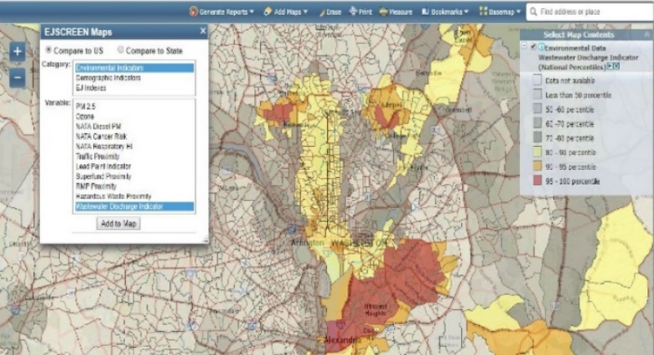
EJScreen
(https://ejscreen.epa.gov/mapper/)
EPA’s web-based GIS tool for nationally consistent EJ screening and mapping
Combines environmental and demographic data to highlight areas where vulnerable populations may be disproportionately impacted by pollution

Slide 18
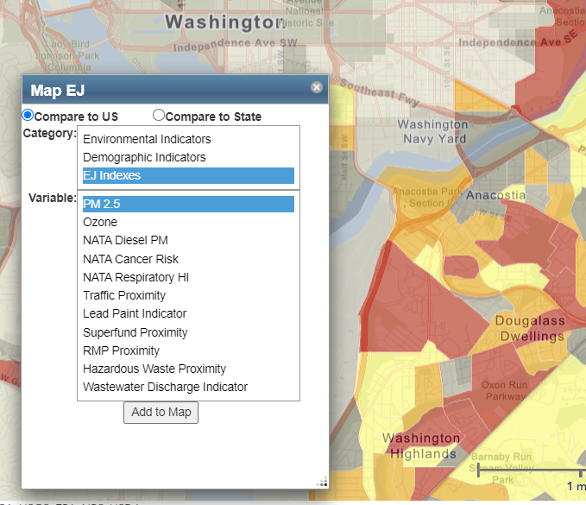
EJScreen
Key Features:
11 EJ Indexes – one for each environmental indicator
Annually updated environmental data
Annually updated demographics – from most recent U.S. Census Bureau American Community Survey (ACS)
Highest resolution data available
Ability to download data
Accessibility / ease of use

Slide 19
EJScreen
EPA uses of EJSCREEN:
Public outreach and engagement
Enforcement targeting
Inclusion in inspection reports
Permitting and NEPA reviews
Reviews of grant projects
Other placed-based initiatives
Inclusion in CCDS/ICIS
Retrospective reporting
EJSCREEN “platforms” for Integration:
Web-based platform (https://ejscreen.epa.gov/mapper/)
ArcGIS platform
(https://www.epa.gov/ejscreen/download-ejscreen-data )
ECHO platform (https://echo.epa.gov/)
Other EPA and State mapping tools also incorporate EJSCREEN data

Slide 20
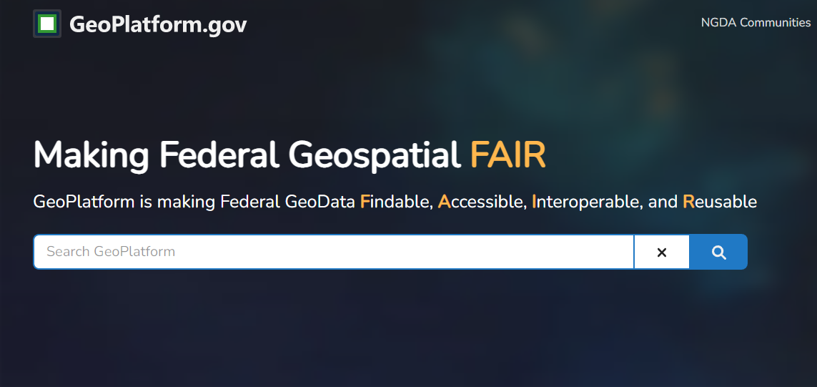
Geospatial Resources
Federal Geoplatform (https://www.geoplatform.gov/)
Data that are published as public at EPA can be searched
Underlying datasets generally updated on a regular basis
ESRI Living Atlas (https://livingatlas.arcgis.com/en/home/)
Collection of geographic information from around the globe
Includes maps, apps, and data layers to support your work

Slide 21
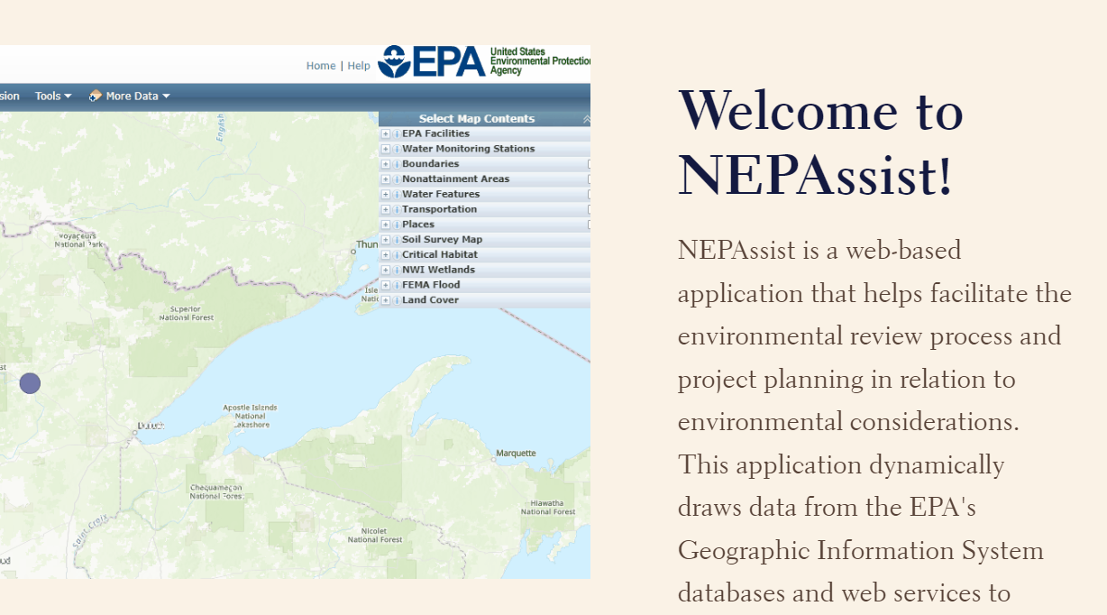
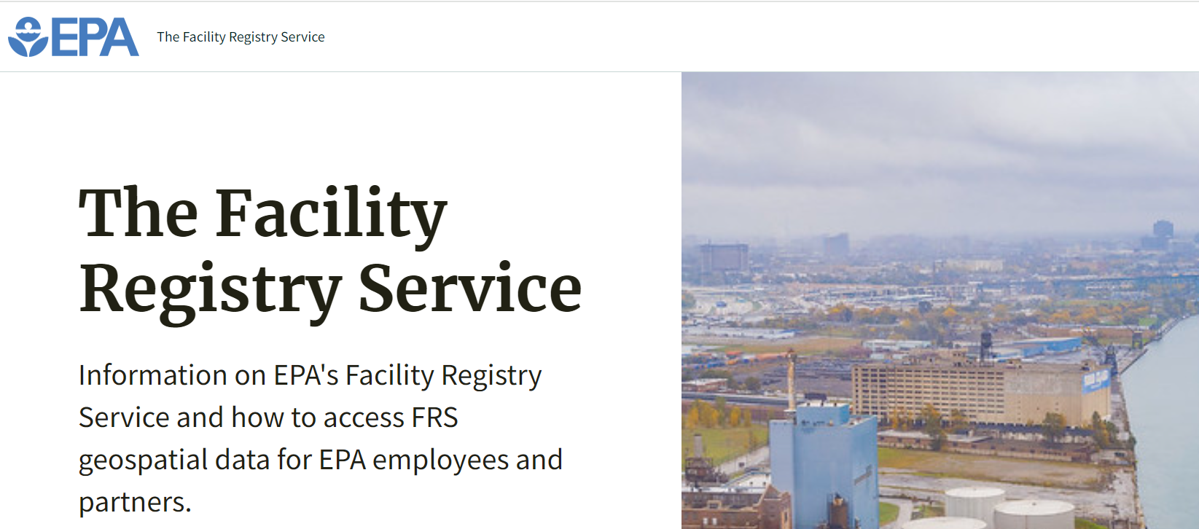
StoryMaps
NEPAssist StoryMap - how to use guide https://storymaps.arcgis.com/stories/556707a1c82a4e49b621d4ca8e141862
FRS StoryMap - how to use guide https://storymaps.arcgis.com/stories/a63f4e4b976e4618931d56819c3b0445

Slide 22
We do the work so you don’t have to!
System of Registries
9/12/2024
22

Slide 23
Links
Links from presentation:
System of Registries - https://sor.epa.gov/sor_internet/registry/sysofreg/home/overview/home.do
EJScreen - https://ejscreen.epa.gov/mapper/
Facility Registry Service (FRS) – https://www.epa.gov/frs
Federal Geoplatform - https://www.geoplatform.gov/
SEGS - https://segs-epa.hub.arcgis.com/
ESRI Living Atlas - https://livingatlas.arcgis.com/en/home/
NEPAssist StoryMap - https://storymaps.arcgis.com/stories/556707a1c82a4e49b621d4ca8e141862
FRS StoryMap - https://storymaps.arcgis.com/stories/a63f4e4b976e4618931d56819c3b0445

Slide 24
Contact
Moderator: Jeffrey Avery (US EPA)
Panelists: Akshay Narang (US EPA), Matt Kelly (US EPA)
9/18/2024
24

Slide 25
Thank you!
Questions?

