Slide 1
Helping Private Well Owners Understand Their Water Quality E2i - 2024 September 18, 2024

Slide 2
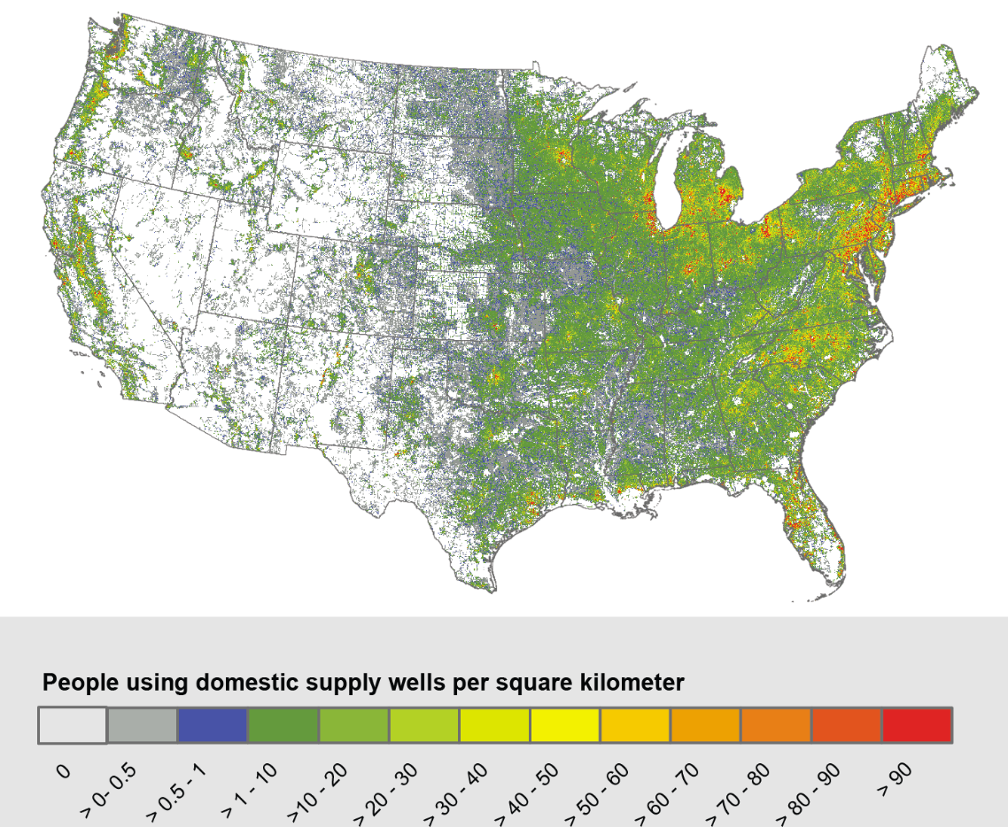
Private Well Context
43M US residents rely on private well water Source: USGS
15% of the population
Private wells are not regulated nationally

Slide 3
EZ – PZ Water Quality Testing
Lab Analysis Report

Slide 4
A free online tool to help private well owners understand
their water quality test results based on agency-specific regulations
Data on Demand Information that is timely, actionable, and customized to agency standards.
Consistent Messaging Agencies can provide clear guidance about health concerns and treatment.
Better Health Decisions Users can make informed decisions about water treatment or additional testing.
Reduced Costs Less staff time responding to info requests. Minimal effort to onboard and maintain.
www.bewellinformed.info

Slide 5
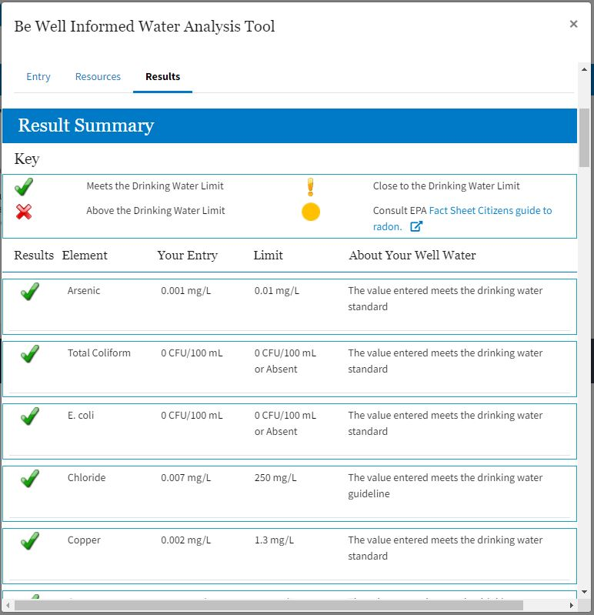
How does Be Well Informed work?
Configure & Customize Upload info on your agency and its specific drinking water standards
Enter Information Well owners anonymously enter lab report data at www.bewellinformed.info
View Results
Well owners see how their water quality compares to agency standards
Get Advice Well owners receive your agency’s recommended water treatment options
www.bewellinformed.info

Slide 6
Demo
https://bewellinformed.info

Slide 7
Partner Agencies
WA
AK
MT
VT
ME
ND
OR
OR
MN
NH
NH
ID
SD
WI
WY
MI
NY
MA
RI
IA
PA
CT
NE
PA
NV
IL
IN
OH
NJ
UT
DE
CO
WV
MD
CA
KS
WV
VA
DC
HI
MO
KY
TN
NC
AZ
NM
OK
Wake County, NC
NM
NM
AR
SC
In Production (12)
AL
GA
MS
MS
TX
Onboarding (3)
LA
FL
FL
Expressed Interest (10)

Slide 8
Let’s Make It Better
Goals for 2025
Complete an overhaul of the site’s user experience and functionality
Expand awareness and participation in the site
Next steps
Finalize list of desired enhancements and functional requirements
Issue Request for Proposals for contractor support
Award contract and begin development
Want to get involved?
Contact Kurt Rakouskas at krakouskas@ecos.org

Slide 9
Example Site Enhancements
Completely revamp the overall look and user experience
Streamline onboarding and customization of contaminants, thresholds, and treatment guidance
Provide a mobile version
Support for customized agency branding
Improved data entry tips and navigation
Support for an expanded list of treatment options
A robust test environment

Slide 10
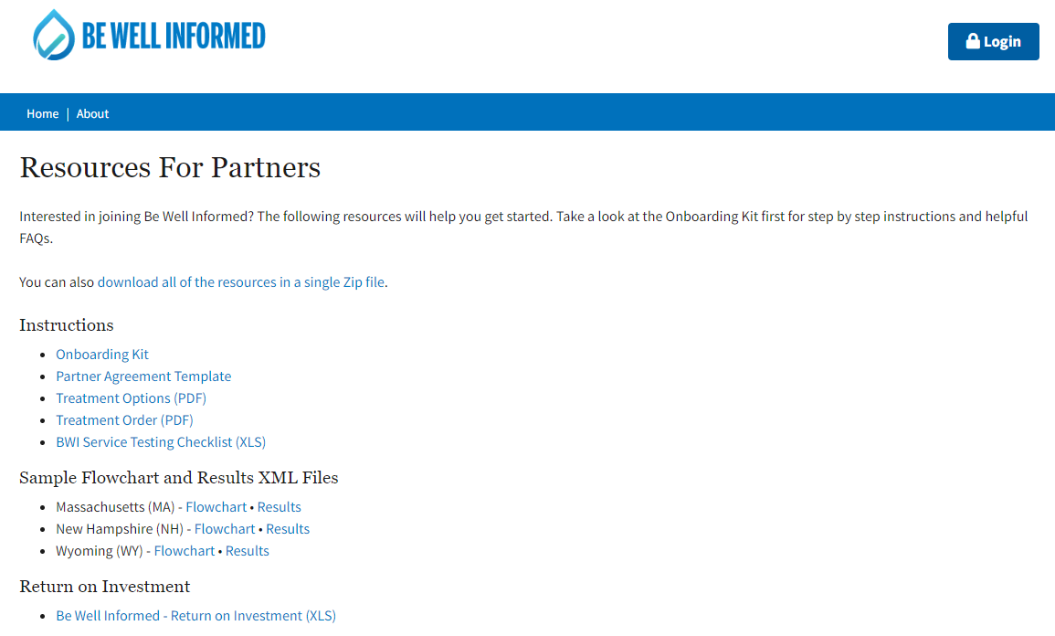
To learn more, visit: https://bewellinformed.info/for-partners

Slide 11
Questions?
Contact Kurt Rakouskas at ECOS
krakouskas@ecos.org | 202.266.4935

