Slide 1
Taking Stock at ‘22
Notes, Trends, & An Interactive Feedback Session with
the Exchange Network Grant Program
Erin McGown, EN Grant Program Manager
Tuesday, September 17, 2024

Slide 2
Agenda
Overview of EN Grant Program
Current EN Grant Trends
Available Resources for Applicants & Grantees
FY24 EN Terms & Conditions
Participant Feedback Activity
9/4/2024
2

Slide 3
Overview of EN Grant Program
9/4/2024
3

Slide 4
Exchange Network Purpose
The purpose of the Exchange Network is to:
Facilitate data sharing;
Reduce burden & avoid costs;
Streamline data collection & exchanges;
Increase data quality & access;
Increase data & IT management capabilities
9/4/2024
4

Slide 5
EN Competitive Grant Program
FY2024 is the EN Grant Program’s twenty-second year. Including FY24, approximately $280,000,000 has been awarded since 2002.
Awards have been issued to all 50 states, 93 tribes/Indian nations, and 5 US territories.
Current annual budget of around $9.5 million, equating to 30 – 40 awards annually.
9/4/2024
5

Slide 6
EN Grant Program: Eligibility
Who is eligible for EN Grants?
States
U.S. Territories
Federally Recognized Tribes, Indian Nations, and Alaska Native Villages
Inter-tribal Consortia of Federally Recognized Tribes and Indian Nations
Other Entities with Status as an Instrumentality of a State or Federally Recognized Tribe/Indian Nation (e.g., university)
9/4/2024
6
Notes:
Note: ineligible entities have the option to partner with an eligible entity, provided that: (1) the lead applicant is an eligible entity; and (2) the partnership is not formed from agencies within a single state, territorial, or tribal government.

Slide 7
EN Grant Program:
Funding Thresholds & Restrictions
Funding thresholds depend on the type of application:
Single Applicants ≤ $300,000;
Eligible EN Partnerships ≤ $500,000.
‘Individual Capacity Building with Mentorship’ applicants ≤ $315,000.
$15K in mentorship support costs.
Certain costs are not allowed: E.g., construction, operations & maintenance, deployment of physical nodes, and others.
9/4/2024
7
Notes:
Note: Funding threshold were increased by $100K in 2023 for all applicant types, as listed above.
Note that certain costs are not allowed.
Construction Costs.
Operations and Maintenance, including previous EN projects and flows.
Workshops and Conferences not primarily benefitting the applicant or ones conducted primarily for EPA’s benefit.
Pre-Award Costs.
Management Fees.
Development and deployment of physical nodes implementing the Exchange Network protocol and specification.

Slide 8
EN Grant Program: Projects
Applicants can apply under one or more EN Project Opportunities. Specific project write-ups within the annual EN Solicitation Notice provide applicants with the information needed to design proposals for a particular service, data exchange, etc.
Applicants can propose their own project that does not fall under an EN Project Opportunity. Applicants can submit projects proposals that do not relate to EN Project Opportunities, provided the project clearly states this and explains its support of one or more EN Funding Area(s).
9/4/2024
8

Slide 9
EN Grant Program: Project Opportunities (1)
Funding Area 1: Helps agencies innovate and modernize the critical data services that power their systems and workflows.
Currently includes Shared Cross-Media Electronic Reporting Rule (CROMERR) Services; Substance Registry Service (SRS); Advanced Water Quality Monitoring Using Sensor Technologies; Open Data, Data Modernization, Digital Transformation Projects, including Geospatial.
9/4/2024
9

Slide 10
EN Grant Program: Project Opportunities (2)
Funding Area 2: Helps stakeholders submit and share programmatic data for twelve EPA programs, which currently includes:
AIR: Emission Inventory System (EIS); Combined Air Emissions Reporting (CAER);
ENFORCEMENT & COMPLIANCE: Integrated Compliance Information System (ICIS) Digital Services; Electronic Reporting of National Pollutant Discharge Elimination System (NPDES) Data;
WASTE: Resources Conservation and Recovery Act Information System (RCRAInfo);
WATER: eBeaches; Safe Drinking Water System (SDWIS); Water Quality Exchange (WQX); Assessment TMDL Tracking and ImplementatioN System (ATTAINS); Drinking Water/Clean Water State Revolving Funds; Underground Injection Control (UIC) Data Availability Projects
OTHER: Facility Registry Service (FRS).
9/4/2024
10

Slide 11
EN Grant Program: Project Opportunities (3)
Funding Area 3: Open only to Tribes and U.S. Territories. Enables applicants to build IT and data management capacity necessary to effectively manage environmental programs and increase meaningful participation in the EN.
Currently includes Individual Capacity Building; Individual Capacity Building with Mentorship; Collaborative Capacity Building.
9/4/2024
11

Slide 12
Current EN Grant Trends
9/4/2024
12

Slide 13
5-Year Applicant Trends
States: Historically, 75% of total grantees;
57% average between 2020-2024.
Tribes (+ Consortia): Historically, 22% of total grantees; 35% average between 2020-2024.
U.S. Territories: Historically, 2% of total grantees AND the average between 2020-2024.
Other Entities: Historically, 1% of total grantees; 6% average between 2020 -2024.
9/4/2024
13

Slide 14
FY24 Applicant/Grantee Trends
Information in this chart depicts percentage of total awards.
Recent years reflect an increase in tribal applicants and grantees; the EN Grant Program consistently meets and exceeds its annual minimum commitment for tribal grantees (increased in FY23 to 20%, from 10%).
Note: ‘Other’ applicants/grantees include those with status as an instrumentality of state or tribe; e.g. an air district with delegated authority or a tribal university.
9/4/2024
14

Slide 15
5-Year Trends: Applications verses Awards
‘FY21 had the most awards in recent years; this largely reflects minimal applications/awards in FY20 (due to COVID-19), which resulted in a large amount of carry-over funds for FY21.
The annual number of denied applications over the past five years ranges from 2 to 13, averaging 6.8 per year.
Annual award numbers reflect a combination of application scores and availability of funding (including any carry-over from the prior year).
9/4/2024
15

Slide 16
5-Year Trends: Average Award Amount
5-Year Average for Award Amounts: $250,692
Note: Funding thresholds were increased by $100K across all applicant types in FY23.
Average award amounts dipped slightly in FY24, compared to the prior year’s average. This is the first time in recent years that the average award amount was lower than the total allowable for non-partnership (individual) awards.
9/4/2024
16

Slide 17
5-Year Trends: % of Partnership Applications
5-Year average for partnership applications (out of total awards): 18.2%
This low number of partnership awards in FY21 is likely due to workplace changes and travel restrictions as associated with COVID-19.
FY23 had an unusually high number of partnership requests and awards; this may be the result of the higher funding thresholds introduced in FY23 (which could request up to $500K).
9/4/2024
17

Slide 18
5-Year Trends: Project Opportunities Trends
9/4/2024
18
Notes:
Retired Project Opportunities: VES*, Radon Data Exchange, Continuous Water Quality Monitoring**, Open Dump Data Exchange, & TRI.
Advanced Water Quality Monitoring with Sensor Technologies was previously ‘Continuous Water Quality Monitoring’

Slide 19
FY24 EN Project Opportunities Trends
9/4/2024
19
Notes:
Retired Project Opportunities: VES*, Radon Data Exchange, Continuous Water Quality Monitoring**, Open Dump Data Exchange, & TRI.
*VES is no longer a stand-alone project opportunity, but new projects demonstrating appropriate use of VES can still be awarded (pending EPA review).
Advanced Water Quality Monitoring with Sensor Technologies was previously ‘Continuous Water Quality Monitoring’

Slide 20
Available Resources for Applicants & Grantees
9/4/2024
20

Slide 21
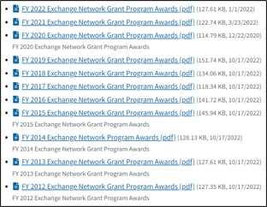
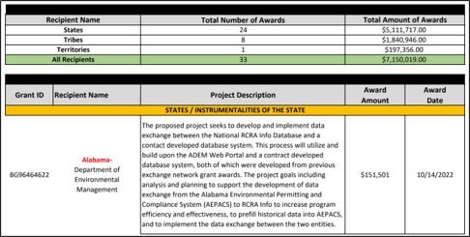
Previous EN Grant Projects Site
Access at https://www.epa.gov/exchangenetwork/previous-exchange-network-grant-projects
9/4/2024
21

Slide 22
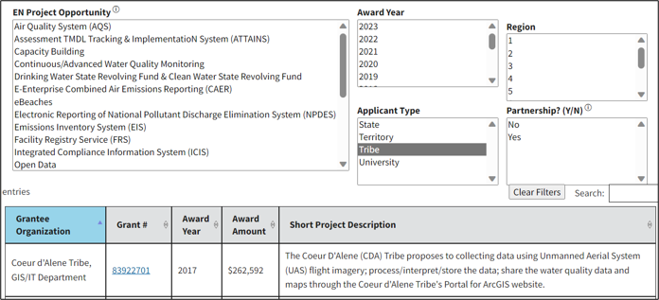
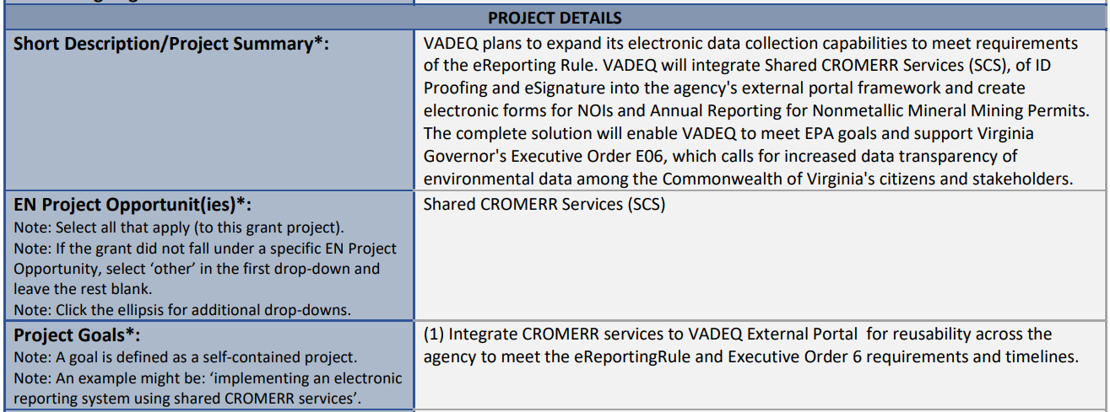
Searchable IT Component and
Project Registration Forms Site
Access at https://www.epa.gov/exchangenetwork/searchable-it-component-and-project-registration-forms ​
Example From:
Virginia DEQ​ (2019)
Grant # 83969901
9/4/2024
22

Slide 23
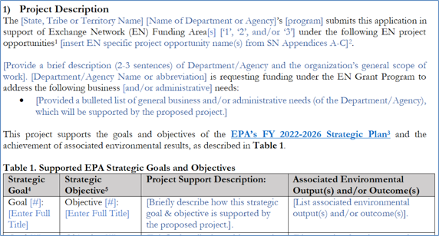
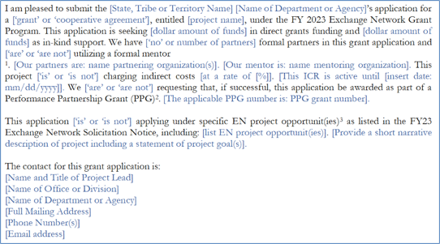
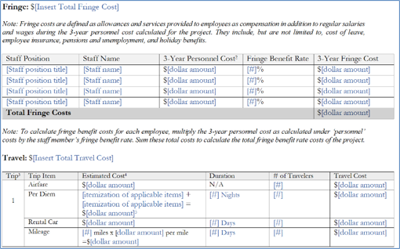
Optional Templates (Cover Letter, Project Narrative, & Budget Narrative)
Access at https://www.epa.gov/exchangenetwork/exchange-network-grant-program#Resources
​
9/4/2024
23

Slide 24
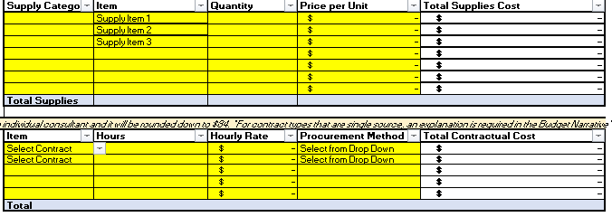
Optional Self-Calculating Budget Tool
Access at https://www.epa.gov/exchangenetwork/exchange-network-grant-program#Resources
​
9/4/2024
24

Slide 25
Other Applicant Resources
SN Appendix D: Applicant guidance on project-relevant topics, e.g., E-Enterprise Digital Strategy, project-budget guidance, etc.
SN Appendix E: Overview of required application attachments, including the submitted (and scored) project narrative.
SN Appendix F: Optional
Pre-Submission Checklist
General and Tribal FAQs: continuously updated lists of frequently asked questions.
EECIP: Inventory for environmental agencies to enter information about projects, technical environment and professional interests.
9/4/2024
25
Notes:
EN Forums: a monthly online venue to discuss how to improve and better use the EN services and partnerships to share information among EPA, states, tribes, and territories, convening on the second Thursday of each month from 1:00-2:00 PM ET

Slide 26
FY24 EN Terms & Conditions
9/4/2024
26

Slide 27
EN Terms and Conditions
Performance Reporting and Final Performance Report: EN grantees must submit semi-annual progress reports electronically through EPA's Central Data Exchange (CDX), twice annually, and submit a final report through CDX within 120 days of project closeout. Reports must include subwardee (partner/mentor) activities, if applicable.
Quality Assurance (QA): All EN grant projects include environmental information operations (EIO). Therefore, all grantees must submit a Quality Assurance Project Plan (QAPP) within 90 days of award.
Registering EN Resources: EN grantees must complete an IT Component and Project Registration form reflecting details of the completed grant and associated developed and reused IT components at the time of grant closeout. This form will be made available on the EN website.
9/4/2024
27
Notes:
Semi annual reporting period: April 1 through September 30 (report due October 31) and October 1 through March 31 (report due April 30).
EIO is defined as ‘work performed to collect, produce, evaluate, or use environmental information and the design, construction, operation, or application of environmental technology.’

Slide 28
Additional EN Terms and Conditions
All award recipients must also:
Meet state/tribal/other cybersecurity condition(s);
Commit to reusing existing EN Tools and Services; and
Follow EPA guidelines as concerns the use of the EPA logo on websites, reports, etc.
Award recipients will also have to meet the following, when applicable:
Competency policy (if requesting over $200K);
Standards for in-kind assistance (if some or all funds are in-kind);
Geospatial data standards (if geospatial data is created);
Requirements for leveraging and voluntary cost match (if either is applicable);
Equipment disposition (if charging equipment costs);
Requirements of the paperwork reduction act (if a cooperative agreement with a survey);
Requirements of substantial involvement (if a cooperative agreement).
9/4/2024
28

Slide 29
Participant Feedback Activity
9/4/2024
29

Slide 30
Participant Feedback Activity – Part 1
Posted around the room are flipchart pages with potential barriers to submitting an EN application. Please grab three sticky notes (blue, yellow, and red) and place on the three barriers most relevant/important to your organization:
BLUE STICKY: Your #1 barrier; the item that is most relevant/important to your organization.
YELLOW STICKY: Your #2 barrier; the item that is second-most relevant/important to your organization
RED STICKY: Your #3 barrier; the item that is third-most relevant/important to your organization.
NOTE: EPA employees should take one green sticky note and put it on the (#1) barrier they think is most relevant to their state, tribal, and territorial partners.
9/4/2024
30

Slide 31
Potential Barriers/Needs for Applicants
Increase to current funding thresholds (currently $300K and $500K)
New and/or improved applicant guidance
New and/or updated EN Project Opportunities (write-ups, activities, etc)
Increased and/or updated technical support and/or technical guidance
A change to current applicant requirements and/or EN T&Cs
Resolving timing concerns (annual application due date, 3-year period of performance, inconsistent SN publication dates, etc)
Enhanced opportunities to partner with other agencies/organizations
Other [please describe on the post-it and/or flipchart]
STICKIES REMINDER:
BLUE: #1
YELLOW: #2
RED: #3
GREEN: EPA
9/4/2024
31

Slide 32
Participant Feedback Activity – Part 2
NOTE: EPA presenter will clarify which of the below options we will do, based on number of participants in the session.
OPTION ONE: Please return to your issue number 1 (that you marked with a blue sticky) to discuss any ideas/comments/feedback/frustrations/etc. with the others who likewise marked this as #1. Capture your thoughts and any suggestions on the paper provided.
If time allows, we will do the same for issue #2.
EPA staff should go to flipboard sheet they marked with their green sticky.
OPTION TWO: Group discussion; please return to your seats and raise your hand if you would like to share your ideas/feedback/comments/frustrations with the group.
9/4/2024
32

Slide 33
Contact
Moderator: Courtney Kerwin (US EPA)
Presenter/POC: Erin McGown (US EPA)
General: ENGrantProgram@epa.gov
Regional: Regional EN Coordinators
Please feel free to send any questions or additional feedback on applicant barriers to Erin McGown OR ENGrantProgram@epa.gov
9/4/2024
33

Slide 34
Thank you!
Questions?

