Slide 1
Square Peg, Round Hole Developing A Data Structure for NRSA & NLA Habitat Data in the Water Quality Exchange
Brandi Easton, Data Manager
Oklahoma Water Resources Board
Notes:
My name is Brandi Easton, I work for the Oklahoma Water Resources Board as the Data Manger for the Water Assessments, Trends, & Environmental Research Division.
I am hear today to talk about our work on getting raw NRSA & NLA habitat data into the water quality exchange.

Slide 2
The National Rivers and Streams Assessment (NRSA) and the National Lakes Assessment (NLA) are a part of EPA’s National Aquatic Resource Surveys (NARS) which provide nationally-consistent physical, chemical and biological data collected by EPA, states and tribes.
The Water Quality Portal (WQP) is the nation’s largest source for water quality data and is the mechanism for anyone to retrieve water monitoring data from EPA.
The Water Quality Exchange (WQX) is the mechanism by which partners can submit data to the WQP.
Notes:
For those who are not completely familiar with the terminology
The National Rivers and Streams Assessment (NRSA) and the National Lakes Assessment (NLA) a part of EPA’s National Aquatic Resource Surveys (NARS) which provide nationally-consistent physical, chemical and biological data collected by EPA, states, and tribes.
The Water Quality Portal (WQP) is the mechanism for anyone to retrieve water monitoring data from EPA.
The Water Quality Exchange (WQX) is the mechanism by which partners can submit data to the WQP.

Slide 3
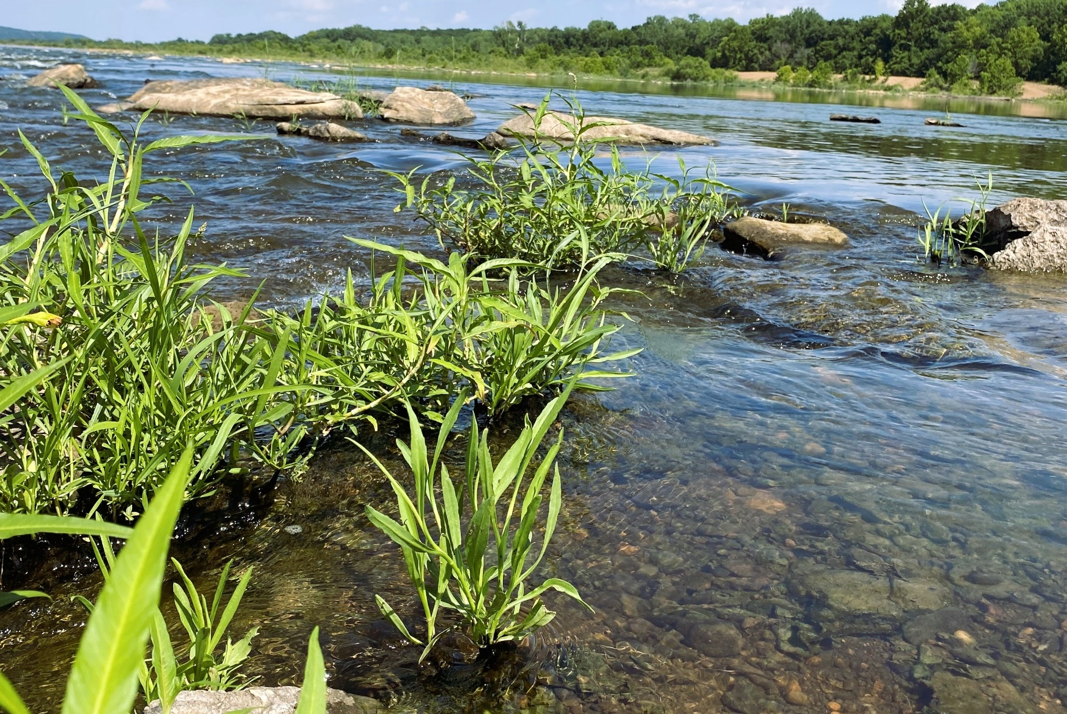
A Tale of Two Projects Made possible by Exchange Network Grants
NRSA
Developed first
Complete
NLA
Developed second
Wrapping up
Notes:
This is a tale of two different projects really. We completely handled NRSA first, and are now in the end phases of the NLA project. A majority of the initial development and puzzling headaches occurred with the NRSA project, by the time we started looking at NLA habitat data I had a pretty good idea of how things would go. So as we go throughout this presentation I will make sure to cover the difference between the NRSA and NLA projects as needed.
Both projects were funded by Exchange Network Grants

Slide 4
NRSA/NLA Raw Collection Data
OWRB Database
WQX
Problems to address:
How to store this data in our database
How to easily import this data into our database
Notes:
Oklahoma Water Resources Board (OWRB) wanted to be able to house our raw habitat data, collected on NARS programs apps, using NARS collection methods, in our database which has a direct connection to WQX.
The project really had two overarching problems to address:
How to store this data in our database
How to easily import this data into our database

Slide 5
Phase 1: Developing a Data Structure
AWQMS: Ambient Water Quality Monitoring System
How to store the data?
Contact NRSA
In AWQMS
AWQMS = WQX Structure
Is there an existing WQX data structure?
Notes:
First we needed to figure out how we were going to store this data in our database. OWRB uses Gold System’s Ambient Water Quality Monitoring System, commonly referred to as AWQMS, it’s structure mirrors WQX. These databases were primarily built to house water quality data, not habitat data. But, we needed to able to store the raw habitat data with as few changes to the database as possible so that it could still be seamlessly sent to WQX.
Working within the confines of the current database would also allow the structure created to be more easily implemented by others, even if they are not AWQMS users.
We first reached out to NRSA staff to see how they were storing raw habitat data and if they had any recommendations. If there was already an existing structure for how this data was stored in the WQX Schema, we should try to match it.

Slide 6
Building A Data Dictionary
Data Dictionary or Data Map: a file that functions like a translator between a data source and it’s destination
No WQX data structure
Must create data dictionary
How to store the data?
Contact NRSA
In AWQMS
AWQMS = WQX Structure
Is there an existing WQX data structure?
Notes:
We were informed that this data was not currently in WQX, and that there had been a couple previous attempts to figure out how to store this data in the WQX data schema, but none had been successful.
So there wasn’t really a reference for us to follow or work from. We were going to have to figure out the best way to store this data ourselves.
We first needed a list of every possible piece of information that potentially needed to be captured, and then create a dictionary, or map, in relation to our database. A data dictionary or data map is a file that functions like a translator between a data source and it’s destination.
While making this data dictionary, we also needed to keep in mind how each piece of information interacted with each other and potential data structure rules within WQX, in order to properly define each data piece.

Slide 7
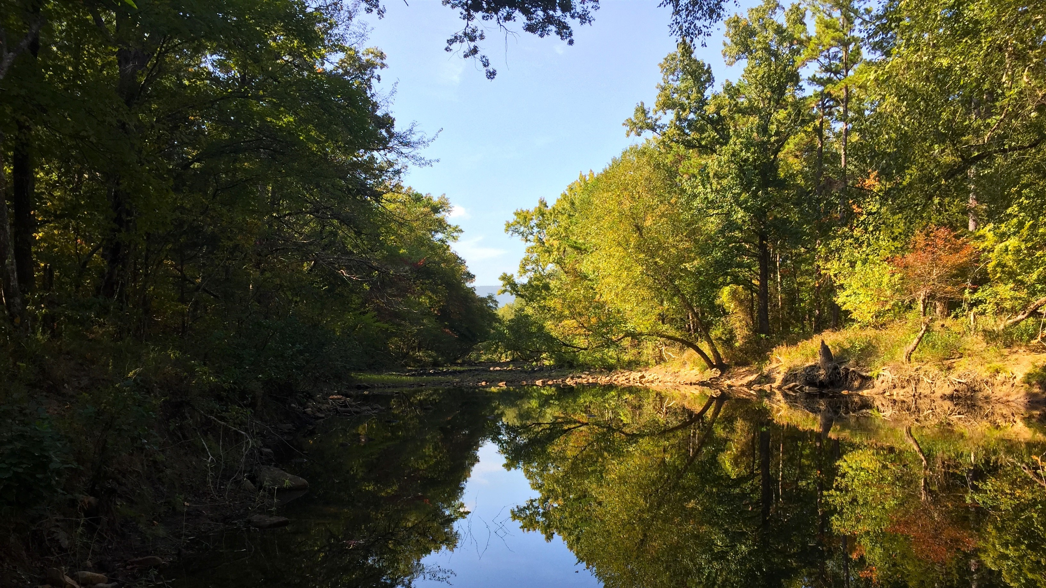
Notes:
As kind of a visual example for this concept, you are out in the field collecting habitat data, and

Slide 8
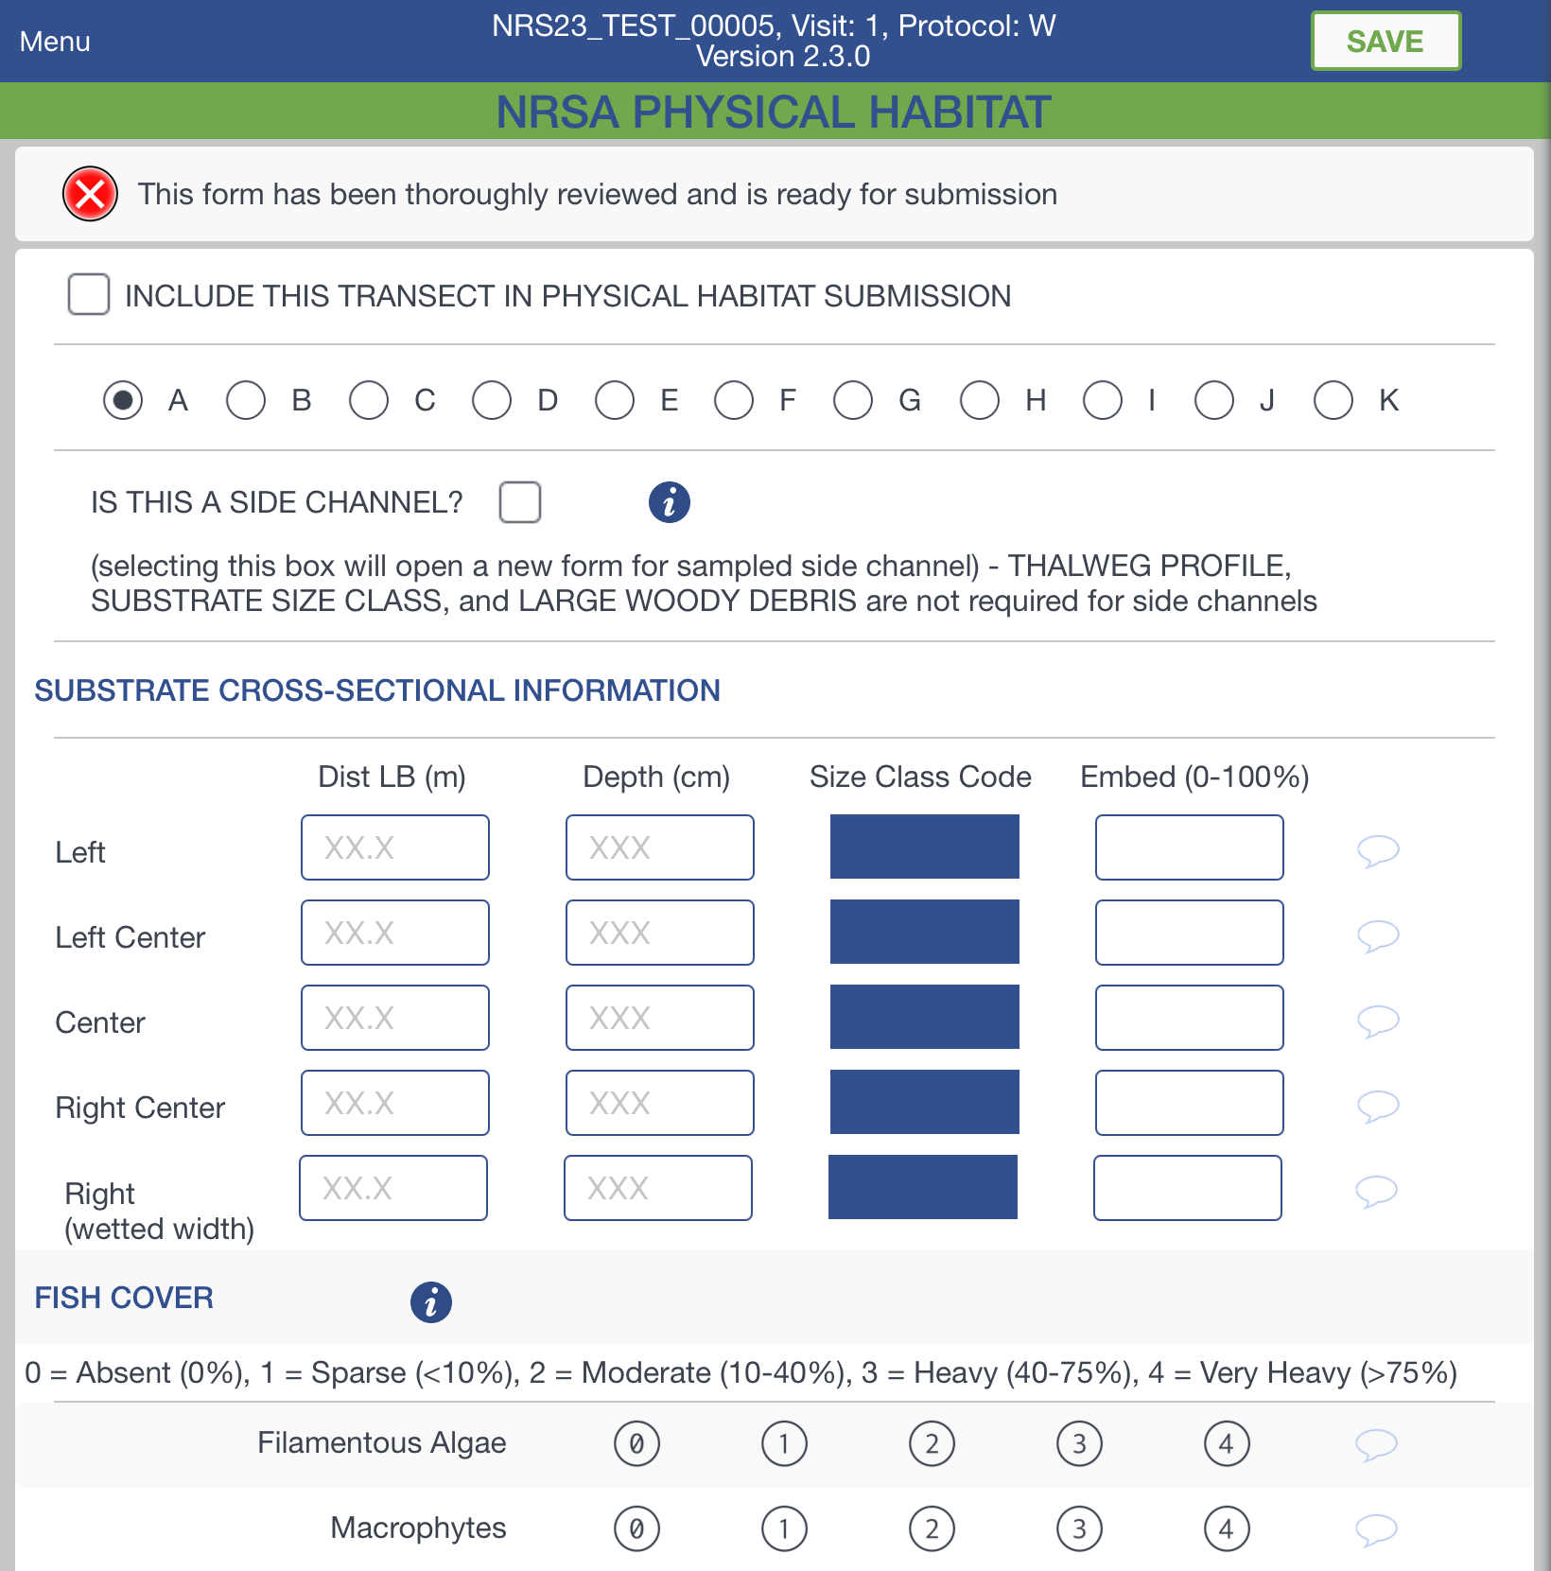
Notes:
entering it into the NRSA collection app.

Slide 9
Notes:
For the Substrate Cross-Sectional Information Section shown, you are measuring distance from left bank, depth, and so on. These are the things you are out measuring and collecting so they are typically what come to mind first as data that needs to be recorded. But you will also need

Slide 10
Notes:
the transect, the position in the stream and potentially a comment.

Slide 11
Result
Result: product of a field measurement, observation, or lab analysis
Metadata: pieces of data providing context or further information on a result
Activity: a group of results that were collected together
Data Management Specialist
Data
Habitat Specialist
Metadata
Sources of reference during mapping: NARS historical collection sheets, NARS field operations manuals, current NRSA/NLA collection app, and the output from the NARS RShiny app
Data would be contained in one activity
Notes:
We needed to understand which pieces of data were results (which are products of a field measurement, observation, or lab analysis, for example things like depth or pH) and which pieces of data were providing context to that result, also known as metadata (metadata can be things like date or analysis method)
This required the coordination between data management specialists and habitat specialists. Neither party had all the expertise required to accomplish the task on their own. We needed to be able to communicate with and understand one another.
I had to learn every aspect of NRSA and NLA habitat data from collection, to data output, to how it is used and analyzed. Next I had to relate that to how it could be best captured in our database, and then finally communicate that to our habitat specialists.
Naturally, there was much confusion had in both parties throughout this process. As soon as we thought we had reached an understanding, we found out all of us had each landed on different understandings.
Initially I thought the most difficult part was going to be learning everything to do with habitat data, but actually figuring out how to effectively communicate database structural concepts to people who had little to no exposure to the inner workings and relationships within the database ended up being much more challenging.
We used historical collection sheets, field operation manuals, current NRSA/NLA collection app, and the output from the NARS RShiny Data Extraction Tool as references when mapping this data. These resources helped inform our decisions throughout the mapping process.
First we started off trying to build the data structure off the assumption that all the data would be contained in one activity. For the purposes of today just think of an activity as a group of results that were collected together.
The things that ended up causing the most difficulties were locational information.

Slide 12
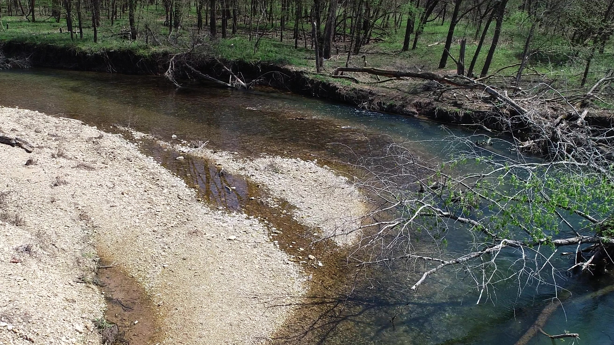
Monitoring Location
Notes:
On most water quality data, you have a monitoring location and that’s about it really. Just one piece of locational data.

Slide 13
Monitoring Location
Transect B
9
Transect A
8
7
6
5
4
3
2
L
1
0
LC
C
FLOW
RC
R
Notes:
With streams habitat you have the monitoring location which contains several transects, and those transects can have stations down the thalweg and relative positions across the stream.

Slide 14
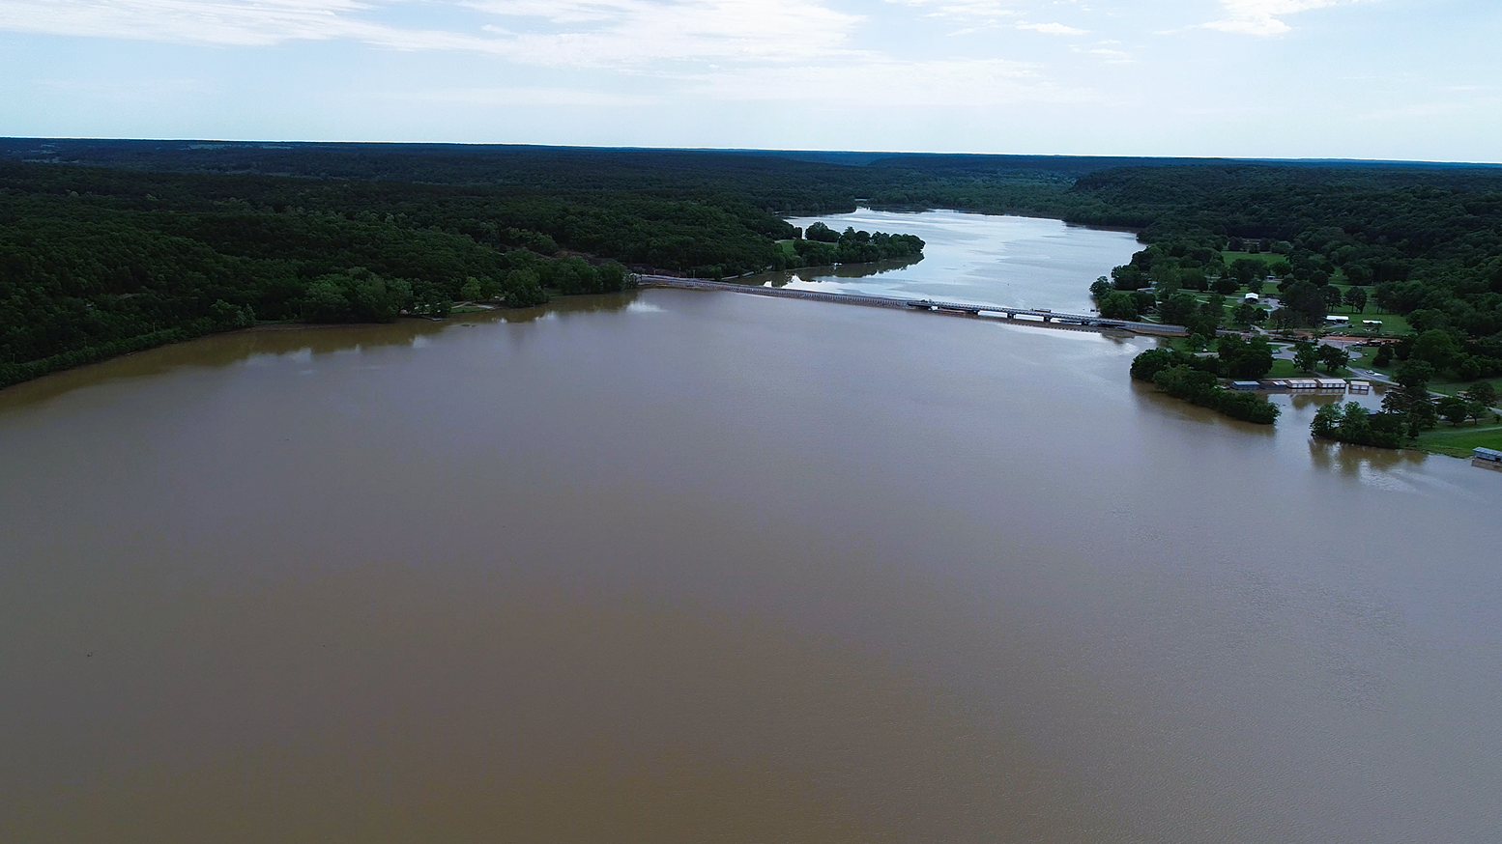
Monitoring Location
C
Station
A
B
Notes:
And with lakes habitat you have the monitoring location which will have several stations around the lake,

Slide 15
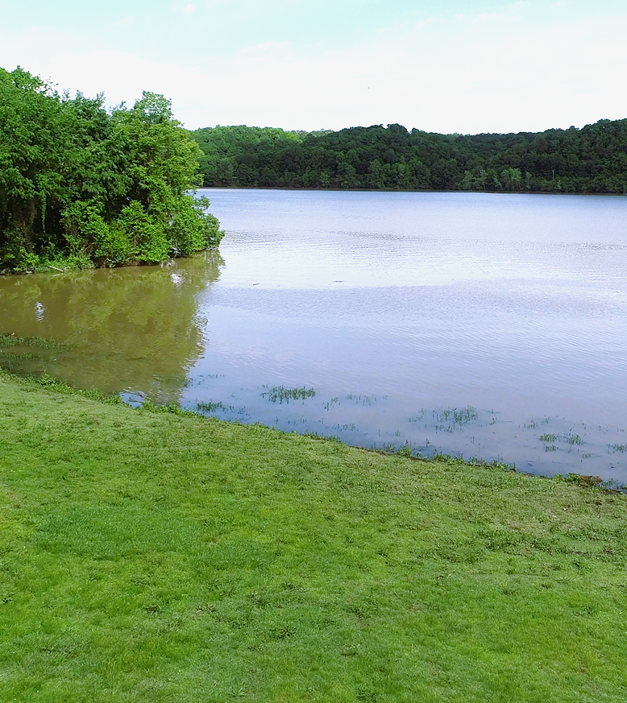
Monitoring Location
Littoral Zone
Littoral Zone
Shoreline Band
Shoreline Band
Drawdown Zone
Riparian Zone
Station A
Notes:
and those stations will have several different habitat zones.
In either scenario, this is a lot of location information to capture, these data are critical to understanding any of the individual results collected at the event. Without this locational data being directly associated to the individual results, you cannot make sense of the raw data.

Slide 16
One Activity
Transect
Stream Position
Station No.
Single Result Locational Element
Element: an individual storage field in a database, visually one can think of this as a column in an export. Some are activity level, meaning they must be the same for all results. Others are result level, meaning they can differ for each result in the activity.
Notes:
I really want to draw your attention to the definition on this page, it is critical to much of what I talk about next. You can think of an element as an individual storage field in a database, visually one can picture this as like a column in an excel file. Some elements are considered activity level, meaning they must be the same for all results. Others are result level, meaning they can differ for each result in the activity.
With one activity for streams habitat data, we would need to store transect in a result level element since the transect could vary throughout the activity. We would also need to store relative stream position and station number in result level elements. Currently, there is only one result level locational element. Having all of these captured in the same result level locational element greatly reduces the usefulness of that element.

Slide 17
The Element Addition Problem
External Database Mapping
Export Mechanism
Import Mechanism
Internal Storage
Search Function
Notes:
In order to address this problem a minimum of 2 new result level elements would be needed for stream position and station number. This is no small change, and trying to accomplish this in the database we use was going to be difficult, and expensive. Keep in mind anytime a single new element is added to a database, changes must be made not only to the internal storage structures, but also: import mechanisms, export mechanisms, potentially search functions, and connections to external databases like WQX. Trying to get WQX and WQP to update as well was going to be even more difficult, and there was no guarantee it was ever going to happen.
Even if WQX and the WQP could add in the needed elements, this would mean that other groups and databases connected to the WQP would need to update as well. Creating an ever expanding element addition problem.
OWRB’s ultimate goal was to have our habitat data in WQX. This problem caused serious concerns for data usability and accessibility.
We simply didn’t have enough of the right kind of elements available for use for the data we needed to keep as metadata.

Slide 18
The Element Addition Problem
External Database Mapping
Export Mechanism
Import Mechanism
Internal Storage
Search Function
ROAD CLOSED
Notes:
This very issue was the road block encountered by previous data mapping efforts of NRSA.

Slide 19
How we get the elements we need, without creating new ones?
Recalculating
Notes:
How do we get the elements we need, without creating new ones?
This was an issue that seriously confounded us, if we could not figure this out our project would stall out at the same place as previous attempts. So we stepped back, and decide to try mapping all over again.
We knew the pieces of data that were causing the most issues, structurally, were location related data. We looked again at all possible data elements, and found 1 more locational element. However the element was activity level.
Then we asked ourselves: How could we organize the data so at least 1 piece of locational data would be the same on all results of that activity?

Slide 20
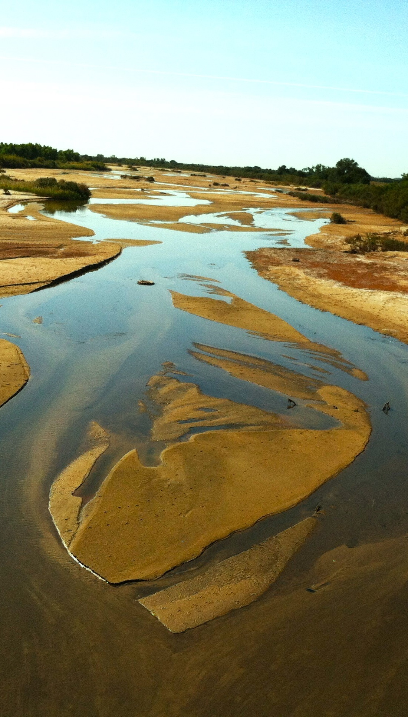
Multiple Activities
Transect A
Transect B
Transect C
Etc.
Non-Transect Data
Notes:
The answer was to have multiple activities for one habitat visit.
Separating out the activities into an activity for all non-transect related data, and then an activity for data collected at each transect, opened up the activity level element available for use.

Slide 21
Multiple Activities
Streams
Transect
Stream Position
Station No.
Sampling Component
Result Sampling Point
Notes:
Transect was now an activity level data and could be stored in Sampling Component. As we were trying to figure out where to separately store relative stream position and station number, we realized that excepting one parameter these data never occurred at the same time, they were always separate. For example, there was never a result collected in the right center section of the stream at station 3. Once we finally realized this, it meant that we could use the same result level locational element, Result Sampling Point, to store relative stream position and station number, so long as they were clearly labeled.
Switching from one activity to multiple activities enabled us to fit the data in our database, and WQX, with no new elements being needed. Everything could be stored in the database as it currently is.

Slide 22
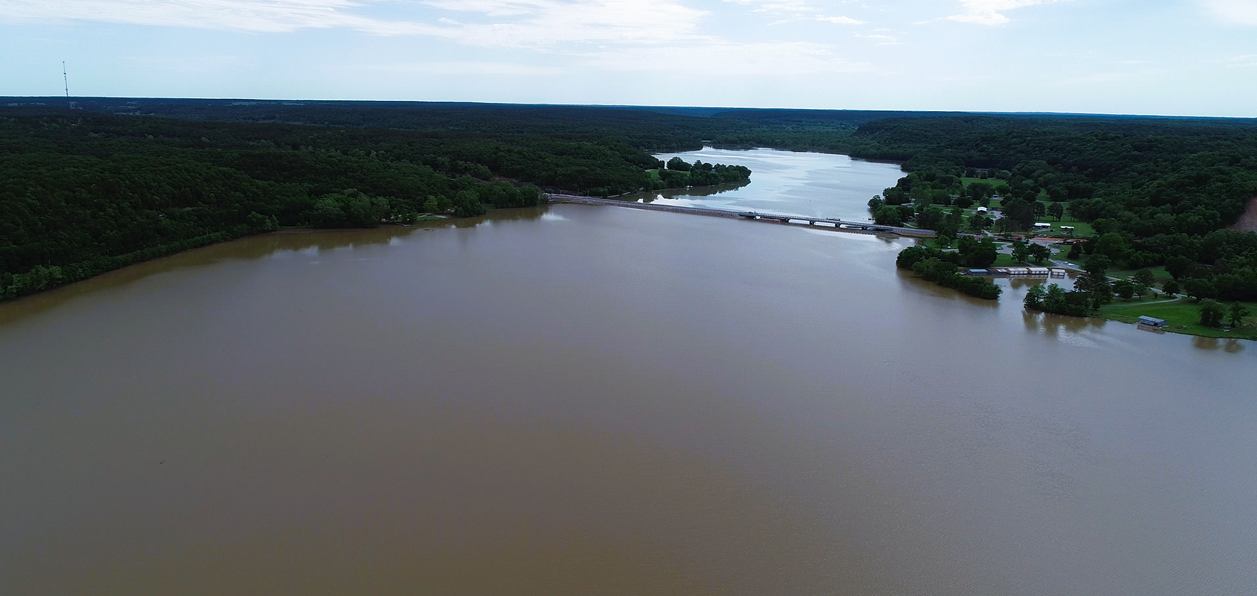
Multiple Activities
Lakes
C
B
Station
A
Launch/
Whole Lake
Index
Notes:
When it came to lakes habitat data, we already knew that having multiple activities was a more feasible data structure. There would be an activity for general “Whole Lake/Launch” results, an activity for Index site results, and an activity for each habitat station around the lake.

Slide 23
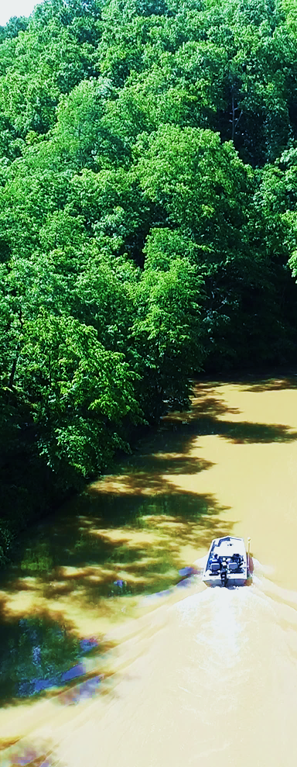
Multiple Activities
Lakes
Station
Lake “Zone”
Sampling Component
Result Sampling Point
Notes:
Station was mapped to Sampling Component, since it would be an activity level data much like transect was in streams. And then the lake “zone” was mapped to Result Sampling Point.

Slide 24
Scope of work
NRSA | NLA
501 | 450
Import or ignore?
Result or metadata?
What is the field name in the app?
What should it be called in the database?
Is there a pick list of values?
Are there units?
How does this data relate to others?
Where is this data at locationally?
What are all the possible outputs for it from the app?
Etc.
Notes:
Even though we had the most problematic issues addressed. There was still a ton of data to go through piece by piece and completely account for.
From NRSA we had a total of 501 data pieces as possible outputs from the NRSA app, and from the NLA app we had 450.
For each piece of data we had to figure out:
Do we want to import it or ignore it?
Is it a result or metadata describing a result?
What is the field name in the app?
What should it be called in the database?
Is there a pick list of values?
Are there units?
How does this data relate to others?
Where is this data at locationally?
What are all the possible outputs for it from the app?
And so on.
This was an enormous amount of work to slog through. But we did it.
Upon completion of the data mapping we met with several NRSA, and then NLA, staff and several other states who were interested in this work. We wanted to make sure that they approved of and agreed with the structure we had developed, and they did.

Slide 25
Phase 1 Complete: Raw Data Mapped and Data Structure Made
Notes:
So, we now had a complete mapping of the raw habitat data to our database. Next, we had to figure out how to get the data into our database with the structure we had created.

Slide 26
Phase 2: Developing A data flow
OWRB Database
?
NARS R Shiny Data Extraction Tool
JSON Files
Notes:
As the data management specialist in this project, it was extremely important for me to facilitate the data flow development process. I needed to ensure that the data flow developed was manageable and as uncomplicated as possible.
There were two possible pathways: using the JSON files which were the direct outputs from the NRSA (and NLA) app, or using the output of the NARS RShiny Data Extraction tool.

Slide 27
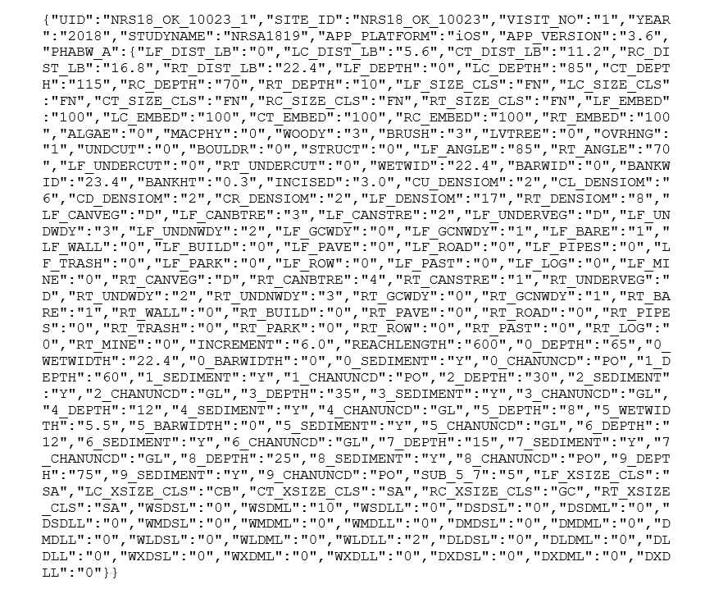
Json files
Notes:
These are what the JSON files look like. They are text based files, that can vary in structure and content based upon what has or has not been entered into the collection app. Because they had that variability factor, using traditional column based database import methods was not an option.

Slide 28
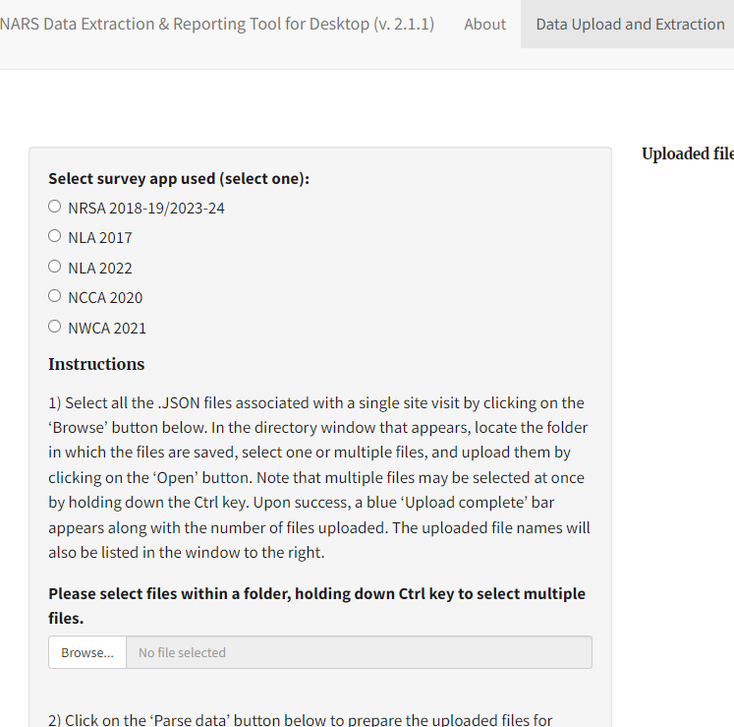
NARS R Shiny data extraction tool
Notes:
NARS does have an RShiny app that will convert these JSON files into an excel format.

Slide 29
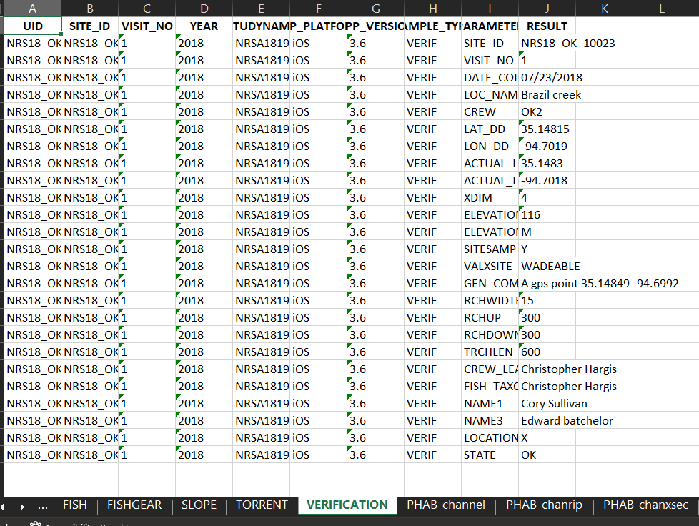
NARS R Shiny data extraction tool
Notes:
However the output is not a format that our database’s import processes could handle in the output’s current structure.

Slide 30
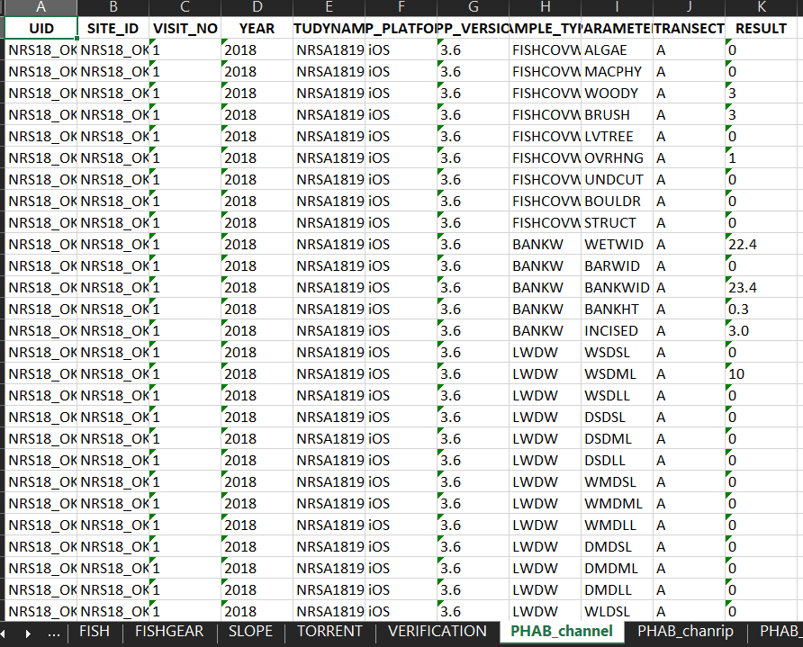
NARS R Shiny data extraction tool
Notes:
It would require us to develop some code to restructure the entire thing in order to import and add in some fields since it is missing some information that WQX requires.

Slide 31
JSON Files
NARS R Shiny Data Extraction Tool
JSON Files
Restructuring Code
VS
OWRB Database
Notes:
After discussing the options with Gold Systems, who are the developers of our database, we decided that using the JSON files would be the best pathway forward.
Going with the JSON files meant fewer data processing steps for us, since it would eliminate the need to convert the JSON files to an excel format and then restructure them.
This required the development of an entirely new import process. In order to guarantee that this worked properly we had to extensively test every output possibility from the NRSA collection app, and work very closely with Gold Systems developers to ensure that they understood exactly what we were needing.

Slide 32
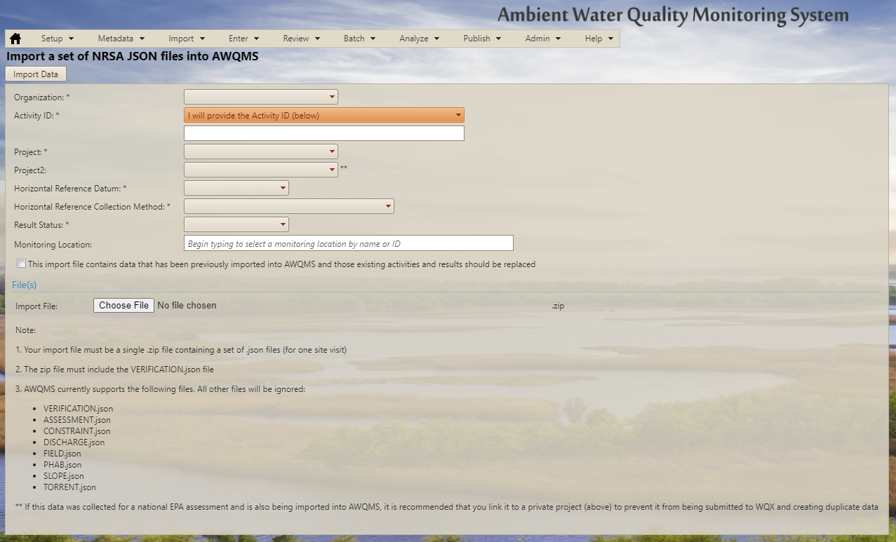
NRSA JSON Import Tool
Notes:
After several months of development and testing, lot’s and lot’s of testing, then reconfiguring the import , and then testing again, we finally had a functional NRSA JSON import tool. One that was simple to use, and facilitated a manageable data flow.
Upon downloading the NRSA JSON habitat forms we emailed to ourselves at the completion of the survey, we can go into the folder they were downloaded to and zip up the applicable files. I say applicable because currently not every JSON file has been mapped and available for use in the tool. Next we log into our database and go to the NRSA JSON file import tool.

Slide 33
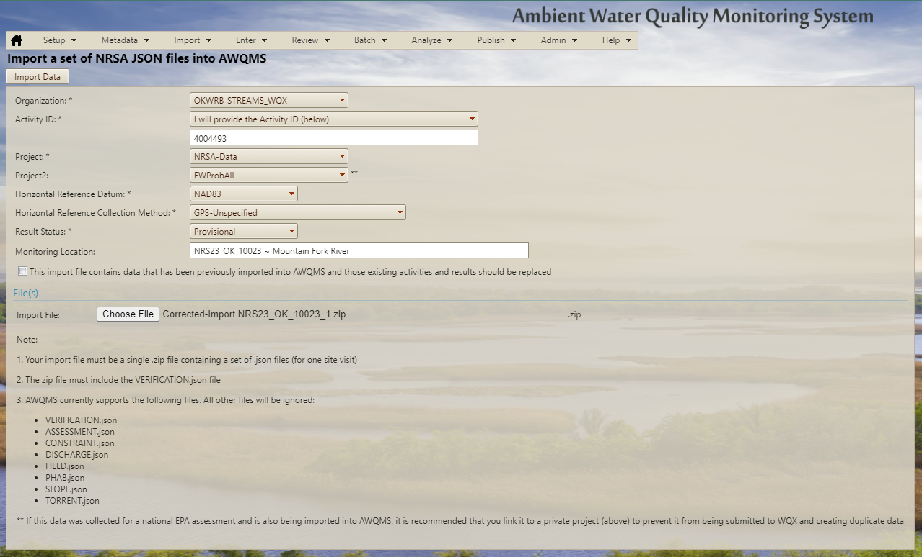
nRSA JSON Import Tool
Notes:
There are some data we have to fill out prior to import, but once that is done we select our zipped file and import.

Slide 34
nRSA JSON Import Tool
Notes:
And that’s it, it is in the database

Slide 35
nRSA JSON Import Tool
Notes:
in the structure we needed it to be in. This is a screenshot from our database where we can see the activities I uploaded in my example, there is a non-transect activity at the top, and then beneath that is an activity for each transect that was sampled in this event

Slide 36
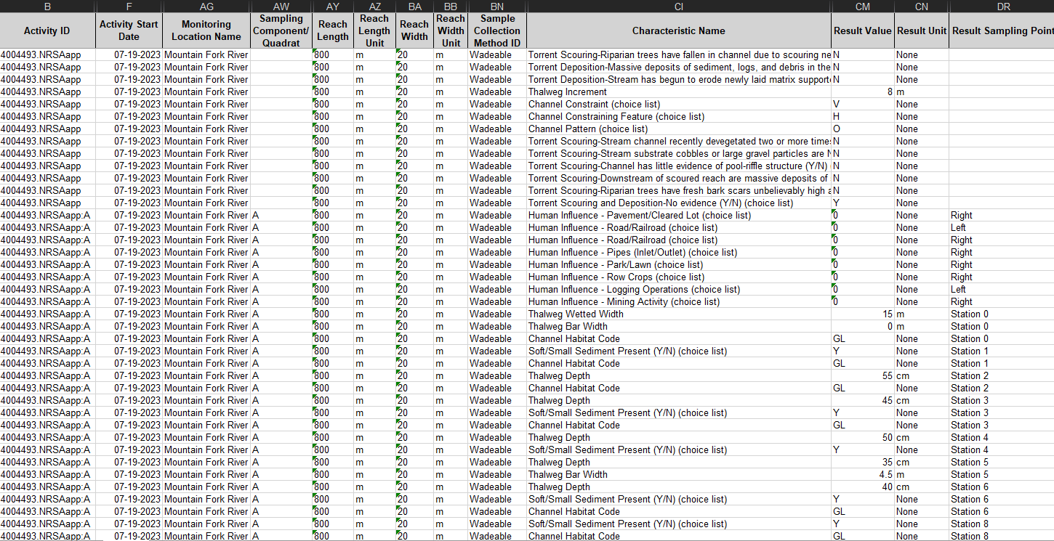
Streams Data
Notes:
This is an example of an edited streams habitat export from our database, I have hidden some columns so we can see some key fields. The most important pieces to pay attention to are

Slide 37
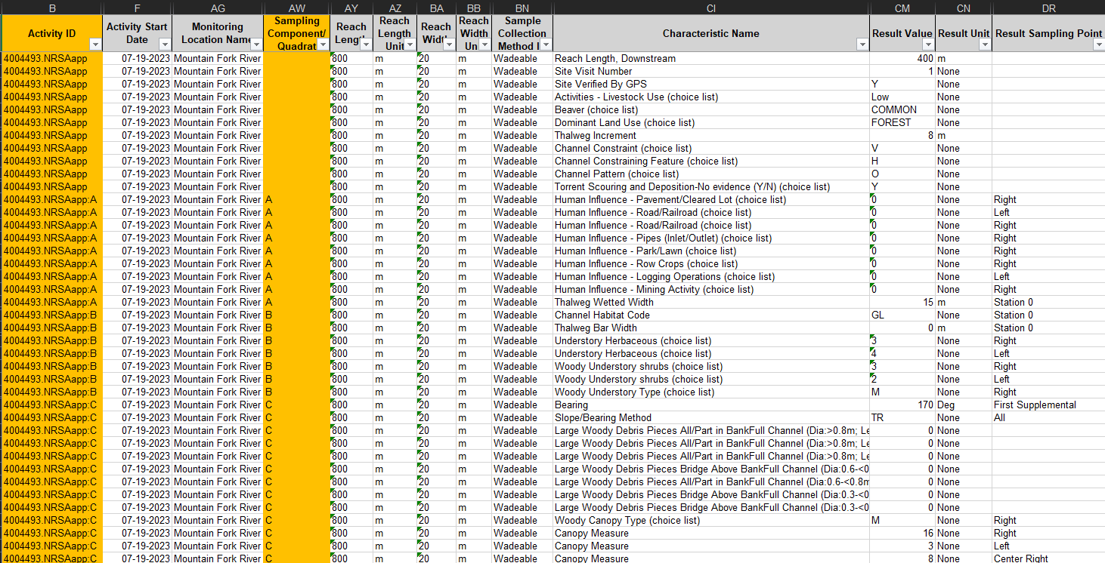
Streams Data
Notes:
the Activity ID in relation to Sampling Component, notice how the Activity ID changes with the transect

Slide 38
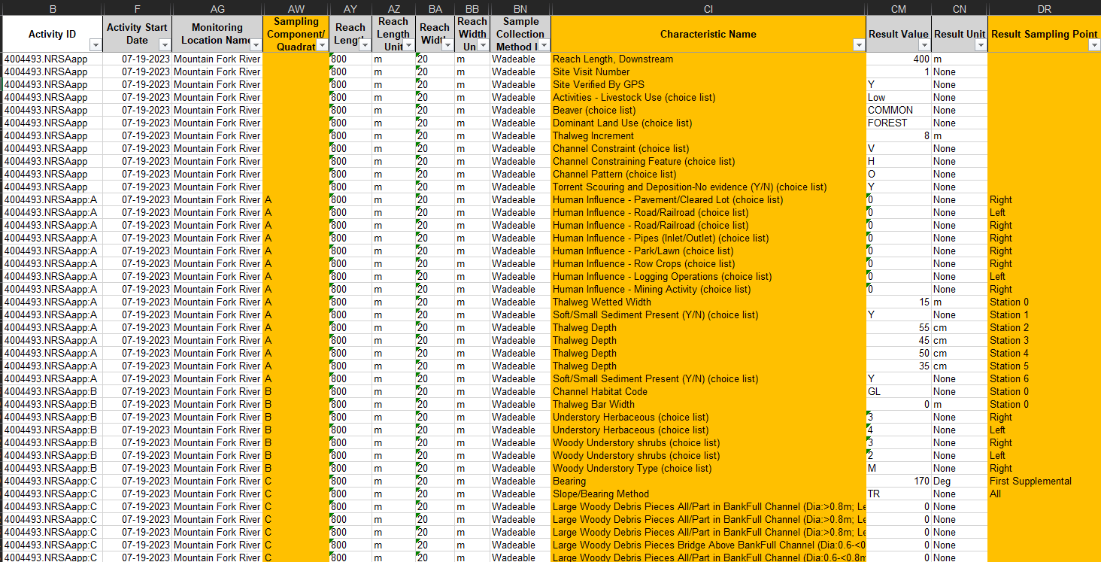
Streams Data
Notes:
And Sampling Component, Result Sampling Point, in relation to the various results that are collected. Every result has all of it’s locational data easily stored and available for use. Obviously there are other important data pieces as well, but for our purposes today I felt that these were the key ones to highlight. And that is how the raw data appears in an export from our database, excepting many other metadata fields.

Slide 39
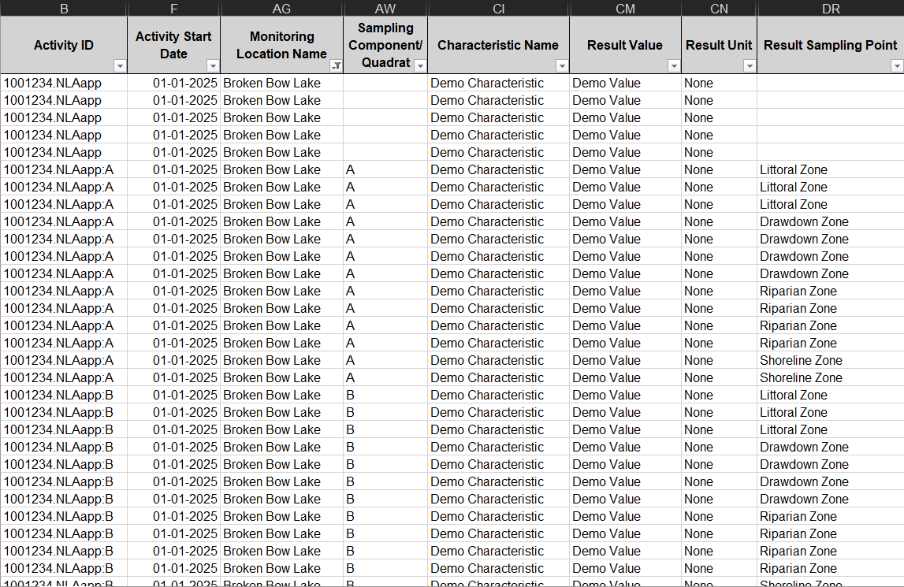
Lakes Data
Notes:
The import tool for NLA is still under development. But it will look and function very similarly to the NRSA tool I just went over. I have created a mock-up of what the lakes data will look like

Slide 40
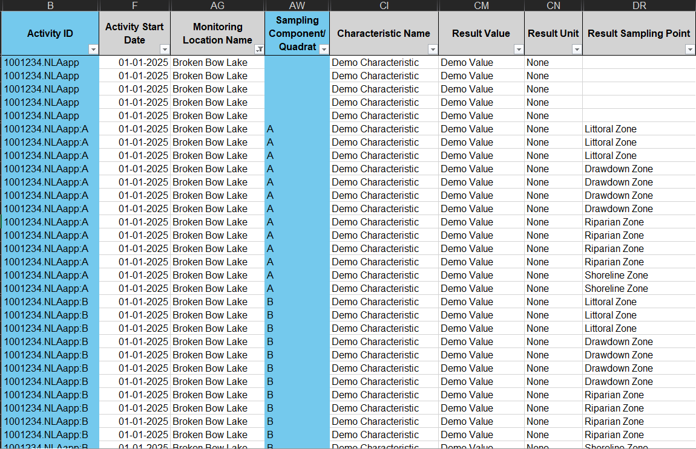
Lakes Data
Notes:
like NRSA the Activity ID changes in relation to Sampling Component, which is where the lake station will be stored

Slide 41
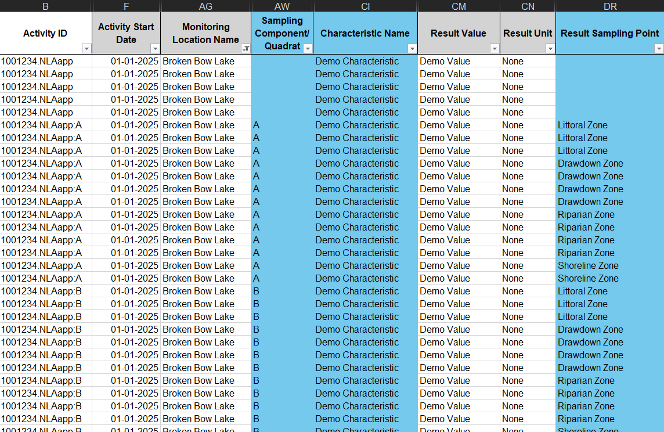
Lakes Data
Notes:
Here you can see the Sampling Component or Station ID in relation to Result Sampling Point or Lake “zone”. Every result has all available locational data appropriately stored.

Slide 42
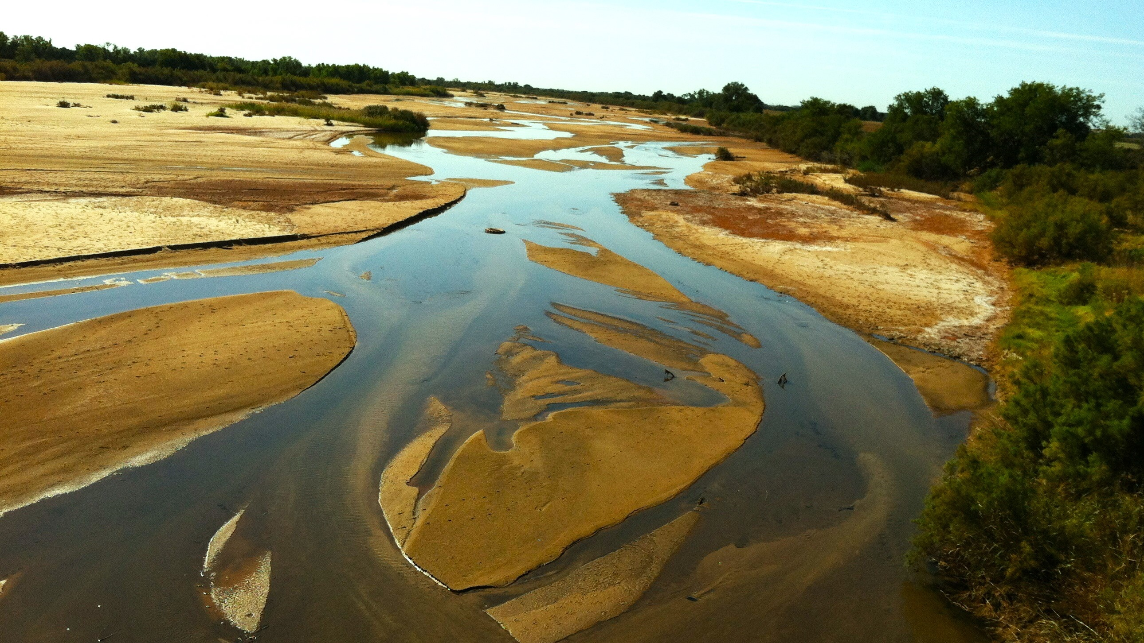
Final Data Flow
NRSA/NLA Collection App
JSON Files
NRSA/NLA JSON Import Tool
OWRB Database
WQX
OWRB raw NRSA habitat data is already in the WQP!
Next Steps
NLA and NRSA biological data have been mapped. Import tools are in development by Gold Systems, expected to be completed soon
Planning a workgroup with NARS staff and several other state agencies who also use AWQMS and the NRSA app, to work together on creating QA, Metric Generation, and Data Visualization R packages for NRSA habitat data
Created a Survey123 App for state probabilistic habitat program, working on developing script to process data to fit general data structure developed for NRSA habitat data
Notes:
In summary we have created a data structure for NRSA and NLA habitat data that fits in WQX and the WQP, and the overall dataflow that was created goes from NRSA/NLA collection app, to JSON files, to import tool, and then it is in the database and available for use.
And I am happy to report that the OWRB has already uploaded all NRSA-like habitat data from 2018-2023 and it is available in the WQP
Next steps: NLA and NRSA biological data have been mapped. Import tools are currently in development by Gold Systems. They are expected to be completed soon, and then import testing can begin.
We were awarded a new Exchange Network Grant to continue developing this work. We are planning a workgroup with NARS staff and several other state agencies who also use AWQMS and the NRSA app, to work together on creating QA, Metric Generation, and Data Visualization R packages for NRSA habitat data.
I also created a Survey123 collection app for our state probabilistic habitat program and am in the midst of a major data flow overall for this program as well. While different sampling approaches, the data for this habitat collection is structurally very similar to NRSA data, so it has been immensely helpful at improving data collection and data flow for this other program as well.

Slide 43
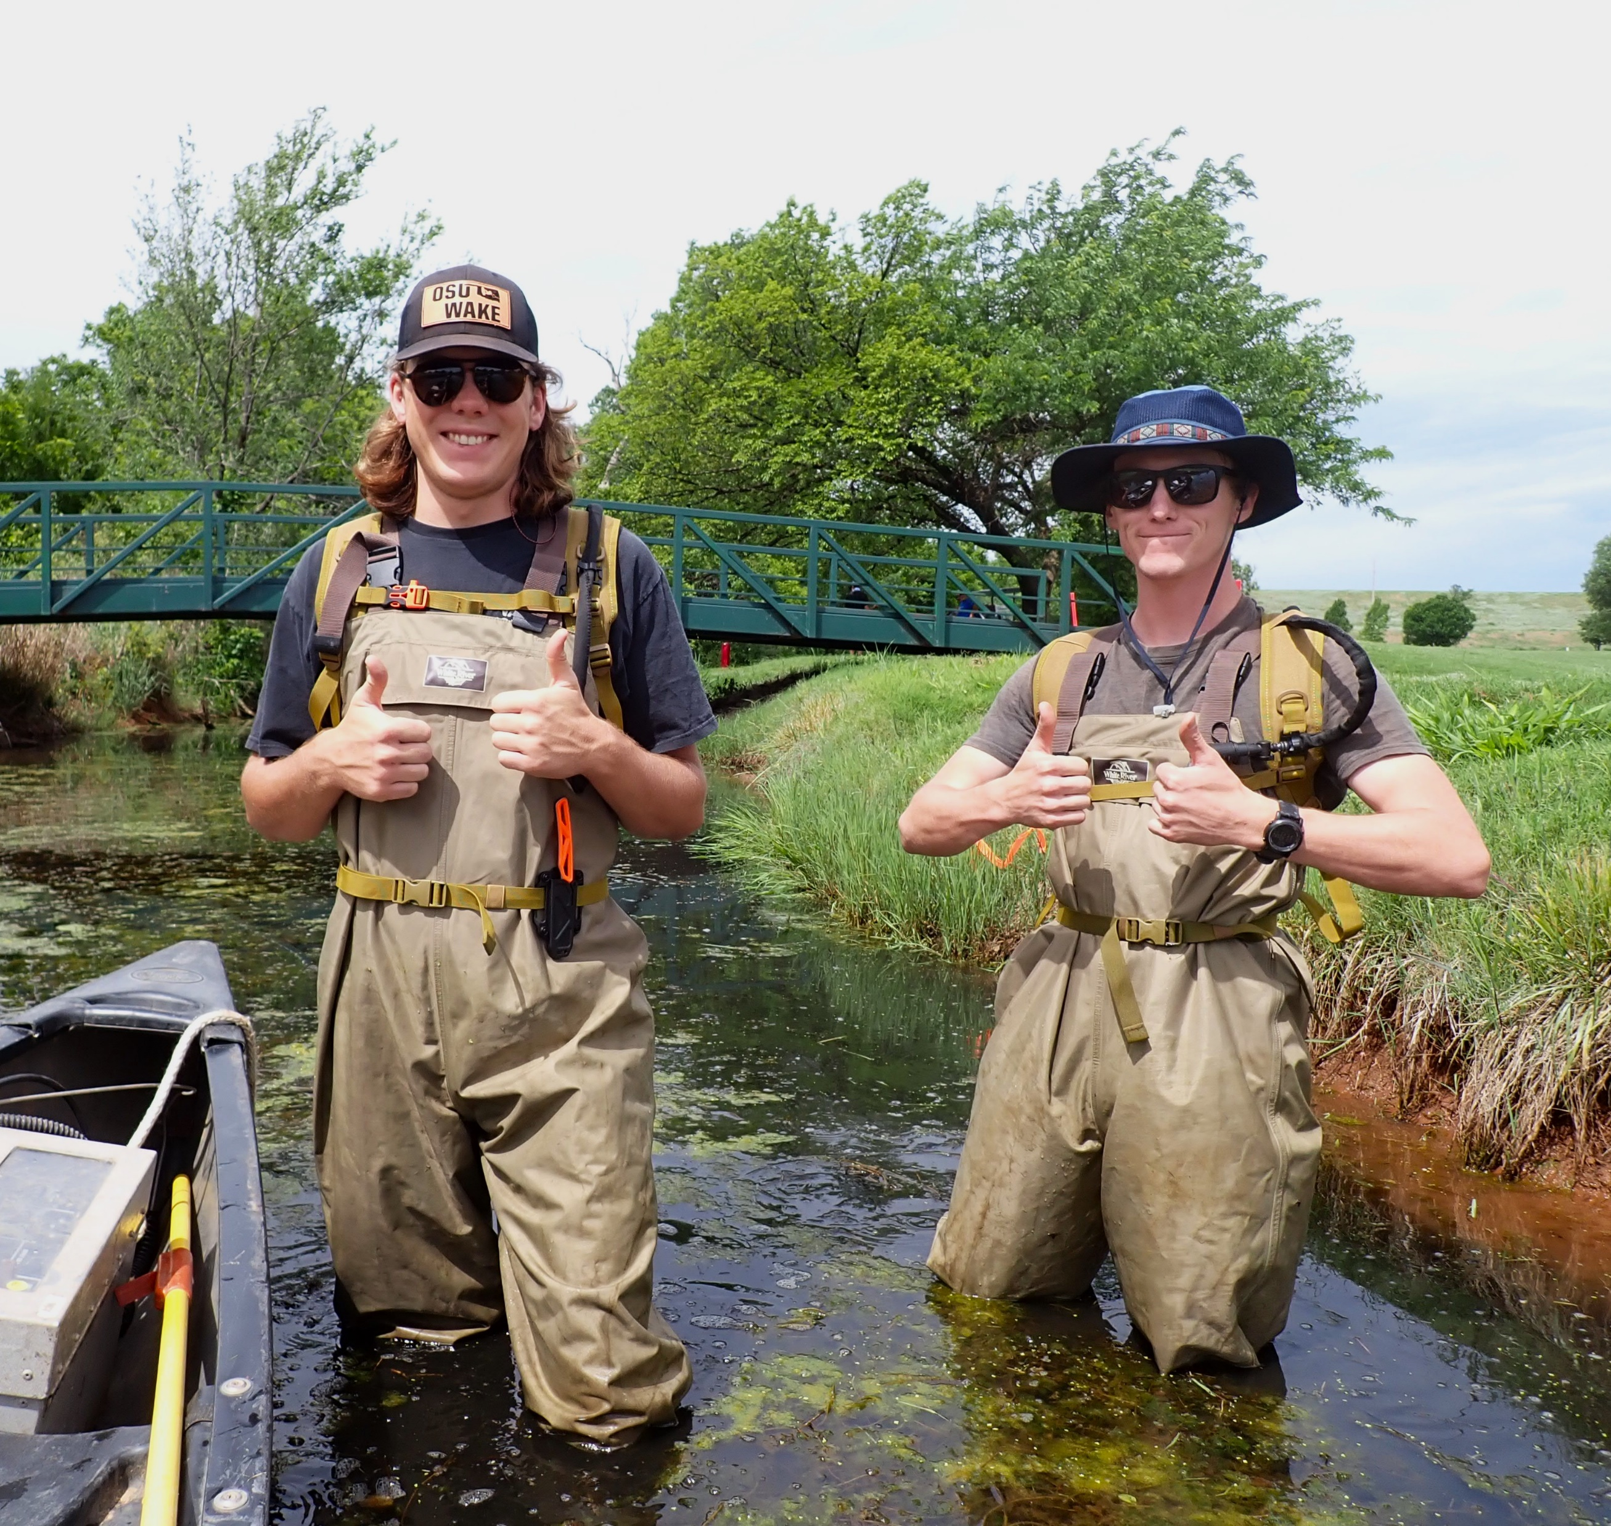
Thank You
Exchange Network Grant Program for funding this project
Monty Porter, Chris Hargis, Jonathan West, and James Decker: OWRB habitat specialists on this project
Ryan Jorgenson and Stephen Beard, Gold Systems developers on this project
Karen Blocksom of EPA, who created the metadata tables we used as starting points in our data dictionaries, made time to meet on this work and answer numerous questions
Numerous staff in the NLA and NRSA programs, who made time to meet on this work
Aaron Borisenko, Sarah Rockwell and Shannon Hubler of Oregon Department of Environmental Quality, who helped in establishing some inter-agency communication and in testing the NRSA import tool

Slide 44
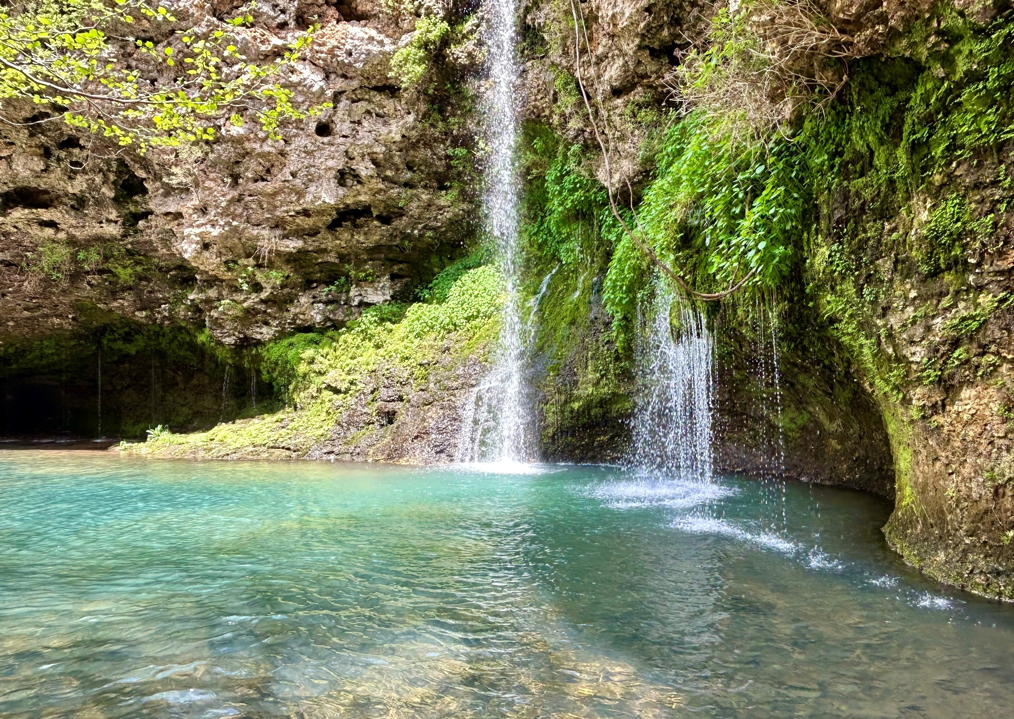
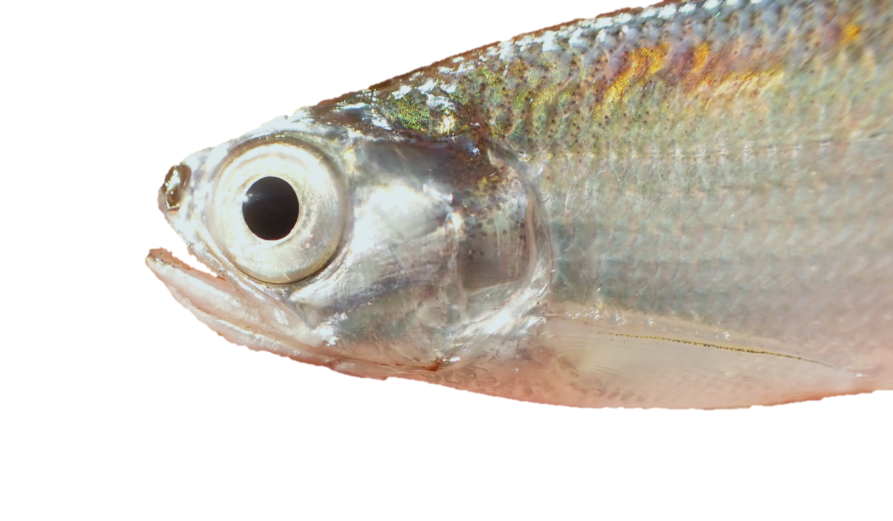
Contact information
brandi.easton@owrb.ok.gov
https://www.linkedin.com/in/brandi-easton-4859ab136/
Questions?
Notes:
I didn’t really get into the nitty gritty details of the data structures made, since going through excel mapping files item by item is a certain kind of happy nightmare, but if anyone is interested in discussing the details of this further, need help implementing this structure yourself, or are AWQMS users and need assistance on the NRSA (and future NLA) import tool I am more than happy to be a resource.

