Slide 1
Practical Data Management Plans
Tuesday, September 17, 2024

Slide 2
What do you mean by Data Management?
Some basic definitions
9/12/2024
2

Slide 3
Data Management
What is Data Management?
The process of storing, organizing, maintaining and using data created, collected, and/or generated by an organization.
What is the goal of data management?
To help organizations optimize the use of data to make informed decisions to maximize the benefit of the organization.
Where did Data Management originate?
1960s: the concept of data management began
1970s: relational databases were developed
1980s: merged data management ecosystems (data warehouses)
1990s/2000s: Big data and data lakes
2010s: Data catalogs and Data Hubs emerge (making data searchable)
9/12/2024
3

Slide 4
Why is Data Management Important?
Good Data Management:
Enhances Data Increases Accessibility
Improves Transparency Increases the possibility of Re-use
Data Management Plan (DMP)
A DMP is a document or plan that contains elements of how a project’s data will be handled. *
The plan describes what data will be acquired; how the data will be managed, described, and stored; what standards will be used; and more.
The goal of a data management plan is to consider the many aspects of data management life cycle to ensure the data are well-managed in the present and prepared for preservation in the future.
*US FWS Data Management Life Cycle - Data Management Plan
9/12/2024
4

Slide 5
Open Data Principles*
Public. Consistent with OMB’s Open Government Directive, agencies must adopt a presumption in favor of openness to the extent permitted by law and subject to privacy, confidentiality, security, or other valid restrictions.
Accessible. Open data are made available in convenient, modifiable, and open formats that can be retrieved, downloaded, indexed, and searched.
Described. Open data are described fully so that consumers of the data have sufficient information to understand their strengths, weaknesses, analytical limitations, security requirements, as well as how to process them.
Reusable. Open data are made available under an open license that places no restrictions on their use.
Complete. Open data are published in primary forms (i.e., as collected at the source), with the finest possible level of granularity that is practicable and permitted by law.
Timely. Open data are made available as quickly as necessary to preserve the value of the data.
Managed Post-Release. A point of contact must be designated to assist with data use and adhere to these open data requirements.
*Data.gov Open Data Principles
9/12/2024
5

Slide 6
How do we begin?
Project Discovery
9/12/2024
6

Slide 7
Project Discovery
The Project Discovery Phase is the first step in the project where everyone involved gathers to figure out and write down the project's scope, goals, limits, and what needs to be achieved. This phase is like plotting the course before starting a long journey. And, as with any adventure, you may discover entirely new things you’ve never heard of nor seen as you plan.
Initiating the project and forming the team: Just like assembling the Avengers, the first step is to gather your project team.
Conducting initial project research: This step involves gathering information about the project domain, community trends, target audience, and competitors. It's like putting on your detective hat and gathering valuable clues about what works and what doesn’t.
Gathering stakeholder requirements and input: Now it's time to put those listening skills to good use. Talk to stakeholders, gather their requirements, and understand their priorities.
Defining project scope and deliverables: It's time to draw the boundaries! Define the project's scope, establish what's in and what's out, and set realistic expectations.
Creating a comprehensive project discovery report: Last but certainly not least comes findings documentation in a comprehensive project discovery report. It's like your project's secret handbook, ensuring that everyone stays on track and that you can refer back to your Sherlock Holmes days when needed.
Project Discovery for Data Management is also known as the “PLAN” component of the data management lifecycle on the next page!
9/12/2024
7

Slide 8
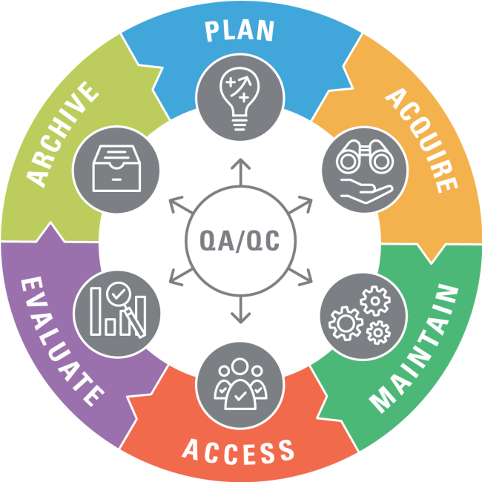
Gather your team - use the data life cycle!
We start with Planning and consider ALL the other data lifecycle steps as part of it.
Its important to include people who can represent ALL the data perspectives
Those who focus on the collection and quality (ACQUIRE)
Those who focus on making sure there is metadata (MAINTAIN)
Those who focus on disseminating the data (ACCESS)
Those who focus on analysis (EVALUATE)
Those who focus on retiring the data when its no longer needed (ARCHIVE)
9/12/2024
*US FWS Data Management Life Cycle - Data Management Plan
8

Slide 9
Some Examples:
At EPA, the groups that are in charge of the Information Collection Requests (ICR), the Central Data Exchange data collection application (CDX) and the Envirofacts public facing website where data is shared are all in different organizational groups.
In Oklahoma, Data Management must be coordinated across agency divisions (subject matter experts working with administrative servicers) and across agencies (environmental and centralized IT domains).
What do you do if you are the only person…use hats
What examples do you ( the audience ) have to share?
9/12/2024
9

Slide 10
Questions, Questions, Questions…and listening
9/12/2024
10

Slide 11
Successful data management plans address:
Data Description, Formats, Metadata
Collection Methods and Acquisition Sources
Quality Assurance and Quality Control
Data Processing, Analysis and Data History
Access and Sharing
Storage, Backup and Security
Archive
9/12/2024
11

Slide 12
Starting the DMP...Don’t Panic
You are essentially asking “WHO, WHAT, WHEN, WHERE, HOW” about each data set that you need
Use the categories from the previous slides and get answers for each of them from your data lifecycle team members ( The WHO)
There are many good DMP template examples
....but if its difficult to begin, don’t get stuck on the format
Through this presentation we are going to do an exercise asking questions and using the data lifecycle. Any Volunteers?
9/12/2024
12

Slide 13
Data Management Plan: Data Descriptions, Format and Metadata
Understanding what you are collecting is the backbone of a data management plan. The type of data dictates what solutions the data management plan will cover. Questions you’ll need to ask include:
What data do we need to collect to support our project ?
Does the data we need to collect include structured data, spatial data, unstructured data, or data collected outside of our organization?
What metadata do we want/need about the data ?
Does the data include location information?
Do we need to know where the data was collected?
Will the data be fixed or changed over time?
Let's start the exercise…
9/12/2024
13

Slide 14
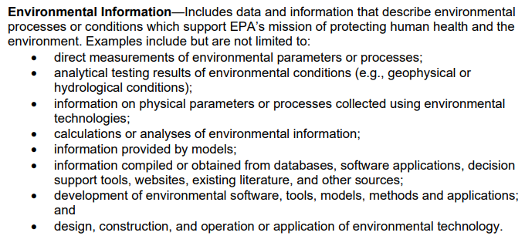
What do you mean by “Data”?
From the EPA CIO Environmental Information Quality Policy:
US EPA Information Quality Policy
Data / Information includes a wide range of outputs and activities.
9/12/2024
14

Slide 15
What do you mean by Metadata?
Understanding the contextual details of your data provides clarity for those who are not subject matter experts. Laying out what it is that you’ll be collecting, why, and what each field means, unifies the team and clearly lays out expectations and needs. Questions for this step include things like:
What needs documented?
Do we need to create a data dictionary?
How do we efficiently label datasets?
Do we need SOPs for data collection to include metadata?
9/12/2024
15

Slide 16
Data Management Plan: Collection and Acquisition Sources
There are multiple ways to get the data you need, for a single project you might be getting multiple sets of data in different ways:
Is there a tool or software application that is collecting the data? Is it manually entered?
Are we purchasing data ?
Are we downloading data from an external trusted source?
Are we generating the data from a model or by combining data sets?
How frequently will data be collected? What can be automated?
How large is the data set?
Do you need to keep track of changes to the data?
9/12/2024
16

Slide 17
Data Management Plan: Quality Assurance and Quality Control
Data quality management is the prevention of data defects or issues within a dataset that reduce our ability to use the data effectively. Potential defects may occur at any stage of the life cycle, including incorrectly entered data, invalid data, and missing or lost data. For this reason, prevention (QA) and detection (QC) of defects are equally important to ensure the quality of your data:
What are the business rules or legal values or value ranges that your data needs to meet?
What processes are in place to check data quality?
What processes are in place to reduce the possibility of getting “bad” data in the first place?
What information do you need at the point of collection to indicate the data quality?
How do you plan to share the data quality with future users?
9/12/2024
17

Slide 18
Data Management Plan: Data Processing, Analysis and Data History
Knowing what questions, you want to use the data to research or answer, and how your planned approach to do so helps to inform the overall project and process. In many cases , this can expand what data needs to be acquired in the first place:
What are the questions you are trying to answer?
Are you using any data outside of your main collection?
What version or vintage of data are you using? Do you need to create version or vintages of your data?
Do you need to look at the data over time?
What tools do you need to do your analysis?
What is the methodology for your analysis?
Are you creating new models or using existing models ?
Are you creating new datasets as a result of your processing or analysis?
9/12/2024
18

Slide 19
Data Management Plan: Access and Sharing
Understanding who needs to use the data while still providing secure data practices is essential. User authentication, end-to-end encryption, etc., provide access and security mechanisms. Questions may include:
Who needs to access the data and how do they need to access it? (API, database, file?)
How and when should the data be accessible internally?
How and when should data be accessible to the public?
How will others discover the data?
How best to provide access to others?
How are we making sure that other users know how to use and not use the data?
9/12/2024
19

Slide 20
Data Management Plan: Storage, Backup and Security
Understanding the best way to securely store and backup data is a limiting factor in laying out the data management plan. The exercise of weighing data sensitivity and storage needs against cost and accessibility concerns, makes viable solutions more readily apparent. Questions may include:
What is the security sensitivity of the data?
Does the dataset include PII, CUI, or other sensitive data?
Does the data need encryption (at Rest, In-Transit)?
Where should it be stored for best cost, accessibility, and security (Cloud, On-Prem…)?
How often do we need / want to backup the data?
What needs to be stored?
9/12/2024
20

Slide 21
Data Management Plan: Archive
Understanding how to archive the data after the project is complete is not the flashiest step, but it is necessary for research (particularly government research) projects. Laying out archiving steps early in the data management plan prevents a lot of heartburn and helps put the scope and cost of possible solutions into focus. Questions may include:
What are our data retention requirements?
What costs will be involved in long term data retention?
What are the various storage types that can be leveraged?
How will they storage types change, and will our solution be migratable in the future?
How will we continue to make the data accessible for other researchers and future projects?
9/12/2024
21

Slide 22
Useful References used for this presentation:
Interstate Technology Regulatory Council (ITRC) Environmental Data Management (EDM) Best Practices
EDM Introduction and Overview
EDM Data Management Planning Overview ( useful template links in section 1.2)
US EPA Data
US EPA Environmental Information Quality Policy
US Fish & Wildlife Service Data Management Life Cycle
US Geological Survey Data Management
9/12/2024
22

Slide 23
Contact
Jennifer Sutton (US EPA)
Joshua Kalfas (Oklahoma Department of Environmental Quality)
9/12/2024
23

Slide 24
Thank You!
Questions?

