Slide 1








NCDEQ Technological Readiness for Digital Transformation
Notes:
Goal - introduce Access DEQ through its 3 buckets
-Digitization: going paperless
--- Accessibility of data
-Digitalization: automating manual processes
---Technology to improve process and performance
-Digital transformation: digitalization at the enterprise level
---Creating a new overarching digital blueprint for DEQ
product vs project idea

Slide 2


DEQ Mission
Providing science-based environmental stewardship for the health and prosperity of all North Carolinians.
AccessDEQ Mission
To leverage the full value of our data to inform and equip DEQ in achieving its mission, and provide insight that supports ethical governance, conscious design, and a learning culture.
Notes:
- disarm situation
- relate

Slide 3
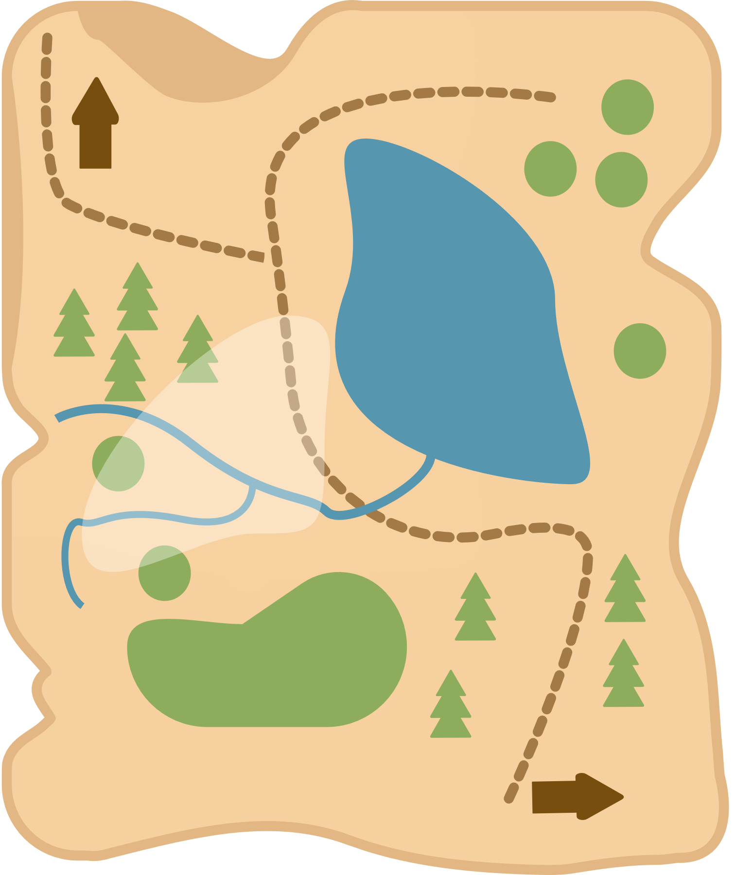
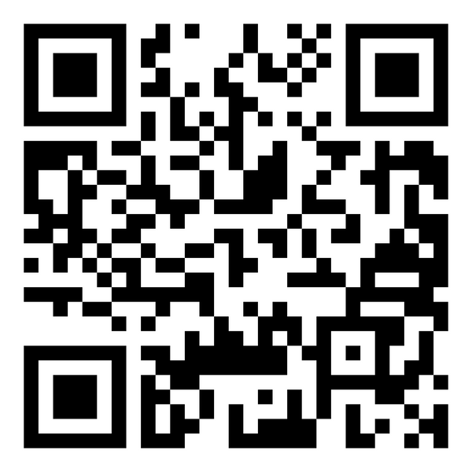

The Data Modernization Journey
Notes:
How long has your organization been under a modernization effort?
Why does Modernization not prevail?

Slide 4



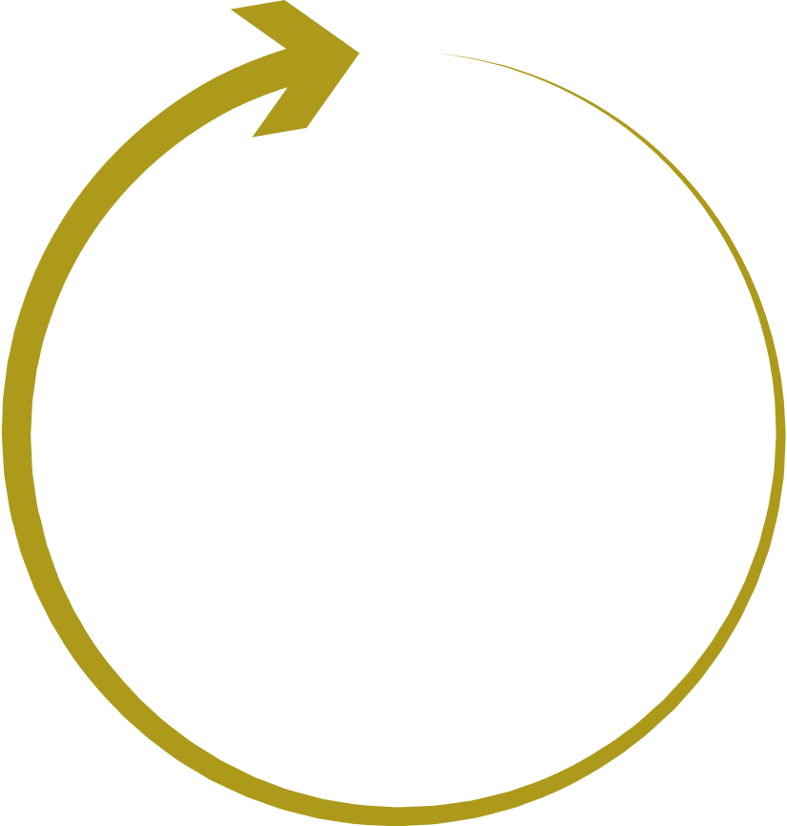







The Merry Go Round of Modernization
I have an idea!
Secure funds for it
Unhappy Customers
Assemble teams
Launch New System
Build New System
Notes:
How? By building systems that are flexible enough to grow/change with changes in policies, processes, and technology itself
by shifting our thinking to see systems as Products and not Projects.

Slide 5









It’s Going To Be A Hike
Fitness Level
Is it feasible?
Base Camp
Is it what the org needs?
Recalculate
Are we still on track?
Map your Summits
Define goals
Notes:
Acclamation to altitude – record management
Prepare your equipment – data management
Base weight - innovation management
--- doesn't have to make sense
--- issues arise during hike
Be prepared to answer questions about record vs data management
Disposing of paper records is expensive
Engage with facilities
Base camp - what is best location in a park for a base camp
Legislative changes - recalculate - * compass not gps * make sure to use analogy
Define your summit - use mountain names from NC

Slide 6






Digitization
  Digitization: Going Paperless
    Making data accessible
Notes:
- what does it take to become paperless
-understanding why the user may prefer paper and why
-provide for physical needs in preparation for digitization

Slide 7





Digitalization
  Digitalization: Automating Manual Processes

Slide 8



The Common Data Model
Governance
Ensures higher data quality and cohesion throughout DEQ
Security
Integration
Protects information, prevents data breaches, and ensures compliance with regulations.
Supports scalability of solutions, Increased efficiency, and better user experience

Slide 9








Digital Transformation
  Digital Transformation: Looking at the Enterprise
    Creating a new overarching digital blueprint for DEQ

Slide 10







Defining Summits
SPECIFIC
MEASURABLE
ATTAINABLE
RELEVANT
TIME-BASED
Notes:
SMART goals are clear, attainable, and meaningful goals that are
specific,
measurable,
achievable,
relevant, and
time-bound
Realizing where to start is critical

Slide 11



Data Strategic Plan
Records Management Strategy
Innovation Roadmap

Slide 12


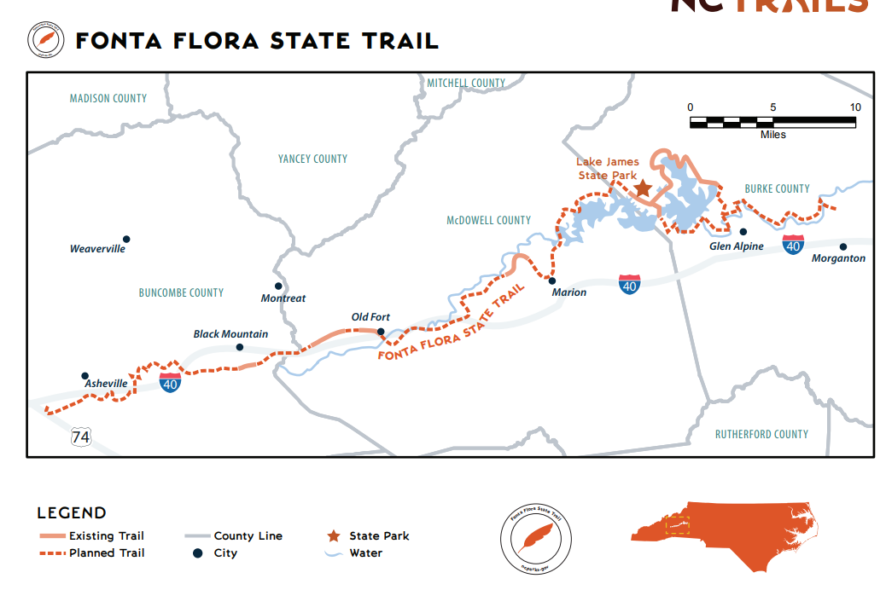





Managing Digital Innovation
Notes:
Divisions and ROs feel isolated in their own "green way". What they can't see (and it is leadership's job to show them) is that DEQ is all in the same park... with many trailheads but the same park.
Trial map of nc
Visualization
Trail system
Each RO is on a different trail

Slide 13
What’s the point?
Providing science-based environmental stewardship for the health and prosperity of all North Carolinians.
Notes:
- what does it take to become paperless
-understanding why the user may prefer paper and why
-provide for physical needs in preparation for digitization

Slide 14
Thank you
Miriam Patrocinio
Chief Data Officer
NC DEQ
Notes:
- what does it take to become paperless
-understanding why the user may prefer paper and why
-provide for physical needs in preparation for digitization

