Slide 1
Enhancing Well Water Data Captured on Northwest Tribal Lands using Survey123
Melino Gianotti
Emergency Coordinator
Notes:
3:30 to 4:15 pm
Salmon Room

Slide 2
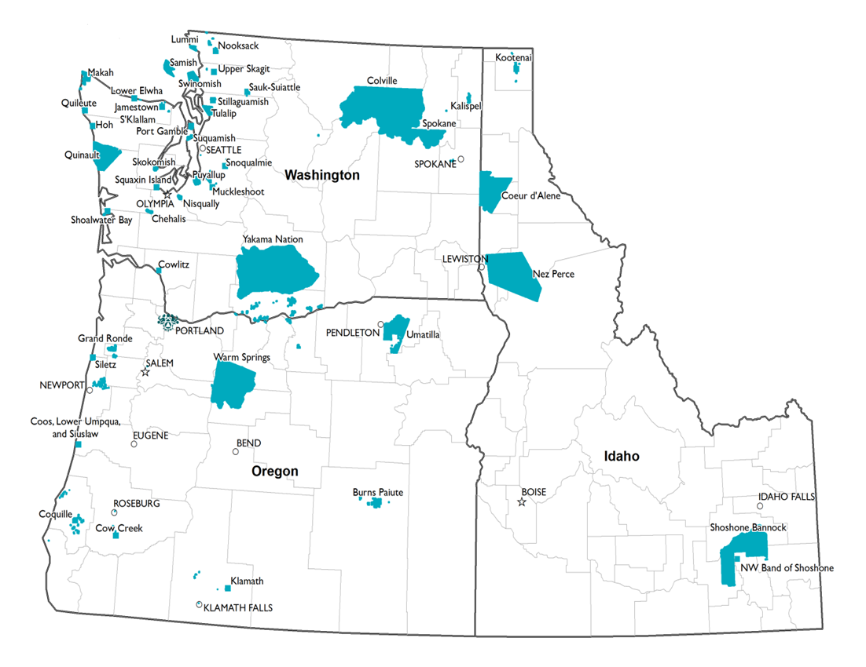
Notes:
Introduce the board

Slide 3
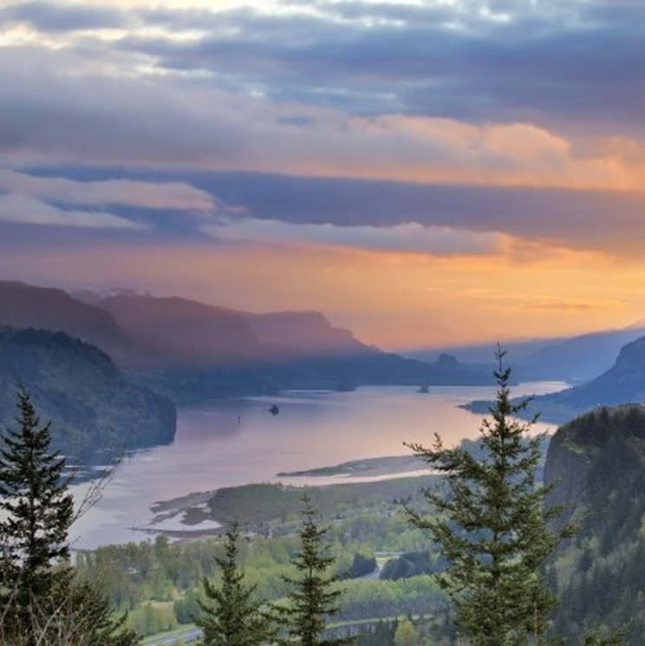
“This (water) is really dirty. All the pollution from all the cities are in the stream you're swimming in. The fish don't have a choice. Neither do the birds that live with the water, or the insects. They have no choice in this matter. Chemicals do scale up on the food chain. If you don't believe it, there's plenty of studies out there that can show you that there's accumulations.”
Notes:
The hook

Slide 4
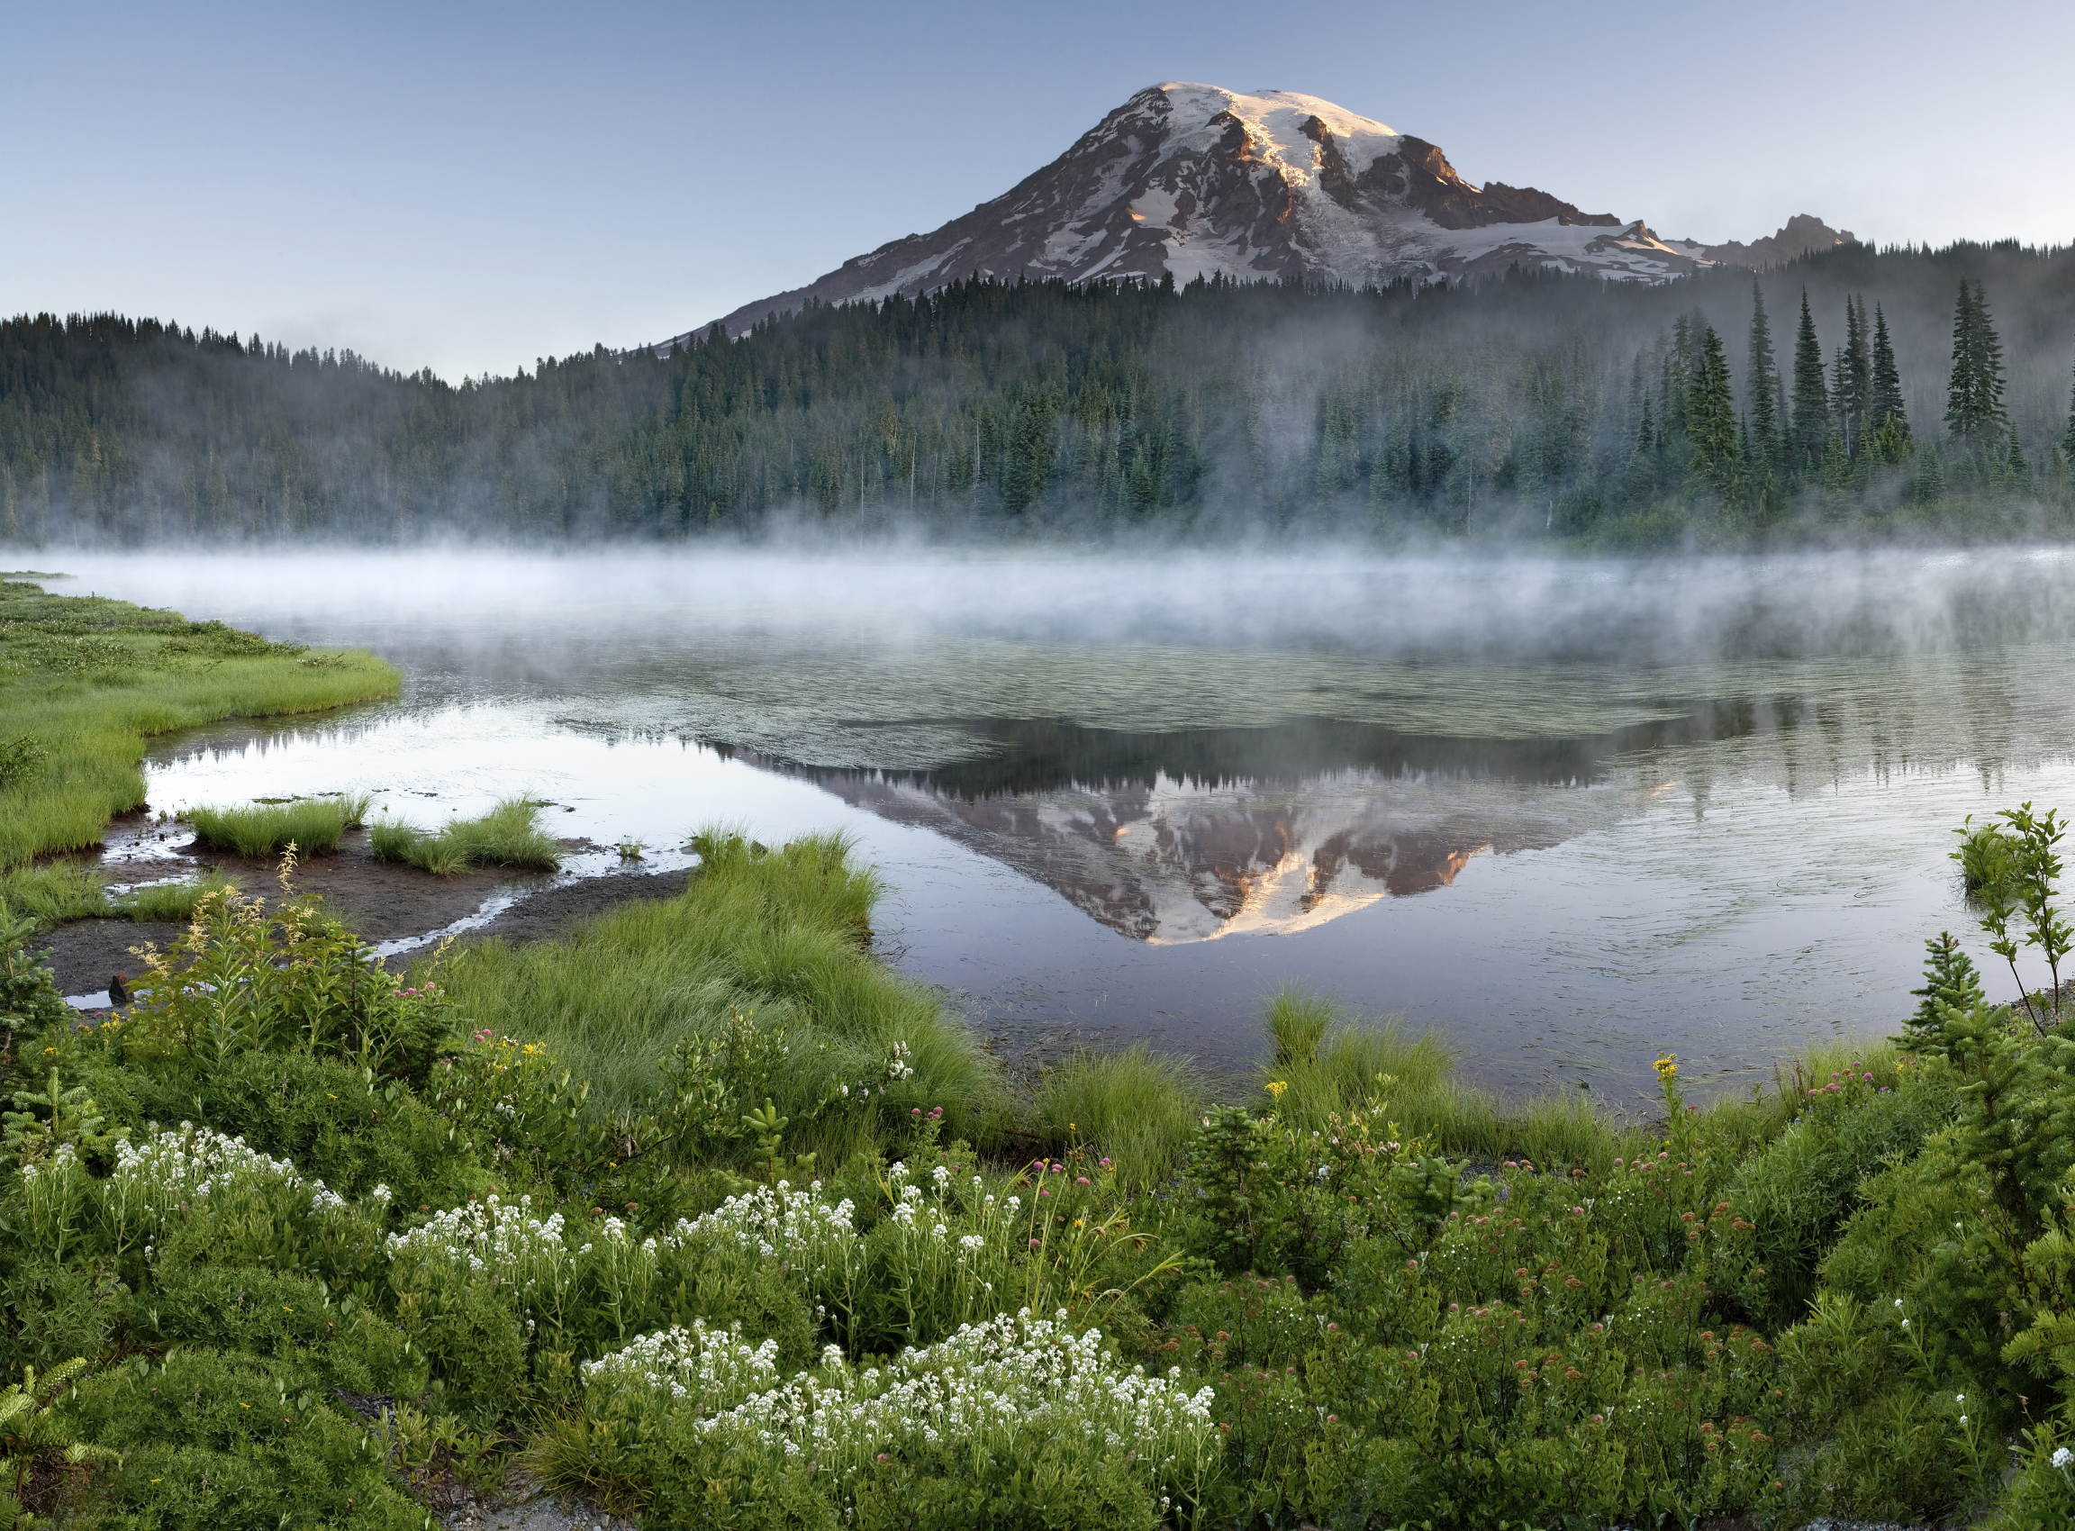
The EPH team supports PNW Tribes by providing comprehensive environmental public health services grounded in culturally-informed science

Slide 5
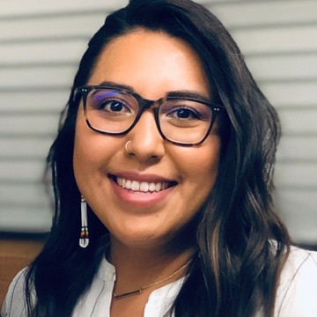
NPAIHB Environmental Public Health Team
Notes:
Contract came over to NPAIHB late 2019, Ryan and Netta were first hires, February 2020

Slide 6
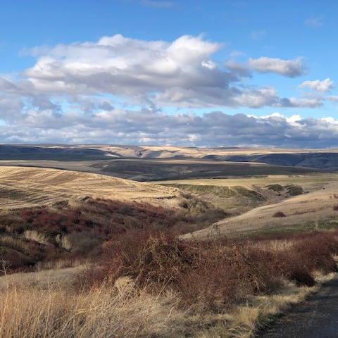
Tribal Environmental Public Health Definition:
Environmental public health focuses on the relationship and the interdependence between people and their environment for the seventh generation.
Notes:
Can list some direct services and projects

Slide 7
Outline
Who we are
Need
Flooding
Agricultural Soil Contamination
Response
Well Water Sampling and Testing
Notes:
Maybe as a side note, quickly add that we do Lead water testing, story data mapping, in-lieu/treaty fishing site inspections, etc.

Slide 8
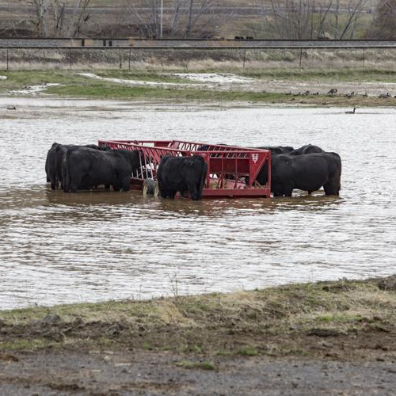
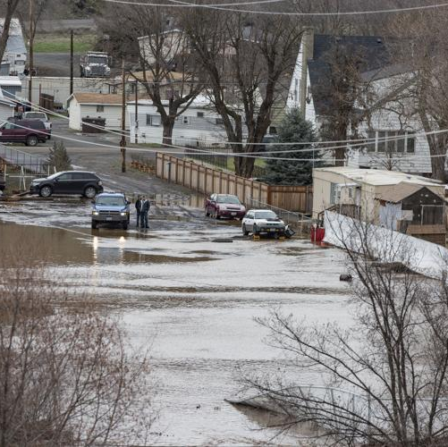
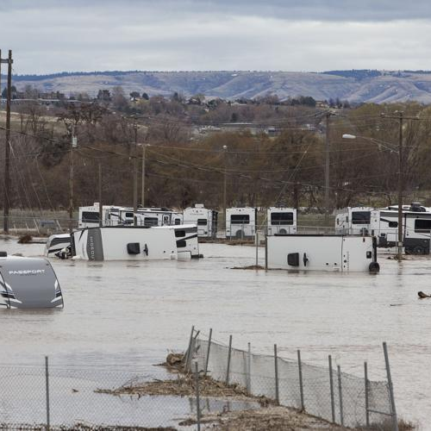
Regionwide Flooding
Across northeast Oregon and southeast Washington in February 2020
Due to heavy rain runoff and melting snow
Road, forest, and residential damage
Notes:
Flooding across three major rivers (umatilla river, south fork walla walla river, and tucannon river)
River shape/path has changed
According to EPA: sediment and flood water can enter and contaminate wells if not tightly capped, especially wells that are more than 10 yrs old and/or less than 50 feet deep. Floods can also cause wells to collapse
Ask around: history involving fed gov regarding wells? Who installed them? Does it vary?
https://www.epa.gov/sites/default/files/2015-05/documents/epa816f05021.pdf
https://www.opb.org/article/2022/06/15/small-eastern-oregon-town-rushes-to-shore-up-river-banks-after-heavy-rains/
Photos from the East Oregonian https://www.eastoregonian.com/news/local/umatilla-river-flooding-flood-waters-hit-umatilla-county/article_8aec71c6-4a0b-11ea-b5ea-ff7c890d3c41.html

Slide 9
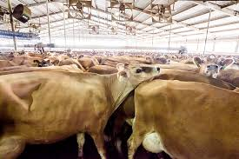
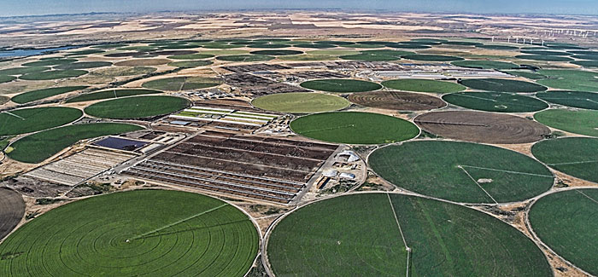
Soil Contamination
Irrigated farmland
Animal feedlots and pastures
Food processing facilities
Residential septic systems
Notes:
Main employers and workforce in area = these rural regions have high nitrate levels
https://www.oregonlive.com/environment/2024/06/why-is-eastern-oregons-groundwater-contamination-crisis-still-unresolved-after-30-years-beat-check-podcast.html#:~:text=Oregon%20Rural%20Action%20and%20other,main%20employers%20in%20eastern%20Oregon.
https://www.eastoregonian.com/news/local/governor-gets-heat-for-water-crisis-in-boardman/article_6d399d30-1e31-11ef-86d4-d7017c253cab.html#:~:text=Nitrogen%20from%20farm%20fertilizers%2C%20animal,low%2Dincome%20and%20Latino%20residents.
Flooding from last slide, also affected alfalfa fields and cattle pastures

Slide 10
Estimated Sources of Nitrate Contamination in the Lower Umatilla Basin
Notes:
https://www.oregon.gov/deq/wq/programs/pages/nitratecontamination.aspx#:~:text=There%20are%20many%20sources%20of,Basin%2C%20LUBGWMA%20Second%20Action%20Plan

Slide 11
Average Nitrate Range Density Map
*Data is displayed as an average of nitrate levels within area and does not represent individual well locations
Well Testing Locations by the County Public Health
Notes:
If ingested at levels of more than 10 milligrams per liter, nitrate contamination can cause health effects like respiratory infections, thyroid dysfunction and stomach or bladder cancer, according to the Environmental Protection Agency.
The maps show nitrate levels in domestic well water, with levels from none detected to more than 25 milligrams per liter, for more than 1,700 households in the region. The well testing was part of Gov. Tina Kotek’s goals for the region.
The more than 1,700 households tested are out of more than 3,200 households OHA has identified with domestic wells in the region.
Of the 1,706 households, 432 are testing in that range, according to the data.
Reverse osmosis water treatment systems are certified to remove nitrate only up to approximately 25 mg/L, so are only effective in households testing between 10 to 25 mg/L nitrate. Households with water testing above 25 mg/L must rely on bottled water delivery. Plumber workforce constraints have limited the pace of installations.
Household privacy ...
From Umatilla County Health Dept.
https://public.tableau.com/app/profile/umatilla.health.department/viz/WellTestingDashboard/PublicDash?publish=yes
Other maps from state that are more invasive:
https://www.oregon.gov/oha/PH/HEALTHYENVIRONMENTS/DRINKINGWATER/SOURCEWATER/DOMESTICWELLSAFETY/Pages/Data.aspx?utm_medium=email&utm_source=govdelivery

Slide 12
Wells
Origin varies
Historic - hand dug cisterns ('40s-'60s)
Modern
I.H.S. would later replace historic
Shallow wells – less than 50 ft
Prevent surface influence
Responsibility:
Homeowners
Tribal programs may provide support
Indian Health Service
Main Goal:
Confederated Tribes of the Umatilla Indian Reservation will provide resources and education to homeowners regarding their wells
Notes:
From shawn:
Responsibility not always clear
Considered shallow wells (less than 50 ft)
Surface influence: pollution from env and soil type (clay good, sand bad)
I.H.S. may have been funding stream for some of the wells and used Local well drilling contractor, but then it is up to property owner to maintain and inspect
I.H.S. may follow up if: well table drops, or wall pouring caves in, contamination
But reaction time is slow and homeowners want faster helper
When drilling, keep pumping untill it runs clear
If licensed needs to follow certain standards
Educating homeowners on their wells _ goal from umatilla

Slide 13
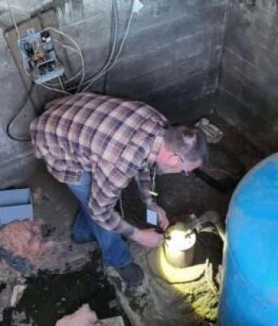
Improving Access to Safe Drinking Water from Private Wells
Build and strengthen capacity to identify, evaluate, and improve domestic well water safety programs
Providing funding and training while collaborating with Tribes to:
Identify private drinking water wells
Conduct screening sampling for contaminants
Perform risk assessments for improving wellhead protection
Develop interventions to control hazards
Evaluate
Notes:
Specific CDC capacity building grant – specific tribes
Facilitated funding through CDC to the tribe
Tribe handled all the processes and data
Requested our help with some of the data
Mapped it
Tribe requested even more assistance!
Getting the full lab test data
Modernizing to digital and integrating into mapping system
Identify, prevent, and control EH hazards
Activities include: 2.1 partner with Tribes to identify, characterize, and evaluate the EH status of individual private wells and the conditions that prevent access to safe drinking water in three Tribal communities;, 2.2 develop interventions to control EH hazards and improve access to safe drinking water; and, 2.3 provide training Tribal EH staff on groundwater basics, wellhead protection, safe drinking water standards, and sampling.
Assess EH intervention effectiveness and impact
Activities include: 3.1 evaluate Tribal EH staff knowledge and technical competencies; 3.2 work with Tribal staff to identify methods for evaluation of interventions; and 3.3 document the interventions, change in policies, and new plans developed as evidence of impact.

Slide 14
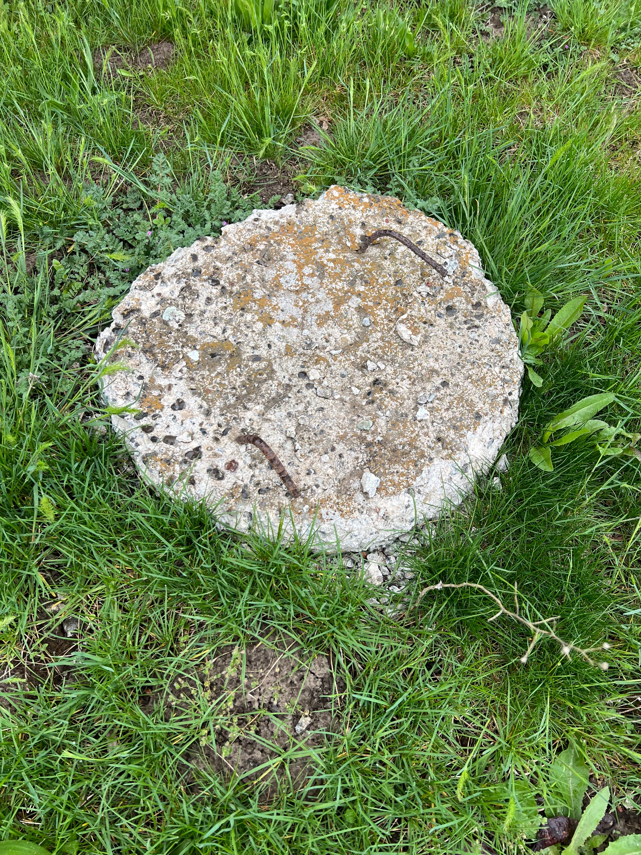
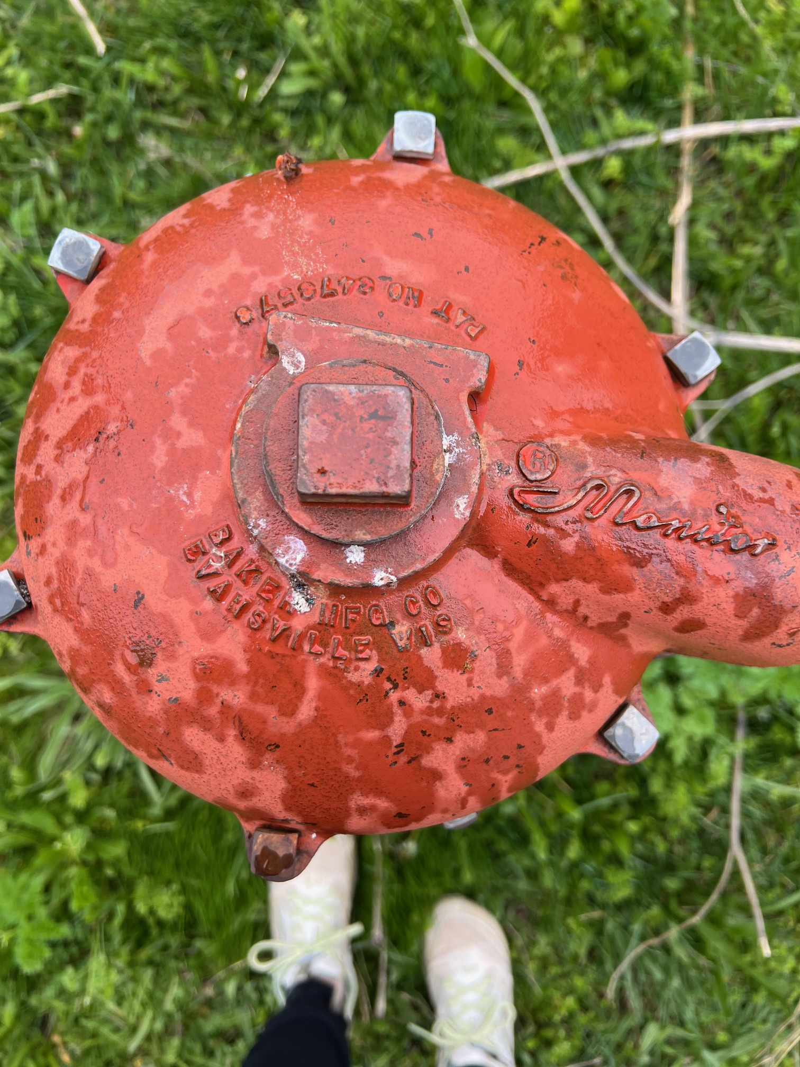
Beginning Steps
Facilitated funding through CDC
Tribe handled all the processes and data
Requested our help with some of the data
We mapped the data from the tribe
Tribe requested even more assistance!
Tribe provided access to the full lab test data
Modernizing to digital and integrating into mapping system
Notes:
Could say all this while showing previous slide, an option

Slide 15
Partnership with Innovate
https://www.innovateteam.com/
Notes:
We already had a partnership with Innovate, who specializes in GIS application systems, and they have been working with us to modernize the well water data collection and build data products for the tribe.

Slide 16
Testing Breakdown
Alkalinity (as CaCO3)
Aluminum
Antimony
Arsenic
Barium
Beryllium
Bicarbonate
Boron
Cadmium
Calcium
Carbonate
Chloride
Chromium Cobalt Conductivity
Copper
CSMR
E. coli
Fluoride
Grains per gallon
Hardness
Hardness (Ca,Mg)
Hardness
Iron
Langelier Saturation Index
Lead
Lithium Magnesium Manganese
Mercury
Molybdenum
Nickel
Nitrate (as N)
Nitrite (as N)
pH
Phosphorus
Potassium
Selenium
Silica
Silver
Sodium Sodium Adsorption Ratio Strontium
Sulfate
Thallium
Tin
Titanium
Total Coliform
Total Dissolved Solids
Turbidity
Uranium
Vanadium
Zinc
Notes:
from the first round of sampling, and the average occupants in a household is 4 with a range of 1 to as many as 12 in one home.

Slide 17
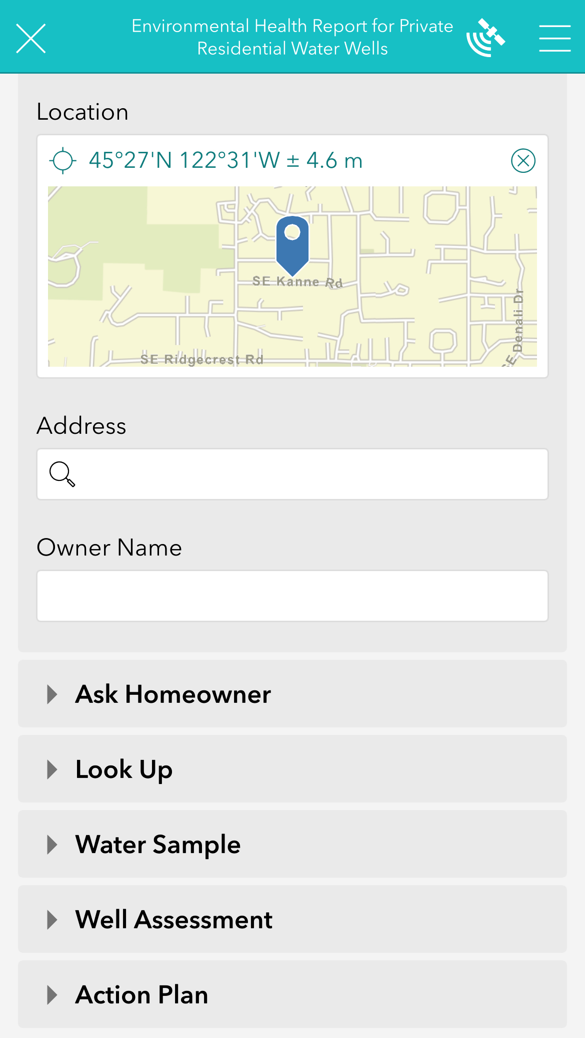
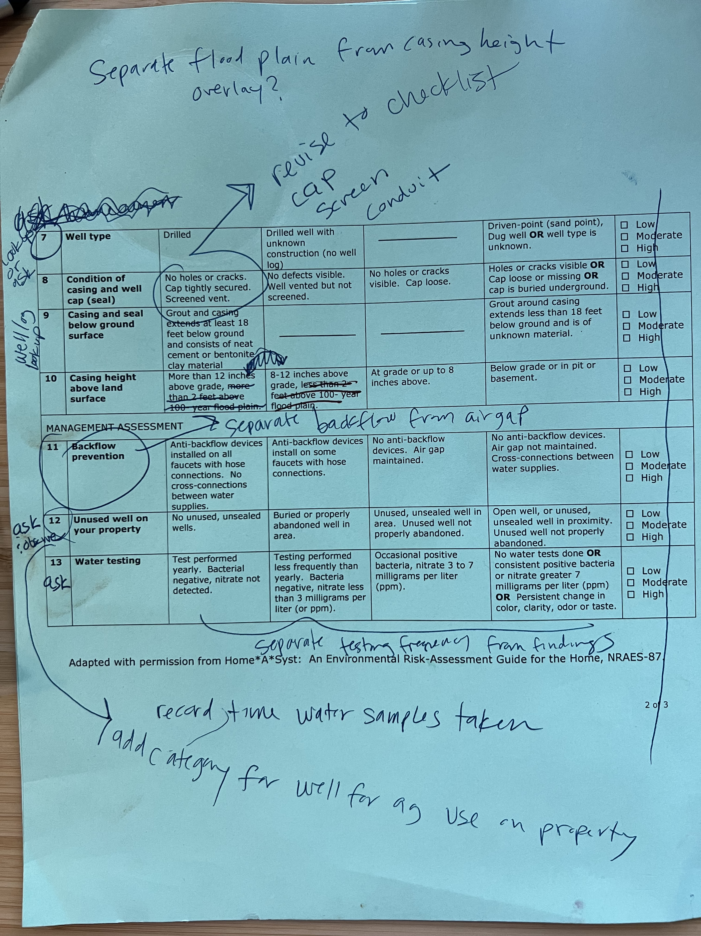
Modernizing Data Collection
Converting Well Water testing and evaluation from paper copy to digital
Add photos to assessment
More accurate location info
Integrate with other map layers - soil layers and flood plain info
Faster integration with lab results
Syncs data with well water testing map
Easier sharing ability
Notes:
Strengthen EH data use and informatics capacity
Activities include: 1.1 document the location and status of private drinking water wells in a data system; and, 1.2 provide training to Tribal EH staff on using data to monitor and anticipate EH hazards and threats to groundwater.
This data will enable Tribes to make data-driven decisions to address, prevent, and control EH hazards associated with individual well drinking water sources.
The Tribes will have developed plans with data that give the field more access to evidence on the effectiveness of EH interventions

Slide 18
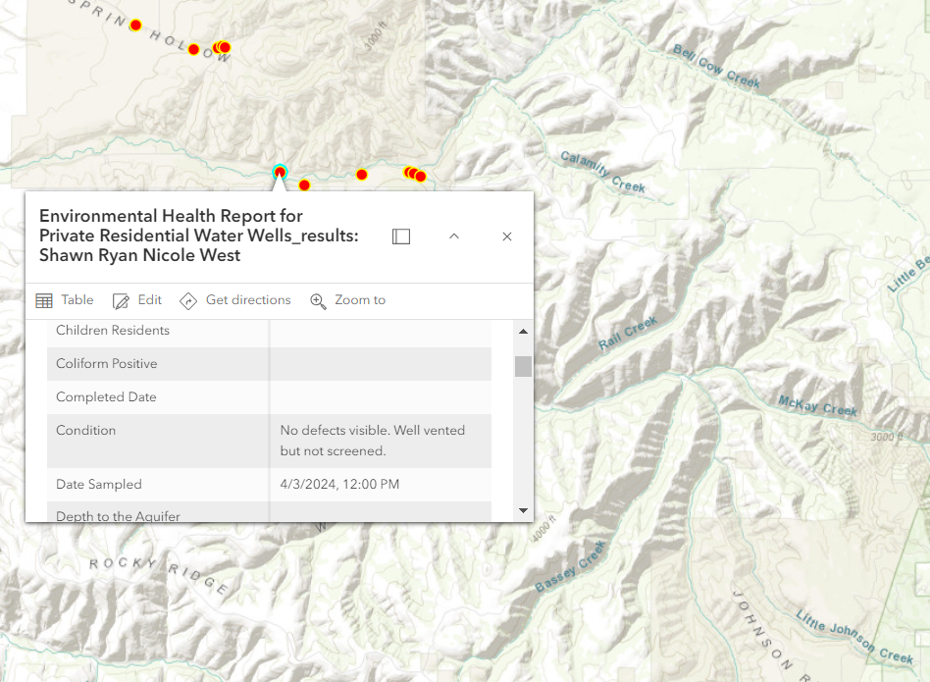
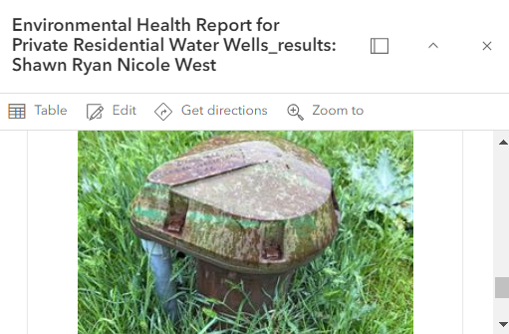
Well Water Mapping
Notes:
Sample number
Date
Zip code
Well type
Condition
Ex: No holes or cracks. Cap tightly secured. Screened vent.
Seal
Height
Ex: More than 18-12 inches above grade, less than 2 feet above 100-year flood plain. inches above grade, more than 8-12 inches above grade, less than 2 feet above 100-year flood plain. feet above 100-year flood plain.
Backflow
Unused wells
Testing Annually
Any positive results from list above
Ex: Coliform
E coli
H2S
F17
Number of residents
Adults
Children
Sensitive individuals

Slide 19
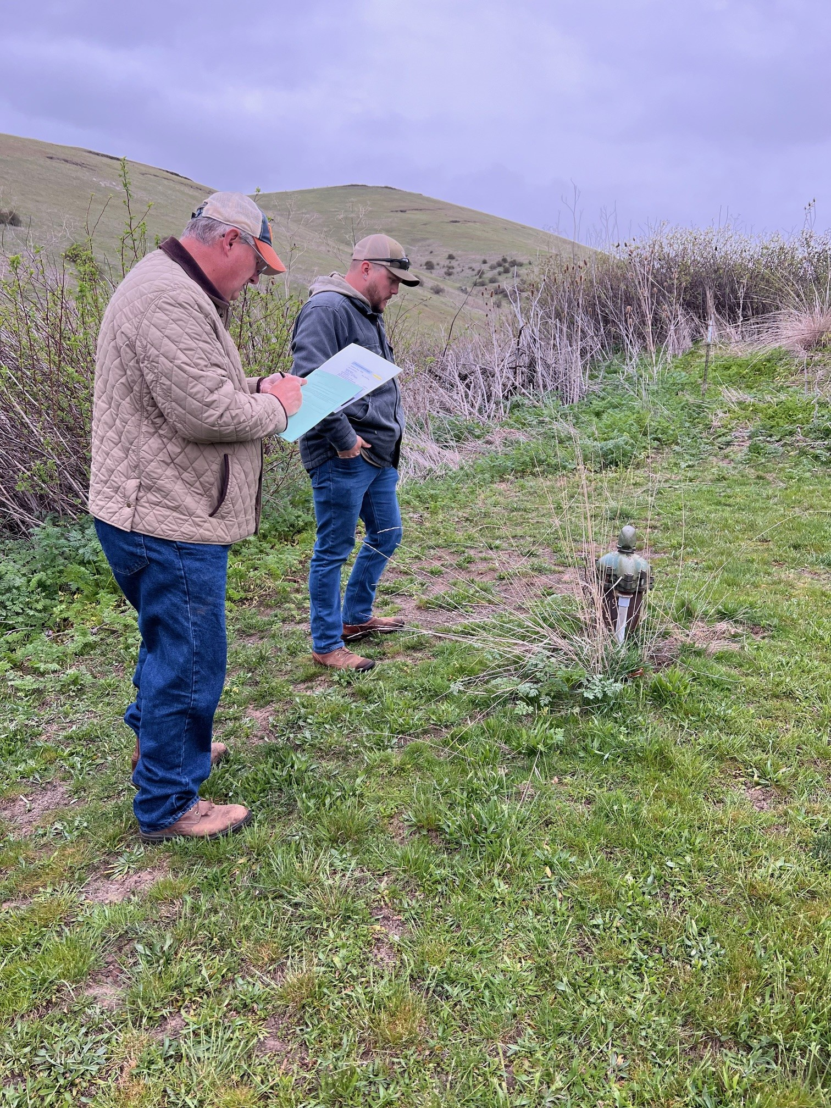
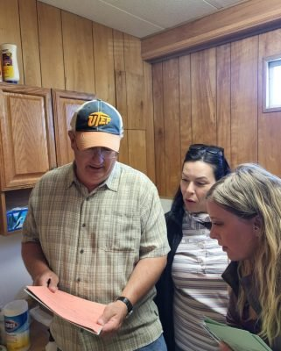
Testing in the Field – First Draft
Both paper and digital
Tested capability:
Photos
Location & GPS
Mapping
Questionnaire Layout
Resource Information
Notes:
Testing the first draft

Slide 20
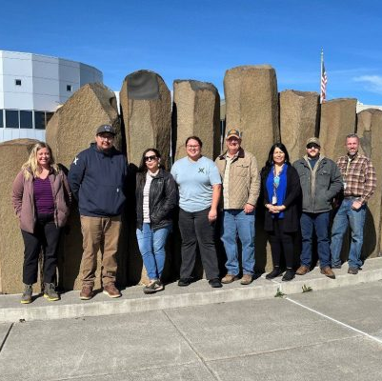
Adjustments – Second Draft
Restructured the layout
Fixed errors and made more realistic for out in the field
Updated information already inputted
Plan to use this new template as we partner with more tribes
Notes:
Changed criteria and expanded assessment – which we learned was a need while out in the field

Slide 21
Next Steps
Integrating the well assessments with the lab results and tribal historic data
Evaluate what products will be useful for tribal action
Expanding to other tribes

Slide 22
“The only way we're going to create miracles is by us. Taking sovereignty and taking it seriously.”
Notes:
The hook

Slide 23
Review & Closing

Slide 24
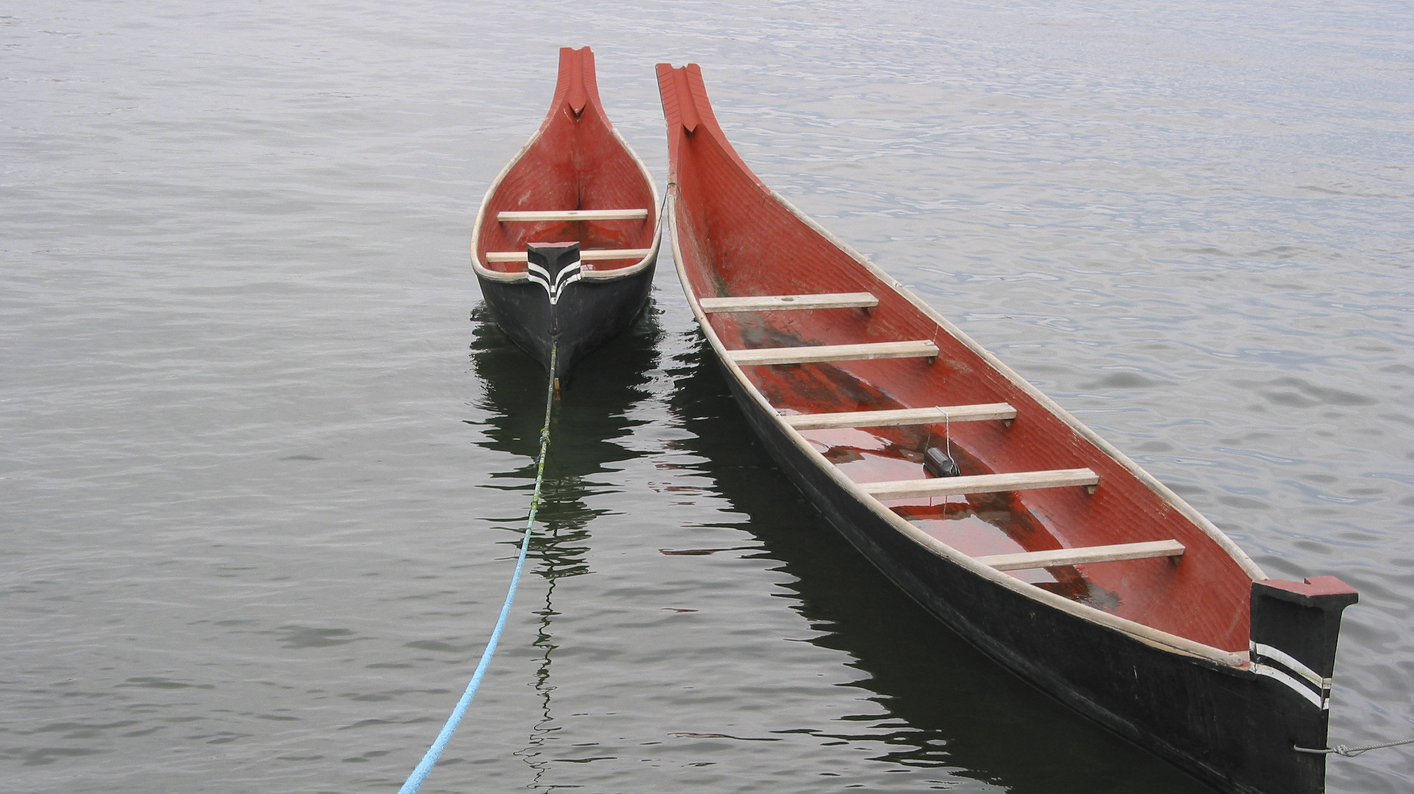
questions?

