Slide 1
Data
Modernization: Water
Shelly Thawley, US EPA Office of Water
Tuesday, September 17, 2024

Slide 2
Introduction
Geographers are the original data integrators

Slide 3
OWOW Mission
OWOW leads national efforts to protect and restore freshwater, coastal, wetland, and ocean ecosystems.
Using watershed, place, and system-based approaches and working in collaboration with states, tribes, federal agencies, and private partners, we: ​
assess, monitor, and communicate the quality of our nation's waters;
reduce and prevent water pollution; and,
design and fund the restoration of impaired waters.

Slide 5
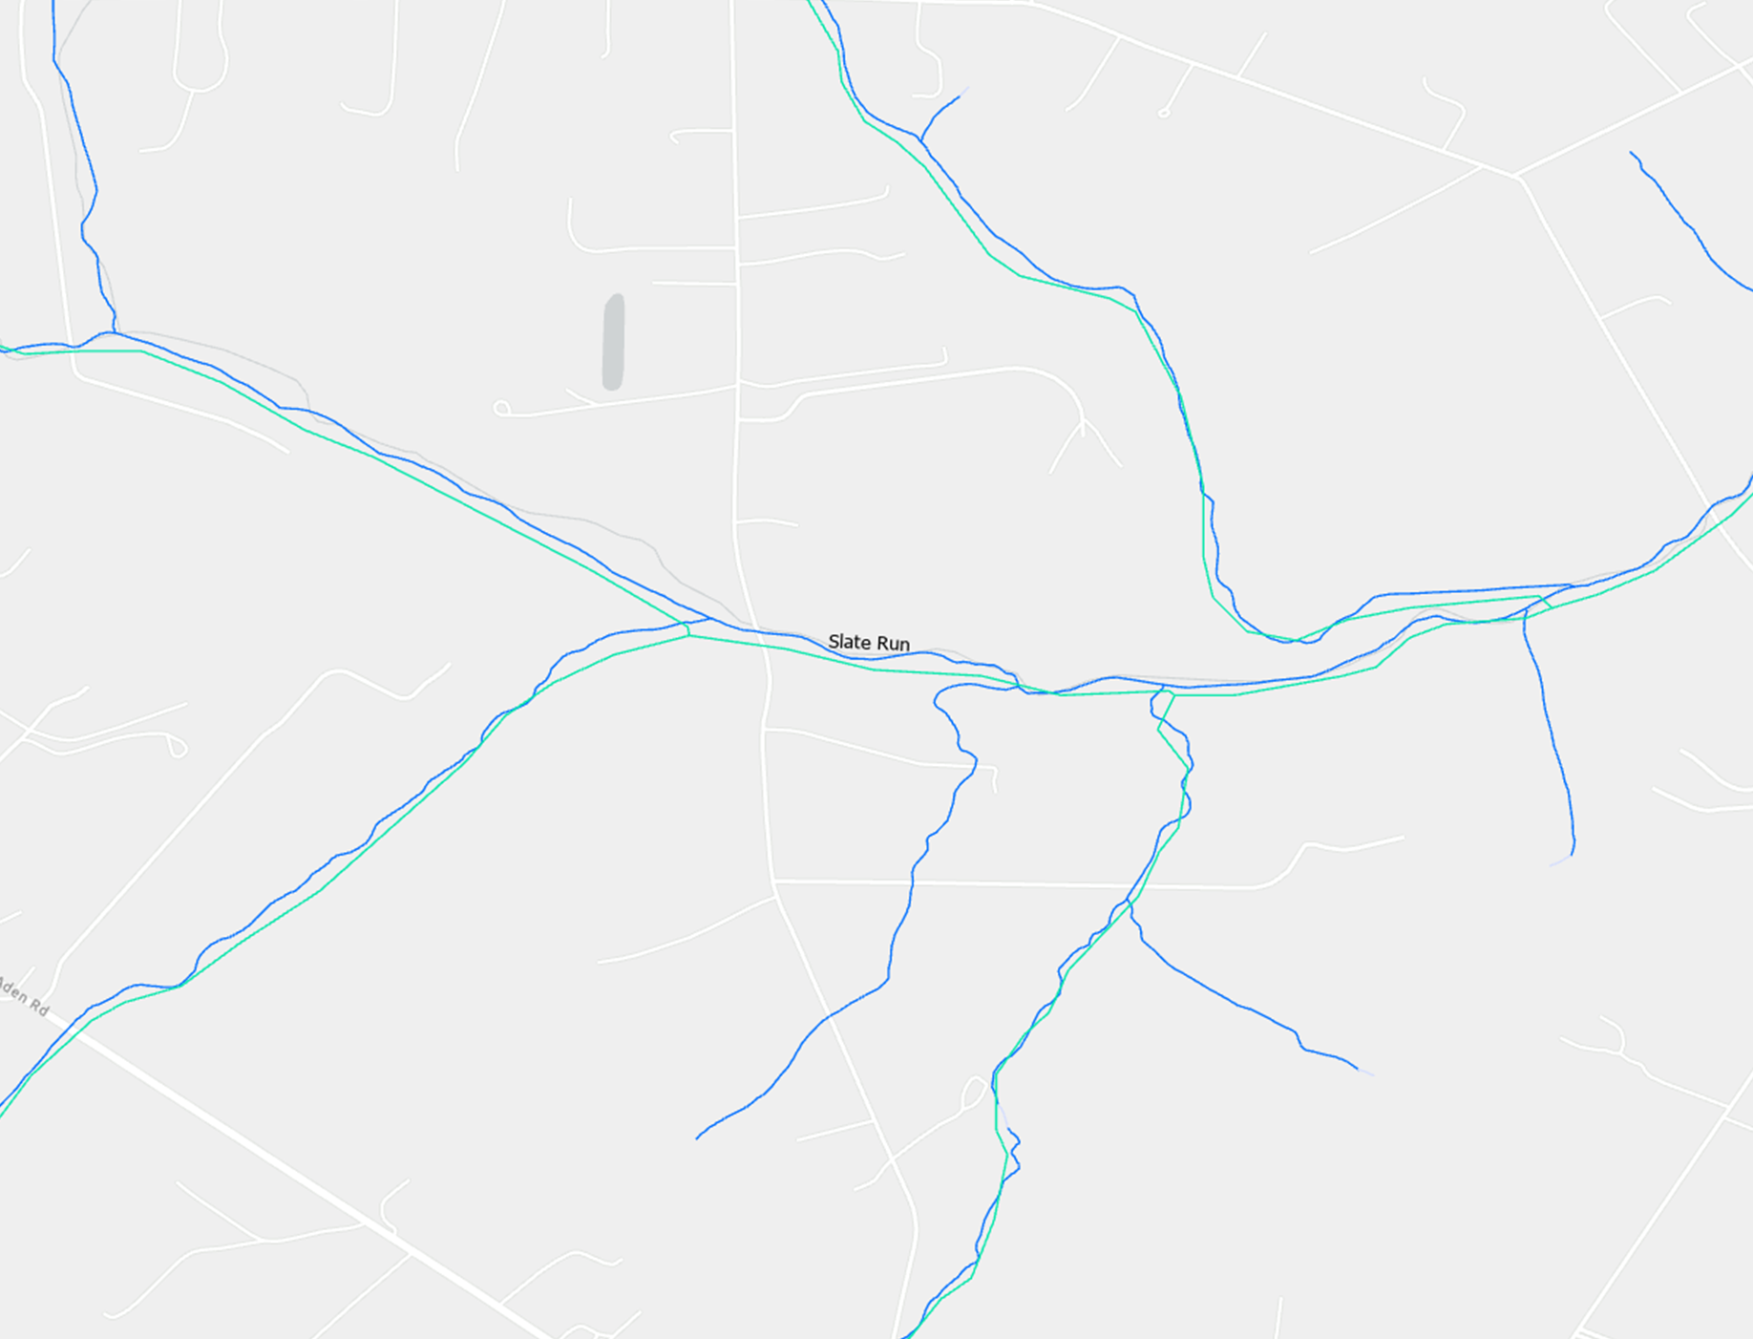
Conflation
noun: conflation; plural noun: conflations
the merging of two or more sets of information, texts, ideas, etc. into one.
"the forceful conflation of two traditions"
Wikipedia:
Conflation is the merging of two or more sets of information, texts, ideas, or opinions into one, often in error.

Slide 6
Geospatial data integration was critical to the response
Emergency Response to Hurricane Katrina

Slide 7
Daily Maps for Congressional Briefings

Slide 8
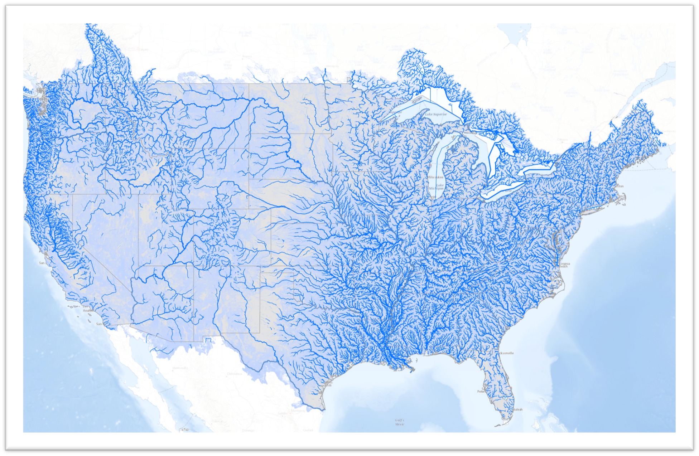
Hydrography: Water Data Spatial Integration
National Hydrography Dataset
and
NHDPLus
Spatial Water Data Standards
https://d9-wret.s3.us-west-2.amazonaws.com/assets/palladium/production/s3fs-public/thumbnails/image/Streamflow_estimates_Map.png

Slide 9
Internet of Water and the IoW Coalition
1. Water data are essential for efficient, equitable, sustainable, and resilient water planning, management, and stewardship.
2. Modern data infrastructure increases the usefulness of water data and enables its broadest possible application.
3. Data equity is necessary for water equity; modern data infrastructure should be implemented and governed so that data are usable by and for overburdened communities.
4. All water data produced for the public good should, by default, be findable, accessible, interoperable, and reusable (FAIR) for public use or authorized users.*
5. Security and privacy risks associated with sharing data can be mitigated using mechanisms for tiered access for authorized users.
6. Commonly accepted data, metadata, and exchange standards should be adopted by water data producers to promote interoperability, efficiency, sharing, equity, and secondary uses of data
7. Control and responsibility over data are best maintained by data producers.
8. Data producers are responsible for sharing data of known quality and documenting essential metadata; data users are responsible for determining whether data are appropriate for specific purposes and uses.
9. Federated, distributed systems of interoperable public water data generally provide scalability and flexibility to meet the diverse needs of data producers and users.
https://internetofwater.org/

Slide 10
Informing Clean Water Act (CWA) Progress
Share Monitoring Data
(WQX/WQP)
106 grant req.
Monitor Waters
106, 104, 319
Is my water safe for swimming, fishing, drinking?
Does it support healthy biology?
What are the leading problems or stressors?
Where should I focus protection and restoration actions?
Are actions effective individually and across the board?
Is chemical, physical, and biological integrity improving?
Supporting CWA Implementation 104, 106, 319, 305(b), 303(d,e), 604(b)
Communicate Water Quality
(HMW, NARS, TMDLs, Success Stories)
Analyze and Report
(TADA, ATTAINS, NARS, R Shiny)
106/305(b)/303(d)
Address Protection and Restoration Priorities
(TMDL, 319)
319/303(d)
Notes:
These are the key questions we face at the national, state, and local level as we aim to achieve the goals of the CWA to protect, restore and maintain the chemical, physical, and biological integrity of the nation’s waters and to ensure they support healthy biological communities and recreation, including swimming and eating fish.
OWOW provides tools and resources to help advance CWA implementation toward achieving these goals
And it starts with partnerships, working with you and your program managers and staff. Working with other Federal agencies and place-based partners

Slide 11
Integrated Water Data Systems Supporting the Clean Water Act
Data Management
Notes:
Together, a variety of data resources and tools – including WQP/WQX, ATTAINS, CST, TADA, and HMW, and others – support the CWA. They have dramatically improved workflows, freeing personnel previously involved in data aggregation, compiling, and other preprocessing, to focus on other tasks such as data analysis and policy implementation. The information served by these systems and tools is used to make Clean Water Act decisions. By working together, across EPA, states, territories, tribal nations, and by following IoW principals for data sharing and exchange, this vision is slowly becoming a reality.

Slide 12
Data Services: Building Blocks of Data Integration
API

Slide 13
How’s My Waterway?
A map-centric tool that allows anyone to learn about water quality
Community
State
National
Delivers water data pulled from 12 different databases through APIs
Communicates progress the states, territories, tribes and EPA are making towards restoring and protecting water quality
No underlying database!

Slide 14
Efficient Multi-Agency Data Integration Example: Extreme Weather Tab

Slide 15
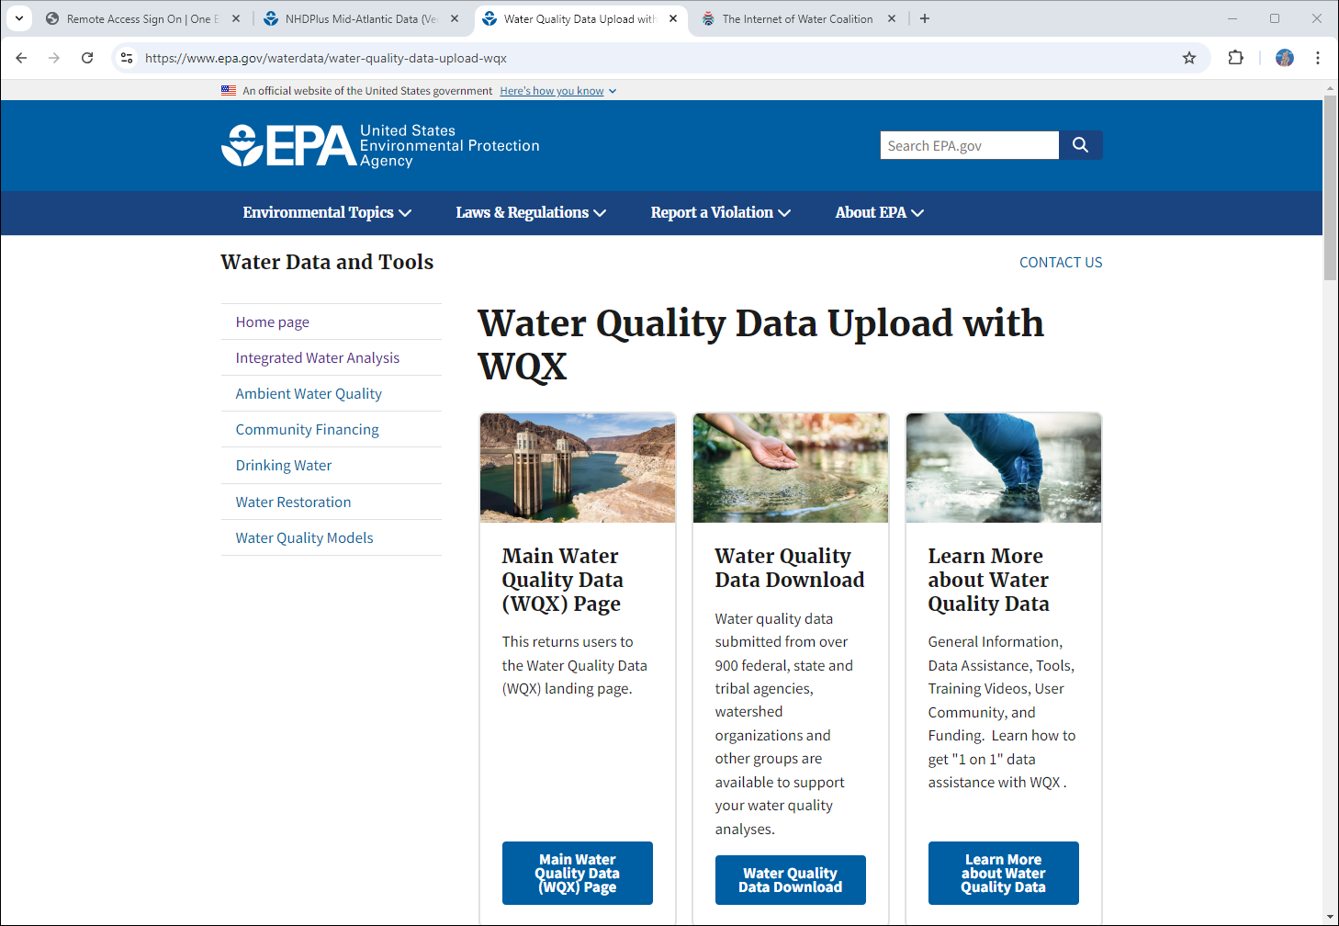
Water Quality eXchange (WQX)
Water Quality Data Standard
CDX
Data Delivery to Water Quality Portal
Presentation this week

Slide 16
Tools for Automated Data Analysis (TADA)
Discover, wrangle, and QC data from the WQP
Assessment methods guide impairment decisions based on:
Period of record
Aggregated measurements
Frequency
Duration
Magnitude
Season
Correction factors
Covariates
Site-specific criteria
Assign beneficial uses
Assessment unit overlay with monitoring locations
Beneficial uses determine numeric criteria used
Notes:
For development purposes, we think of these as separate modules.
Module 1 – Discover, wrangle, and QC. This has represented the majority of the work so far in both package and Shiny app development.
Module 2 – Geospatial components. We have recently begun work on this module. Collaborators from the Ross Syndicate Lab at Colorado State University have begun developing TADA functions which leverage ATTAINS geospatial web services and will help TADA users assign Monitoring Locations to Assessment Units. Stay tuned for updates on presentations from Ross Syndicate staff on these new functions at one or more TADA Working Group meetings this summer.
Modules 3+4 – We are the planning and requirements phase for these modules. Our goal for these modules is to create an editable Excel template that users can fill out with information from their numeric criteria and assessment methods assist in making impairment decisions from numeric water quality data.
There are still some challenges to be overcome including: formatting water quality standard information as the criteria search tool does not include narrative standards, duration and frequency or methodologies. System crosswalk development and maintenance is also needed to properly associate parameters, designated, uses, etc. between the different systems and tools involved.

Slide 17
Exploring AI Technologies for Data Harmonization
Cross-walking terminology is a labor-intensive manual process.
How Do I search for Nitrogen data?
Nitrate
Nitrate/Nitrite (Nitrite + Nitrate as N)
Nitrite
Nitrogen
Nitrogen, Ammonia
Nitrogen, Nitrate
Nitrogen, Nitrite
Nitrogen, Total
Kjeldahl Nitrogen

Slide 18
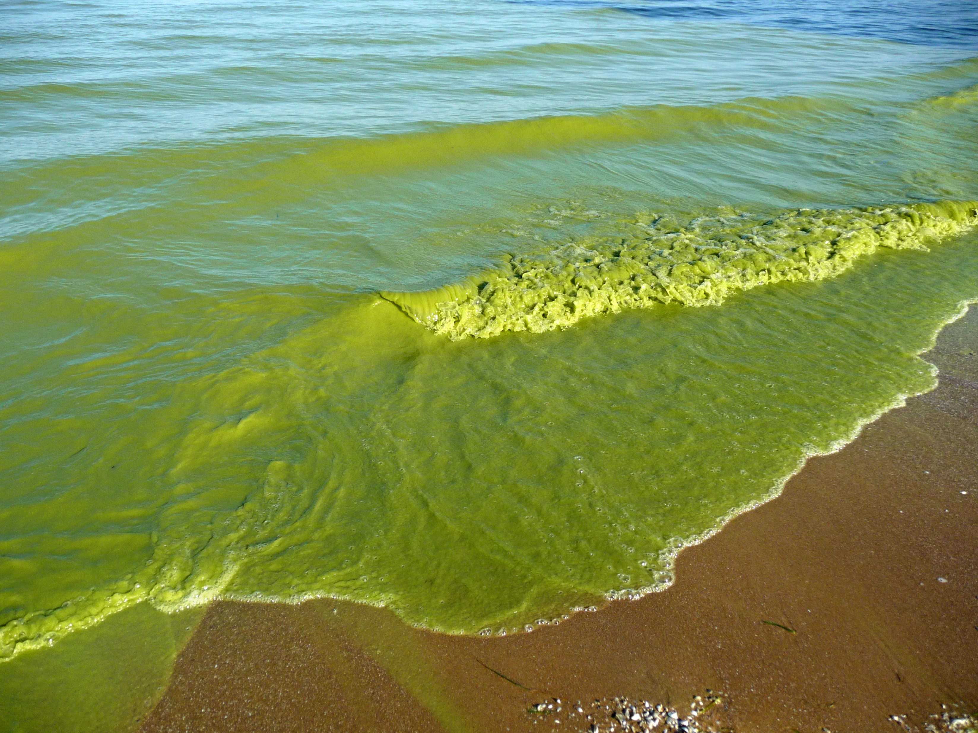
Emerging Issue: Harmful Algal Blooms
Congressional Directive: The Federal family will coordinate on the collection, storage and visualization and communication of HABs
Inter-agency coordination
Pushing the limits of existing technology
No budget
Citizen science component
1st deliverable: report on the state of HABS data collection federal-wide

Slide 19
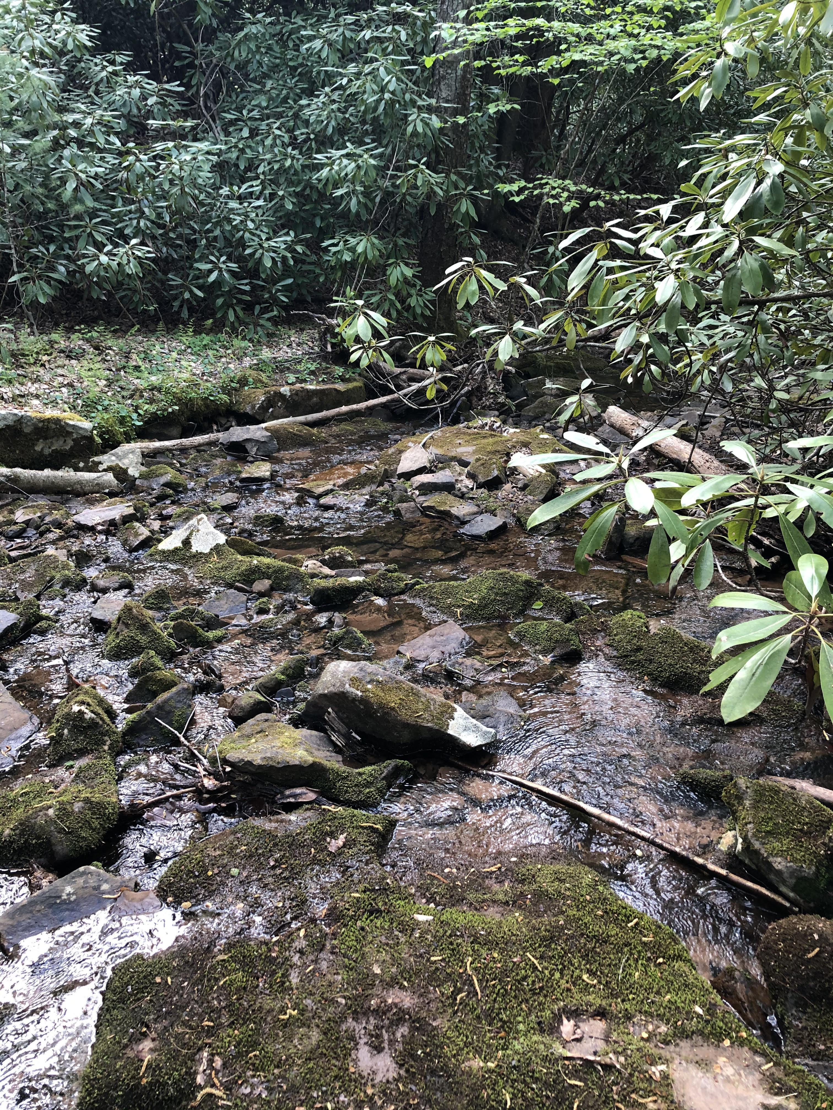
Thank you
Shelly Thawley
Thawley.Michelle@epa.gov

Slide 20
Data
Modernization: Air
Chet Wayland and Ketan Patel, US EPA Office of Air and Radiation
Tuesday, September 17, 2024

Slide 21
Why it Matters
Successful air quality management programs depend on access to high quality data (air monitoring data, emissions inventory data, permitting data, source compliance data, etc.)
Data are used in the development of regulatory actions, analyses of trends, communication with the public and stakeholders
Our data systems are aging and were historically developed, owned and operated by program offices
Centralized IT shops changed that and while better for IT development and consistency and efficiencies, it has often created a void between the developers/operators and the users
It is critical to have communication and coordination between the IT and Program sides… Both are essential to the success of environmental programs and to protecting the environment and public health.

Slide 22
Unified Platform (Air Data) Agenda
Why – Current State & Benefits
What – Unified Platform Overview
When – Schedule
How – Project Approach
Where – Hosting
Who – Stakeholders
9/16/2024
22
Notes:
Good morning, everyone! Thank you, Chet and Shelly. I wish we were where OW is now. As Chet mentions, my name is Ketan Patel. I am an IT project manager in the Office of Air Quality Planning and Standards.
As you have heard from Shelly, now on the backend of the office of water’s data modernization effort and from Chet on how successful air quality management relies on high-quality data from various sources, and while moving towards a centralized IT solution can improve development and efficiency, maintaining strong communication between IT and our programs is essential to ensure both technical and programmatic needs are met.
So today, keeping that in mind, I will provide a high-level overview of the OAQPS’ Unified Platform project, as we are in the start of this effort. This will include going over the current state (which Chet hinted at); benefits; what is the Unified Platform; the schedule; the approach we are taking; hosting; and stakeholder communications and engagement (which is critical). Lastly, I will focus on the steps we are taking with data modernization/data discovery which is part of our first phase.
I can take questions at the end. I will be around today and early tomorrow if you want to catch me between sessions.

Slide 23
Why? Current State of Office of Air Quality Planning and Standards (OAQPS) Systems
State of OAQPS Systems
OAQPS has many information collection systems at different stages of the life cycle.
Overlap in
ambient,
emissions,
and
regulatory
information amongst systems.
Old, difficult to use, cumbersome web applications and tools.
Data is hard to access and difficult to analyze due to siloed databases.
9/16/2024
23
Notes:
Let me provide some background. OAQPS started with several information collection systems managed in one division covering our ambient air quality and emissions; but over time, has developed systems across the office to support our other programmatic needs. This has resulted in:
Many systems in various stages of the life cycle (oldest being, over 30 years old),
Opportunities of overlap in information collection, business processes, shared services, and system features.
Not to mention the overlap in stakeholders using the systems.
The older the system, the more difficult to use and the ability for our consumers to find, access and connect the information has become more cumbersome.
There is also a cost to operate, maintain, and enhance all of these systems which becomes not sustainable.
As a solution, OAQPS is moving all of these information collection systems to an IT centric division, the Outreach and Information division (OID); while the programs will still be managed by the divisions the systems came from. For example, for the compliance and emissions data reporting interface (CEDRI), the program will still be managed in the Sector Policies and Programs Division, but the IT will be managed in OID.
Old Notes:
OAQPS is managing many information collection systems that ends up being not sustainable to operate, maintain, and enhance.
Our existing OAQPS systems have a lot of overlaps; AirNow and AQS are collecting approximately 80% of the same data.
We have systems that are various stages of the life cycle including systems that over 20 + years old.
We know our tools are antiquated, difficult to use and cumbersome.
And for our consumers of air data, it is hard to find, access, and connect the data that we have made available to the public.
There is overlap by intention because one feeds the other as intended which will make combining the two functions of the system easier.
OLD Notes:
And many more….
Hard to sustain so many IT systems
Rationalize paper pain points

Slide 24
Why? Benefits of the Unified Platform Project
Reduce the burden on SLTs, industry, and EPA
Single submission portal that uses the same login as the system.
Modern system portal from which to view, modify, and download information.
Single set of facility information that serves multiple programs.
Streamlined user experience.
Lower overall IT operational costs
Reduced IT infrastructure hosting costs.
Lower operation and maintenance costs.
Faster application development and updates.
This work includes the development of a unified platform to incorporate programmatic and community air quality information, to improve accessibility of the information for permitting authorities and communities so that EPA can better monitor air quality improvements over time.
9/16/2024
24
Notes:
We see many benefits to building the Unified Platform. We want to modernize the way our state, local, tribal agencies and our industry partners are submitting data to EPA and to be able to retrieve it.
Our plan is to streamline the user experience, with more modern user interfaces and less cumbersome to navigate the systems.
This results in less burden for all of users and us, we can roll new features and enhancements to the systems out faster and the overall cost to maintain the new unified platform helps all of us.

Slide 25
What? Project Guiding Principles
Ensure stakeholder communication and engagement throughout the life of project.
Follow the Agency’s digital strategy.
Adopt
a cloud-first approach.
an API/microservices-oriented architecture approach.
an open-source software first approach.
if practical, low code/no code solutions.
Focus on using Agency shared services that add value to the project.
Legacy systems will be gradually phased out in favor of the new Unified Platform.
Notes:
From the project Charter, here are some of the guiding principles that we are following:
The first bullet is why I am here today presenting and plan for continued communications in these types of conferences and meetings. It is important for us to communicate and engage with our stakeholders throughout the life of this project. We established a project email box, up@epa.gov and setting up a website to ensure we are communicating progress.
The unified platform will follow the Agency’s digital strategy including adopting a cloud-based approach, API/microservices architecture, open-source software approach, and when practical, low code-no code solutions.
We will evaluate the Agency shared services, to figure out if they fit within the unified platform architecture and if not, we will find easier and more efficient methods for SLT, industry, and EPA users.
Ultimately, we will be phasing out our old systems in favor of the new Unified Platform.

Slide 26
What? Unified Platform Future State Vision
Data Producers
Submission
Ingest & Process
Store
Data Products
Consumers
Regulatory Processing
Visualizations
Industry
OAQPS Processed Data
Reports
Websites
Data Validation
Admin Processing
BI Tools
Maps
State
Ambient
EPA & SLT Air Agency Users
Ambient Data
Emissions
Local
Stack Tests
Emission Inventories Emission Factors
Periodic Reports
OAQPS
Data Hub
Air Modelers
Regulatory
API
Services
EPA Policy Makers
Tribal
SIPS Exceptional Events
Title V Petitions
EPA Applications
Role-based access to EPA’s Ambient, Emissions and Regulatory web applications
Academic and Research Institutions
EPA
SLT Users
EPA Users
Other Federal Agencies
Raw Data
Media
General Public
Role Based Access
Information, regardless of the program, is submitted by regulated/non-regulated entities, processed and stored in the same “place.”
9/16/2024
26
Notes:
This graphic shows the flow of data throughout the lifecycle.
Data producers submit the various types of information based on associated program through a consolidated authentication method into a data hub.
The information then gets processed via our automated validations, then SLT and EPA users will have web-based applications to access the data and perform quality assurance and administrative tasks.
Once all the processing steps are complete, the data is stored and then API services feed data products to distribute the data in many different ways to our data consumers.
Again, this is a simplified view of the process.
OLD:
Architecture guiding principals – open source, vendor agnostic, can put in any cloud with compute power and storage
Ambient Data – AirNow, AQS
Stack Tests, Emission Inventories, Emission Factors, Periodic Reports – CAERS, CEDRI, EIS, ERT, and WebFIRE
SIPS, Exceptional Events, Title V Petitions = SPeCS for SIPS, SPeCS for EE, POTVP
Note for Kristin – I removed applicability determinations from the diagram as I am not certain if this will be included or not. I updated the names of the INCLUDED systems on slide 4.
Emphasis on API data distribution

Slide 27
What? Unified Platform Project Scope
Data Producers
Existing Systems
AirNow (incl. AirNow Tech, AirNow App, AirNow.gov)
Air Quality System (AQS) (includes AQS DataMart)
Combined Air Emissions Reporting System (CAERS)
Compliance and Emissions Data Reporting Interface (CEDRI)
Electronic Reporting Tool (ERT)
Web and Factor Information Retrieval Database (WebFIRE))
Emissions Inventory System (EIS)
State Planning Electronic Collaboration System (SPeCS) for SIPS
SPeCS for Exceptional Events (EE)
Petitions to Object to Title V Permits (POTVP)
SPeCS for Emissions Guideline Plans (EGPs)
Ambient
Industry
Ambient
Ambient Data
State
Emissions
Stack Tests
Emission Inventories Emission Factors
Periodic Reports
Local
Emissions
Tribal
SIPS Exceptional Events
Title V Petitions
Regulatory
Regulatory
EPA
Other Federal Agencies
9/16/2024
27
Notes:
This graphic illustrates what systems are in scope of the Unified Platform Project. As mentioned earlier, OAQPS began with several large information collection systems, which include the Air Quality System and AirNow, both falling under the Ambient category and we also have the Emissions Inventory system which is under the emissions business line. Since then, we now have these other systems/applications which reside in other divisions. OAQPS does manage many other web applications, tools, and models, but those will not be included in this project. We will be cognizant to see how this platform can support these other assets in a future phase.

Slide 28
When? Unified Platform Project Timeline
2024
2025
2026
2027
Data Inventory
Discover
Data Ingest Prototyping
Sprint
Sprint
Sprint
Sprint
Sprint
System Feature Inventory
Business Process Mapping
User Stories
User Stories
User Stories
User Stories
User Stories
Design
Design Future State Vision & Architecture, Define Scope of MVP, Plan for Build Phase
Detail Design
Detail Design
Detail Design
Detail Design
Detail Design
Build
Build
Build
Build
Build
Build
Test
Test
Test
Test
Test
Test
Data
Data Processing Build
Data Processing Build
Data Processing Build
Data Processing Build
Data Processing Build
Data Quality Assurance
UAT
User Testing
User Testing
User Testing
User Testing
User Testing
Final User Acceptance Testing
Training
Create Training Material
End User Training
Ongoing OMS Compliance and EPA Administrative Requirements
Cutover Planning
Implementation
Implement
Continuous Stakeholder Communication & Engagement
9/16/2024
28
Notes:
Right now, we are in the discover and design phase for the rest of 2024 an early 2025.
Our goal is to start building in 2025 and we are prioritizing Ambient process first.
We plan to engage the SLT community, industry partners, and other stakeholders throughout the life of the project.
2024/early 2025 we are gathering inputs, designing the overall unified platform.
During 2025, we build the unified system in iterations called sprints in which we will be looking to SLTs, industry partners for feedback and to perform user testing.
Again, depending on program and data flow will dictate who we will need to engage with us, as industry is also a “data producer.”
OLD:
Phased-In approach, leaders in state and local agencies as early adopters
Work with air data management companies on future changes
Starting with Ambient before Emissions

Slide 29
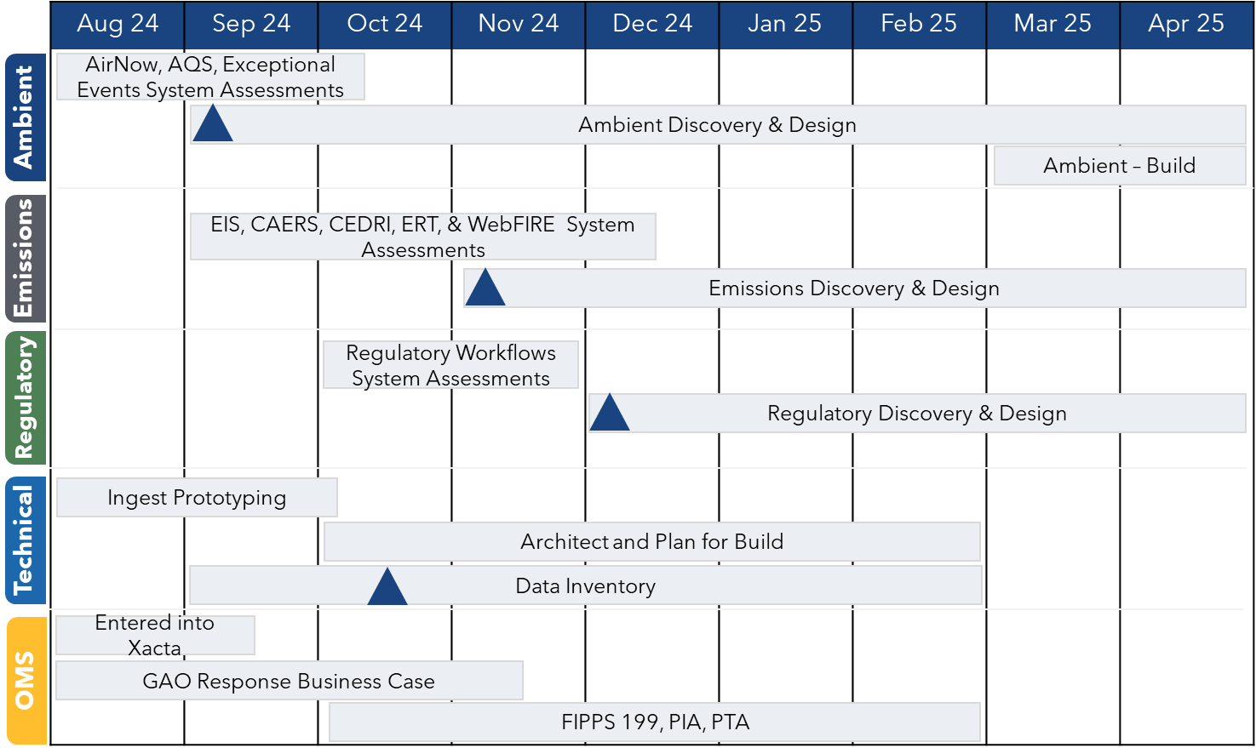
When? Discover and Design Phase
9/16/2024
29
Notes:
Here we are illustrating the schedule for the top left box in the previous slide where we are showing specific assessments, discovery and design, data inventory tasks, along with other Office of mission support requirements we will need to meet. The project will be moving quickly and we will look for responsive stakeholder engagement.

Slide 30
How? Project Approach
DISCOVERY
DESIGN
BUILD
IMPLEMENT
Communicate and receive input from stakeholders.
Evaluate all data collection to remove redundancy.
Rationalize business processes.
Ensure anything built in the future system brings value to the EPA mission.
Focus on the information and processes needed for OAQPS programs and EPA stakeholders.
Baseline the scope of the "must haves" in version 1.0 of the unified platform; Minimal Viable Product.
Continue to communicate to stakeholders and gather inputs on designs.
Leverage user experience experts to design user interfaces.
Design unified platform using modern data approaches.
Select modern technology stack leveraging open-source software.
Multiple development teams build and test unified platform.
Early and often demo to gather feedback as needed.
Stakeholder communication and training.
Rollout new user authentication.
Phased cutover plan.
We will have failures but need to start and try, fail fast, learn and iteratively adjust.
9/16/2024
30
Notes:
Throughout the life of the Unified Platform project, we follow a four-step process; Discovery, Design, Build and Implement as you see across the top of this slide. We are currently in the discovery phase where our focus is evaluating all the data and system functionality that OAQPS systems have today.
Our goal is to remove redundancies, streamline business processes and reimagine OAQPS’ IT application portfolio for years to come. During the design phase, we leverage user experience experts to design fresh, easy to use user interfaces.
Once we have established our baseline scope, we have defined requirements and designs ready, we begin building the unified platform using an iterative and agile software development approach in which we demo our progress early and often and will be looking for feedback and inputs.
Lastly, we train our users and rollout the new Unified Platform.

Slide 31
How? Discovery Phase
1
Baseline OAQPS Data
across all systems
BENEFITS
DATA INVENTORY
DATA INGEST PROTOTYPING
Analyze Raw Data, Demo Event Stream
2
Identifies Duplication Early
Informs Data Architecture
Discovery
Phase
3
Informs Data Storage &
Architecture Approach
Defines the OAQPS Unified Platform MVP
4
Baseline OAQPS system features & business needs
Builds Strong Foundation
BUSINESS PROCESS MAPPING
SYSTEM FEATURE INVENTORY
Creates Clear Vision and Scope for the OAQPS Unified Platform
5
Document EPA OAQPS business processes
9/16/2024
31
Notes:
Diving a little bit deeper into the Discovery Phase, we have broken out the work into four workstreams; Data Inventory, Data Ingest, Business Process Mapping and System Feature Inventory. The benefits of these workstreams are early identification of duplication, a well-informed data architecture, a strong technical foundation and clearly defined scope for the Unified Platform MVPs or Minimal Viable Products.

Slide 32
How? Data Inventory
Garbage In = Garbage Out.
Must Start with Data Inventory.
Where is the data coming from.
Who owns the data.
What applications are using it.
What format is the data in.
How is it being cleansed or transformed (mutated).
Is the data public or private.
How often is the data submitted.
What are the relationships across systems and domains.
And so on…..
Data governance drives this entire project; important to establish a strong foundation.
Our technical team learns from the foundation up, starting with the raw data.
Our goal is to develop the data standards now with flexibility for years to come.
Data inventory drives data privacy, security, compliance and governance methodologies.
Need to get the data story first, investigate the data and drive the project plans incrementally.
Notes:
"Garbage In = Garbage Out": We must start with a comprehensive data inventory to ensure data quality and integrity, covering where the data comes from, ownership, usage, format, and relationships across systems.
Data governance is key to the success of the project, providing a strong foundation that drives privacy, security, compliance, and ensures flexibility for future data standards.
Our technical team builds expertise from the ground up, starting with raw data to create adaptable, long-lasting data standards.

Slide 33
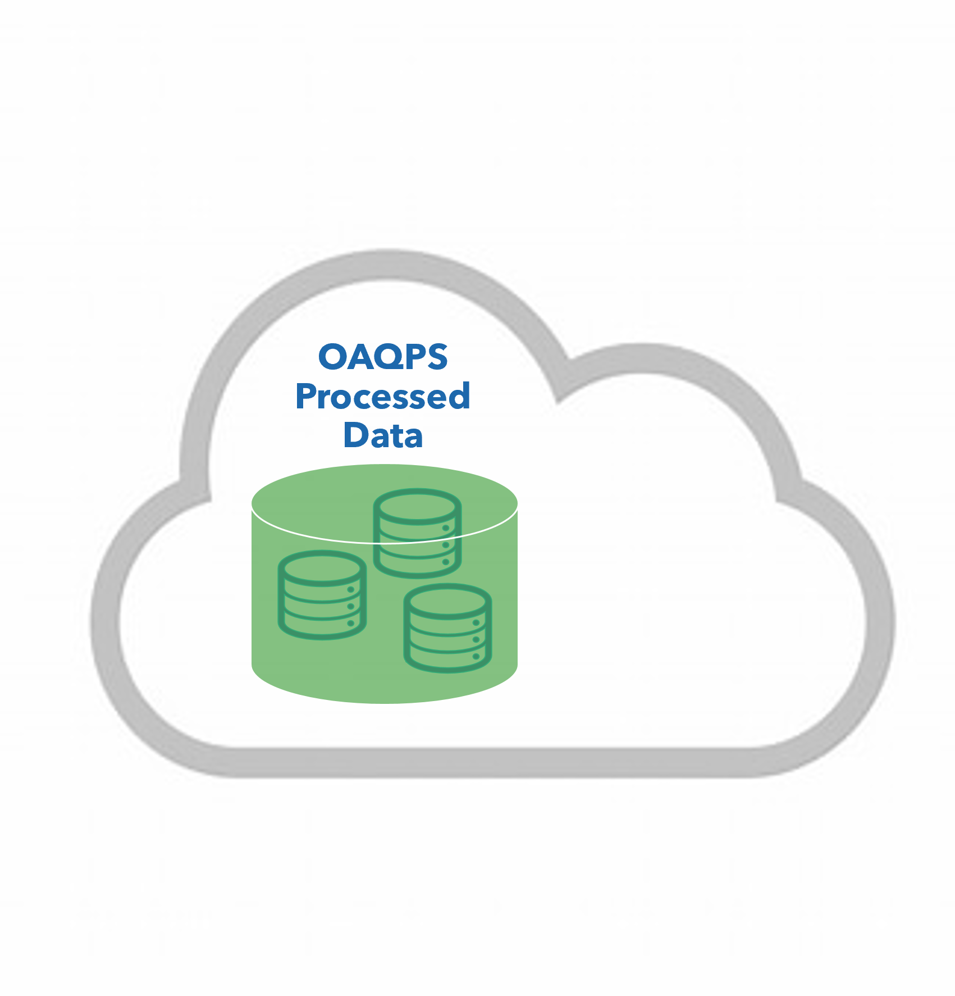
Where? Hosting
Cloud first approach
Centralized data store
Breaking down silos
Consumers will access OAQPS data in one place
Unified infrastructure
Notes:
As an architecture guiding principle we are vendor agnostic and will be developing so we can put in any cloud with compute power and storage.

Slide 34
Who? Phased Stakeholder Engagement
Knowledge Management Repositories, Recorded Interviews, Lean Events, Documentation & Training Videos
Leverage existing Outreach and Information Division (OID) knowledge base and resources and then reach out to other OAQPS divisions.
Engage external partners.
A phased approach will reduce the level of effort required and burden on our Divisional, SLT, and Industry partners.
Outreach & Information Division & Other OAQPS Divisions
Other EPA Offices, EPA Regions, State, Locals, Tribes, Industry, IT Vendors, IT Consultants, etc.
OMS Compliance & EPA Administrative Requirements
9/16/2024
34
Notes:
As part of the overall IT Strategy, OAQPS has a “working” communications and engagement plan that lays out how we plan to communicate and engage with each stakeholder type. The process we plan to follow is leverage internal OAQPS knowledge base to develop inventory, design features, etc. before reaching out to our external partners. We need to make sure we are aligned internally, before we go to our external partners. This entail will reduce the level of effort required and the burden on our partners.

Slide 35
Thank you!
Questions?

Slide 36
Appendix
How – Data Discovery Details

Slide 37
How – Data Discovery
Data Inventory
Ingest Prototyping
System Features
Business Processes
Meet with system managers, program managers, & other stakeholders to inventory all data being collected by OAQPS systems today.
Where is the data coming from? Who owns the data? How often is the data submitted?
Rationalize the Data: What is duplicative, what don’t we need anymore, what needs to be added
Standup Cloud-based Sandbox Environment
Establish the foundational infrastructure
Start ingesting raw data & understanding it
Prototype data storage concepts
Fail fast, iteratively learn and move on to next concept
Meet with system managers to inventory system features that exist today
Rationalization: What is duplicative, what don’t we need, what is part of the UP Minimal Viable Product
What new features are desired; What features need redesign
Summarize findings
Document the user and or data flows through the systems as they are today
Document future state desired business workflows
Tie in the data that is associated with the system feature and business processes for a comprehensive view of every feature within every system today
9/16/2024
37
Notes:
Starting on the left with “Data Inventory”, we plan to catalogue every piece of data that OAQPS systems collect today. We will be asking questions such as “Where is the data coming from”, “Who owns the data”, “How often is the data submitted” …and we will also be looking for stakeholder inputs on known data duplication, what data is no longer needed and/or what data needs to be added for the future.
Moving to “Ingest Prototyping”, we have stood up a cloud-based sandbox environment where our technical team is already building out the foundational architecture and will soon start prototyping raw data ingest and data storage options.
Next is the “System Feature Inventory” where we meet with our OAQPS system managers and stakeholders to capture a functional inventory of what each of the OAQPS existing systems does today. We then work with you all as the stakeholders to rationalize and understand what is needed for the future.
And lastly, all the way to the right we have “Business Process Mapping” where we learn and document how users interact with the systems and how the data flows through the systems.

