Slide 1
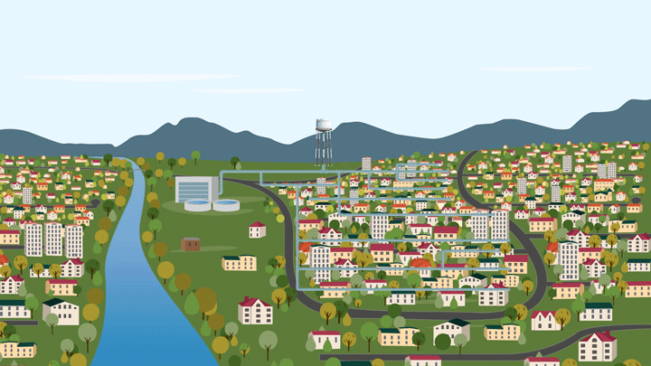
Using Machine Learning to Model Drinking Water Service Area Boundaries
Andrew Murray Ph.D. | GEOGRAPHER U.S. EPA | Office of research And development

Slide 2
Disclaimer
This document has been reviewed in accordance with U.S. Environmental Protection Agency policy and approved for publication. The views expressed by individual authors, however, are their own, and do not necessarily reflect those of the U.S. Environmental Protection Agency.

Slide 3
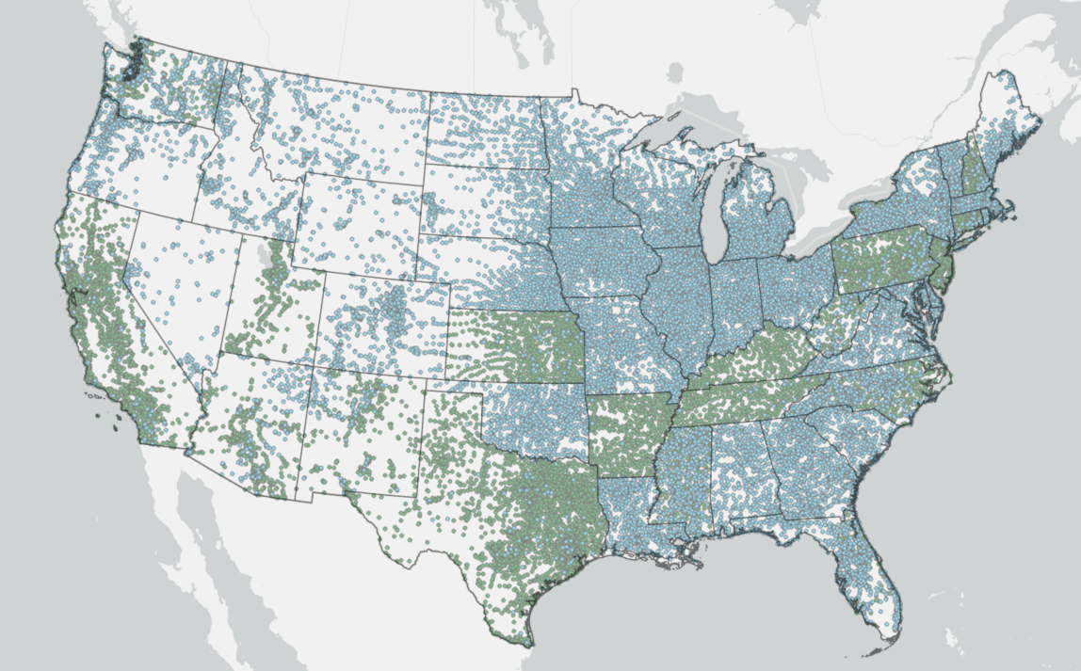
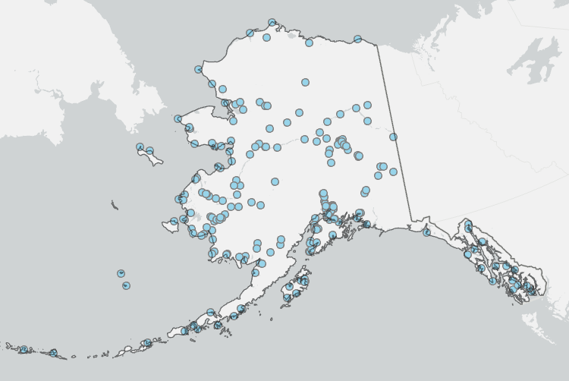
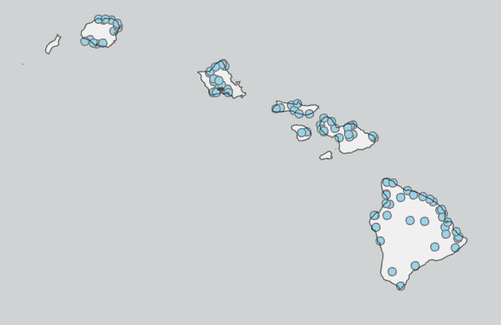
Overview
Municipal / State Sourced Boundaries
37.4% (18,449 Systems)
System Count:
44,415
Population Served:
313 Million
Geographic Building Block:
Census Blocks & Parcels
State / Utility Provided
Modeled

Slide 4
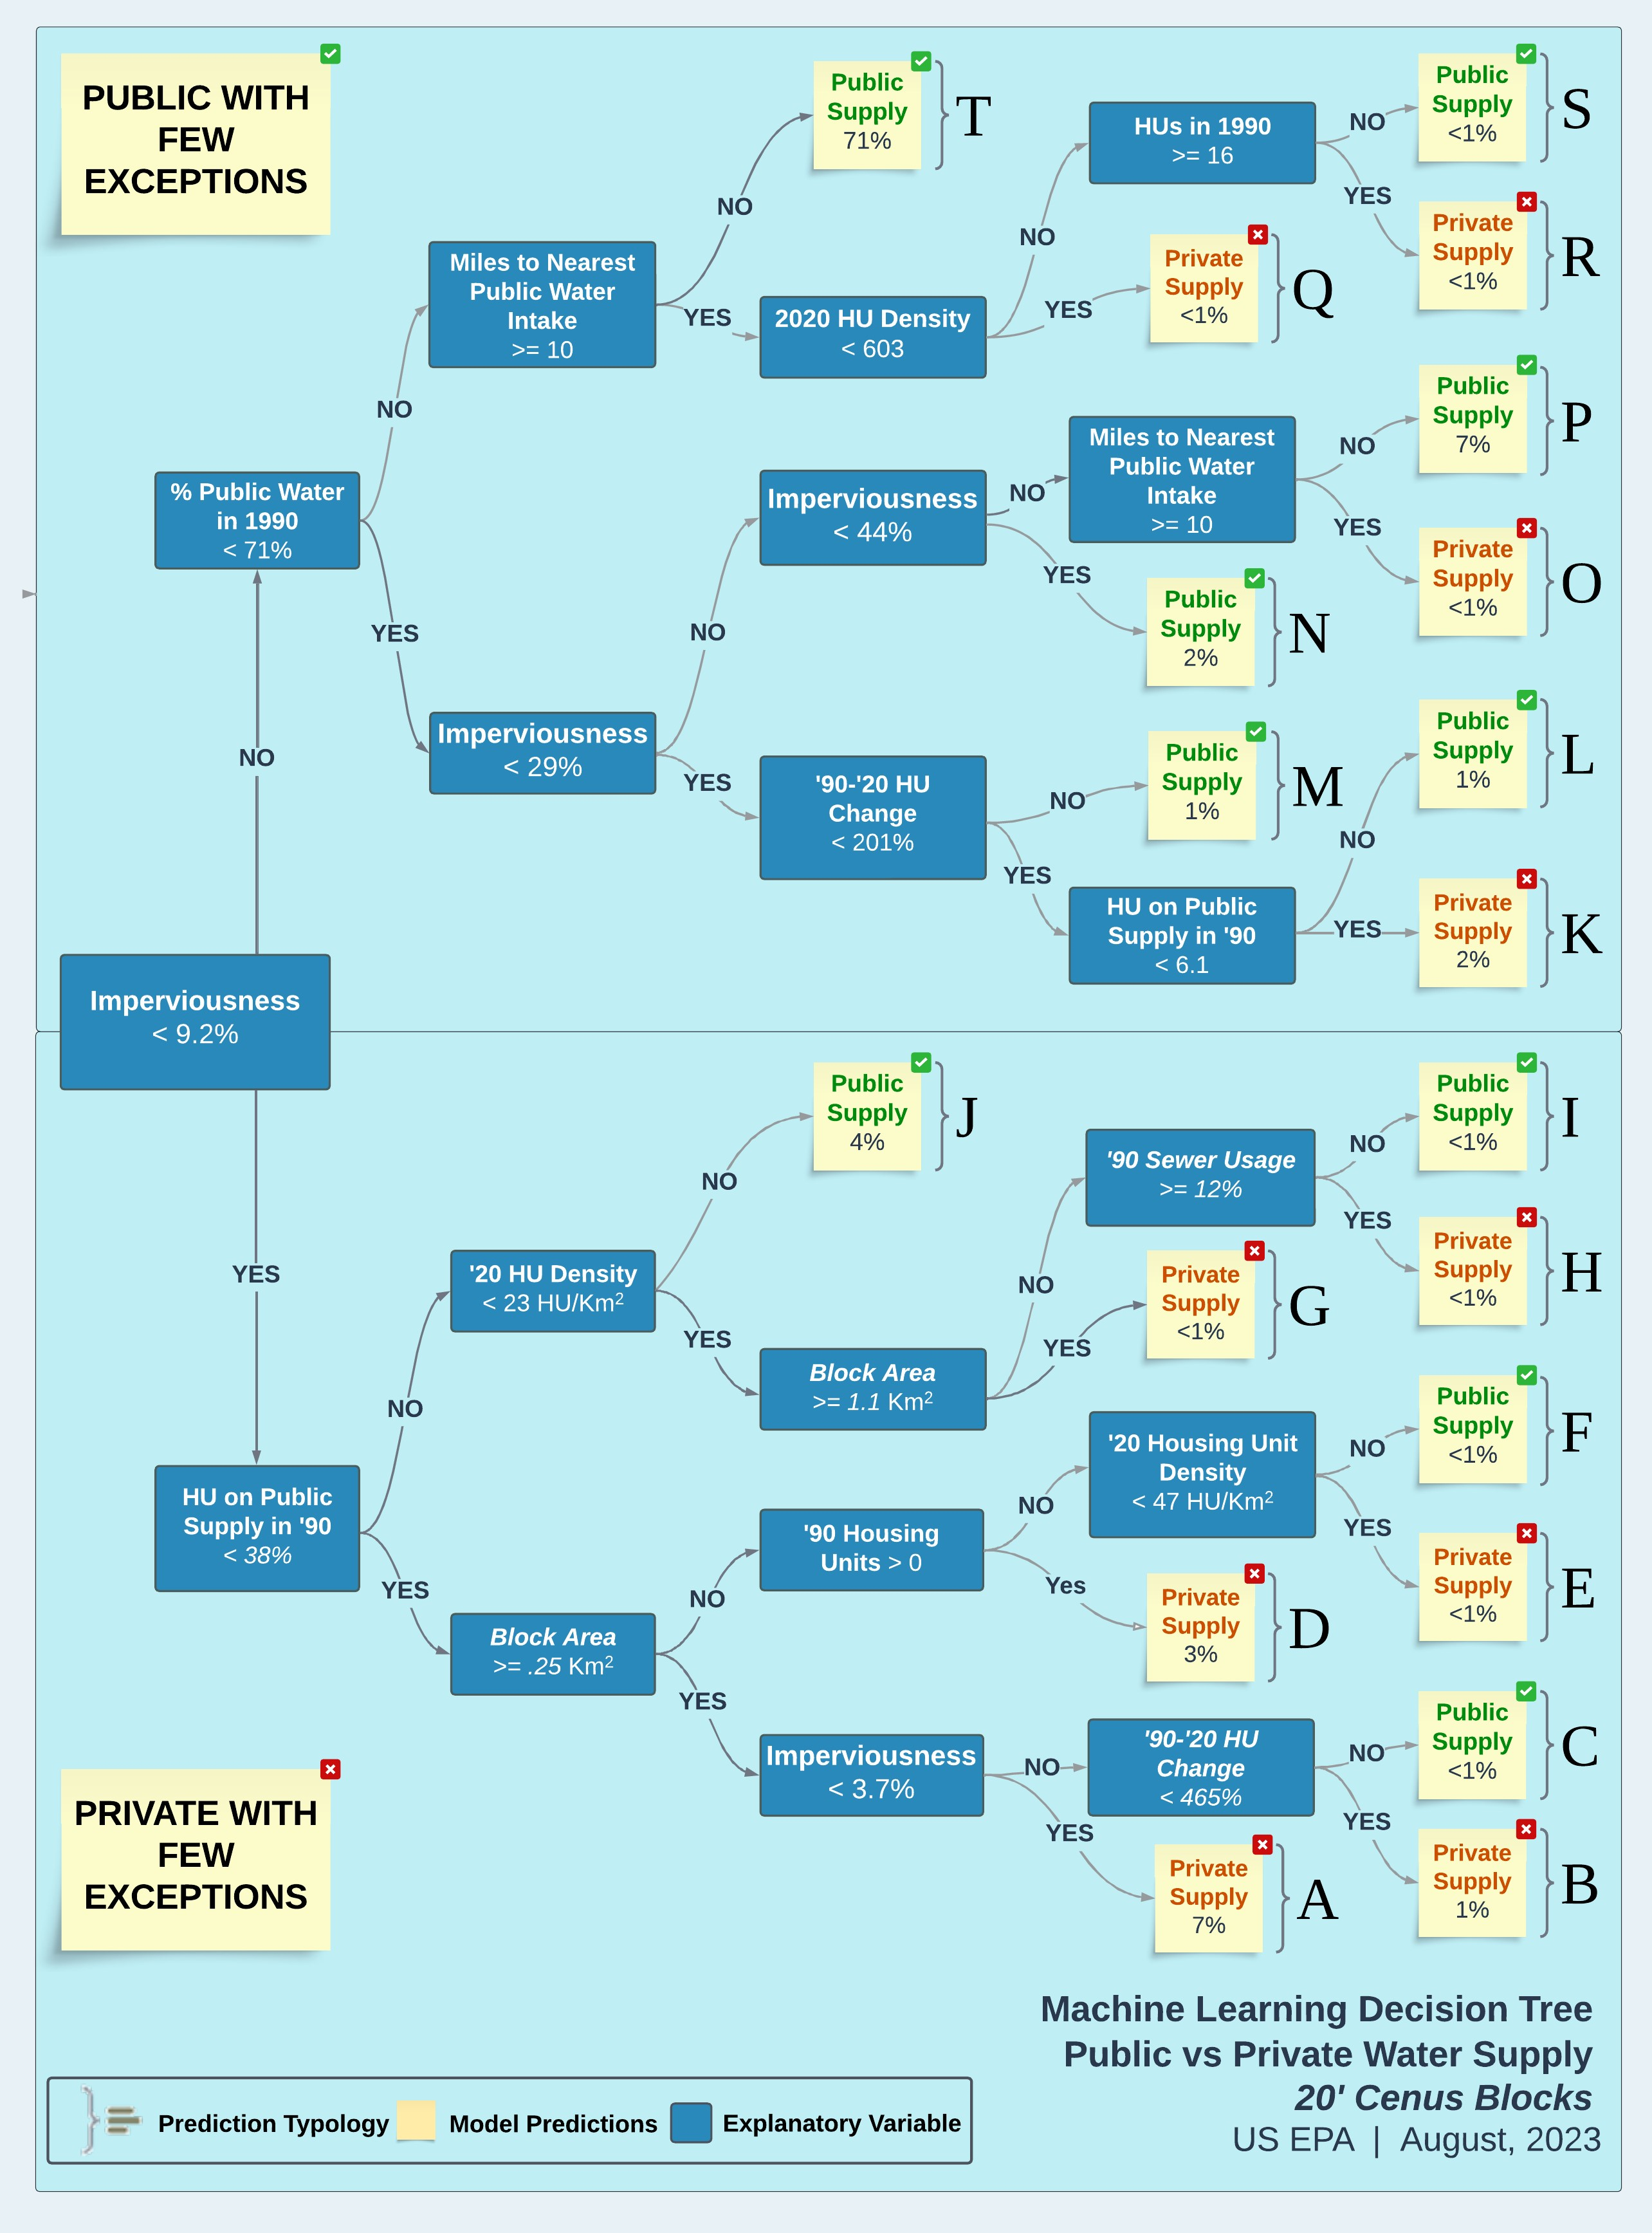
Decision Tree Model: Predicting Public Water System Boundaries
Model was trained on CA, CT, NJ state datasets
Trained on 700,000 Census blocks
Predicted 2 types of census blocks:
Blocks served by public water supply (between 1%-100% public)
Blocks served by private water supply (100% private)
Validated the model using out-of-bag training data
R² = .95

Slide 5
Further validation
95% of modeled census blocks are correctly predicted as “public” when compared to state boundaries
98% of state boundary area is covered by modeled boundary area
Modeled boundaries
State supplied Boundaries

Slide 6
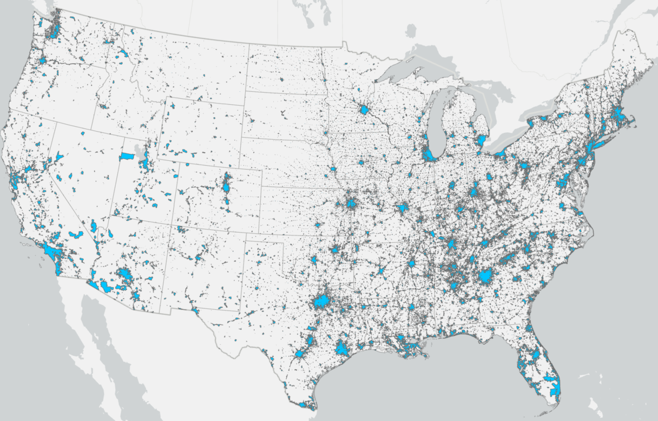
NATIONAL MAP OF PUBLIC AND PRIVATE WATER SERVICE AREAS
Public water
Private water
*Alaska & Hawaii not shown

Slide 7
From Public Water → Water system

Slide 8
Explanatory variables for random forest model
Other variables
Locations of wells, intakes and treatment plants
Service area type (HOA, Mobile home park, sub-division)
Place name
County name
Sub-county name
1990 census
Imperviousness
Presence of publicly owned treatment works

Slide 9
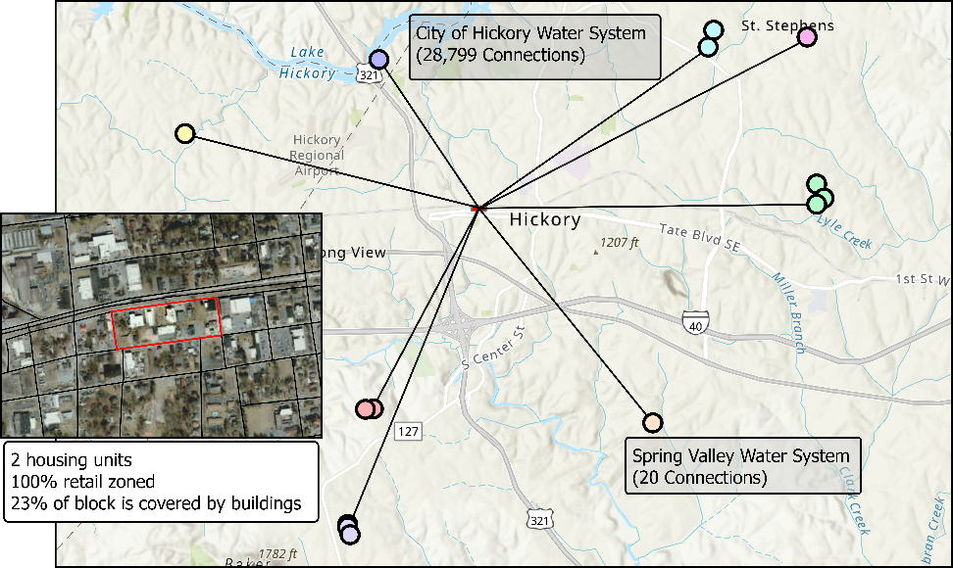
Dr. Andrew Murray U.S. EPA/ORD/CESER/LRTD/CAISB
Over 1 trillion model permutations to
“get the Best answer”

Slide 10
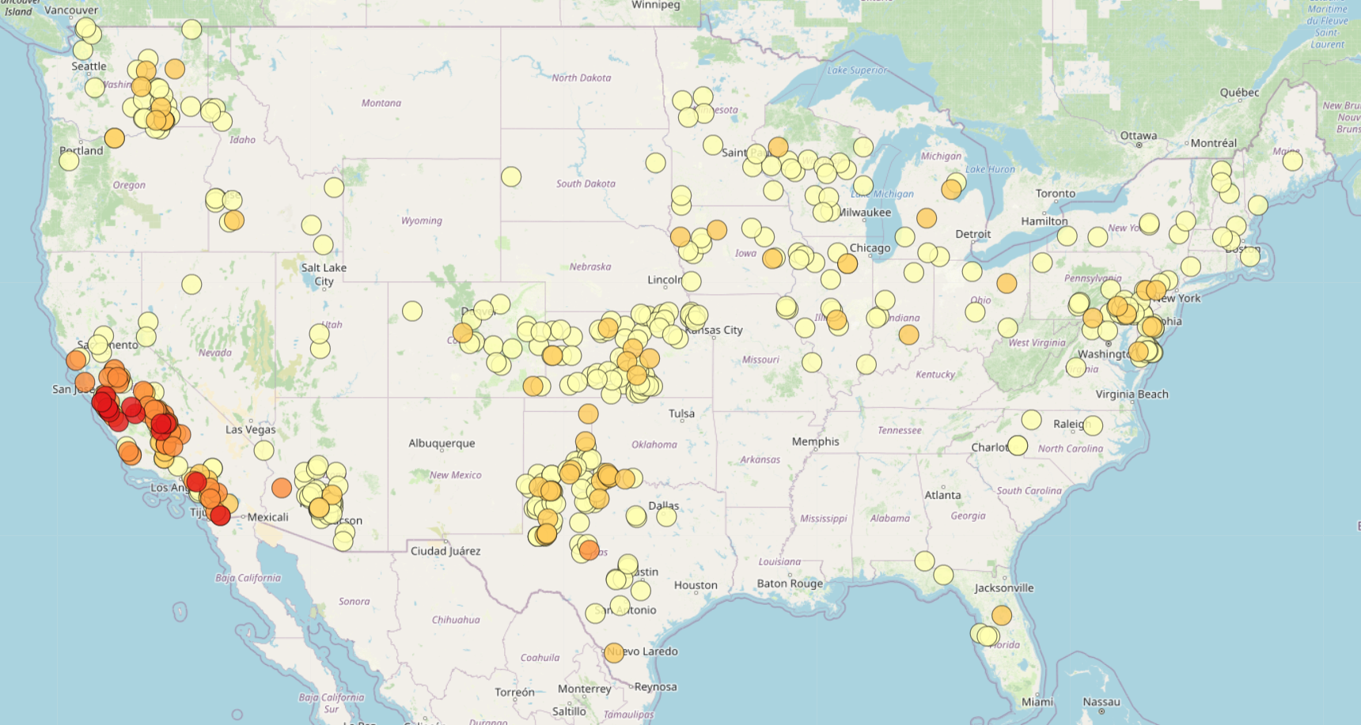
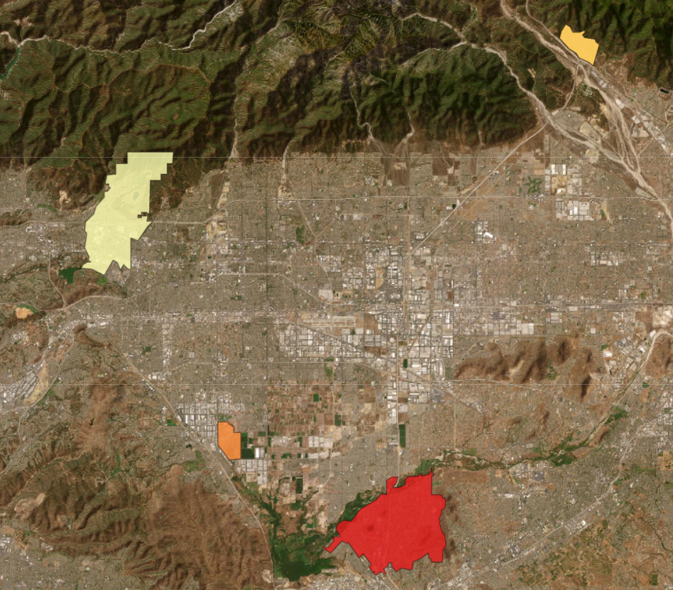
Linking violations to people
$118k
Mostly White
$112K
50% White
$125K
10
> 50
Macro
Nitrate [ug/L]
Micro
Prison:
Population: ~2,800
70% Minority

Slide 11
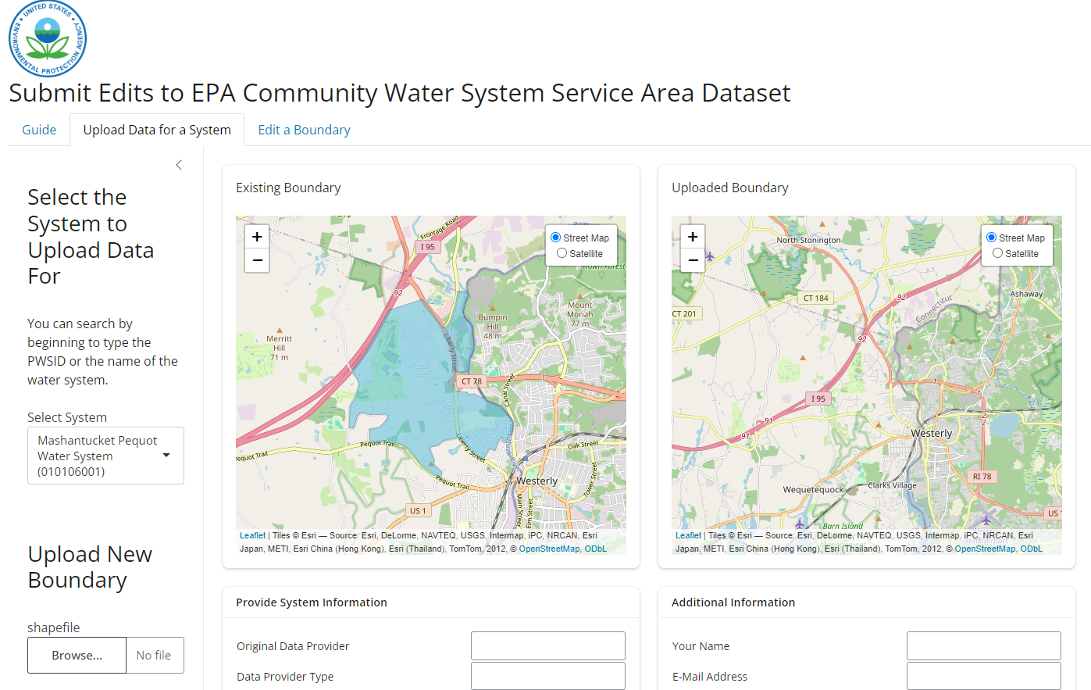
Future advancements
EPA will continue to provide updates to this dataset in two major ways:
Major Annual Updates scheduled for 2025 & 2026
Periodic Updates to include boundaries that are submitted to us

Slide 12
resources
CONTACT:
Andrew Murray
Murray.AndrewR@epa.gov
EPA Service Areas Website

